Slide 1
Session 2: Introduction to CSS
CSS (Cascading Style Sheets)

Slide 2

Introduction to CSS
What is CSS?
CSS (Cascading Style Sheets) is used to define the visual appearance of a webpage.
CSS allows you to change the layout, colors, fonts, spacing, and many other visual aspects of HTML elements.
Why Use CSS?
Separation of Content and Style: HTML is used to structure the content, while CSS controls the look of the page.
Consistent Styling: CSS ensures that multiple pages of a website can share a common design.
Responsive Design: CSS makes it easier to design layouts that work across different screen sizes (mobile, tablet, desktop).

Slide 3
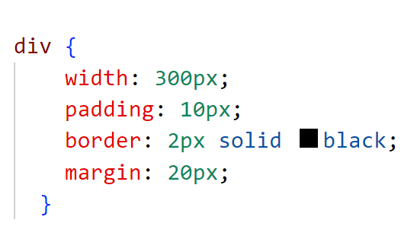
CSS Box Model
Box Model Components:
Every HTML element is a box with content, padding, border, and margin.
Content: The actual content of the element (e.g., text or image).
Padding: Space between content and border.
Border: A border around the element.
Margin: Space between the element’s border and surrounding elements.

Slide 4
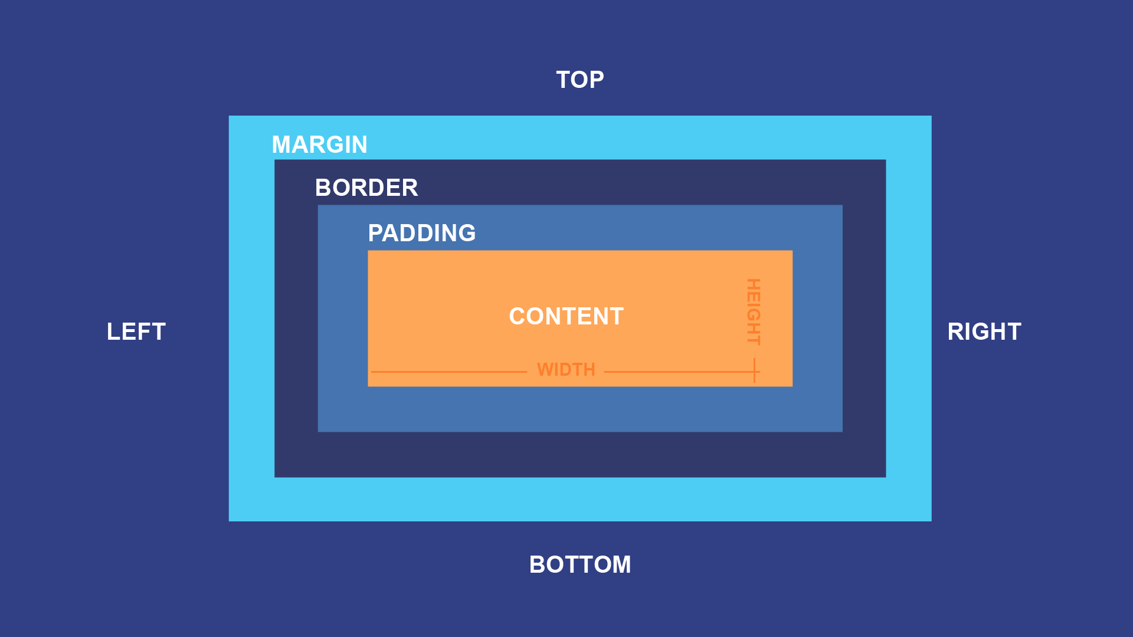
CSS Box Model

Slide 5
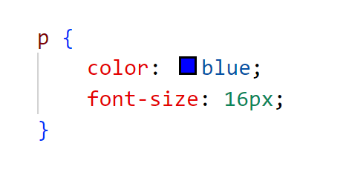
How CSS Works:
CSS works by selecting HTML elements and applying rules (properties and values) to them.

Slide 6
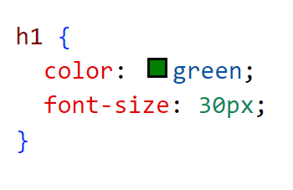
CSS Syntax
CSS Syntax:
Selector: The HTML element you want to style.
Property: The aspect of the element you want to change.
Value: The value you want to apply to the property.

Slide 7
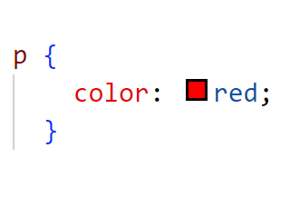
CSS Selectors
What are CSS Selectors?
Selectors are patterns used to select and style HTML elements.
Types of CSS Selectors:
Element Selector: Selects all elements of a specific type

Slide 8
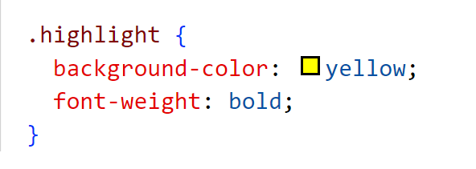
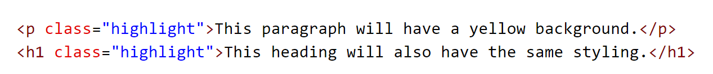
CSS Selectors
What is a Class Selector?
The Class Selector targets all elements with a specific class attribute.
Class selectors are reusable, meaning you can apply the same style to multiple elements

Slide 9
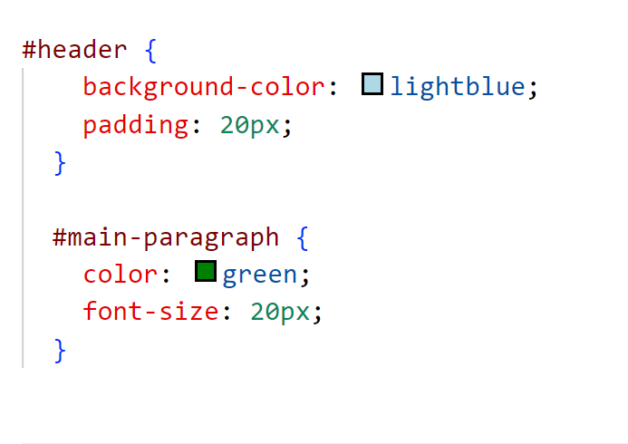
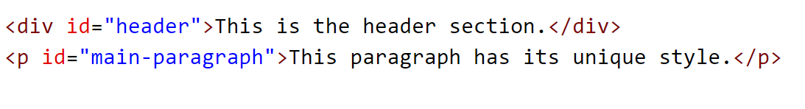
CSS Selectors
What is an ID Selector?
The ID Selector targets a unique element with a specific ID.
Each ID should be unique within a page.

Slide 10
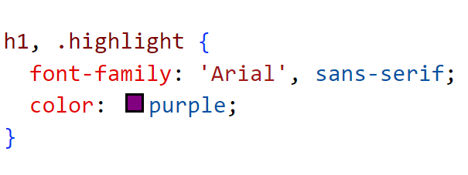
Selecting Multiple Elements
What is Selecting Multiple Elements?
You can target multiple elements in a single CSS rule by separating the selectors with a comma. This way, multiple elements can share the same style.

Slide 11
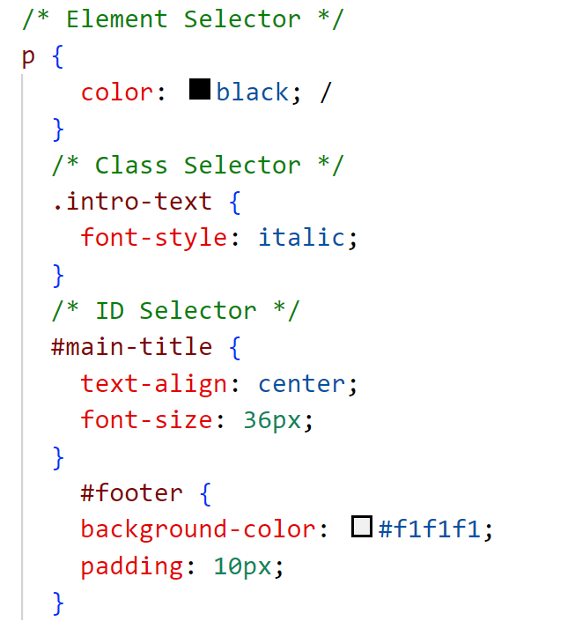
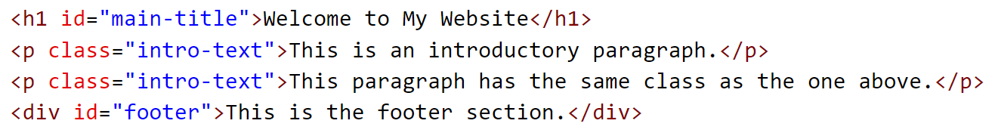
Example 1: Full Example of Element, Class, and ID Selectors

Slide 12
Summary of Selectors
Element Selector:
Targets HTML elements directly, like <p>, <h1>.
Class Selector: Targets elements with the same class (class="someClass"), and can apply styles to multiple elements.
ID Selector: Targets a single element with a unique ID (id="someID"), often for one-time use on a page.
Multiple Selectors: Combine multiple selectors (comma-separated) to apply the same style to multiple elements.

Slide 13
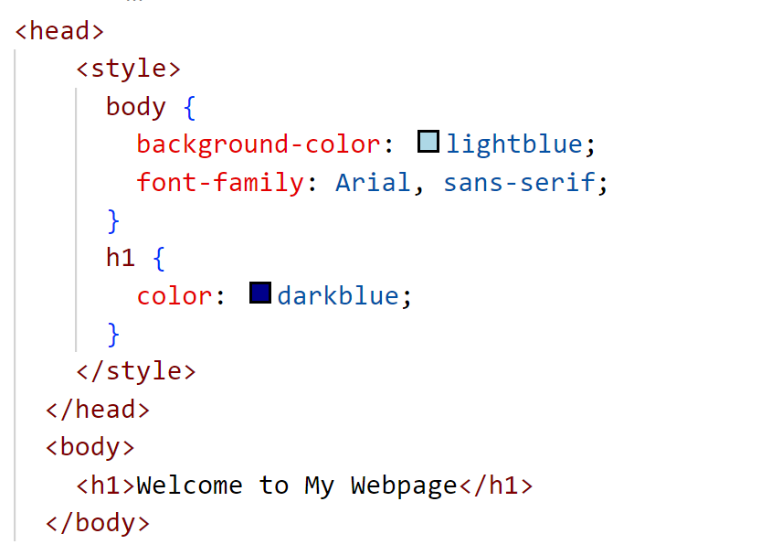
Internal CSS vs External CSS
What is Internal CSS?
Internal CSS is written within the <style> tag inside the <head> section of the HTML document.
It is used to style the elements of that specific HTML document.

Slide 14
Internal CSS
Pros:
Quick to Implement: Ideal for styling small websites or individual pages.
No External File Needed: All styles are contained within the same HTML file.
Cons:
Limited Reusability: The styles are applied only to the page where they are defined.Increased
File Size: If you have multiple pages, each HTML file will contain its own styles, increasing the overall file size.
Difficult to Maintain: For larger websites, internal CSS can become hard to manage, especially if styles are repeated across multiple pages.

Slide 15
External CSS
What is External CSS?
External CSS is written in a separate .css file and linked to the HTML document using the <link> tag in the <head> section.
The external CSS file can be used across multiple HTML documents.

Slide 16
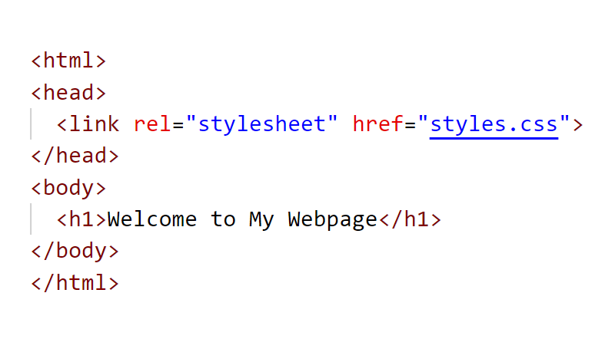
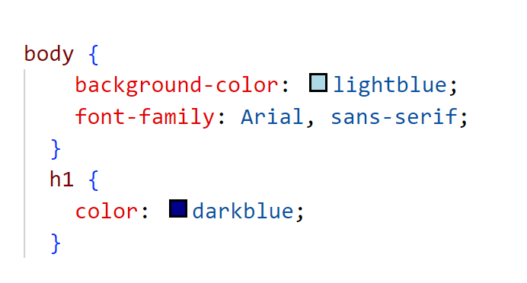
External CSS

Slide 17
External CSS
Pros:
Smaller HTML Files: The HTML files remain small since they don't contain the styling directly.
Smaller HTML Files: The HTML files remain small since they don't contain the styling directly.
Cons:
Additional HTTP Request: Every time the HTML file is loaded, an additional HTTP request is made to fetch the CSS file, which may slightly impact loading times (though caching reduces this issue).
Requires Link to External File: The CSS file must be linked correctly for it to work. If the link is broken or incorrect, the styles won’t be applied.
Maintainability: It’s easier to update and maintain styles because you only need to make changes in one CSS file instead of each HTML document.

Slide 18
When to Use Internal CSS vs External CSS
Internal CSS:
Use when you have a single-page website or when the styles are very specific to that page.
Ideal for quick prototyping or when working on a small website with minimal styling.
External CSS:
Best for multi-page websites or when you want to reuse the same styles across different pages.
Ideal for large websites or projects where maintaining consistency and ease of updates is important.

Slide 19
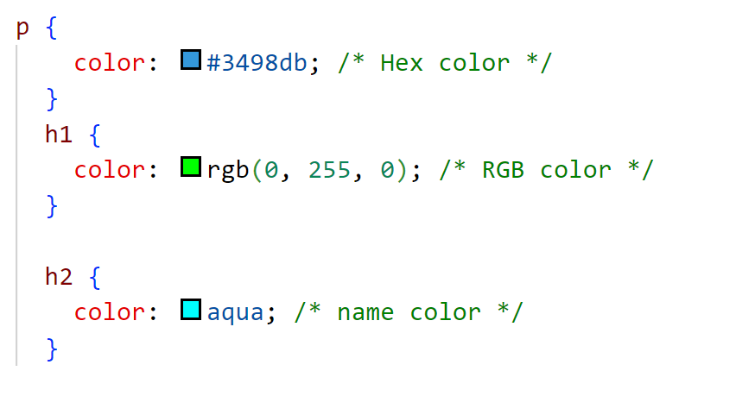
CSS Colors
Coloring Elements in CSS:
Colors can be defined using:
Names (e.g., red, blue).
Hex values (e.g., #ff0000 for red).
RGB values (e.g., rgb(255, 0, 0) for red).

Slide 20
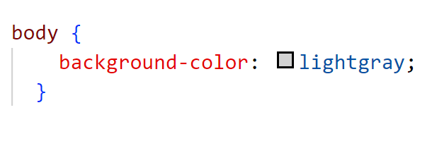
CSS Backgrounds
Adding Backgrounds:
You can add background colors, images, or gradients to elements.
Background Color:

Slide 21
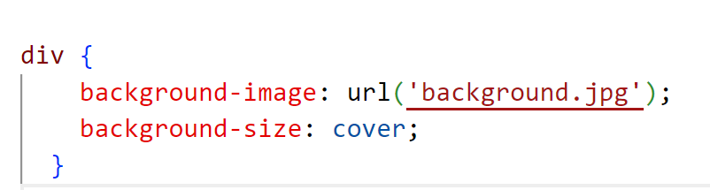
CSS Backgrounds
Background Image:

Slide 22
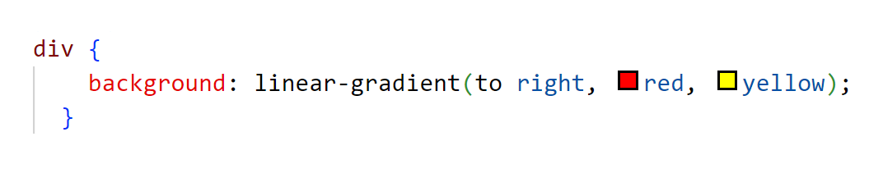
CSS Backgrounds
Gradient Background:

Slide 23
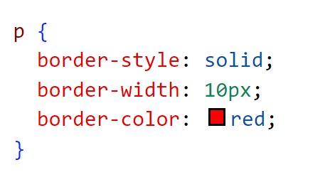
CSS Borders
Setting Borders:
You can add borders to elements using the border property.
Border Properties:
border-width: Sets the border thickness.
border-color: Sets the border color.
border-style: Defines the border style (e.g., solid, dotted, dashed).

Slide 24
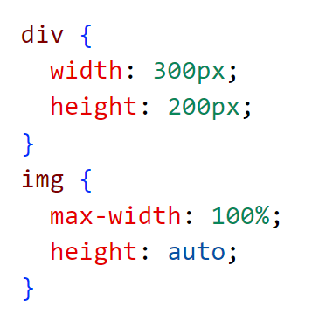
CSS Height, Width, and Max-width
Setting Height and Width:
Use height and width to define the size of an element.
Max-width:
Use max-width to limit the width of an element, regardless of screen size.

Slide 25
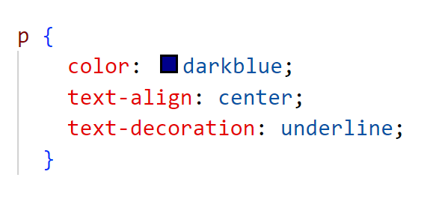
CSS Text
Text Properties:
Text Color: color: red;
Text Alignment: text-align: center;
Text Decoration: text-decoration: underline;

Slide 26
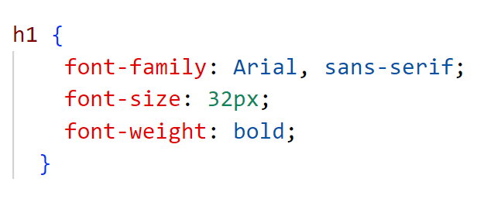
CSS Fonts
Font Properties:
You can change fonts using
font-family
font-size
font-weight.

Slide 27
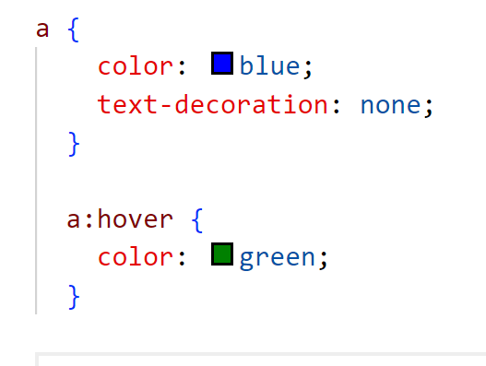
CSS Links
Styling Links:
Links can be styled using
Color
text-decoration
hover states.

Slide 28
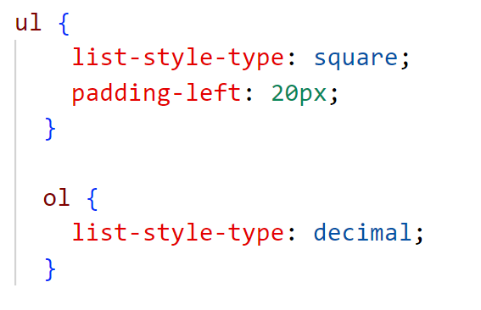
CSS Lists
Styling Lists: You can customize the appearance of lists (unordered or ordered) using CSS.

Slide 29
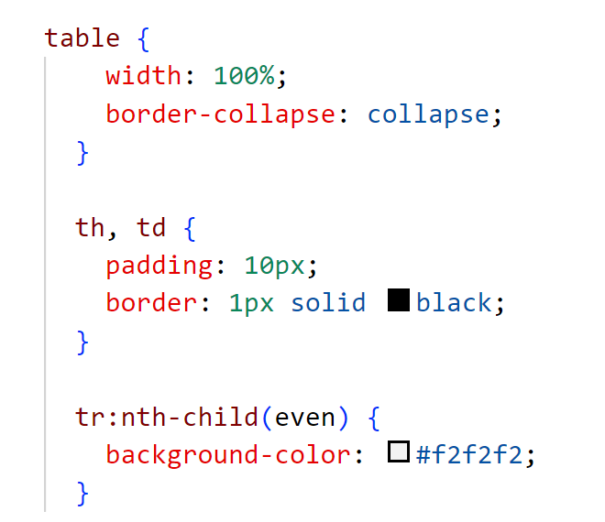
CSS Tables
Styling Tables: You can style tables with borders, padding, and alternate row colors.

Slide 30
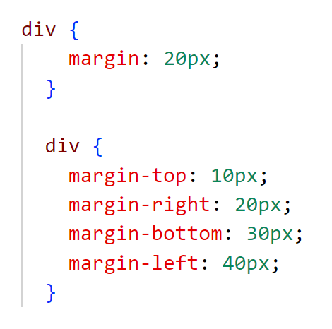
CSS Margins
What are Margins?
Margins are the space outside an element's border, pushing other elements away.

Slide 31
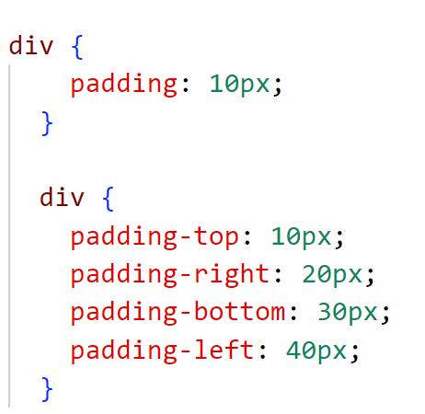
CSS Padding
What is Padding?
Padding is the space between an element's content and its border.

Slide 32
Lab Activity: Creative Webpage Design Using HTML & External CSS
Lab Activity: Creative Webpage Design Using HTML & External CSS
Objective:
Students will create a fully functional and visually appealing webpage by applying the HTML and External CSS concepts learned in Day 2. This will test their creativity, attention to detail, and ability to organize a webpage using HTML structure and CSS styling.
Refer to the document in google classroom.

