Slide 1
JavaScript Basics
JavaScript in web development

Slide 2
Introduction to JavaScript
What is JavaScript?
JavaScript is a scripting language that runs in the browser.
It allows you to add interactivity, dynamic content, and logic to websites.
JavaScript makes websites interactive, allowing users to respond to actions, validate forms, and manipulate the DOM (Document Object Model).

Slide 3
Introduction to JavaScript
Role of JavaScript in Web Development:
JavaScript is essential for client-side programming (running on the user's browser).
It works with HTML (structure) and CSS (style) to create dynamic, interactive web applications.

Slide 4
The Importance of JavaScript in Web Development
Why Use JavaScript?
Interactivity: Enables dynamic actions such as form validation, event handling (e.g., click, hover), and animations.
Manipulation: Allows dynamic manipulation of the webpage content (like adding/removing elements or changing styles).
Backend Communication: Through AJAX, JavaScript can communicate with the server without reloading the page, making web applications faster and smoother.
Notes:
JavaScript can be used to validate form input, update content without refreshing, and create interactive features like image sliders.

Slide 5
Declaring Variables in JavaScript
Using let, const, and var
let: Used to declare a variable whose value can be changed later.
const: Used to declare a constant variable whose value cannot be changed after initialization.
var: Older syntax for declaring variables, but less preferred due to issues with scoping and hoisting.
When to Use:
Use let when you need a variable that can be reassigned.
Use const when you want a variable to remain constant.
Use var only if you are working with older code, as it is now largely outdated.
let name = "John";
const age = 25;
var city = "New York";

Slide 6
Data Types in JavaScript
let greeting = "Hello,World!";
let age = 25;
let temperature = 98.6;
let isActive = true;
let hasCompleted = false;
let nothing = null;
let uninitialized;
Strings: Used to represent text.
Numbers: Represent numeric values (integers or floats).
Booleans: Represent true or false values.
Null: Represents an intentional absence of a value.
Undefined: A variable declared but not initialized.

Slide 7
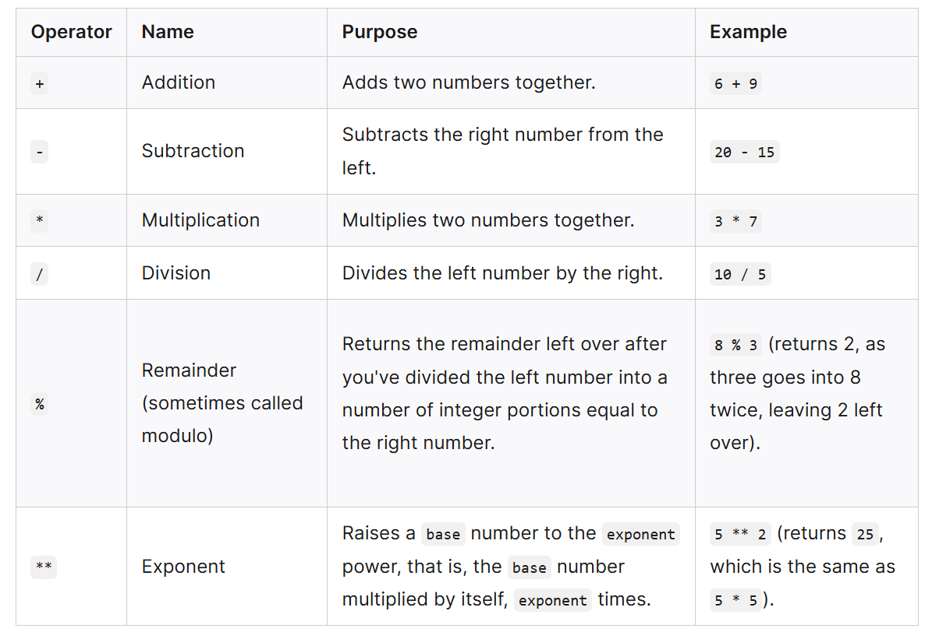
JavaScript Arithmetic Operations
What Are Arithmetic Operators in JavaScript?
Arithmetic operators are used to perform mathematical calculations like addition, subtraction, multiplication, and division.
These operators work with numbers and can be used in various expressions.

Slide 8
Examples
let sum = 5 + 3;
console.log(sum);
let difference = 10 - 4;
console.log(difference);
let product = 5 * 3;
console.log(product);
let quotient = 6 / 2;
console.log(quotient);
let remainder = 5 % 3;
console.log(remainder);

Slide 9
Control Flow in JavaScript
Conditional Statements:
if statement: Executes a block of code if the condition is true.
else statement: Executes a block of code if the condition in the if statement is not met.
else if statement: Specifies a new condition if the first if statement evaluates to false.
The else if is used when you have multiple possible conditions to check. If the first condition is false, JavaScript moves to the else if condition and checks it.
You can use else if as many times as needed, but else is optional and will only run if none of the conditions are true.
switch statement: Used when you have multiple conditions, and you want to check for a specific value.

Slide 10
IF
let age = 20;
if (age >= 18) {
console.log("You are an adult.");
}

Slide 11
else
let age = 5;
if (age >= 18) {
console.log("You are an adult.");
} else {
console.log("You are a minor.");
}

Slide 12
else if
let age = 18;
if (age < 18) {
console.log("You are a minor.");
} else if (age == 18) {
console.log("You just became an adult!");
} else {
console.log("You are an adult.");
}

Slide 13
switch
let day = "Friday";
switch (day) {
case "Monday":
console.log("Start of the week");
break;
case "Friday":
console.log("End of the week");
break;
default:
console.log("Midweek");
}

Slide 14
Activity 1: Variable Declaration and Control Flow (if, else-if, else)
Objective:
This activity will help you practice variable declaration in JavaScript, as well as control flow using if, else-if, and else statements. Later, you'll implement the same logic using a switch case statement to see how both can be used in different scenarios.
Part1: Exam Grade Classification
Declare a variable called grade and assign it a numeric value between 0 and 100.
Write a JavaScript program that:
If the grade is greater than or equal to 90, logs "A"
If the grade is greater than or equal to 80 but less than 90, logs "B"
If the grade is greater than or equal to 70 but less than 80, logs "C"
If the grade is greater than or equal to 60 but less than 70, logs "D"
If the grade is less than 60, logs "F"

Slide 15
Activity 2: Using switch-case Statement
Rewrite the problem Exam Grade Classification using a switch statement

Slide 16
Loops in JavaScript
Loop Types
Loops are structures that repeatedly execute a code block while a specific condition is true. In JavaScript, there are three types of loops:
while;
do-while;
for.

Slide 17
Loops in JavaScript
for Loop
Used for running a block of code a specific number of times.
for (let i = 0; i < 5; i++) {
console.log(i); // Logs 0, 1, 2, 3, 4
}

Slide 18
Loops in JavaScript
while Loop
Runs a block of code while a given condition is true.
let i = 0;
while (i < 5) {
console.log(i); // Logs 0, 1, 2, 3, 4
i++;
}

Slide 19
Loops in JavaScript
let count = 0;
do {
console.log(count);
count++; // Increment the counter
} while (count < 5);
do-while loop is a type of loop in JavaScript that executes the code block at least once, and then repeats the loop as long as the specified condition is true.

Slide 20
Nested Loops in JavaScript
What is a Nested Loop?
A nested loop is a loop inside another loop. The outer loop runs first, and for each iteration of the outer loop, the inner loop runs completely.
Nested loops are useful when you need to iterate over multi-dimensional data structures (e.g., a 2D array) or when you need to perform repetitive tasks that depend on multiple variables.
When to Use Nested Loops:
Iterating through a 2D array (like a matrix or grid).
Performing complex repetitive tasks: If your task requires nested iterations, such as finding pairs of values or checking multiple conditions.

Slide 21
Nested Loops in JavaScript
for (let i = 0; i < 3; i++) {
// Outer loop runs 3 times
for (let j = 0; j < 60; j++) {
// Inner loop runs 60 times for each outer loop iteration
console.log("Outer: " + i + ", Inner: " + j);
}
}

Slide 22
Activity 3: Loop Activity – Drawing a Triangle
Instructions:
Write a JavaScript program that uses a for loop to draw a right-angled triangle made of * symbols.
The program should print the following pattern (with 5 rows):
*
**
***
****
*****

Slide 23
Activity 4: Loop Activity – Drawing a Reverse Triangle
Instructions:
Write a JavaScript program that uses a for loop to draw a reverse right-angled triangle made of * symbols.
The program should print the following pattern (with 5 rows):
markdown
*****
****
***
**
*

Slide 24
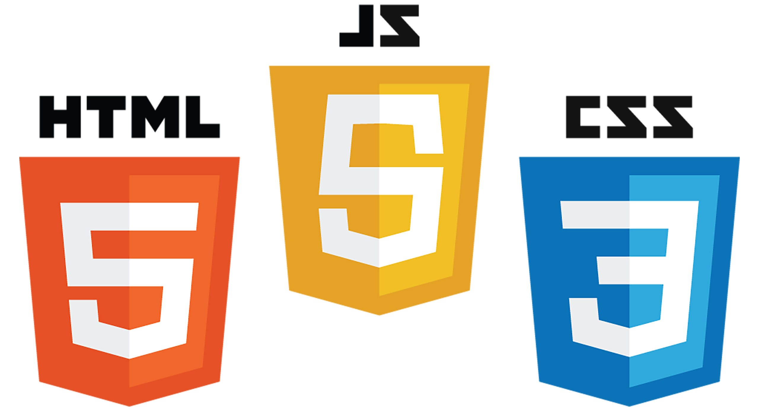
Inserting a script in HTML
How to Insert JavaScript in an HTML Document
JavaScript can be added to HTML documents in three main ways:
Inline JavaScript: Directly within an HTML element (e.g., using onclick).
Internal JavaScript: Within the HTML document using the <script> tag.
External JavaScript: Linking an external .js file to the HTML document.

Slide 25
Using the <script> Tag (Internal JavaScript)
What is the <script> Tag?
The <script> tag is used to include JavaScript within an HTML document.
It can be placed in the <head> or <body> section of the HTML, but it is more common to place it just before the closing </body> tag to ensure the HTML content is fully loaded before the JavaScript runs.

Slide 26
Simple Internal JavaScript
<body>
<h1>Welcome to JavaScript!</h1>
<p id="demo">This is a paragraph.</p>
<script>
document.getElementById("demo").innerHTML = "Hello, JavaScript!";
</script>
</body>

