Slide 1
Functions and Arrays
Adding it all together with DOM

Slide 2
Functions in JavaScript
What is a Function?
A function is a reusable block of code designed to perform a specific task.
function functionName(parameter1, parameter2) {
// Code block
return result;
}

Slide 3
Function Declaration:
Creating a Function:
function greet(name) {
console.log("Hello, " + name + "!");
}
Calling a Function:
greet(“Robert");

Slide 4
Function Parameters and Return Values:
Passing Parameters: Explain how parameters allow functions to accept values.
Return Values: Show how functions can return values.
function add(a, b) {
return a + b;
}
let sum = add(5, 10);
console.log(sum);

Slide 5
Activity 5: Create a Function to Calculate the Area of a Circle
Instructions:
Write a JavaScript function called calculateArea(radius) that calculates the area of a circle using the formula:
Area=𝜋×radius²
The function should return the calculated area in the terminal.

Slide 6
Arrays in JavaScript
What is an Array?
Definition: An array is a special variable that can hold more than one value at a time.
Creating an Array:
let fruits = ["apple", "banana", "cherry"];
console.log(fruits[0]);

Slide 7
Understanding the Index Property of an Array
What is the Index of an Array?
In JavaScript, an array is a list-like object used to store multiple values in a single variable.
Each element in an array has a numeric index, which is used to access its value.
Indexing starts from 0 in JavaScript, meaning the first element in the array is at index 0, the second element is at index 1, and so on.
let array = ["apple", "banana", "cherry"];
In this example:
"apple" is at index 0
"banana" is at index 1
"cherry" is at index 2

Slide 8
How to Access Elements Using Index:
You can access any element in the array by using the index inside square brackets [].
let fruits = ["apple", "banana", "cherry"];
console.log(fruits[0]);
console.log(fruits[1]);
console.log(fruits[2]);

Slide 9
Manipulating Arrays
.push(): Adds an element to the end of the array.
.pop(): Removes the last element of the array.
.shift(): Removes the first element of the array.
.unshift(): Adds an element to the beginning of the array.
let fruits = ["apple", "banana", "cherry"];
fruits.push("orange");
console.log(fruits); // ["apple", "banana", "cherry", "orange"]
fruits.pop();
console.log(fruits); // ["apple", "banana", "cherry"]
fruits.shift();
console.log(fruits); // ["banana", "cherry"]
fruits.unshift("kiwi");
console.log(fruits); // ["kiwi", "banana", "cherry"]

Slide 10
Iterating Through Arrays
Using a while loop:
Using a for loop:
let fruits = ["apple", "banana", "cherry"];
fruits.push("orange");
for (let i = 0; i < fruits.length; i++) {
console.log(fruits[i]);
}
let fruits = ["apple", "banana", "cherry"];
let i = 0;
while (i < fruits.length) {
console.log(fruits[i]);
i++;

Slide 11
Activity 6: Create an Array and Manipulate it
Instructions:
Create an array of numbers, then use .push(), .pop(), .shift(), and .unshift() to manipulate the array.
Add a loop to iterate through the array

Slide 12
DOM Manipulation in JavaScript
Document Object Model

Slide 13
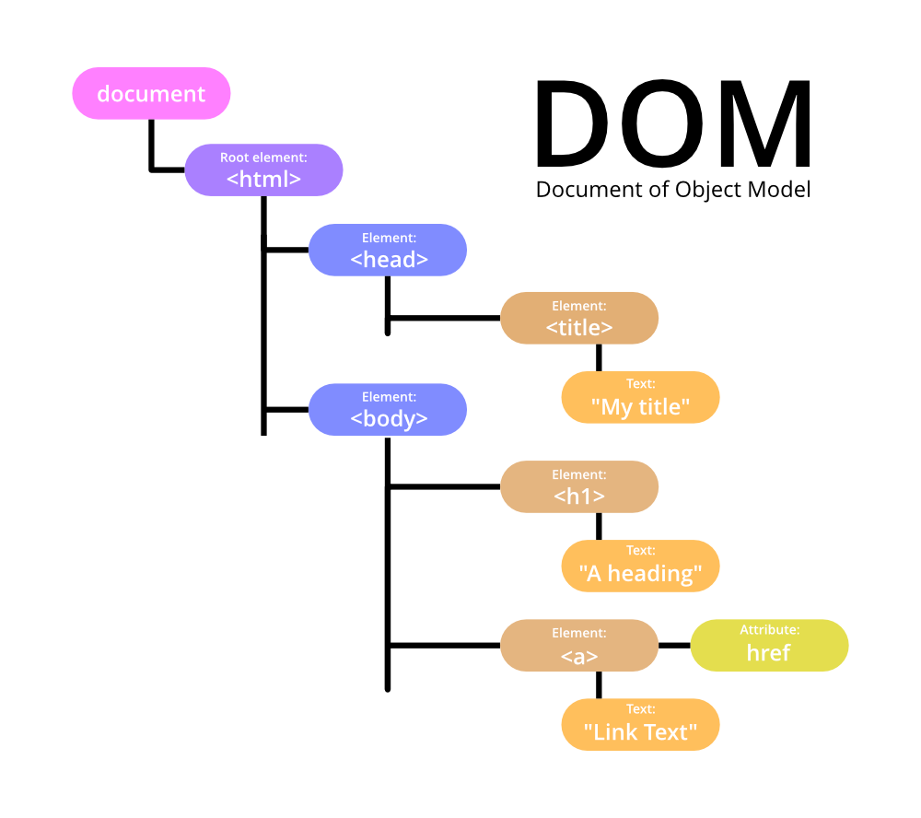
What is the DOM?
The DOM (Document Object Model) is a programming interface for web documents. It represents the structure of the document as a tree of nodes, where each node is an object representing part of the page (e.g., elements, text).
JavaScript allows you to access and manipulate these nodes to change the content, structure, and styling of a web page.

Slide 14
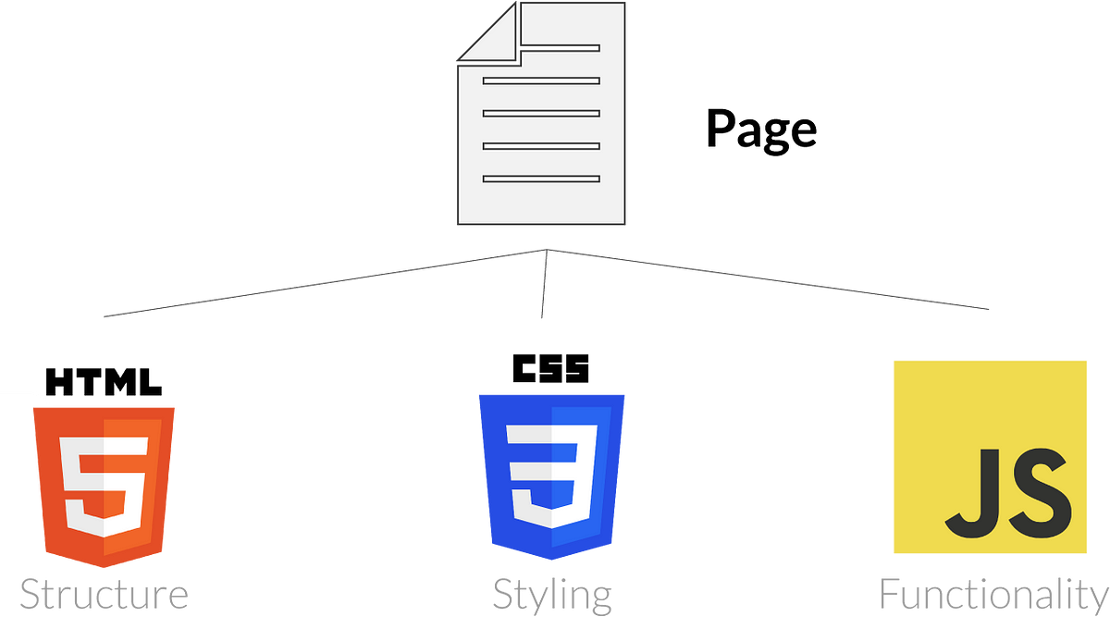
Introduction to the DOM
The Relationship Between HTML, CSS, and the DOM:
HTML provides the structure of the page.
CSS provides the styling of the page.
JavaScript interacts with the DOM to dynamically change the content and styling of the page.

Slide 15
Selecting HTML Elements
Using getElementById():
Syntax
Select a single element by its id.
let element = document.getElementById("elementId");

Slide 16
Using getElementById():
<p id="demo">Hello!</p>
<script>
let element = document.getElementById("demo");
console.log(element.textContent); // Outputs: Hello!
</script>

Slide 17
Selecting HTML Elements
Using getElementsByClassName():
Syntax
elect all elements with a specific class.
let elements = document.getElementsByClassName("className");

Slide 18
Using getElementsByClassName()
<p class="paragraph">First paragraph.</p>
<p class="paragraph">Second paragraph.</p>
<script>
let elements = document.getElementsByClassName("paragraph");
console.log(elements[0].textContent); // Outputs: First paragraph.
</script>

Slide 19
Modifying HTML Content
Changing innerHTML:
Syntax
Modify the HTML content of an element.
element.innerHTML = "new content";

Slide 20
Changing innerHTML
<div id="content">Old Content</div>
<script>
let content = document.getElementById("content");
content.innerHTML = "New Content!";
</script>

Slide 21
Modifying HTML Content
Changing textContent
Syntax
Modify only the text content of an element.
element.textContent = "new text";

Slide 22
Changing textContent
<p id="para">Old text</p>
<script>
let para = document.getElementById("para");
para.textContent = "New text!";
</script>

Slide 23
Manipulating CSS Styles
Changing CSS Properties using style
Change an element’s inline styles dynamically.
element.style.property = "value";

Slide 24
Changing CSS Properties
<div id="box" style="width: 100px; height: 100px; background-color: red;"></div>
<script>
let box = document.getElementById("box");
box.style.backgroundColor = "blue"; // Change the background color to blue
</script>

Slide 25
Activity 7: Change Background Color Using Text Input
Instructions:
Create an input field where the user can enter a color name (e.g., "red", "blue", etc.) or a hex color code (e.g., "#ff0000").
Create a button that, when clicked, will change the background color of the page to the color entered in the input field.
Make sure the input field is cleared after the background color is changed.

Slide 26
Lab Activity: Create an Interactive Web Page Using DOM Manipulation
Objective:
This lab activity is designed to give students the opportunity to explore their creativity while practicing DOM manipulation with JavaScript. They will create a web page that allows for dynamic interaction and changes based on user input and interactions.

