Slide 1
Introduction to Responsive Design
From Grid to Flex

Slide 2
What is Responsive Design?
Responsive Design is an approach to web design that makes web pages render well on a variety of devices and window or screen sizes. This ensures a consistent user experience across desktop, tablet, and mobile devices.
Why is it important?: Users access websites from various devices (smartphones, tablets, laptops, desktops).
Responsive websites adjust their layout and content based on the screen size and resolution of the device.
It allows for a better user experience and ensures greater accessibility.

Slide 3
The CSS display Property
What is the display Property?
The display property defines how an element is displayed on the webpage.
It is used to set the layout behavior of an element, such as whether it behaves like a block or inline element.

Slide 4
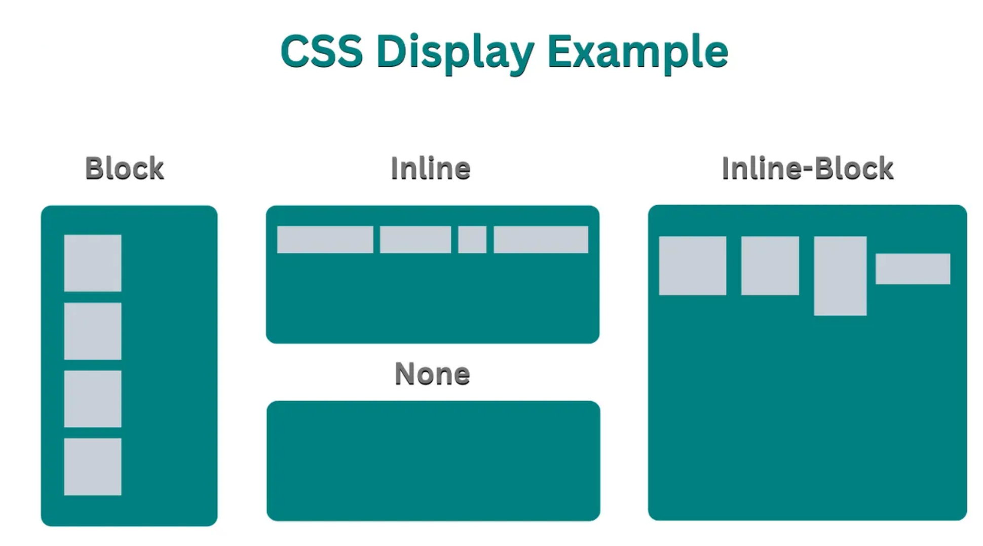
The CSS display Property
Common Values:
block: The element takes up the full width available, pushing subsequent elements to the next line (e.g., <div>, <p>).
inline: The element only takes up as much width as it needs and doesn’t break the flow of the document (e.g., <span>, <a>).
inline-block: A hybrid between block and inline; allows width and height adjustments while flowing inline.
flex: Enables Flexbox layout.
grid: Enables Grid layout.

Slide 5
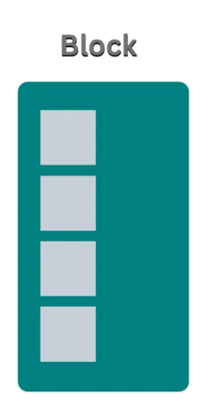
Common display Property Values:block
div {
display: block;
}
block: The element takes up the full width available and starts on a new line. Block-level elements include <div>, <p>, and <h1>.

Slide 6
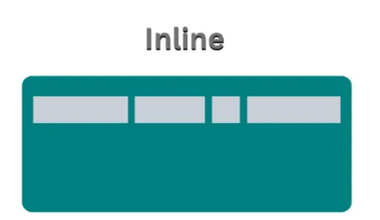
Common display Property Values: inline
a {
display: inline;
}
inline:The element only takes up as much width as it needs and doesn’t break the flow of the document. Inline elements include <span>, <a>, and <strong>.

Slide 7
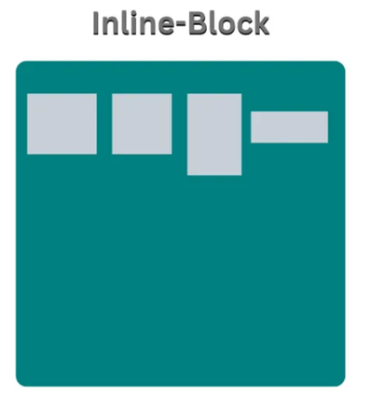
Common display Property Values: inline-block
div {
display: inline-block;
}
inline-block:A hybrid between block and inline. The element behaves like an inline element, but you can set its width and height.

Slide 8
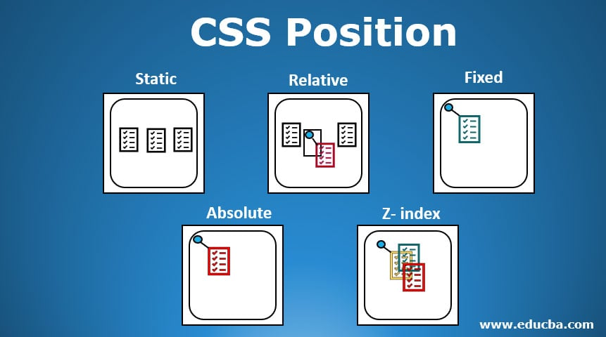
Understanding the position Property in CSS
What is the position Property?
The position property is used to control the positioning of an element on the webpage. It specifies how an element is positioned within its container or relative to other elements.

Slide 9
Values of the position Property :static
static (default): This is the default positioning for elements. They are positioned according to the normal document flow
Elements are placed based on the order in the HTML (top to bottom).
.static-example {
position: static;
}

Slide 10
Values of the position Property :relative
relative: The element is positioned relative to its normal position (i.e., where it would be in the normal document flow).
You can move the element from its original position using top, right, bottom, or left.
.relative-example {
position: relative;
top: 20px; /* Moves the element 20px down from its normal position */
left: 30px; /* Moves the element 30px to the right */
}

Slide 11
Values of the position Property: absolute
absolute: The element is positioned relative to its nearest positioned ancestor (an ancestor with position: relative, absolute, or fixed).
The element is removed from the normal document flow and can be precisely positioned using top, right, bottom, and left properties.
.absolute-example {
position: absolute;
top: 50px; /* Moves the element 50px from the top of its nearest positioned ancestor */
left: 100px; /* Moves the element 100px from the left of its nearest positioned ancestor */
}

Slide 12
Values of the position Property: fixed
fixed: The element is positioned relative to the browser window (viewport), and it stays in place even when the page is scrolled.
The element is removed from the normal document flow, and you can position it using top, right, bottom, and left. The element remains fixed in the same position as you scroll..
fixed-example {
position: fixed;
bottom: 10px; /* Keeps the element 10px from the bottom of the viewport */
right: 20px; /* Keeps the element 20px from the right side of the viewport */
}

Slide 13
Values of the position Property: sticky
sticky: The element is treated as relative until it reaches a defined scroll position, then it behaves like fixed.
How it works: This is commonly used for sticky headers that remain visible as the user scrolls down the page.
.sticky-example {
position: sticky;
top: 0; /* Makes the element stick to the top of the viewport once it's scrolled to that position */
}

Slide 14
Flexbox
CSS layout

Slide 15
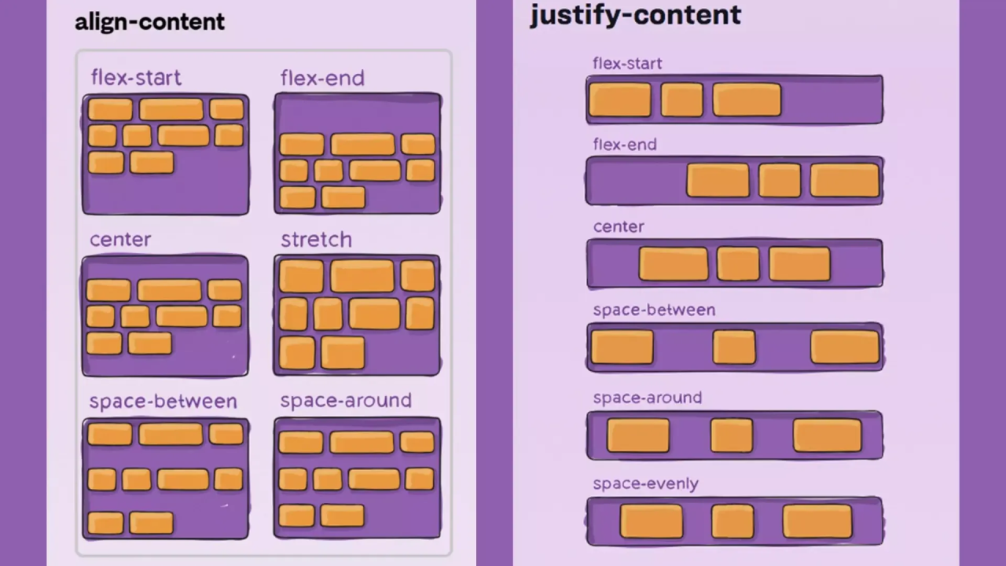
What is Flexbox?
Flexbox (Flexible Box Layout) is a CSS layout module designed to create more efficient layouts and alignments, especially for one-dimensional layouts (either rows or columns).
It allows elements to grow, shrink, and distribute space in a container, making it easier to build complex layouts without using floats or positioning.
Why Use Flexbox?
It simplifies the process of creating responsive layouts.
It helps in aligning items both vertically and horizontally.
It eliminates the need for calculating widths, making it easier to create flexible layouts.

Slide 16
Flexbox Container
What is a Flexbox Container?
The Flexbox container is the parent element that holds all the flex items.
To make an element a flex container, you apply the CSS property display: flex to the container.
.container {
display: flex;
}

Slide 17
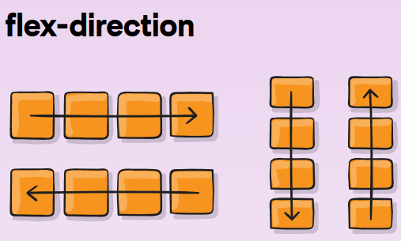
Flexbox Container Properties
flex-direction: Specifies the direction of the main axis (row, column).
.container {
flex-direction: row | row-reverse | column | column-reverse;
}

Slide 18
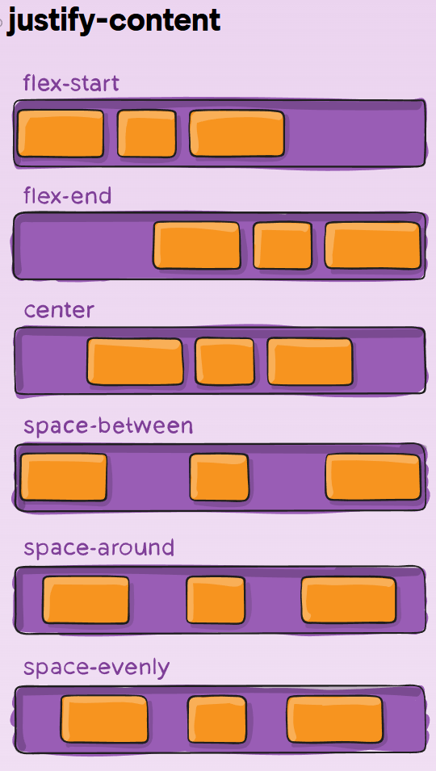
Flexbox Container Properties
justify-content: Aligns flex items along the main axis (horizontal by default).
.container {
justify-content: flex-start | flex-end | center | space-between | space-around | space-evenly;
}

Slide 19
Flexbox Container Properties
align-items: Aligns flex items along the cross axis (vertical by default).
.container {
align-items: flex-start | flex-end | center | space-between | space-around | space-evenly ;
}

Slide 20
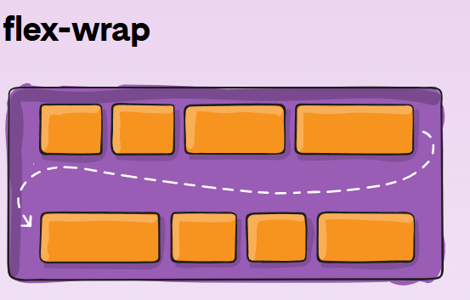
Flexbox Container Properties
Flex-wrap: Determines if items should wrap onto multiple lines.
.container {
flex-wrap: nowrap | wrap | wrap-reverse;
}

Slide 21
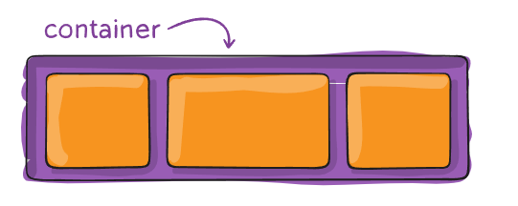
Basic Flexbox Syntax: Flex container
.flex-container {
display: flex;
justify-content: space-between; /* Aligns items horizontally */
align-items: center; /* Aligns items vertically */
}

Slide 22
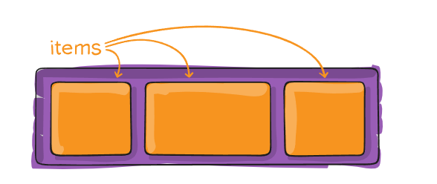
Flexbox Items
What are Flexbox Items?
Flexbox items are the direct children of a flex container.
By default, flex items will be arranged in a row (horizontally). You can change this behavior using flex-direction.

Slide 23
Flex Item Properties:
flex-grow: Defines how much a flex item should grow relative to the rest of the items. (Default is 0, meaning items won't grow.)
flex-shrink: Defines how much a flex item should shrink relative to the others when there’s not enough space. (Default is 1, meaning items will shrink.)
flex-basis: Sets the initial size of a flex item before any growing or shrinking occurs.
align-self: Allows a specific flex item to override the align-items property and align itself differently.
.container {
display: flex;
}
.item {
flex-grow: 1; /* Items will grow to fill available space */
}

Slide 24
Class Activity 1: Flexbox Layout Challenge
Objective:
The goal of this activity is to practice and learn the basics of Flexbox by creating a simple webpage layout. You will work with Flexbox container properties and Flexbox item properties to arrange and align items within a container.

Slide 25
Class Activity 2: Flexbox Froggy Challenges
Objective:
The goal of this activity is to enhance your understanding of Flexbox by completing all the challenges on the Flexbox Froggy website. This interactive game will help you learn how to use various Flexbox properties in a fun and engaging way.
nstructions:
Visit the Flexbox Froggy Website:
Go to the following URL: https://flexboxfroggy.com/.
This website will present you with a series of 24 interactive challenges that teach you how to use Flexbox to align and position items on the webpage.
Complete All 24 Challenges:
Start from the first challenge and complete each one in sequence.
Each challenge will teach you a new Flexbox property and how to use it to position the frogs correctly in the game.

