Slide 1
CSS Grid
Introduction to CSS Grid

Slide 2
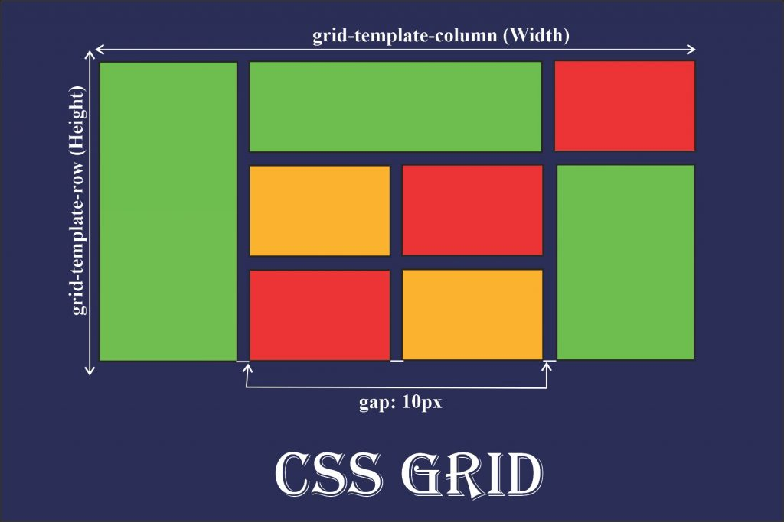
What is CSS Grid?
CSS Grid is a two-dimensional layout system for the web, allowing you to design both rows and columns simultaneously.
It provides a powerful way to create complex and responsive layouts.
CSS Grid gives you full control over rows, columns, and gaps between elements in a grid, which can be tricky to achieve with traditional layout methods like floats.

Slide 3
Why Use CSS Grid?
Enables creating complex layouts without needing floats or positioning.
Makes it easier to build responsive designs by adjusting the grid for different screen sizes.
Provides better control over alignment and spacing of elements.

Slide 4
Basic CSS Grid Structure
Basic CSS Grid Container
To create a grid, you need to define a container with display: grid.
The items inside this container will automatically become grid items.
.container {
display: grid;
grid-template-columns: repeat(3, 1fr);
grid-gap: 20px;
}

Slide 5
Defining Rows and Columns
Creating Grid with Columns and Rows
grid-template-columns: Defines the number and size of columns.
grid-template-rows: Defines the number and size of rows.
You can set sizes in px, %, or fr (fractional units).
.container {
display: grid;
grid-template-columns: 1fr 2fr;
/* 1 fraction for the first column, 2 fractions for the second column */
grid-template-rows: auto 100px;
/* Auto for the first row, 100px for the second row */
}

Slide 6
Grid Gaps
Setting Gaps Between Grid Items
grid-gap: Defines the space between grid items, both vertically and horizontally.
You can set it separately for rows and columns.
grid-row-gap and grid-column-gap can be used to set individual row or column gaps.
.container {
display: grid;
grid-template-columns: repeat(3, 1fr);
grid-gap: 20px;
/* Adds 20px gap between both rows and columns */
}

Slide 7
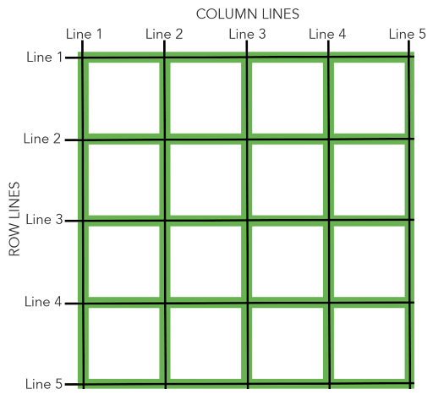
Grid Lines, Tracks, and Cells
Understanding Grid Lines and Tracks
Grid lines: These are the boundaries that define the edges of your grid rows and columns.
grid-template-columns defines columns (vertical lines).
grid-template-rows defines rows (horizontal lines).
Grid Tracks: The space between two adjacent grid lines (a row or column).
Grid Cells: The individual areas where grid items are placed.

Slide 8
Placing Grid Items
Positioning Grid Items
You can place grid items on specific rows and columns using grid-column and grid-row properties.
grid-column: Defines the starting and ending points for columns.grid-row: Defines the starting and ending points for rows.
.item1 {
grid-column: 1 / 3;
/* Spans from column 1 to column 3 */
grid-row: 1 / 2;
/* Spans from row 1 to row 2 */
}

Slide 9
Grid Item Sizing
Explicit and Implicit Grid Sizing
Explicit sizing: You define the grid structure using grid-template-columns and grid-template-rows.
Implicit sizing: Automatically generates rows or columns for grid items that overflow the defined grid.
.container {
display: grid;
grid-template-columns: 1fr 1fr;
grid-auto-rows: 200px;
/* Items beyond the defined grid will be placed in new rows with a height of 200px */
}

Slide 10
Class Activity 3: CSS Grid Practice - Build a Responsive Layout
Objective:
The goal of this activity is to practice and reinforce your understanding of CSS Grid by building a simple, responsive webpage layout. You will work with grid containers, grid items, and media queries to create a layout that adjusts based on screen size.

Slide 11
Class Activity 4: Grid Attack - CSS Grid Challenges
Objective:
The goal of this activity is to practice and reinforce your understanding of CSS Grid by completing all the challenges on the Grid Garden website.
Instructions:
Visit the Grid Attack Website:
Go to the following URL: https://codingfantasy.com/games/css-grid-attack/play
This website presents a series of 80 interactive challenges that will help you understand and use various CSS Grid properties to help the plants grow in the garden.
Complete At least 25 Challenges:
Start from the first challenge and complete each one in sequence. Each challenge introduces new CSS Grid concepts and guides you through solving the problems.

Slide 12
Introduction to Media Queries
Making websites fully responsive

Slide 13
What is a Media Query?
A Media Query is a CSS technique used to apply styles based on the device's characteristics such as screen width, height, resolution, and orientation.
Media queries are a fundamental tool in responsive web design, enabling developers to create layouts that adapt to different screen sizes and devices.
Why Use Media Queries?
Adapt Layouts: Media queries allow a webpage to adjust its layout for different screen sizes (desktop, tablet, mobile).
Improve User Experience: Ensures that content is readable and usable on all devices.
Create Responsive Designs: Helps implement flexible designs without using fixed-width layouts.

Slide 14
Media Query Syntax
Basic Syntax of Media Queries
@media: The keyword that defines a media query.
Condition: The feature to query, such as width, height, orientation, etc.
CSS styles: The styles that apply when the condition is true.
@media (max-width: 768px) {
/* Styles will be applied for screens 768px or smaller */
body {
background-color: lightblue;
}
}

Slide 15
Media Query Features
@media (max-width: 600px) and (orientation: portrait) {
body {
font-size: 14px;
}
}
Common Media Features:
width: The width of the viewport.
height: The height of the viewport.
orientation: The orientation of the device (landscape or portrait).
resolution: The screen resolution (useful for high-DPI displays like Retina screens).
aspect-ratio: The ratio of the viewport's width to its height.

Slide 16
Media Query Types
min-width and max-width
min-width: Applies styles when the viewport is greater than the specified width.
max-width: Applies styles when the viewport is smaller than the specified width.
/* For devices with a width of 600px or more */
@media (min-width: 600px) {
body {
background-color: lightgreen;
}
}
/* For devices with a width of 600px or less */
@media (max-width: 600px) {
body {
background-color: lightblue;
}
}

Slide 17
Orientation
/* For portrait mode */
@media (orientation: portrait) {
body {
font-size: 16px;
}
}
/* For landscape mode */
@media (orientation: landscape) {
body {
font-size: 18px;
}
}
orientation
portrait: Applies styles for devices with a vertical screen orientation.
landscape: Applies styles for devices with a horizontal screen orientation.

Slide 18
Responsive Grid Layouts
.container {
display: grid;
grid-template-columns: repeat(4, 1fr);
grid-gap: 20px;
}
@media (max-width: 768px) {
.container {
grid-template-columns: 1fr 1fr;
/* Stack items in 2 columns on small screens */
}
}
Use media queries to adjust the grid layout for different screen sizes.
grid-template-columns and grid-template-rows can be adjusted inside media queries to make the grid layout more responsive.

Slide 19
Lab Activity 5: Build a Personal Portfolio Website
Objective:
The goal of this activity is to create a Personal Portfolio Website using HTML, CSS, Flexbox, and CSS Grid. You will apply everything you've learned so far to design and structure a professional-looking webpage. This will allow you to showcase your skills and knowledge of web development and responsive design.

