Slide 1
DOM Manipulation with Event Listeners
JavaScript Advanced Topics

Slide 2
DOM Manipulation with Event Listeners
What is Event Handling?:
Definition: Event listeners are used to handle user interactions like clicks, key presses, or hover actions.
Why Use Event Listeners?:
Separation of concerns: JavaScript is used to handle behavior, while HTML is used to define structure.
Multiple events on dynamic elements: Dynamically added elements can be managed with event listeners.
element.addEventListener('event', function() {
// Handle the event here
});
let button = document.getElementById("myButton");
button.addEventListener("click", function() {
alert("Button clicked!");
});

Slide 3
Activity 1: Click Button to Change Text
Instructions:
Create a Button: Create a button element with the text "Click me".
Create a <div> Element: This will display a message that changes when the button is clicked.
Add an Event Listener:
Use JavaScript's addEventListener method to listen for a click event on the button.
Change Text: When the button is clicked, change the text inside the <div> to a different text.

Slide 4
Forms and Form validation
Data Validation

Slide 5
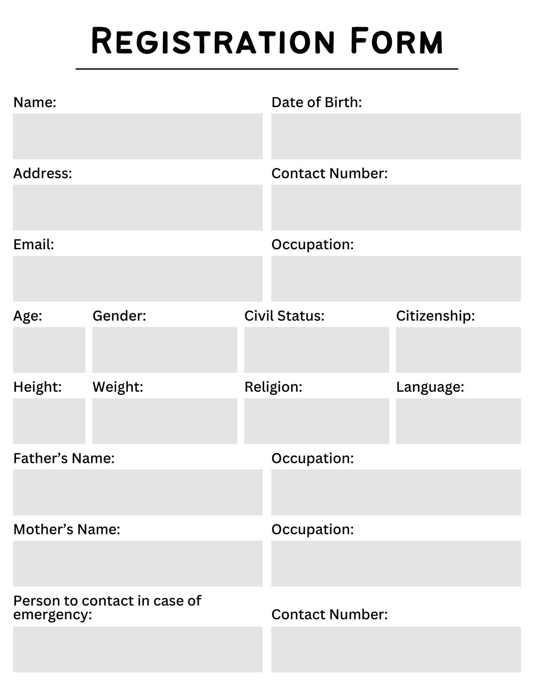
The <form> Tag in HTML
What is the <form> Tag?
The <form> element is used to collect user input in a structured way on web pages.
It is the container for form controls like text fields, radio buttons, checkboxes, and buttons.

Slide 6
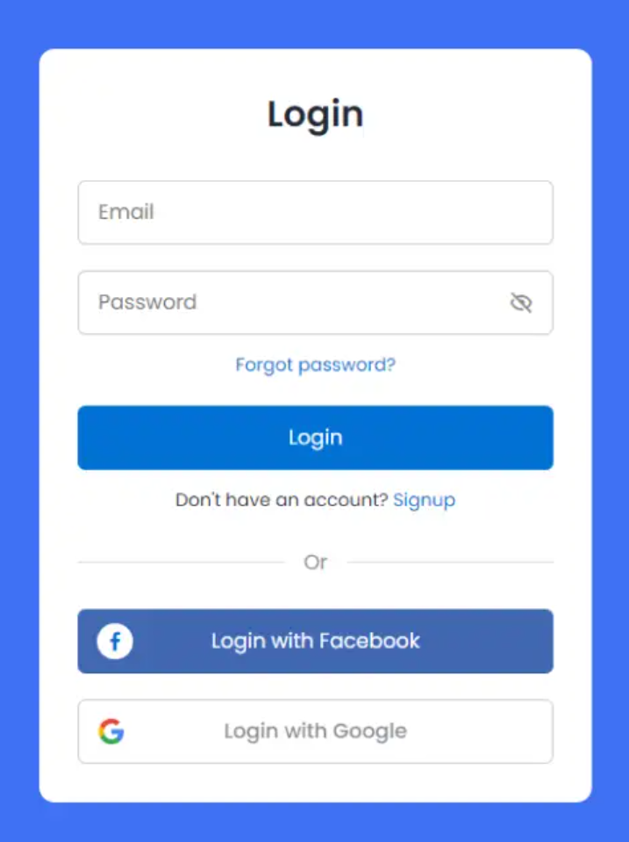
Common Uses of <form>
Submit user data: Sends user input to a server for processing (e.g., contact forms, login forms).
Interactive user interface: Collects information such as name, email, password, etc.

Slide 7
Key Attributes of the <form> Tag
action: Specifies the URL to which the form data will be sent for processing.
Example: <form action="submit_form.php">
method: Defines how data will be sent to the server.
Common methods are GET and POST.
GET: Appends data to the URL (visible in the browser's address bar).
POST: Sends data in the body of the request (more secure for sensitive data).
Example: <form method="POST">
name:Assigns a name to the form for easier access via JavaScript.
Example: <form name="contactForm">
target:Specifies where to display the response after form submission.
Common values:
_blank: Open in a new window/tab.
_self: Default, open in the same window/tab.
Example: <form target="_blank">

Slide 8
Example of a Simple Form
<form action="/submit" method="POST">
<label for="name">Name:</label>
<input type="text" id="name" name="username">
<button type="submit">Submit</button>
</form>

Slide 9
Introduction to Form Validation
Form Validation:Ensures that the user inputs the correct data before submission.
Why is Form Validation Important?:
Prevents incorrect or malicious data from being submitted.
Enhances user experience with real-time feedback.
Validating Required Fields:
Ensure that required fields are not left empty.
<form id="myForm">
<input type="text" id="username" placeholder="Username" required>
<input type="email" id="email" placeholder="Email" required>
<button type="submit">Submit</button>
</form>
<script>
document.getElementById("myForm").addEventListener("submit", function(event) {
let username = document.getElementById("username").value;
let email = document.getElementById("email").value;
if (!username || !email) {
alert("Please fill out all required fields.");
event.preventDefault();
}
});
</script>

Slide 10
Activity 2 : Form Validation with Phone Number, Checkbox, and Rating
Instructions:
1. Create a form that validates the following:
Phone Number Validation( type text):
The phone number must be 10 digits long (no spaces or special characters).
Checkbox Validation (type checkbox):
The user must check a box to agree to the terms and conditions.
Radio Button Validation(type radio):
The user must select a rating from 1 to 5.
2. If any of these validations fail, prevent form submission and display the appropriate error message.

Slide 11
JavaScript Fetch API
Introduction to the Fetch API

Slide 12
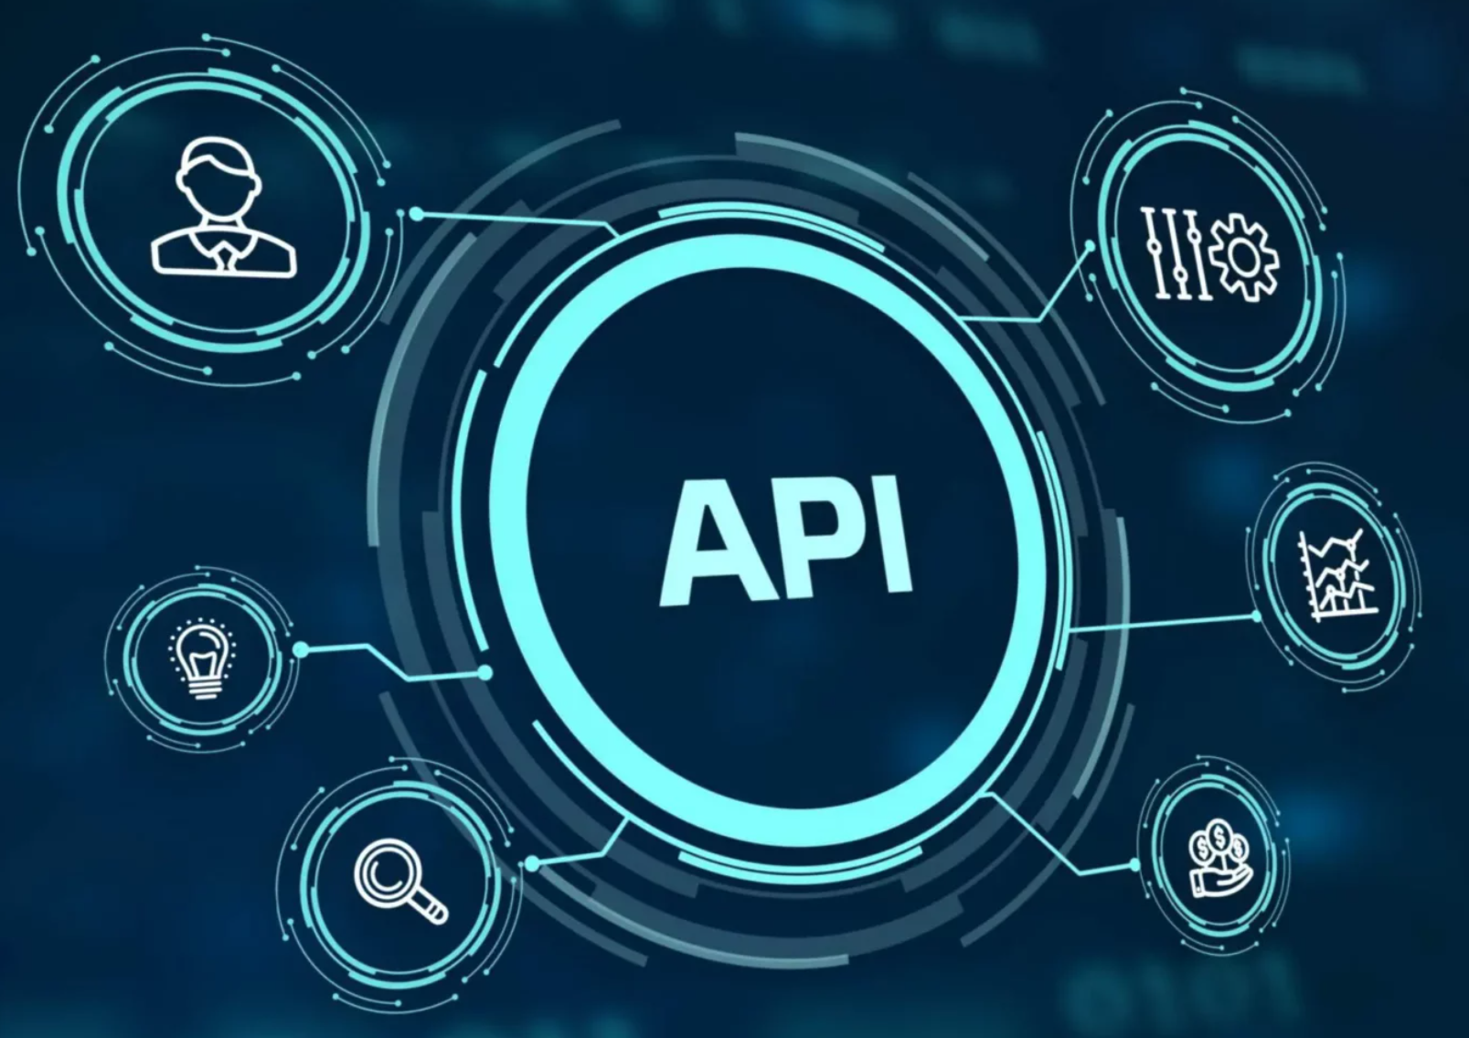
What is an API?
Definition:
API stands for Application Programming Interface.
It is a set of rules and protocols that allows different software applications to communicate with each other.

Slide 13
Key Concepts
Interface:
An API acts as an interface between two software systems, allowing them to interact without needing to know the internal workings of each other.
Request and Response:
Request: One system (client) sends a request to another system (server) for specific data or services.
Response: The server processes the request and sends back the data or confirmation.

Slide 14
Types of APIs
Web APIs:
APIs accessed over the internet, often using HTTP (e.g., REST APIs, GraphQL).
Example: Twitter API allows applications to fetch tweets or post new tweets.
Library APIs:
A set of functions or classes in a software library that you can use in your application.
Example: jQuery API provides methods for manipulating HTML elements.
Operating System APIs:
Interfaces provided by an operating system for software to interact with hardware or system resources.
Example: Windows API for interacting with file systems, windows, and processes.

Slide 15
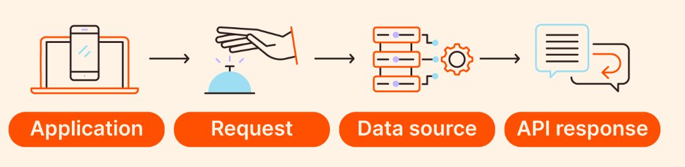
How APIs Work
Client sends a request to an API (via HTTP).
API processes the request.
Server sends a response with the requested data or confirmation.
Client uses the received data.

Slide 16
Example of an API Request
A weather app might use an API to get the current temperature from a weather service:
Request: GET /weather?city=London
Response: { "temperature": "15°C", "description": "Clear skies" }

Slide 17
Why APIs are Important
Interoperability: APIs allow different systems to work together, even if they are built on different platforms or technologies.
Efficiency: APIs enable developers to reuse existing services, reducing the need to "reinvent the wheel."
Flexibility: APIs allow external developers to build applications that interact with your system or service.

Slide 18
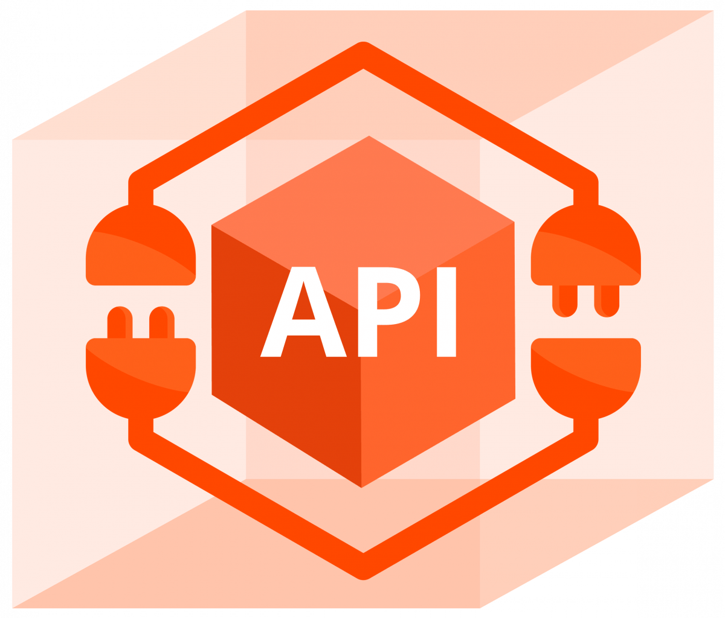
Introduction to the Fetch API
What is the Fetch API?
A modern JavaScript API for making HTTP requests (GET, POST, etc.) and handling responses asynchronously.
Making a GET Request:
Fetch data from a public API (e.g., JSONPlaceholder) and display it dynamically on the page.

Slide 19

JavaScript Fetch API
What is the Fetch API?: A modern JavaScript API for making HTTP requests (GET, POST, etc.) and handling responses asynchronously.
Making a GET Request:
Fetch data from a public API (e.g., JSONPlaceholder) and display it dynamically on the page.

Slide 20

What is JSON?
JSON stands for JavaScript Object Notation.
It is a lightweight data interchange format that is easy for both humans to read and machines to parse and generate.

Slide 21
JSON Structure
Objects:
A collection of key-value pairs enclosed in curly braces {}.
Each key (property) is a string, followed by a colon :, and then the value can be a string, number, boolean, array, or another object.
{
"name": "John",
"age": 30,
"isStudent": false
}

Slide 22
JavaScript Fetch API
Making a GET Request:
Fetch data from a public API (e.g., JSONPlaceholder) and display it dynamically on the page.
fetch("https://jsonplaceholder.typicode.com/posts")
.then(response => response.json())
.then(data => {
console.log(data);
})
.catch(error => {
console.log("Error fetching data: ", error);
});

Slide 23
JavaScript Fetch API
<ul id="postList"></ul>
<script>
fetch("https://jsonplaceholder.typicode.com/posts")
.then(response => response.json())
.then(data => {
let postList = document.getElementById("postList");
data.forEach(post => {
let li = document.createElement("li");
li.textContent = post.title;
postList.appendChild(li);
});
});
</script>
Displaying API Data on the Page:
Retrieve data from the API and display it dynamically on the web page.

Slide 24
Free Public APIs
https://github.com/public-apis/public-apis
https://public-apis.io/

Slide 25
Bootstrap

Slide 26
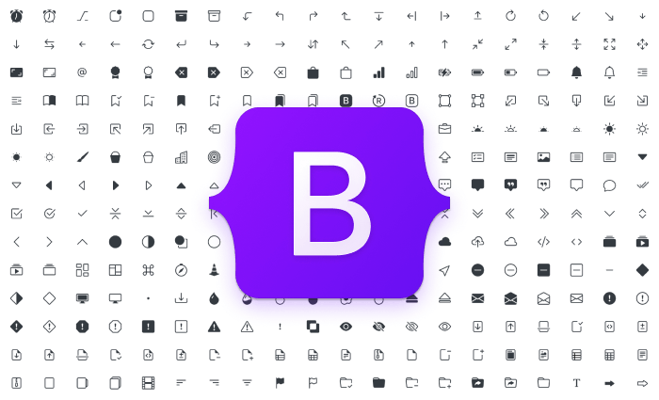
What is Bootstrap?
What is Bootstrap?
Bootstrap is a widely used front-end framework designed to help developers quickly create responsive and mobile-first websites.
It includes a wide range of pre-designed components, such as:
Buttons
Alerts
Forms
Navigation bars and more
Responsive Grid System: Bootstrap's grid system helps you design flexible and responsive layouts with ease.

Slide 27
Key Features of Bootstrap
Responsive Grid System
Grid system: Bootstrap uses a 12-column layout by default, where you can specify how much space a column should take on different screen sizes (large, medium, small, extra small).
<div class="container">
<div class="row">
<div class="col-md-6">Column </div>
<div class="col-md-6">Column </div>
</div>
</div>

Slide 28
Bootstrap Grid System
Breakpoints in Grid System
Extra Small (col): 12 columns (default)
Small (col-sm): 576px and up
Medium (col-md): 768px and up
Large (col-lg): 992px and up
Extra Large (col-xl): 1200px and up

Slide 29
Common Bootstrap Components
Buttons
Bootstrap provides pre-designed buttons with different styles such as primary, secondary, success, danger, etc.
<button class="btn btn-primary">Primary Button</button>
<button class="btn btn-secondary">Secondary Button</button>

Slide 30
Bootstrap Forms
Bootstrap offers pre-designed form elements that are responsive and easy to use.
<form>
<div class="mb-3">
<label for="exampleInputEmail1" class="form-label">Email address</label>
<input type="email" class="form-control" id="exampleInputEmail1" aria-describedby="emailHelp">
</div>
<button type="submit" class="btn btn-primary">Submit</button>
</form>

Slide 31
Setting Up Bootstrap
You can include Bootstrap by adding a link to the CDN in the <head> of your HTML file.
html
<link rel="stylesheet" href="https://stackpath.bootstrapcdn.com/bootstrap/4.5.2/css/bootstrap.min.css">

Slide 32
