Slide 1

Neural Network and
Deep Learning
Introduction of artificial neural network
using keras
경희대학교 컴퓨터공학과
2019102191 신주영

Slide 2
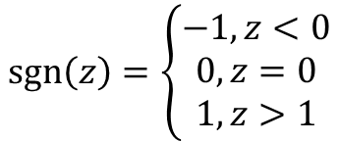
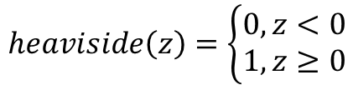
$$heaviside\left(z\right)=\left\{\begin{matrix}0, z<0 \\ 1, z≥0\end{matrix}\right.$$
$$\operatorname{sgn}\left(z\right)=\left\{\begin{matrix}−1, z<0 \\ 0, z=0 \\ 1, z>1\end{matrix}\right.$$

