Slide 1

Machine Learning
Machine Learning at a Glance
경희대학교 컴퓨터공학과
2019102191 신주영

Slide 2
Machine Learning’s definition
It is a research field that allows computers to have the ability to learn without explicit programming.
If the performance of a computer program on a dataset T was improved by experience E when the accuracy of a computer program on a dataset T was measured as P, this computer program learned about data T and accuracy P by experience E.
Training set: Samples used by the system to learn
Training instance: Each training data

Slide 3
Why using Machine Learning
Traditional solutions require many manual tuning and rules: one machine learning model can simplify code and perform better than traditional methods.
Complex problems with no solutions in traditional ways: solutions can be found with the best machine learning techniques.
Flexible environments: Machine learning systems can adapt to new data.
Gain insight from complex issues and massive amounts of data

Slide 4
Application example
Analyze and automatically classify product images on the production line
Scan the brain to diagnose the tumor
To classify news articles automatically
To automatically summarize long documents
Chatbot
Predicting the company's earnings for the coming year
To detect fraudulent credit card transactions
Reduce high-dimensional datasets to low-dimensional(2D, 3D)

Slide 5
Types of Machine Learning Systems
Training under human supervision? (Supervised, Unsupervised, Semi-supervised, reinforcement Learning)
Do you learn progressively in real time? (Online learning, Batch Learning)
Compare known and new data points or create predictive models by finding patterns in the training data set (Case-based learning and model-based learning)

Slide 6
Supervised Learning
In supervised learning, a label is included in the training data.
Classification is a typical supervised learning task.
Regression task is to predict the target value using features.

Slide 7
Supervised Learning algorithms
K-Means algorithm
Linear regression
Logistic regression
Support Vector Machine(SVM)
Decision tree and random forest
Neural network

Slide 8
Unsupervised Learning
Unsupervised learning is literally unlabeled in training data.
The system must learn without any help.
Clustering | Outlier detection, Dimensionality reduction | Visualization, Dimensionality reduction | Association rule learning
K-Means | One-class SVM | Principal component analysis (PCA) | Apriori
DBSCAN | Isolation forest | Kernel PCA | Ecalt
Hierarchial cluster analysis (HCA) |  | Locally linear embedding(LLE)
 |  | t-SNE

Slide 9
Unsupervised Learning
Clustering refers to the process of dividing objects into several clusters (subgroups) when they are given.
Visualization creates a 2D or 3D representation capable of schematizing large, unlabeled, high-dimensional data.
Dimension reduction simplifies data without losing too much information.
Outlier detection is one of the data analysis techniques based on data mining, which detects outliers, "observed values suspected of being generated by different methods from other observations within a data" (Hawkins, 1980).
Novelty detection aims to detect new samples that look different from all the samples in the training set.
Association rule learning finds relationships between characteristics in large amounts of data.

Slide 10
Semi-supervised learning
Semi-supervised learning deals with labeled data only in part.
For example, if you add a label to that cluster after clustering, other data points are assigned labels.

Slide 11
Reinforcement learning
In reinforcement learning, the agent observes the environment and executes the action and receives a reward(penalty) as a result. And we execute a strategy called policy to get the greatest reward.

Slide 12
Batch learning
In batch learning, the system cannot learn progressively.
In order for batch learning systems to learn about new data, new versions of the system must be trained from scratch using the full data.

Slide 13
Online learning
Online learning trains the system by injecting data one at a time or in small batches called mini-batch.
The data that has been learned is no longer needed, so you can throw it away.
incremental learning algorithms can also be used for systems that learn very large datasets that cannot fit into the main memory of a single computer.

Slide 14
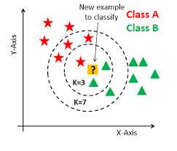
Case-based learning
Measure the similarity between the surrounding samples.
A representative example is the kNN algorithm.

Slide 15
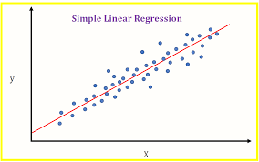
Model-based learning
A model of a given sample is made and used for prediction.

Slide 16
Model-based learning procedure
Analyze data
Select model
Train model using train data
Predict result and hope this model will generalized well

Slide 17
Key challenges in Machine Learning
Not enough training data
Unrepresentative training data
Low quality data
Irrelevant characteristics
Over-fitting
Under-fitting

Slide 18
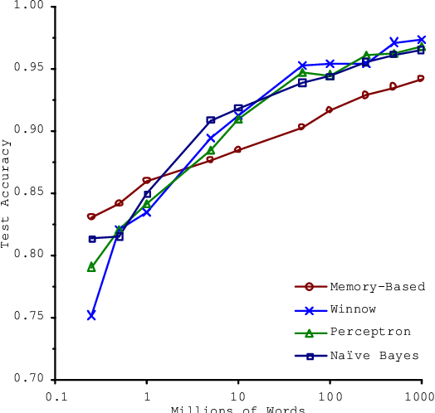
Not enough training data
Machine learning algorithms need a lot of data to work well.
A very simple problem also requires thousands of data.
Complex problems such as image and speech recognition may require millions of data.

Slide 19
Unrepresentative training data
If the sample is small, sampling noise (Unrepresentative data by chance) is generated.
Even very large samples may not be representative if the sampling method is incorrect.

Slide 20
Low quality data
If the training data is full of errors, outliers, and noise, it is difficult to find patterns with built-in machine learning systems and does not work well.
So training data purification is important.
  If you are certain that some samples are outliers, it is recommended that you ignore them or correct them manually.
  If some samples are missing a few attributes, it is necessary to decide whether to ignore all of these attributes, ignore this sample, fill in the missing values, or train the model separately from the model with this attribute.

Slide 21
Irrelavant training data
Feature selection: Choose the most useful characteristic for training among the characteristics you have.
Feature extraction: Combining properties creates more useful properties. Representatively, dimension reduction algorithms can be helpful.

Slide 22
Over-fitting
The accuracy of the training data is good, but it is called overfitting because an error may occur in an actual test.
Constraining the model to reduce the risk of overfitting is called regularization.

Slide 23
Under-fitting
Under-fitting occurs when the model is too simple to learn the inherent structure of the data.
Key techniques to address this issue
  We select a robust model with more model parameters.
  It provides better properties for learning algorithms.
  Reduce the constraints of the model.

Slide 24
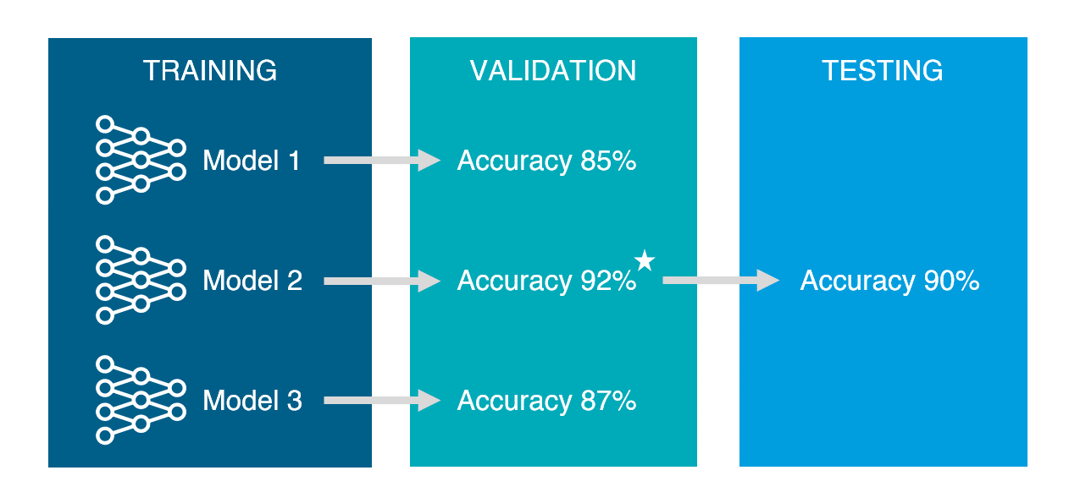
Test and Validation
Holdout Validation: We evaluate several candidate models by tearing off part of the training set and choose the best one.
  Training data: dataset to train
  Test data: dataset to test
Cross Validation: For each validation set, models trained from the rest of the data are evaluated on that validation set.

Slide 25
Practice problem
1. How can I define machine learning
2. Name four types of problems that machine learning can help you with
It is a research field that allows computers to have the ability to learn without explicit programming.
one machine learning model can simplify code and perform better than traditional methods.
solutions can be found with the best machine learning techniques.
Machine learning systems can adapt to new data.
Gain insight from complex issues and massive amounts of data

Slide 26
Practice problem
3. What is labeled training set
4. What are the two most widely used supervised learning tasks?
Labeled data is a designation for pieces of data that have been tagged with one or more labels identifying certain properties or characteristics, or classifications or contained objects.
Regression
classification

Slide 27
Practice problem
5. What are the five most widely used unsupervised learning task
6. What kind of machine learning algorithm can be used to walk the robot on multiple terrain without prior information
Clustering
Outlier detection
Dimensionality reduction
Visualization
Association rule learning
Reinforcement learning

Slide 28
Practice problem
7. Which algorithm should I use to divide the customer into groups
8. Can you see the problem of spam detection as a problem of supervised or unsupervised learning
Supervised Learning: SVM
Unsupervised Learning: K-Means
Supervised Learning

Slide 29
Practice problem
9. What is online learning
10. What is out-of-core learning
Online learning trains the system by injecting data one at a time or in small batches called mini-batch.
Applying online learning algorithms(mini-batch) to systems that learn very large datasets that can’t fit into the main memory of a computer.

Slide 30
Practice problem
11. Which learning algorithm relies on silmilarity measurements to make predictions?
12. What is the difference between the model parameters and the hyper parameters of the learning algorithm?
Case based learning (kNN, etc…)
The model parameter is a parameter obtained by learning, and the hyper parameter is a parameter that must be input before learning

Slide 31
Practice problem
13. What are model-based algorithms looking for? What is the most common strategy this algorithm uses for success? How do you make predictions?
14. What are the main challenges of machine learning?
Generalized model
Regularization
Enter the characteristics of the new sample into the prediction function of the model using the parameters found by the learning algorithm.
Insufficient data
Poor data quality
Unrepresentative data
A meaningless trait
Over-fitting
Under-fitting

Slide 32
Practice problem
15. What is the problem if the model performs well in the trainig data but generalizes poorly in the new sample? What are the three possible solutions?
16. What is the test set and why should I use it?
Over-fitting
It simplifies by selecting a model with a small number of model parameters, reducing the number of characteristics in training data, or imposing constraints on the model.
More training data
Reduce training data’s noise
To prevent over-fitting

Slide 33
Practice problem
17. What is the purpose of the validation set?
18. What is a training-development set? When do I need it and how do I use it?
To choose the best model and tune the hyperparameter.
It is to separate part of the training set and create another one.
When a data mismatch occurs.

Slide 34
Practice problem
19. What is the problem with tuning the hyper parameter using the test set?
Hyperparameters create models optimized for test sets.

