Slide 1

Unsupervised Learning
K-Means Algorithm

Slide 2
Fundamental Concept
A method of dividing data of similar characteristics into groups is called clustering.
The group to which the data points belong is determined as the group whose distance between the data points and the center of each group is closest.
Determining the center of this group is an important operation of the K-means algorithm.

Slide 3
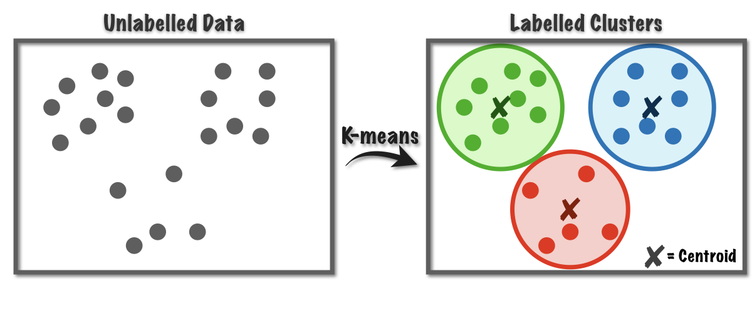
Fundamental Concept

Slide 4
Algorithm
K-means algorithmd's learning process
  Choose and center the appropriate number of data pointers by the number of groups
  Calculates the distance between a data point and each center to determine the nearest center as the group to which that data point belongs
  Average data points for each group and set them as new centers
  Repeat steps 2-3 until convergence

Slide 5
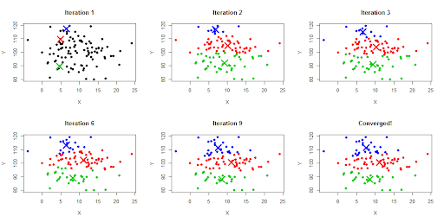
Algorithm

Slide 6
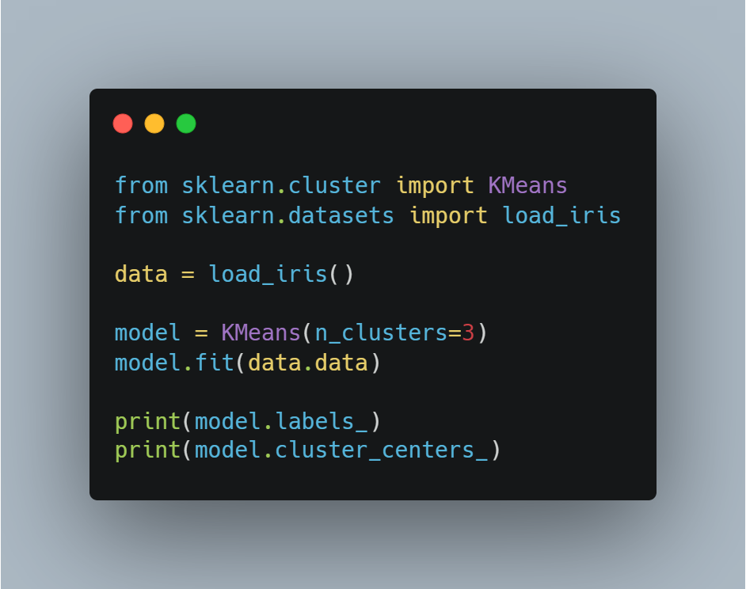
Sample Code
Import libraries
Load iris dataset
Make K-Means model
Set n_cluster
Fit data
Print labels
Print cluster’s center

Slide 7

Within-cluster sum of squares, WCSS
The good or bad of clustering is evaluated quantitatively by calculating the WCSS.
The smaller the distance between the center of the group and the data point belonging to the group, the smaller the WCSS value.

Slide 8
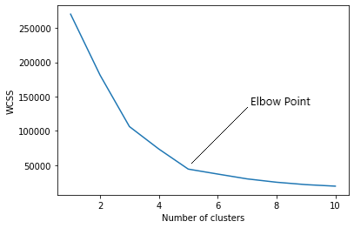
WCSS elbow method
The number of clusters can be determined using the WCSS elbow-method.
Determine the number based on the point on the graph that looks like an elbow.

Slide 9
Over-fitting in unsupervised learning
If there are too many clusters for a particular dataset, a generalized model is not created.
For example, there are three actual types of iris varieties, but setting the cluster to five creates an unsuitable model.

