Slide 1

Supervised Learning
SVM (Support Vector Machine)

Slide 2
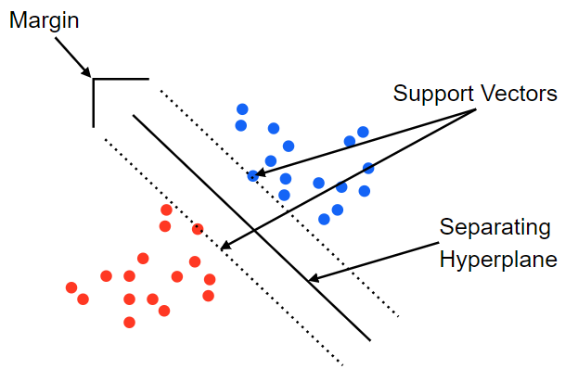
Fundamental Concept
The decision boundaries obtained by SVM maximize margin between groups, so learn to have no points belonging to the boundaries and classify them more clearly than logistic regression.

Slide 3
Algorithm
SVM deals with the problem of binary classification of planes assuming linear and complete classification is possible.
Maximize the margin between groups to obtain a good decision boundary to classify.

Slide 4
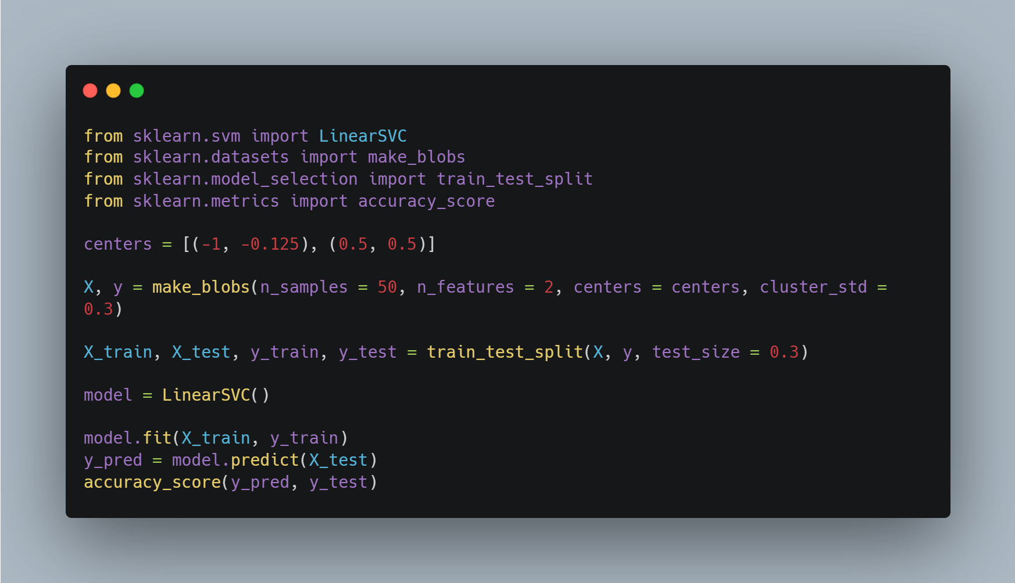
Sample Code
Import libraries
Set center coordinate of data
Make random numbers based on center coordinate
Make SVM model
Learning data
Get accuracy

Slide 5
Margin and Support vector
If the margin does not contain data, it is called hard margin.
Allowing some data to be contained in margin is called soft margin.
Learning data is divided into three categories.
  data outside margin: data outside the margin based on the decision boundary
  margin data: data for determining margin based on decision boundaries
  data inside margin: data that are in margin or misclassified based on the boundary of the boundaries

Slide 6
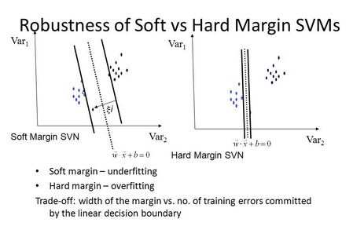
Hard margin and Soft margin
The left graph using soft margin is not affected by the fact that the learning results are far away.
The graph on the right using hard margin is greatly influenced by the point far away.
How much data in the margin is allowed in soft margin follows the hyperparameters set by the person himself.

