Slide 1

Supervised Learning
SVM(Support Vector Machine) Using Kernel

Slide 2
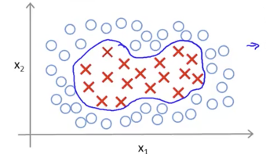
Fundamental Concept
In SVM, it is difficult to classify data in which the boundary of each label is curved because the decision boundary is a straight line.
Complex decision boundaries can be learned by applying kernel techniques to SVM.

Slide 3
Algorithm
Kernel technique: linear regression after transferring data to another feature space
Conditions required to allow linear separation of data that cannot be linearly separated
  There is a higher dimension space than the learning data, and each point of the learning data corresponds to a point of the higher dimension space.
  Points corresponding to learning data in a high-dimensional space can be linearly separated, and actual learning data is projection in a high-dimensional space.

Slide 4
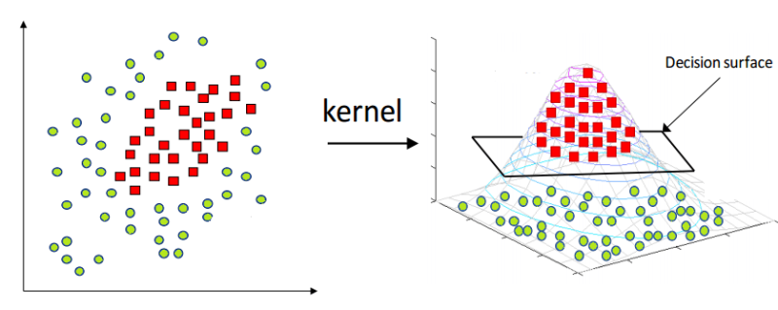
Algorithm

Slide 5
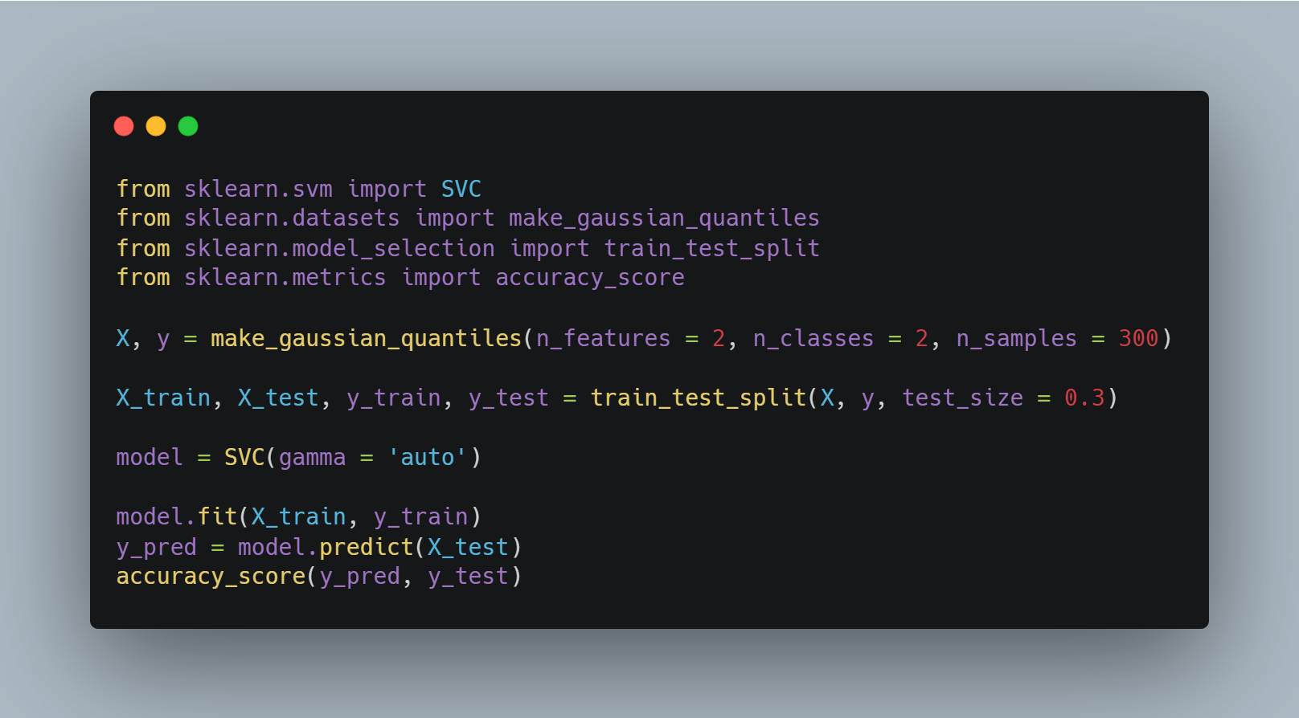
Sample Code
Import libraries
Make gaussian quantiles
Set train, test dataset
Make SVM model
Learn and predict data
Check accuracy

Slide 6
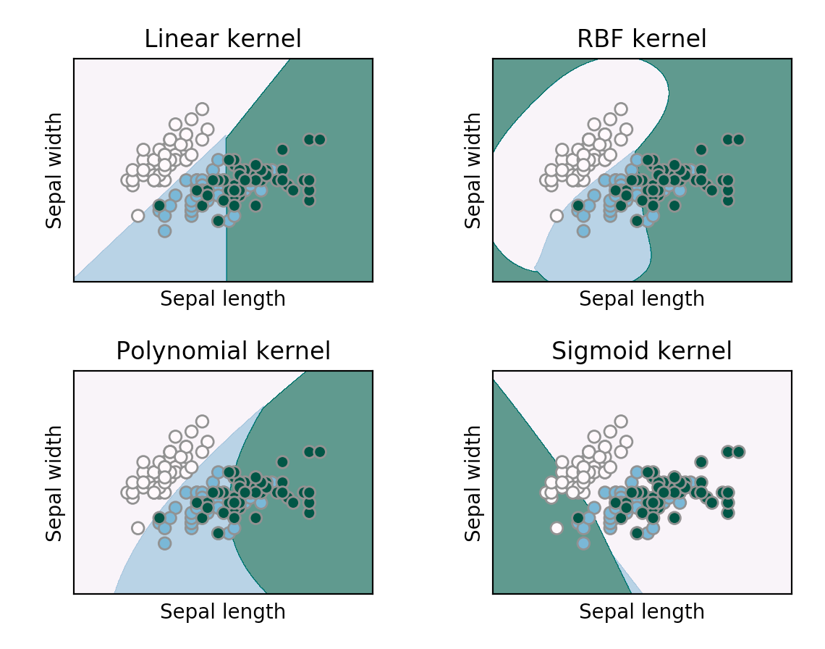
Difference in learning outcomes using kernel functions

Slide 7
Points to note
The larger the hyperparameter value, the more complex the decision boundary is learned from the data.
Kernel techniques are recommended to be used to require accuracy rather than feature analysis.
It should be noted that meaningful decision boundaries are not obtained as a result of learning.

