Slide 1

Supervised Learning
Neural Network

Slide 2
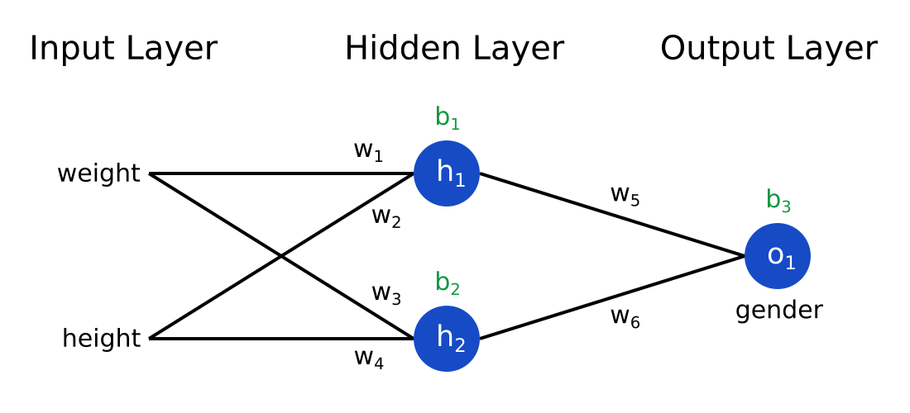
Fundamental Concept
A neural network is a model that learns complex decision lines by defining a hidden layer between the input layer and the output layer
It can be applied to both regression and classification, but it is mainly applied to classification problems.
The above figure is a neural network in which the input layer is 2D, the hidden layer is 2D, and the output layer is 1D.

Slide 3
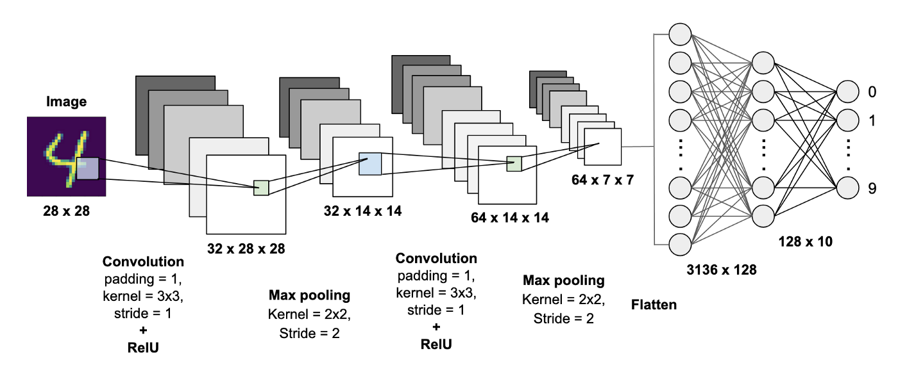
Fundamental Concept

Slide 4
Fundamental Concept fault perceptron
After applying a neural network to classifying NIST, a dataset composed of cursive letters, we will check the classification results.
NIST has 10 cursive letters ranging from 0 to 9.
The input layer represents the input cursive numeric image itself.
The pixel values of each point are stored in a 1D column vector.
The hidden layer calculates a value received from the input layer with a nonlinear function such as a sigmoid function.
The larger the hyperparameters, the more complex decision lines are learned, but overfitting is likely to occur.
The output layer also calculates the value received from the hidden layer as a nonlinear function.
The output layer outputs 10 probabilities that the input cursive numerical image belongs to one of 0 to 9.

Slide 5
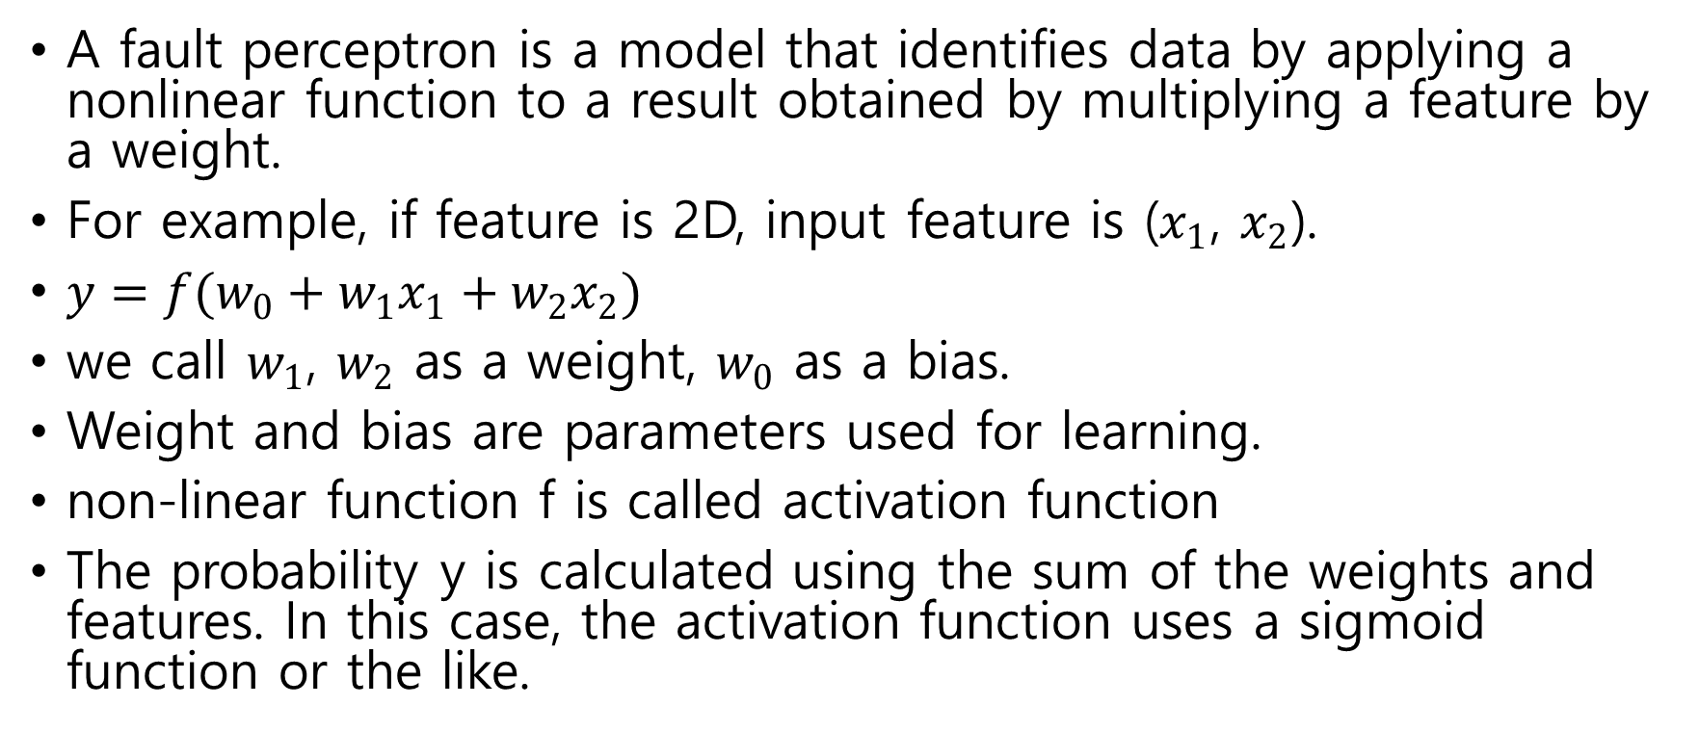
Fundamental Concept fault perceptron
A fault perceptron is a model that identifies data by applying a nonlinear function to a result obtained by multiplying a feature by a weight.
For example, if feature is 2D, input feature is ($x_{1}$, $x_{2}$).
$y=f(w_{0}+w_{1}x_{1}+w_{2}x_{2})$
we call $w_{1}$, $w_{2}$ as a weight, $w_{0}$ as a bias.
Weight and bias are parameters used for learning.
non-linear function f is called activation function
The probability y is calculated using the sum of the weights and features. In this case, the activation function uses a sigmoid function or the like.

Slide 6
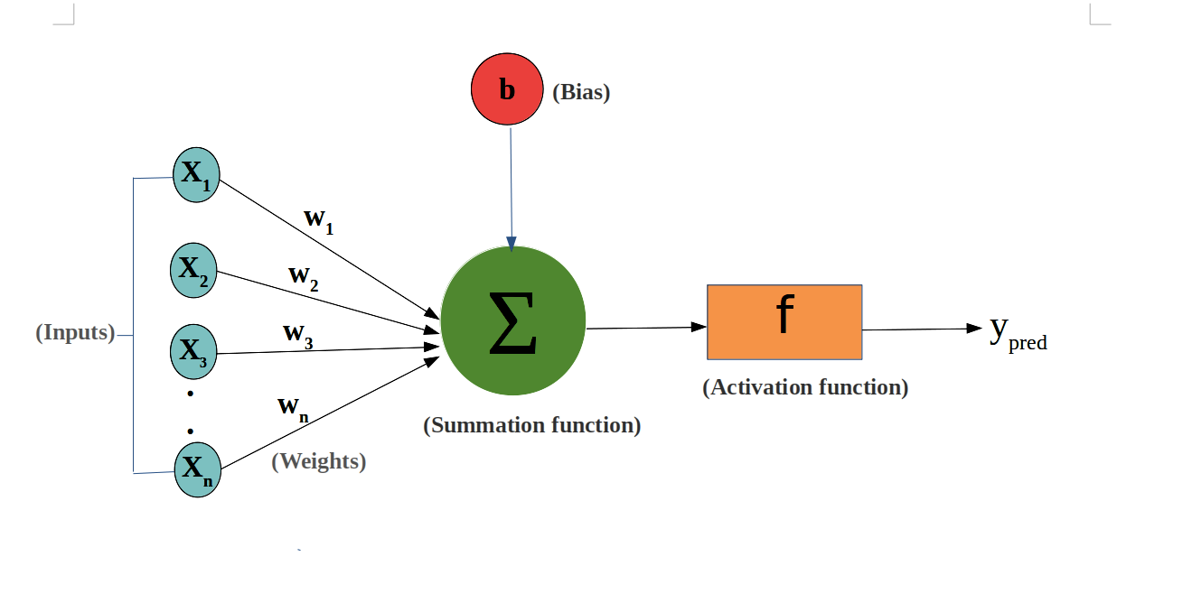
Fundamental Concept fault perceptron

Slide 7
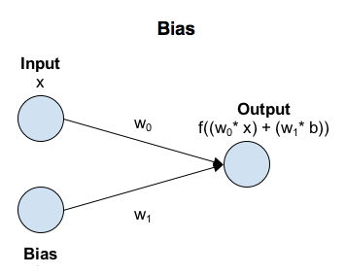
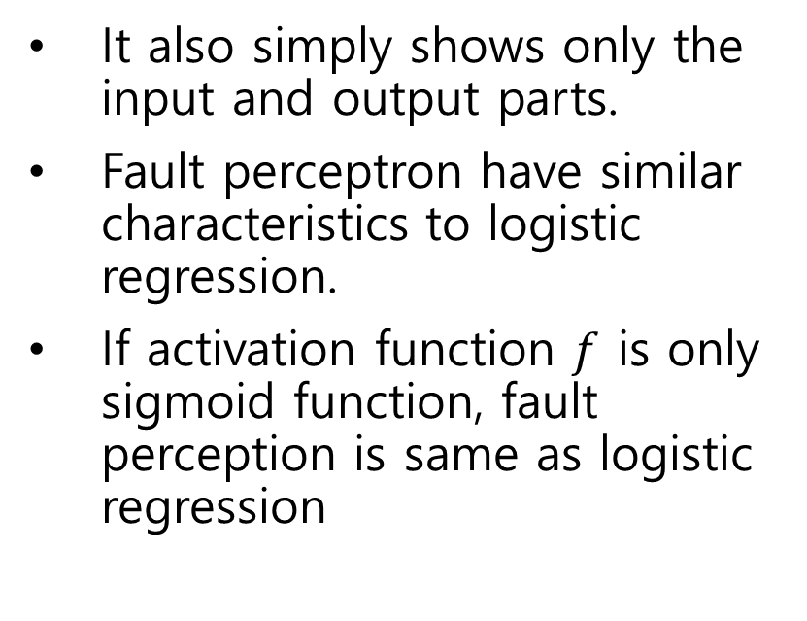
Fundamental Concept fault perceptron
It also simply shows only the input and output parts.
Fault perceptron have similar characteristics to logistic regression.
If activation function $f$ is only sigmoid function, fault perception is same as logistic regression

Slide 8
Fundamental Concept
Neural Network
A neural network is a model that defines several fault perceptron to represent complex decision line.
fault perceptron can't learn decision line correctly.
Set a hidden layer between the input and output.
Set the decision to make the final decision by combining the output results of the two layers.

Slide 9
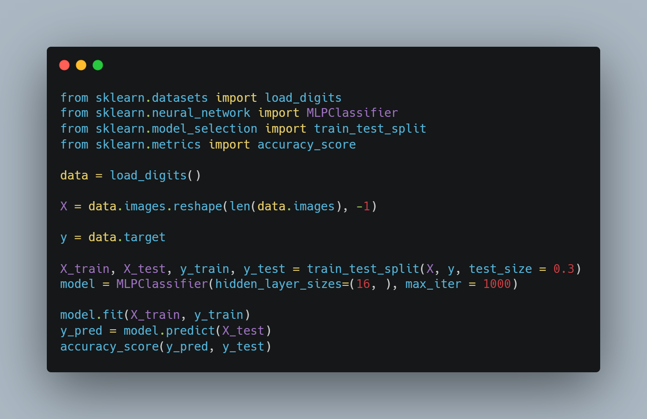
Sample Code
Import libraries
Load data
Reshape images
Set label data
Set training, test data
put training data to model
Predict result
Check accuracy

Slide 10
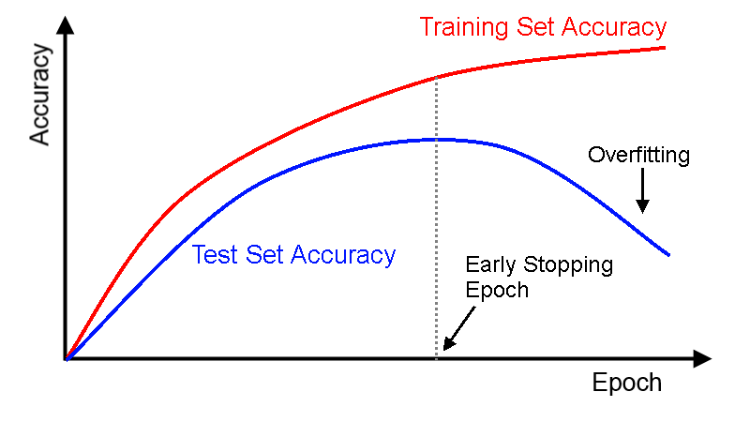
Early stopping
Some of the learning data is further divided into evaluation data used during learning.
It stores evaluation indicators such as loss in order with evaluation data used during learning so that the degree of learning progress can be known.
If there are signs of overfitting during learning, the learning is terminated in the middle.

