Slide 1

Unsupervised Learning
Latent Dirichlet Allocation, LDA

Slide 2
Fundamental Concept
One of the dimensional reduction methods suitable for modeling documents.
Various topics can be covered by using words in the document as input data.
It is used in NLP, etc
Create latent topics with the words in the document to indicate what each document is composed of.
You can explain that there are multiple topics in a document.

Slide 3
Algorithm
Assign a topic randomly to each word in a document
Calculate the probability of each topic in a document from the topic you assign to the word
Calculate the probability of words by topic from the topic you assign to the word
Reassign the topic to each word in the document with the probability of multiplying by 2 and 3
Repeat courses 2 through 4 until converging conditions

Slide 4
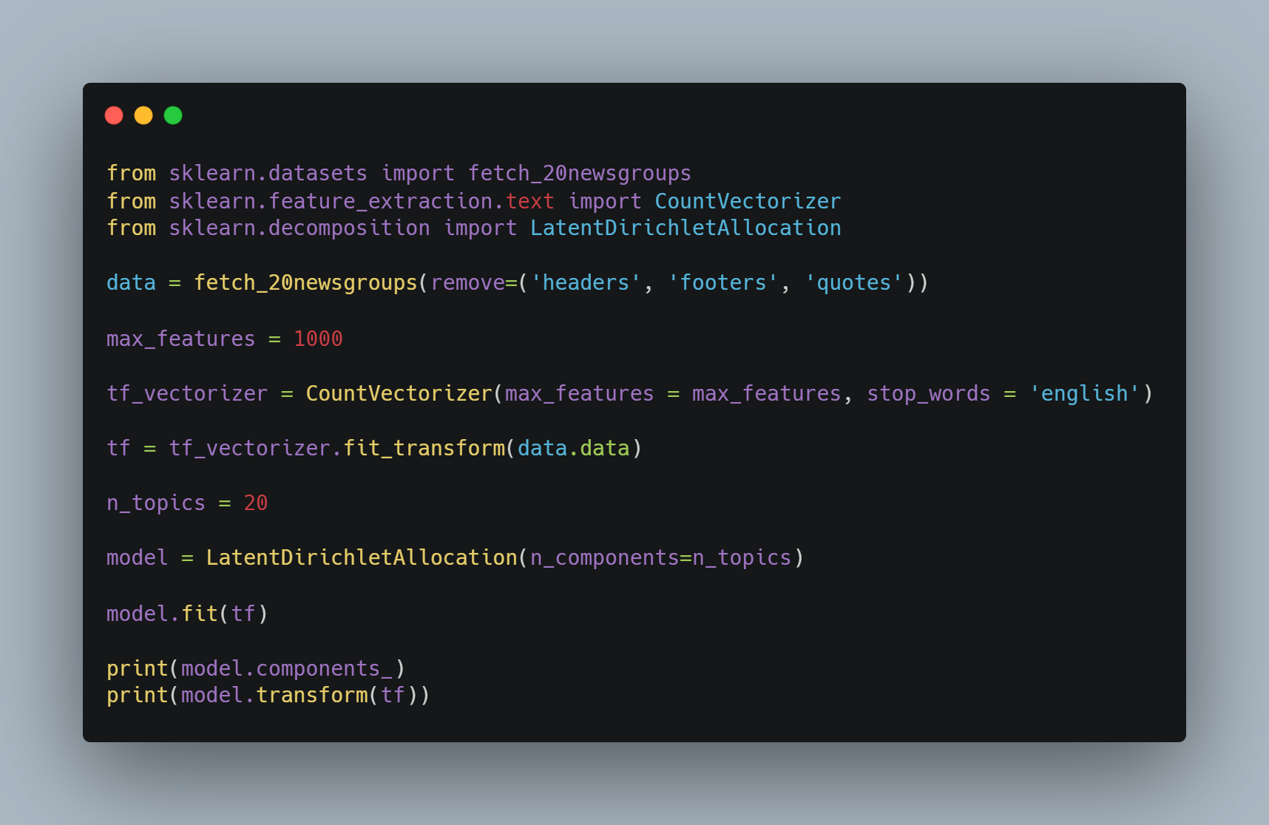
Sample Code
Import libraries
Make dataset
Set max feature
Set stop words
Train data
Print results

Slide 5
Disposal of stop word
Topic 4
:00 10 25 15 12 11 16 20 14 13 18 30 50 17 55 40 21 ...
Topic 6
:people said know did don didn just time went like say think told
As described above, the distribution of topics that are difficult to intuitively explain the topic can be improved by learning to exclude stop word.

