Slide 1

Unsupervised Learning
PCA (Principal Component Analysis)

Slide 2
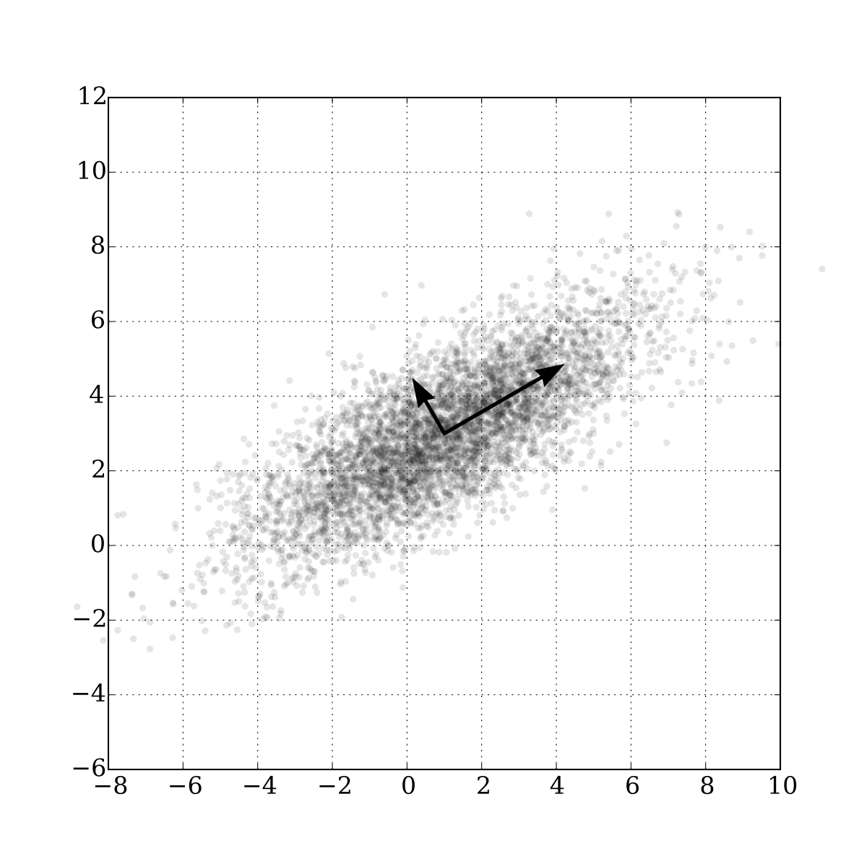
Fundamental Concept

Slide 3
Fundamental Concept
Using PCA, correlated multivariate data can be concisely represented as the main component.
PCA is a method used to reduce variables in data.
It is a representative dimension reduction method that can be applied to data that is correlated between variables.
Dimension reduction means 'It is expressed as several variables while maintaining the characteristics of data with many variables.'
It helps reduce complexity when analyzing multivariate data.

Slide 4
Fundamental Concept
Two ways to reduce variables
  Choose only important variables and do not use the remaining variables.
  constructing a new variable from the original data variable
PCA reduces variables by constructing a new variable from the original data variable
The data represented in a high-dimensional space is represented by a lower-dimensional variable.
We call lower-dimensional axis as a principal component

Slide 5
Fundamental Concept
Find the direction and importance necessary for data principal component analysis.
  The direction of the line is the direction of the data.
  Length represents importance.
    The direction of the data is determined by how much weight is assigned to the data variable when configuring a new variable.
    The importance of data is related to changes in variables.
The orthogonal line is used as a new axis and converted into original data.
  The changed data at this time is called the principal component score.
  It is called the first principal component and the second principal component from the value of the axis with the greatest importance among the principal components.

Slide 6
Algorithm
The principal component analysis calculates the principal component in the following order.
  Calculate variance covariance matrix
  Solve eigenvalue problems and calculate eigenvalue of eigenvectors
  Construct data in each principal component direction

Slide 7
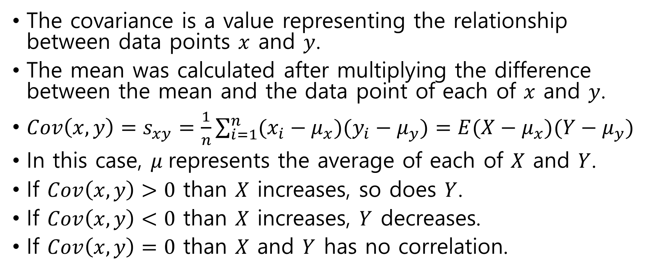
Algorithm
Covariance
The covariance is a value representing the relationship between data points $x$ and $y$.
The mean was calculated after multiplying the difference between the mean and the data point of each of $x$ and $y$.
${Cov\left(x, y\right)=s}_{xy}=\frac{1}{n}\sum_{i=1}^{n}{(x_{i}−μ_{x})(y_{i}−μ_{y})}=E(X−μ_{x})(Y−μ_{y})$
In this case, $μ$ represents the average of each of $X$ and $Y$.
If $Cov\left(x, y\right)>0$ than $X$ increases, so does $Y$.
If $Cov\left(x, y\right)<0$ than $X$ increases, $Y$ decreases.
If $Cov\left(x, y\right)=0$ than $X$ and $Y$ has no correlation.

Slide 8
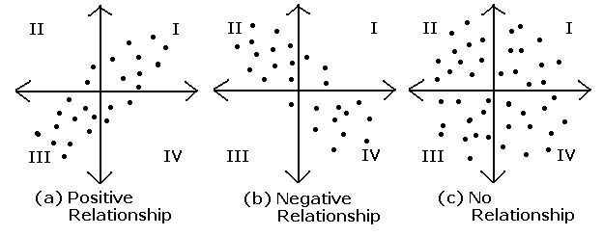
Algorithm
Covariance

Slide 9
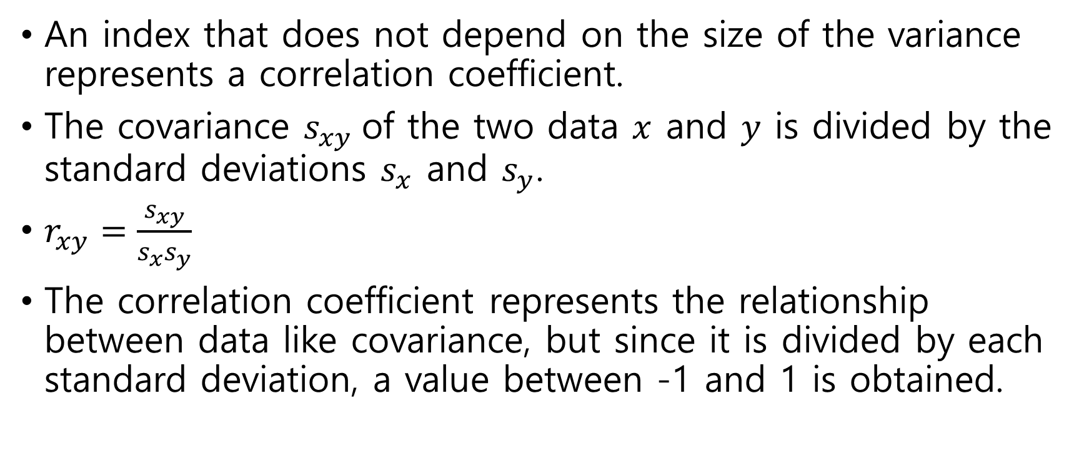
Algorithm
Correlation
An index that does not depend on the size of the variance represents a correlation coefficient.
The covariance $s_{xy}$of the two data $x$ and $y$ is divided by the standard deviations $s_{x}$ and $s_{y}$.
$r_{xy}=\frac{s_{xy}}{s_{x}s_{y}}$
The correlation coefficient represents the relationship between data like covariance, but since it is divided by each standard deviation, a value between -1 and 1 is obtained.

Slide 10
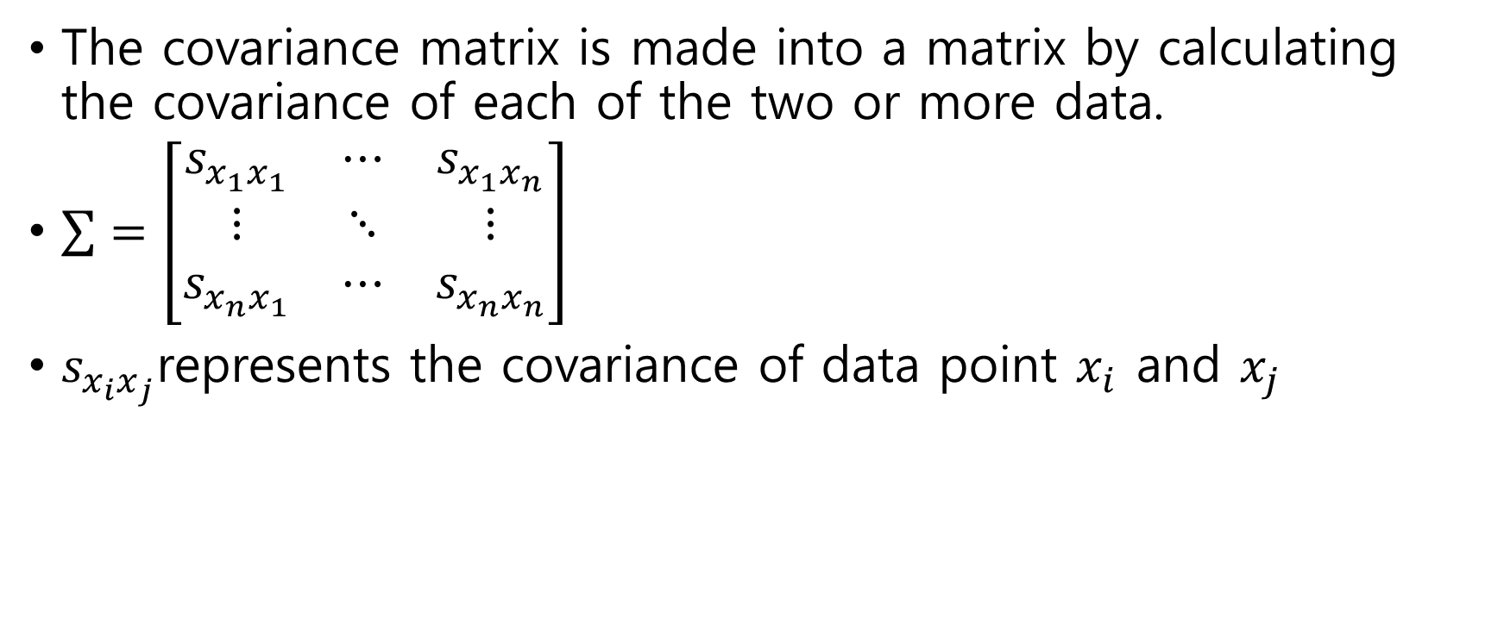
Algorithm
Covariance Matrix
The covariance matrix is made into a matrix by calculating the covariance of each of the two or more data.
$\sum{=\left[\begin{matrix}s_{x_{1}x_{1}} & ⋯ & s_{x_{1}x_{n}} \\ ⋮ & ⋱ & ⋮ \\ s_{x_{n}x_{1}} & ⋯ & s_{x_{n}x_{n}}\end{matrix}\right]}$
$s_{x_{i}x_{j}}$represents the covariance of data point $x_{i}$ and $x_{j}$

Slide 11
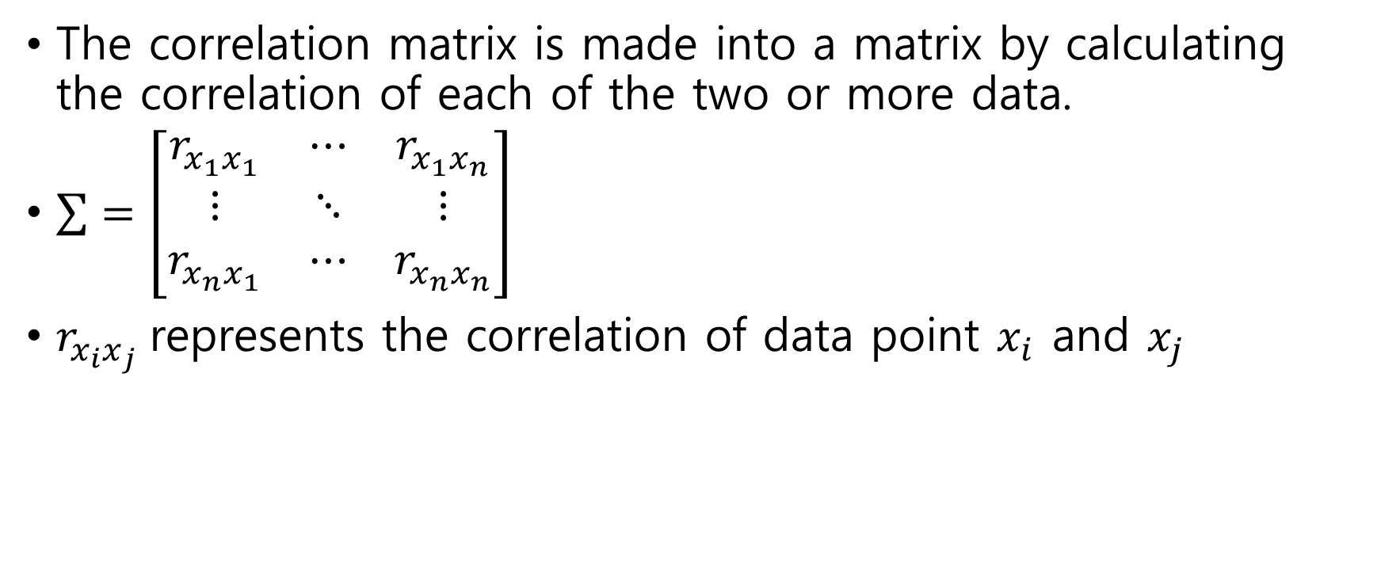
Algorithm
Correlation Matrix
The correlation matrix is made into a matrix by calculating the correlation of each of the two or more data.
$\sum{=\left[\begin{matrix}r_{x_{1}x_{1}} & ⋯ & r_{x_{1}x_{n}} \\ ⋮ & ⋱ & ⋮ \\ r_{x_{n}x_{1}} & ⋯ & r_{x_{n}x_{n}}\end{matrix}\right]}$
$r_{x_{i}x_{j}}$represents the correlation of data point $x_{i}$ and $x_{j}$

Slide 12
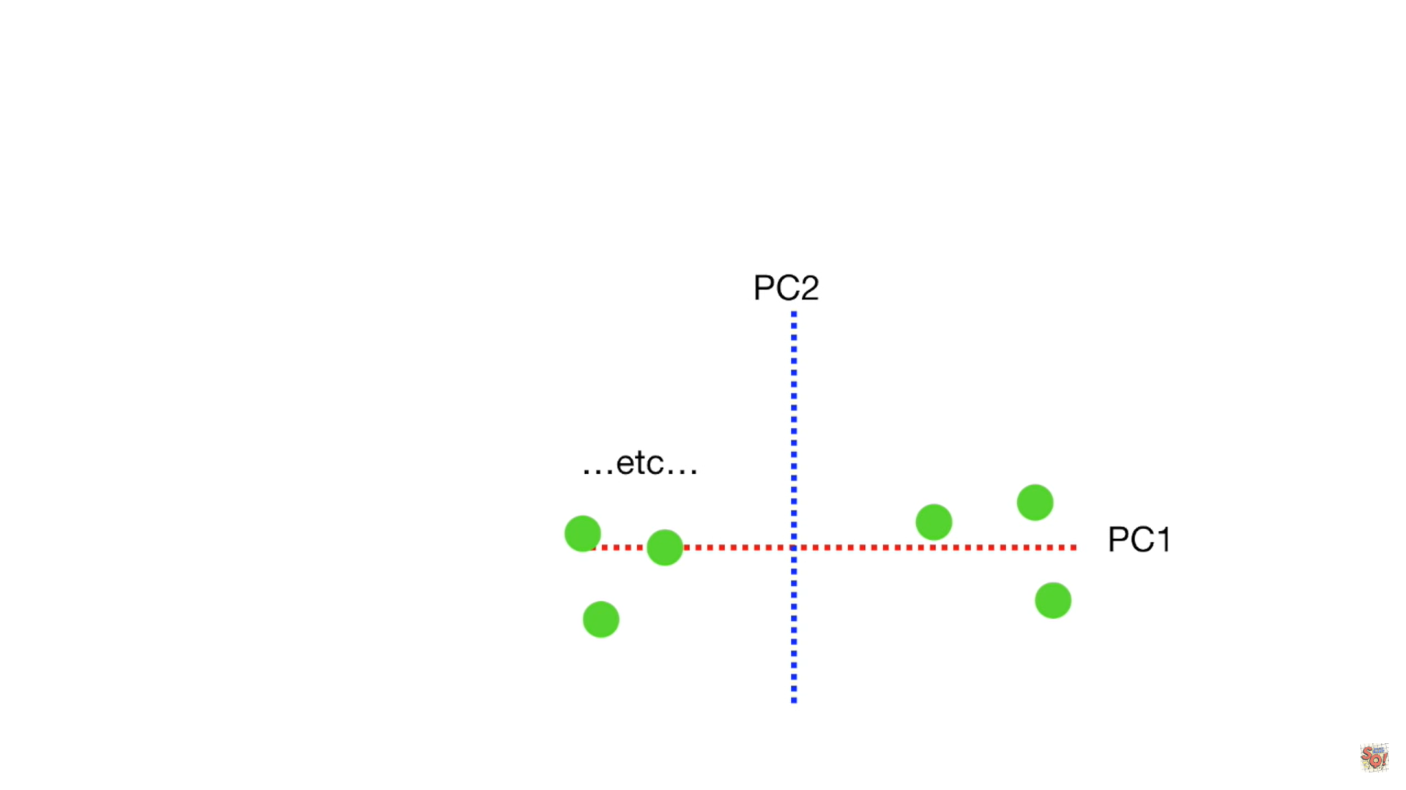
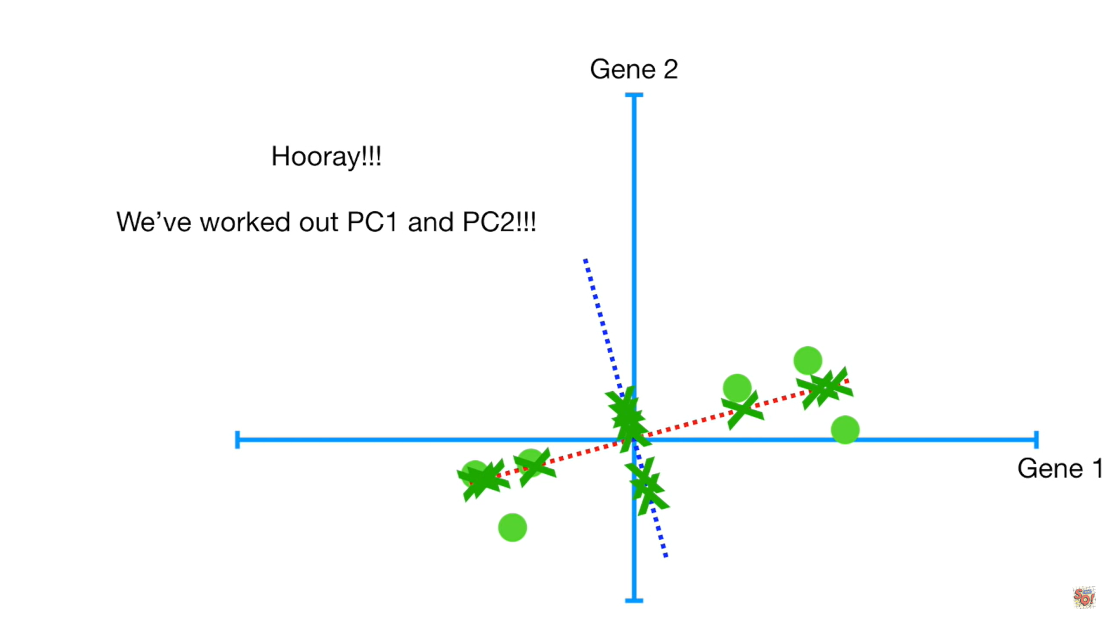
Algorithm

Slide 13
Algorithm
The direction of the data is related to the eigenvector.
The importance of data is related to eigenvalues.
If the eigenvalue calculated for each principal component is divided by the total sum of several eigenvalues, the importance of the principal component can be expressed as a ratio, which is called the contribution rate.
The value obtained by adding the contribution rate sequentially from the first main component is called the cumulative contribution rate.

Slide 14
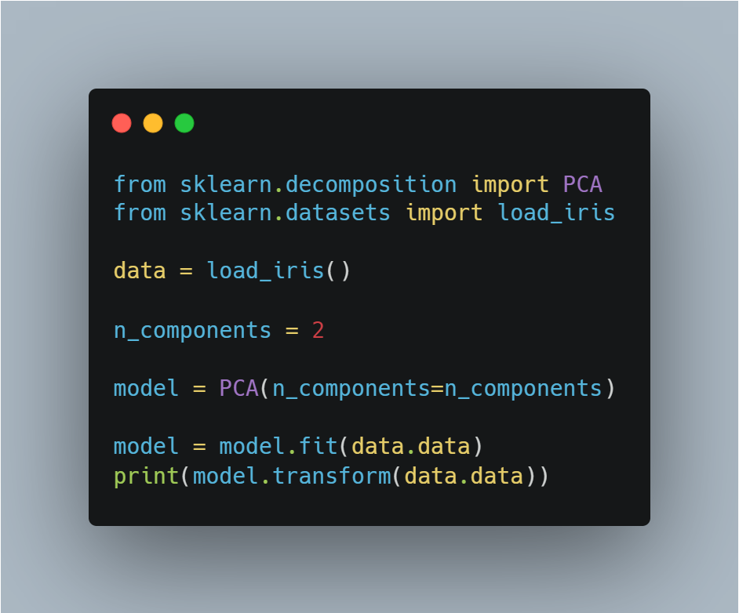
Sample Code
Import libraries
Get iris dataset
Make PCA model
Train data into model
Print transformed data

