Slide 1

Unsupervised Learning
Latent Semantic Analysis, LSA

Slide 2
Fundamental Concept
It is used in the field of data information retreival
By using LSA, we can see the latent relevance of words from a large amount of document data.

Slide 3
Algorithm
Convert the sentence below to matrix X
  자동차로 회사에 출근했다.
  차로 출근했다.
  레스토랑에서 햄버거를 먹는다.
  레스토랑에서 파스타를 먹는다.
 | 문장1 | 문장2 | 문장3 | 문장4
자동차 | 1 | 0 | 0 | 0
회사 | 1 | 0 | 0 | 0
출근 | 1 | 1 | 0 | 0
차 | 0 | 1 | 0 | 0
레스토랑 | 0 | 0 | 1 | 1
햄버거 | 0 | 0 | 1 | 0
먹다 | 0 | 0 | 1 | 1
파스타 | 0 | 0 | 0 | 1

Slide 4
Algorithm
Decompose the matrix X.
  The matrix X, which is an 8X4 matrix, is represented by the product of the 8X4 matrix U, the 4X4 matrix D, and the 4X4 matrix V^T.
    Matrix U: Matrix with transformation information of characteristics made of words
    Matrix D: Matrix with information importance
    Matrix V: Matrix with word features and document conversion information
$X=UDV^{T}=\begin{matrix}0.00 & −0.45 & −0.45 & 0.00 \\ 0.00 & −0.45 & −0.45 & 0.00 \\ ⋮ & ⋮ & ⋮ & ⋮ \\ −0.32 & 0.00 & 0.00 & −0.71\end{matrix}×\begin{matrix}2.24 & 0 & 0 & 0 \\ 0 & 1.90 & 0 & 0 \\ 0 & 0 & 1.18 & 0 \\ 0 & 0 & 0 & 1.00\end{matrix}×\begin{matrix}0.00 & 0.00 & −0.71 & −0.71 \\ −0.85 & −0.53 & 0.00 & 0.00 \\ −0.53 & 0.85 & 0.00 & 0.00 \\ 0.00 & 0.00 & 0.71 & −0.71\end{matrix}$

Slide 5
Algorithm
The matrix D is a diagonal matrix. Diagonal elements list values in order of greater importance of information.
Therefore, if we reduce the dimension to three matrices, we should look at D carefully.
Since the original data has four features, let's say that the dimension is reduced to two features.

Slide 6
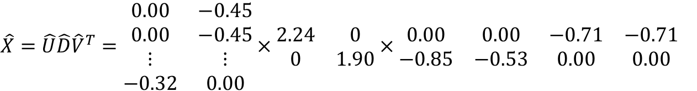
Algorithm
From the diagonal element values of a matrix D with four features, choose two elements of greater importance to form a 2X2 diagonal matrix.
The other two matrices are also changed to correspond to the elements selected in D.
The matrix U deletes the entire elements of the third and fourth columns and replaces them with an 8X2 matrix.
The matrix V^T deletes all elements of the third and fourth rows to form a 2X4 matrix.
$\hat{X}=\hat{U}\hat{D}{\hat{V}}^{T}=\begin{matrix}0.00 & −0.45 \\ 0.00 & −0.45 \\ ⋮ & ⋮ \\ −0.32 & 0.00\end{matrix}×\begin{matrix}2.24 & 0 \\ 0 & 1.90\end{matrix}×\begin{matrix}0.00 & 0.00 & −0.71 & −0.71 \\ −0.85 & −0.53 & 0.00 & 0.00\end{matrix}$

Slide 7
Algorithm
Table of 2 features divided by latent variables
 | A | B
자동차 | 0.00 | 0.85
회사 | 0.00 | 0.85
출근 | 0.00 | 1.38
차 | 0.00 | 0.53
레스토랑 | 1.41 | 0.00
햄버거 | 0.71 | 0.00
먹다 | 1.41 | 0.00
파스타 | 0.71 | 0.00

Slide 8
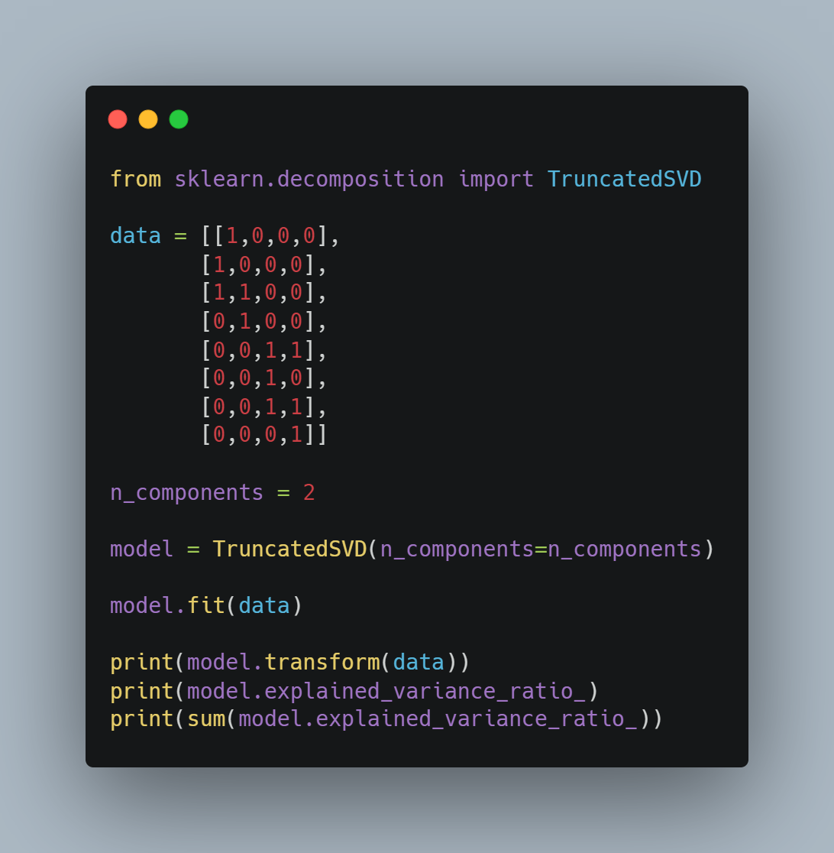
Sample Code
Import library
Set data
Set dimension to reduce
Print transformed data
Print Contribution Rate

Slide 9
Points to note
It is difficult to properly explain the relevance of words with the converted matrix. If each dimension is orthogonal or the matrix element is negative, it is difficult to properly explain the relevance.
The calculation can take a very long time.

