Slide 1

Unsupervised Learning
Local Linear Embedding, LLE

Slide 2
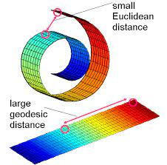
A Dictionary Concept
manifold: The low-dimensional manifold is a low-dimensional shape bent or twisted in a high-dimensional space.

Slide 3
Fundamental Concept
LLE is an algorithm that represents a curved or twisted structure in a high-dimensional space as a simple structure in a low-dimensional space.
LLE is one of the manifold learnings that dimensionally reduce data of nonlinear structures.
LLE takes out the 2D structure hidden in the 3D space and represents it as 2D data.

Slide 4
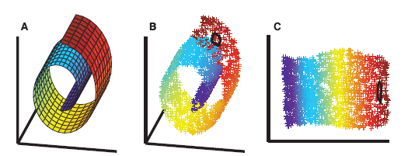
Fundamental Concept

Slide 5
Fundamental Concept
Three steps in LLE
  Construct kNN graph
  Calculate the reconstruction of weights for reconstructing every point by its neighbors
  Use the obtained weights to embed the points in the low dimensional subspace

Slide 6
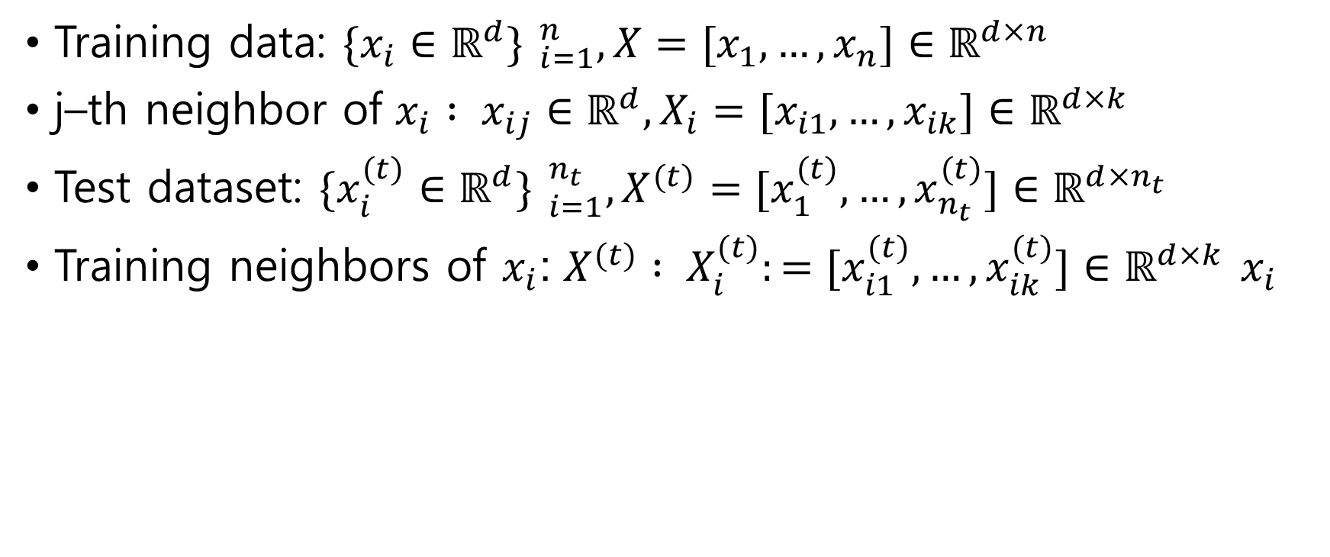
Algorithm
Training data: ${\{x_{i}∈ℝ^{d}\} }_{i=1}^{n}, X=[x_{1},…,x_{n}]∈ℝ^{d×n}$
j–th neighbor of ${x_{i} : x}_{ij}∈ℝ^{d}, X_{i}=[x_{i1},…,x_{ik}]∈ℝ^{d×k}$
Test dataset: ${\{x_{i}^{(t)}∈ℝ^{d}\} }_{i=1}^{n_{t}}, X^{(t)}=[x_{1}^{(t)},…,x_{n_{t}}^{(t)}]∈ℝ^{d×n_{t}}$
Training neighbors of $x_{i}$: $X^{(t)} : X_{i}^{(t)}:=[x_{i1}^{(t)},…,x_{ik}^{(t)}]∈ℝ^{d×k}$ $x_{i}$

Slide 7
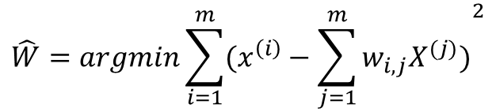
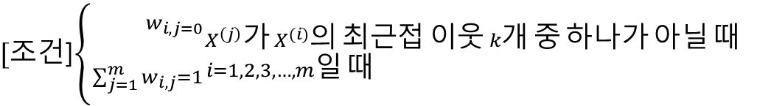
Algorithm
LLE step 1
Linear regional relationship modeling.
Fix the sample and find the optimal weight.
$$\hat{W}=argmin\sum_{i=1}^{m}{{(x^{\left(i\right)}−\sum_{j=1}^{m}{w_{i, j}X^{(j)})}}^{2}}$$
$[조$건]$\left\{{}_{\sum_{j=1}^{m}{w_{i,j}=1}}^{w_{i, j=0}}{{}_{i=1, 2, 3, …, m일 때 }^{X^{\left(j\right)}가 X^{(i)}의 최근접 이웃 k개 중 하나가 아닐 때}{}}\right.$

Slide 8
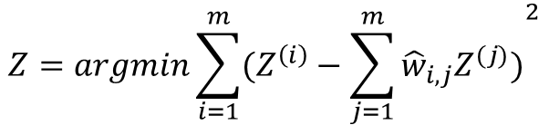
Algorithm
LLE step 2
Reduce the dimension of preserving relationships
Fix the weights and find the optimal location of the sample image in the low-dimensional space.
$$Z=argmin\sum_{i=1}^{m}{{(Z^{\left(i\right)}−\sum_{j=1}^{m}{{\hat{w}}_{i, j}Z^{(j)})}}^{2}}$$

Slide 9
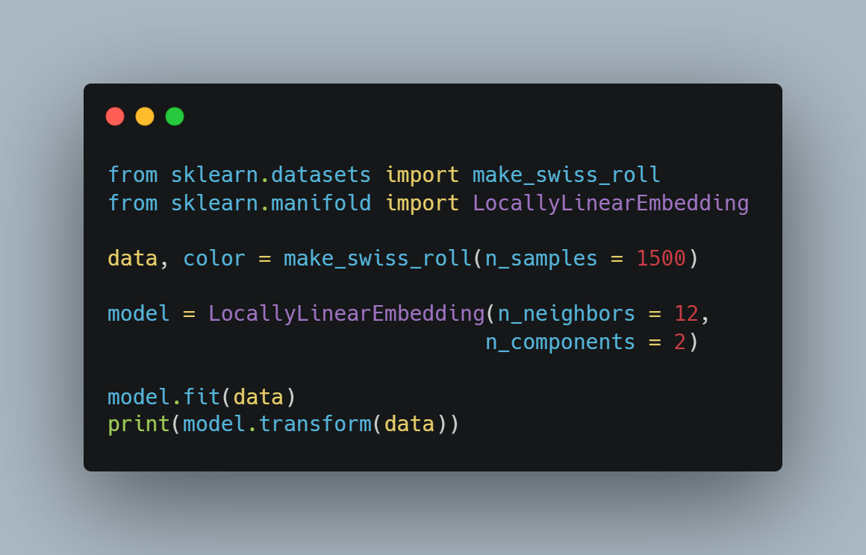
Sample Code
Import libraries
Make dataset
Set n_neighbors and dimension
Train data
Print result

