Slide 1

Unsupervised Learning
t-distributed stochastic neighbor embedding, t-SNE

Slide 2
Fundamental Concept
It is a method of dimensionally reducing complex data in high dimensions to two dimensions.
t-SNE is one of manifold learning and aims to visualize complex data.

Slide 3
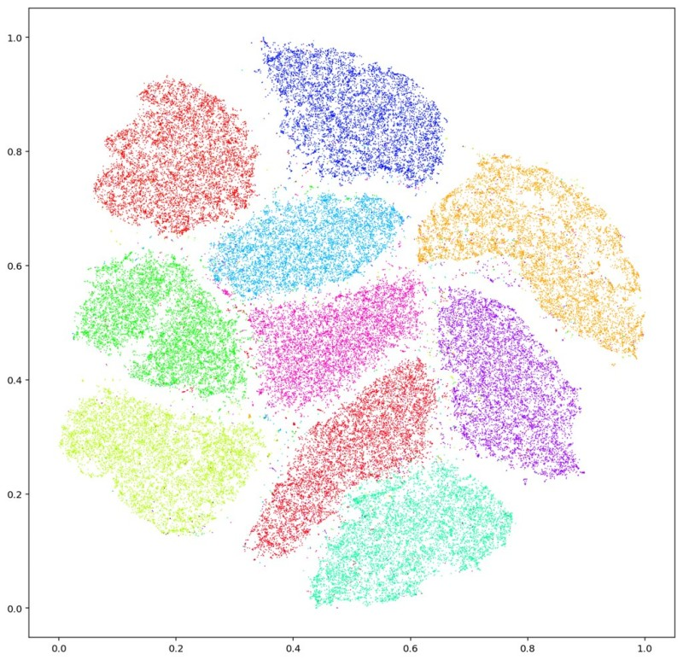
Fundamental Concept

Slide 4
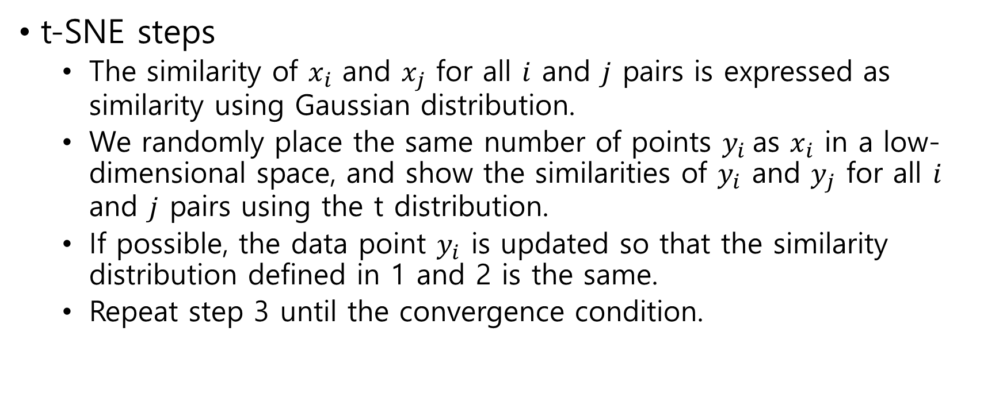
Algorithm
t-SNE steps
  The similarity of $x_{i}$ and $x_{j}$ for all $i$ and $j$ pairs is expressed as similarity using Gaussian distribution.
  We randomly place the same number of points $y_{i}$as $x_{i}$ in a low-dimensional space, and show the similarities of $y_{i}$ and $y_{j}$ for all $i$ and $j$ pairs using the t distribution.
  If possible, the data point $y_{i}$ is updated so that the similarity distribution defined in 1 and 2 is the same.
  Repeat step 3 until the convergence condition.

Slide 5
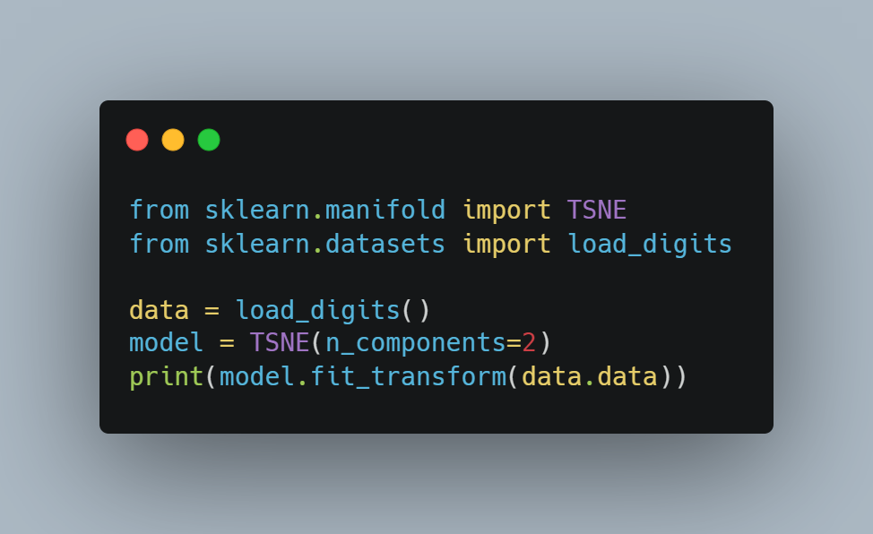
Sample Code
Import libraries
Load data
Make t-SNE model
Print result

