Slide 1

Supervised Learning
Linear Regression
경희대학교 컴퓨터공학과
2019102191 신주영

Slide 2
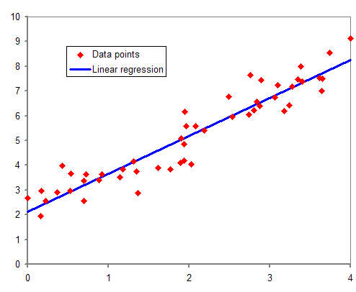
Fundamental concept
A technique for modeling relationships in which dependent variables change large or small as independent variables grow
y = ax + b, a is called the inclination and b is called the y-intercept

Slide 3

Algorithm
Usually, in linear regression, the learning parameters a and b of the data points that are not on a straight line must be calculated
Create a straight line to minimize the mean square error
Mean square error formula
$$\sum_{i=1}^{n}{\frac{y_{i}−{\left(a+bx_{i}\right)}^{2}}{n}}$$

Slide 4
Algorithm
A function that defines the relationship between error and learning parameters is called a loss function.
Linear regression finds a parameter with a minimum loss function value among various straight lines.
Finding parameters that minimize loss function values is also a concept commonly used in guidance learning algorithms.

Slide 5
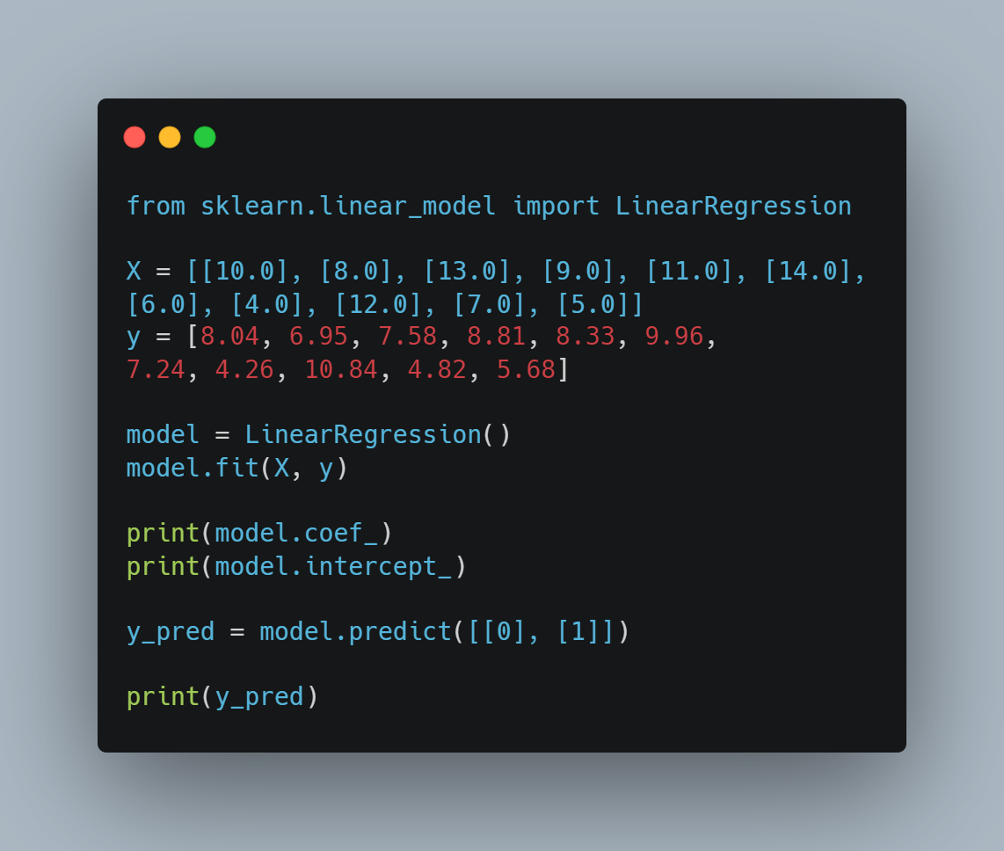
Sample code
From sklearn, import Linear Regression
Set X, y variable
Make Linear Regression variable
Fit X, y to Linear Regression model
Print inclination and y-intercept
Predict y-values when x is 0 and 1 with the predict method

Slide 6

Output
We can get inclination by model.coef_ method
We can get y-intercept by model.intercept_ method
We can get y-values when x is 0 and 1 by model.predict method

Slide 7
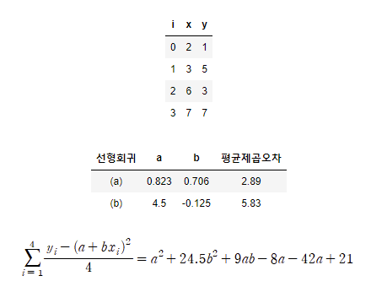
Method of minimizing mean square error
Let x and y as shown on the right.
The table below shows the average square error values according to the values a and b.
Substituting the x and y values into the mean square error formula, the following equation can be obtained.
Therefore, the minimum value of the equation according to the values a and b may be obtained.

Slide 8
Type of linear regression
Since polynomial regression is not linear, it may be awkward to call it linear regression, but because it is linear regression for learning parameters rather than independent variables, polynomial regression is also included in linear regression.
선형회귀의 종류 | 함수 정의 예
단순선형회귀 Simple linear regression | y = ax + b
다중선형회귀 multiple linear regression | z = ax + by + c
다항회귀 Polynomial regression | y = ax^2 + bx + c

Slide 9
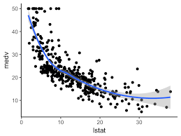
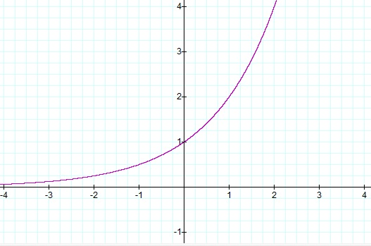
Nonlinear regression
y = e^x
y = 1/x

