Slide 1

Supervised Learning
Regularization
경희대학교 컴퓨터공학과
2019102191 신주영

Slide 2
Fundamental concept
Normalization is used as a way to prevent over-fitting of the model
In over-fitting, the error between the execution result and the correct answer data is very small, but the error between the result of executing the model with test data and the correct answer data is very large

Slide 3
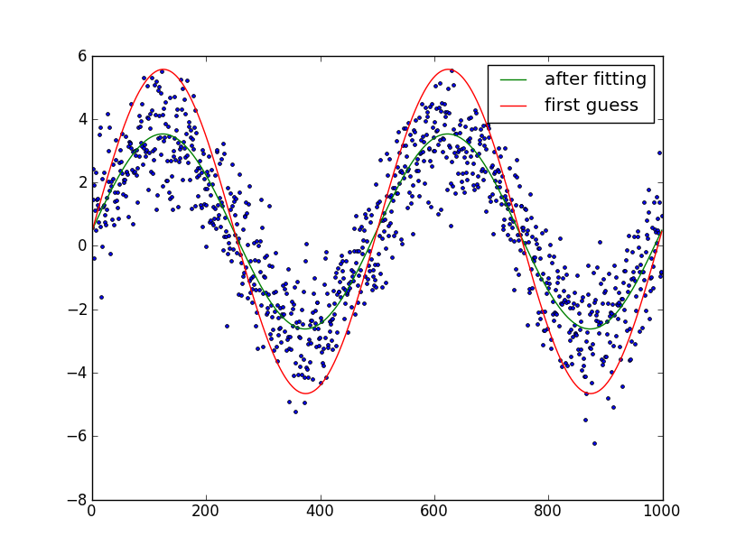
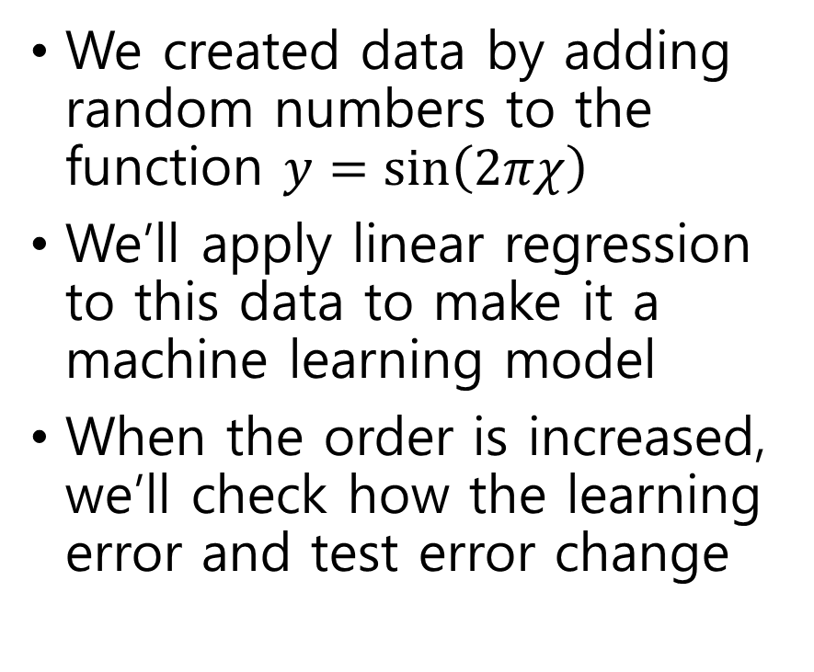
Fundamental concept making practice data
We created data by adding random numbers to the function $y=\sin\left(2πχ\right)$
We’ll apply linear regression to this data to make it a machine learning model
When the order is increased, we’ll check how the learning error and test error change

Slide 4
Learning errors and test errors by order
As the order increases, the learning error gradually decreases
The test error increases as the order increases
The sixth-order linear regression is a complex model, so learning errors are reduced, but over-fitting occurs and cannot be called a generalized model.
차수 | 학습오차 | 검정오차
1 | 0.412 | 0.618
2 | 0.176 | 0.193
3 | 0.081 | 0.492
… | … | …
6 | 0.024 | 3.472

Slide 5
Consequences of using normalization for linear regression
Normalization prevents over-fitting by adding a penalty term to the loss function
When the order increased, the test error did not increase, so that over-fitting could be prevented
We’re going to regularization method as a ridge regression
차수 | 학습오차 | 검정오차
1 | 0.412 | 0.612
2 | 0.372 | 0.532
3 | 0.301 | 0.394
… | … | …
6 | 0.159 | 0.331

Slide 6
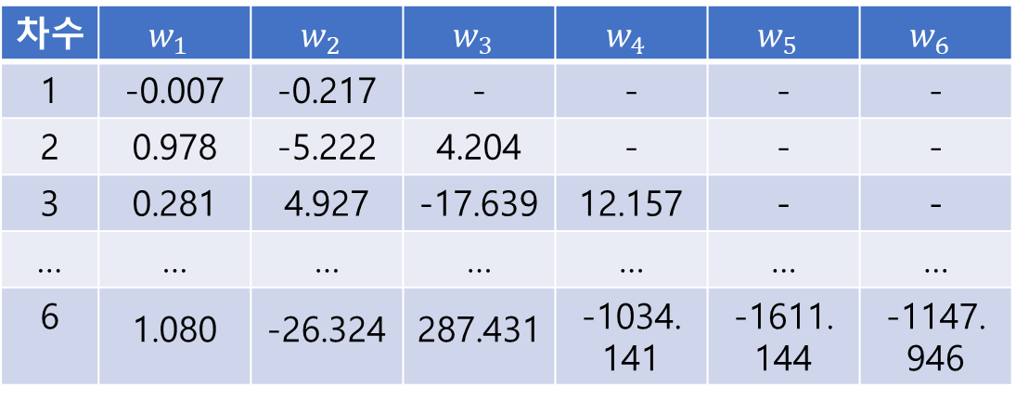
Algorithm only linear regression
As the order increases, the absolute value of the learning parameter gradually increases.
차수 | $$w_{1}$$ | $$w_{2}$$ | $$w_{3}$$ | $$w_{4}$$ | $$w_{5}$$ | $$w_{6}$$
1 | -0.007 | -0.217 | - | - | - | -
2 | 0.978 | -5.222 | 4.204 | - | - | -
3 | 0.281 | 4.927 | -17.639 | 12.157 | - | -
… | … | … | … | … | … | …
6 | 1.080 | -26.324 | 287.431 | -1034. 141 | -1611. 144 | -1147. 946

Slide 7
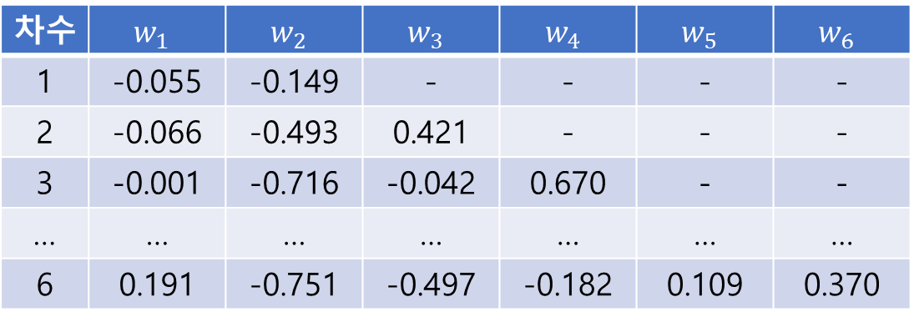
Algorithm linear regression with normalization
Normalization reduces the increase in learning parameters.
차수 | $$w_{1}$$ | $$w_{2}$$ | $$w_{3}$$ | $$w_{4}$$ | $$w_{5}$$ | $$w_{6}$$
1 | -0.055 | -0.149 | - | - | - | -
2 | -0.066 | -0.493 | 0.421 | - | - | -
3 | -0.001 | -0.716 | -0.042 | 0.670 | - | -
… | … | … | … | … | … | …
6 | 0.191 | -0.751 | -0.497 | -0.182 | 0.109 | 0.370

Slide 8
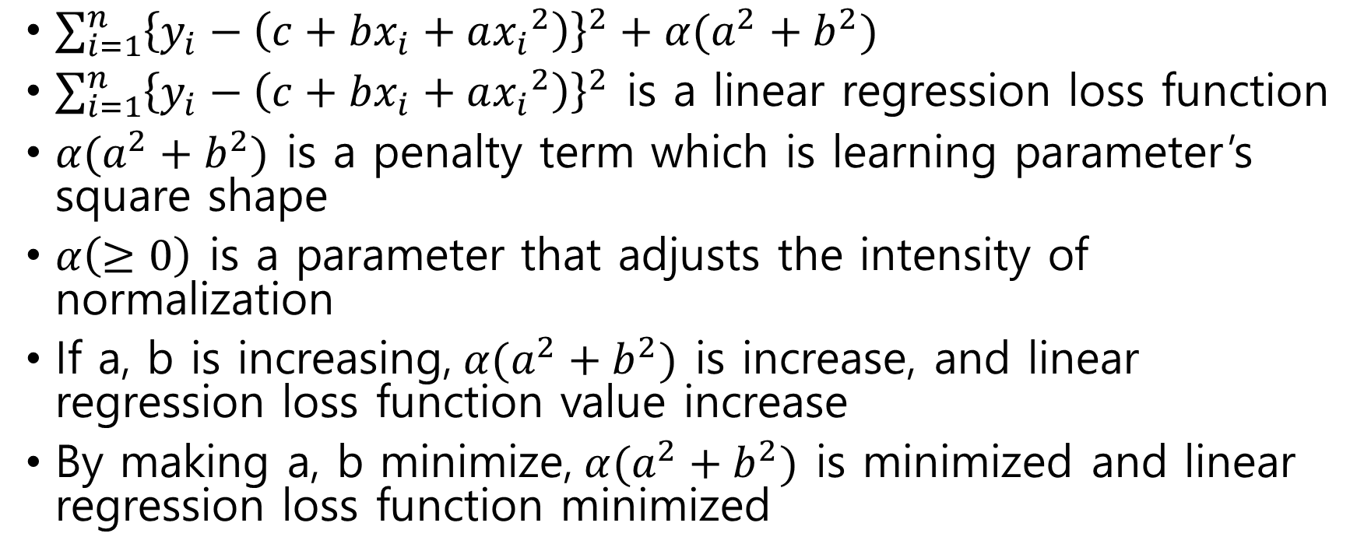
Algorithm loss function and penalty term
$\sum_{i=1}^{n}{{\left\{y_{i}−\left(c+bx_{i}+a{x_{i}}^{2}\right)\right\}}^{2}}+α(a^{2}+b^{2})$
$\sum_{i=1}^{n}{{\left\{y_{i}−\left(c+bx_{i}+a{x_{i}}^{2}\right)\right\}}^{2}}$ is a linear regression loss function
$α(a^{2}+b^{2})$ is a penalty term which is learning parameter’s square shape
$α\left(≥0\right)$ is a parameter that adjusts the intensity of normalization
If a, b is increasing,$α(a^{2}+b^{2})$ is increase, and linear regression loss function value increase
By making a, b minimize,$α(a^{2}+b^{2})$ is minimized and linear regression loss function minimized

Slide 9
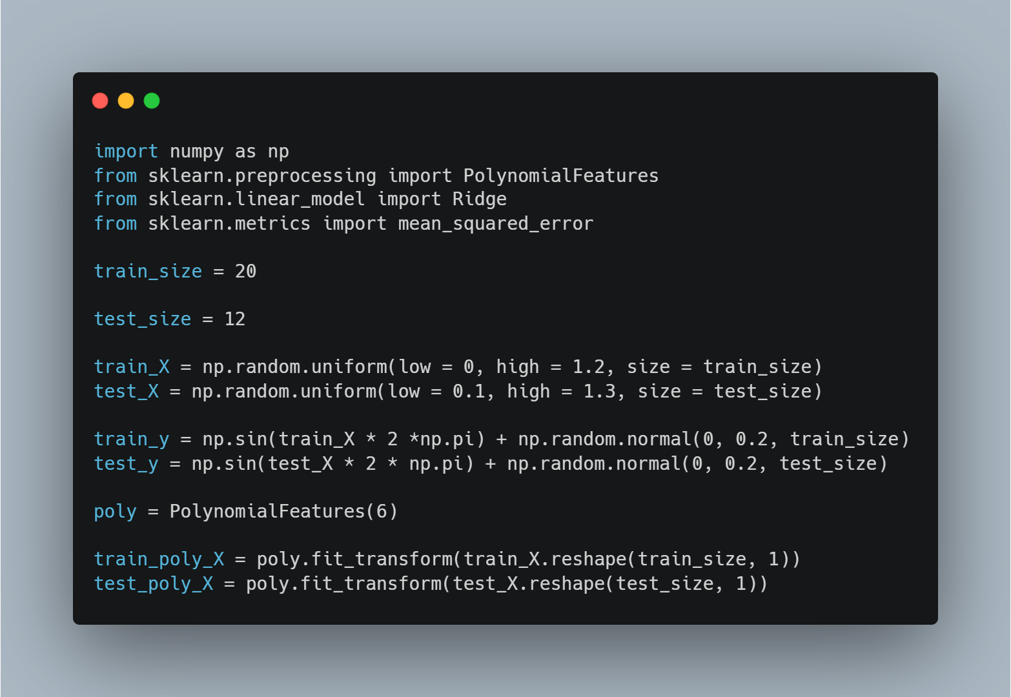
Sample code
Import numpy, PolynomialFeatures, Ridge, mean_squared_error
Set training data and test data
Construct a six-order linear regression model
Conversion of the results into an array after learning the characteristics of the learning data in the sixth equation

Slide 10
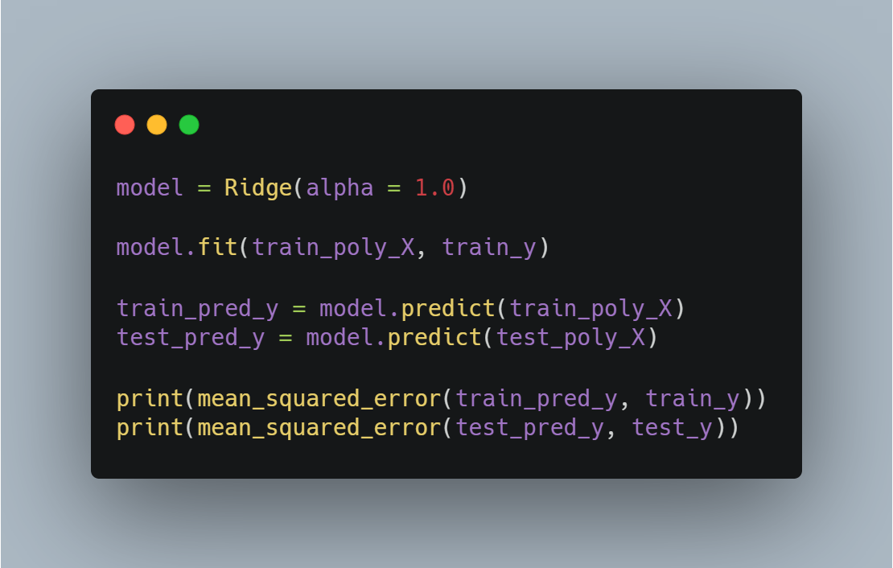
Sample code
Make ridge model and learn as a dependent variable of 6th-order learning outcomes and learning data
Predict output results of models made by learning from rigid regression
Calculation of mean square error

Slide 11
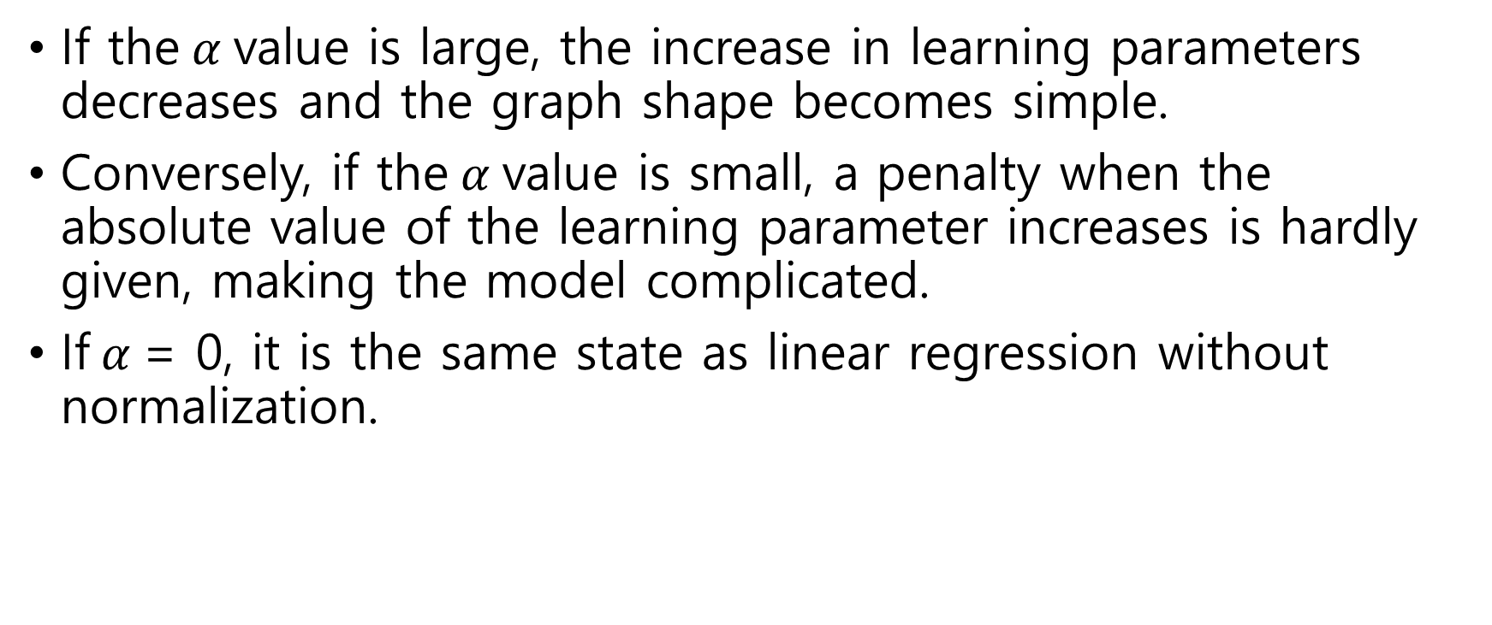
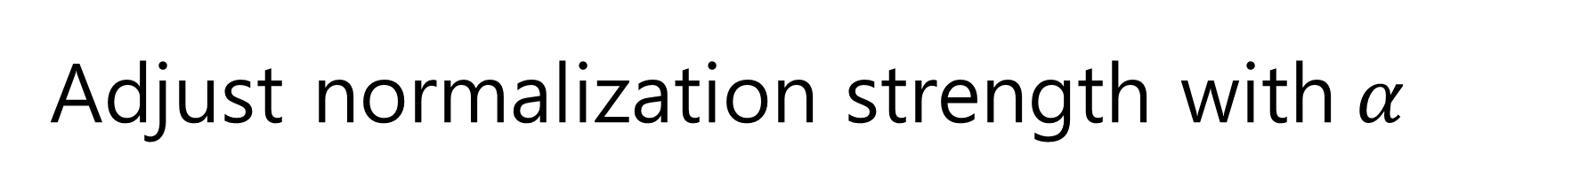
Adjust normalization strength with$α$
If the$α$value is large, the increase in learning parameters decreases and the graph shape becomes simple.
Conversely, if the$α$value is small, a penalty when the absolute value of the learning parameter increases is hardly given, making the model complicated.
If$α$= 0, it is the same state as linear regression without normalization.

Slide 12
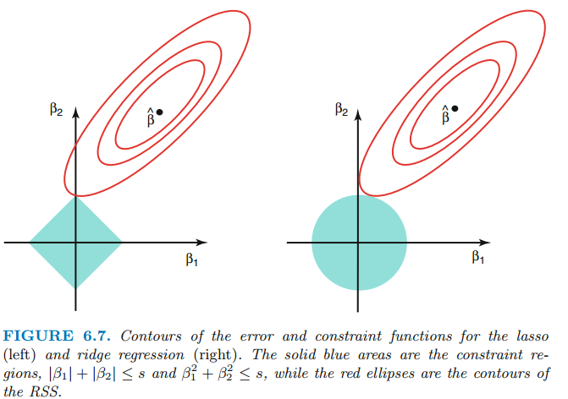
LASSO regression
In rigid regression, the graph is circular as shown in the right picture because the penalty term is the sum of the learning parameters squared.
In LASSO regression, the penalty term is the sum of the absolute values, so the graph is square as shown in the figure on the right.

Slide 13
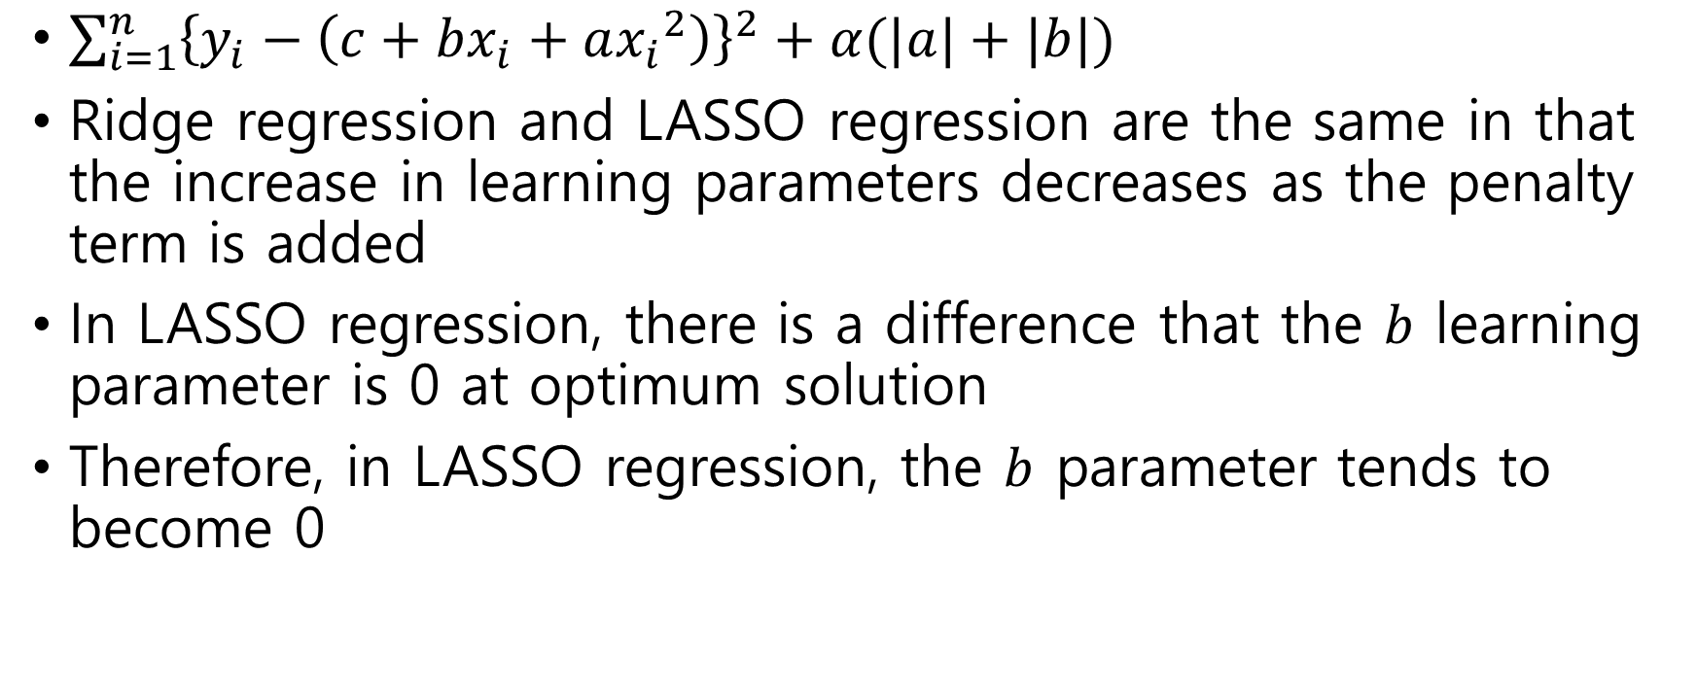
LASSO regression
$\sum_{i=1}^{n}{{\left\{y_{i}−\left(c+bx_{i}+a{x_{i}}^{2}\right)\right\}}^{2}}+α(|a|+|b|)$
Ridge regression and LASSO regression are the same in that the increase in learning parameters decreases as the penalty term is added
In LASSO regression, there is a difference that the $b$ learning parameter is 0 at optimum solution
Therefore, in LASSO regression, the $b$ parameter tends to become 0

