Slide 1

Supervised Learning
Logistic Regression
경희대학교 컴퓨터공학과
2019102191 신주영

Slide 2
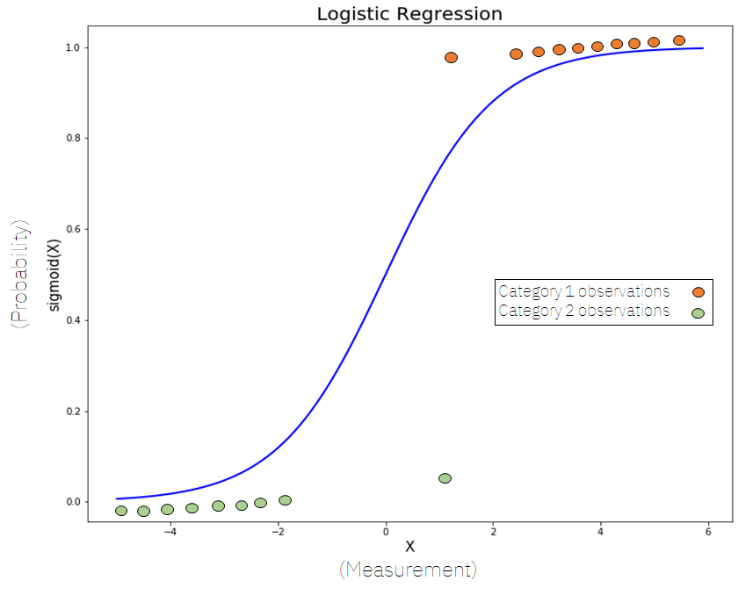
Fundamental Concept

Slide 3
Fundamental Concept
Logistic regression is an algorithm that learns the probability of an event occurring
Usually, binary classification is performed, but more than three classification problems can also be dealt with

Slide 4
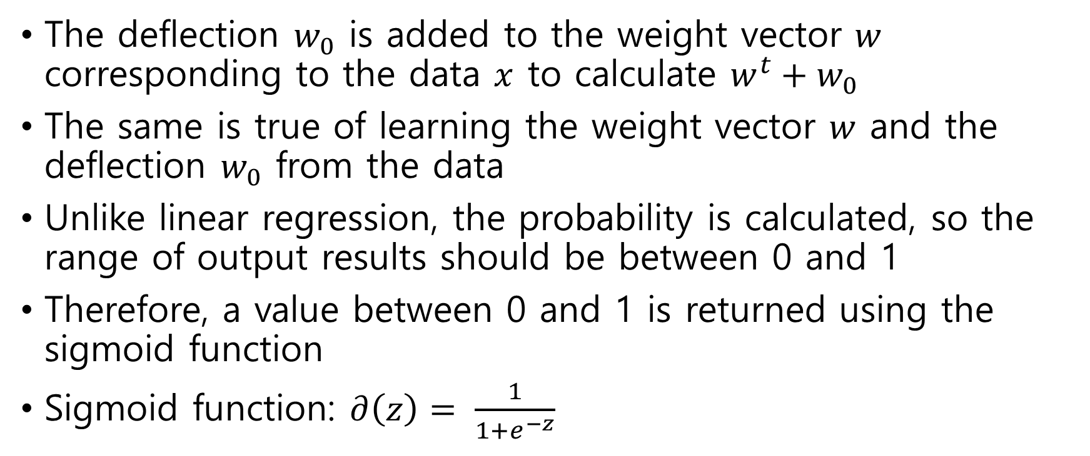
Algorithm
The deflection $w_{0}$ is added to the weight vector $w$ corresponding to the data $x$ to calculate $w^{t}+w_{0}$
The same is true of learning the weight vector $w$ and the deflection $w_{0}$ from the data
Unlike linear regression, the probability is calculated, so the range of output results should be between 0 and 1
Therefore, a value between 0 and 1 is returned using the sigmoid function
Sigmoid function: $∂\left(z\right)= \frac{1}{1+e^{−z}}$

Slide 5
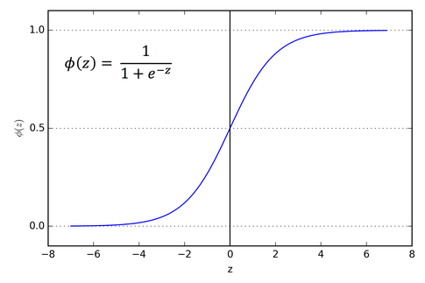
Algorithm sigmoid function graph

Slide 6
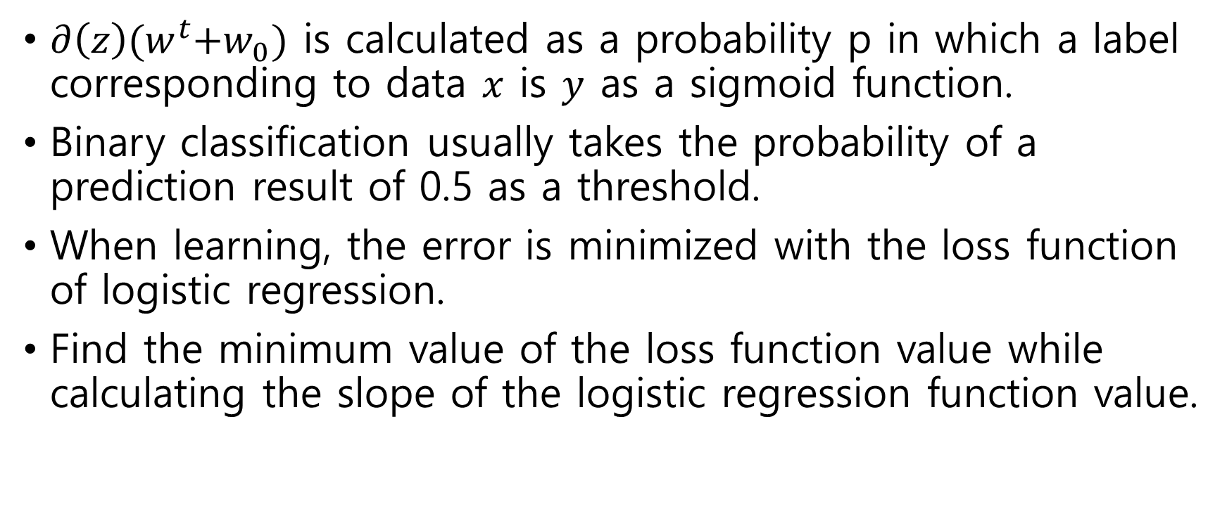
Algorithm
$∂\left(z\right){(w}^{t}+w_{0})$ is calculated as a probability p in which a label corresponding to data $x$ is $y$ as a sigmoid function.
Binary classification usually takes the probability of a prediction result of 0.5 as a threshold.
When learning, the error is minimized with the loss function of logistic regression.
Find the minimum value of the loss function value while calculating the slope of the logistic regression function value.

Slide 7
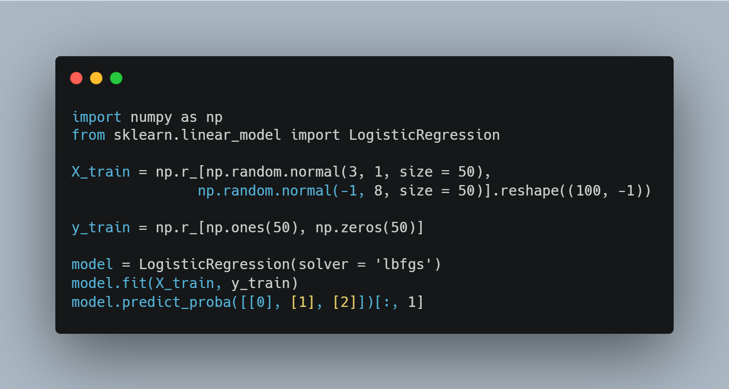
Sample Code
Import numpy and sklearn
Make feature data
Make label data
generation and learning and prediction of logistic regression models

Slide 8
Determination boundary
When unknown data is put into the model trained to solve the classification problem and classified, the classification result changes to a boundary of some data.
The boundary in which the classification results change is called the determination boundary.
In logistic regression, the decision boundary is where the result of calculated probability is 50%.

