Slide 1

Supervised Learning
Naïve Bayes Classification
경희대학교 컴퓨터공학과
2019102191 신주영

Slide 2
Fundamental Concept
The Naïve Bayes Classification is one of the algorithms for predicting results based on probability.
Calculate the probability of which label the data belongs and classify the data into the label with the highest probability.
We’re going to use The Naive Bayes classification going to be used to classify virtual news article titles into ‘영화' and ‘우주'.
학습 데이터 | 카테고리
감동을 준 명작 영화가 부활 | 영화
화려한 액션 영화가 개봉 | 영화
명작의 부활에 세계가 감동 | 영화
모래 폭풍이 화성을 덮다 | 우주
마침내 화성 탐사 재개 | 우주
VR로 보는 화성의 모래 폭풍과 감동 | 우주
검정 데이터 | 카테고리
부활한 명작에서 보여주는 액션에 감동 | ??

Slide 3
Fundamental Concept
According to the table, there are three categories of articles in the learning data, one for 영화 and one for 우주.
Simply put, there is a 50 % chance that a title is a movie or a universe.
We will take an example by paying attention to the word ＇감동' included in the test data.

Slide 4
Fundamental Concept
학습 데이터
기사제목 6개
영화 카테고리
3개
우주 카테고리
3개
없음
1개
있음
2개
없음
2개
있음
1개
카테고리 | ‘감동’이 나타날 조건부 확률
영화 | 2/3
우주 | 1/3

Slide 5
Algorithm
Data Preprocessing
When dealing with the classification problem of natural language processing into the Naive Bayes classification, input data must be converted into a vector composed of features.
The preprocessing in this example is to convert the article title to BoW (Bag of Words) and then create a vector consisting of feature and label pairs.

Slide 6
Algorithm
Data Preprocessing
First, only nouns are extracted from the article title of the learning data. At this time, the word order is ignored and treated as a set.
학습데이터 | 카테고리
{“감동”, “명작“, “영화“} | 영화
{“화려”, “액션”, “영화“} | 영화
{“명작”, “세계“, “감동“} | 영화
{“모래 폭풍“, “화성”} | 우주
{“화성”, “탐사“, “재개“} | 우주
{“VR”, “탐사”, “재개”} | 우주

Slide 7
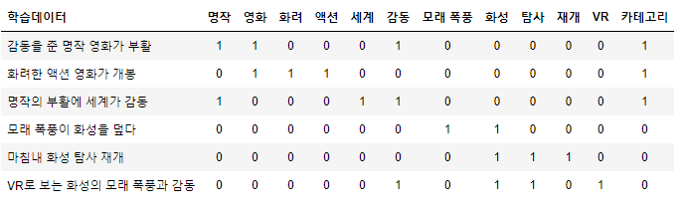
Algorithm
Data Preprocessing
Second, Change the word set and category of the feature to be easy to handle.
When the learning data includes words in a set of words, add 1 and 0 when not included.
As shown in the table above, a pair of features and labels is called BoW depending on whether there is a word in a natural language sentence.

Slide 8
Algorithm
Data Preprocessing
Third, The test data is also converted to BoW.

Slide 9
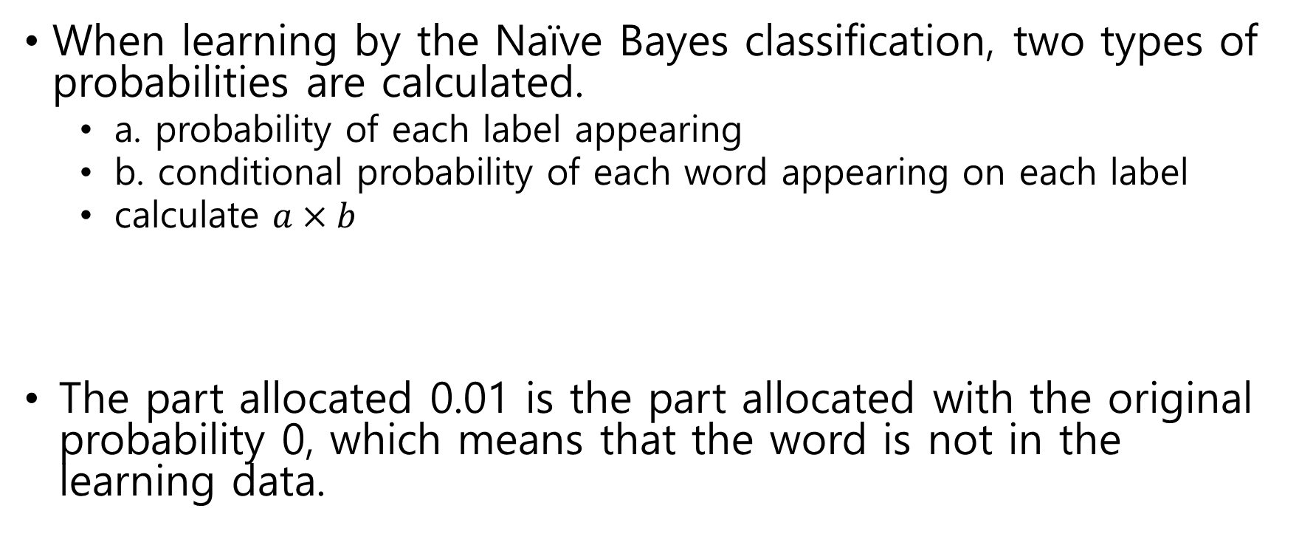
Algorithm
Calculate Probability
When learning by the Naïve Bayes classification, two types of probabilities are calculated.
  a. probability of each label appearing
  b. conditional probability of each word appearing on each label
  calculate $a×b$
The part allocated 0.01 is the part allocated with the original probability 0, which means that the word is not in the learning data.
 | 명작 | 영화 | … | 감동 | … | VR
영화 | 2/3 | 2/3 | … | 2/3 | … | 0.01

Slide 10
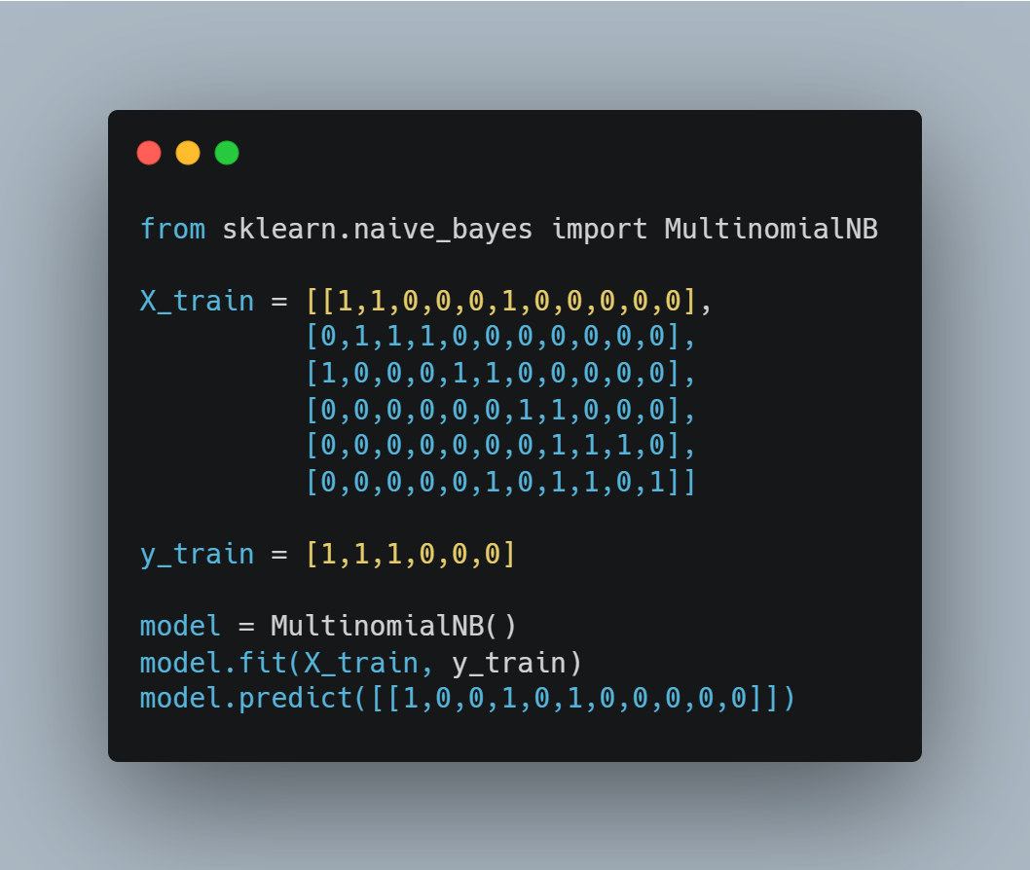
Sample Code
Import libraries
Make X, y data
Make model and training
Predict result

