Slide 1

Supervised Learning
kNN (k-Nearest Neighbors Algorithm)
경희대학교 컴퓨터공학과
2019102191 신주영

Slide 2
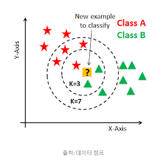
Fundamental Concept
kNN can be applied to both classification and regression problems.
When classifying unknown data, the distance to the learning data is calculated to determine how the data is classified up to k points nearby, and then the data is classified by majority vote 2.

Slide 3
Algorithm
calculating the distance of learning data from input data
Search for k learning data close to input data
Categorize input data that is not known by majority vote in the label of learning data.

Slide 4
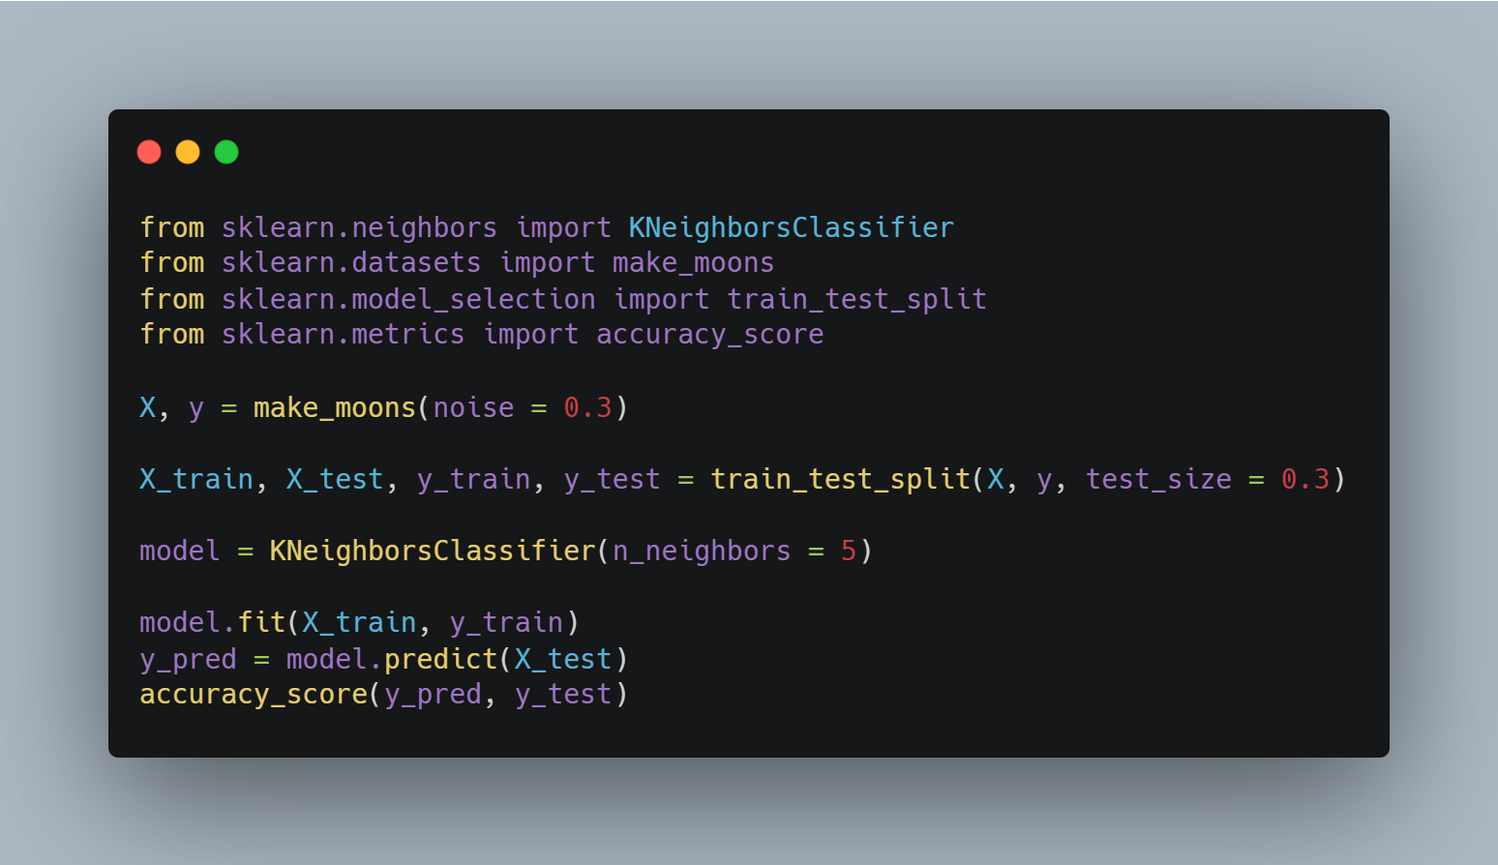
Sample Code
Import libraries
Make sample data
Set training, test data
Train data
Predict result
Calculate accuracy

Slide 5
Difference in decision boundary according to k value
The smaller the k value, the more likely over-fitting occurs.
Conversely, if the value of k is too large, the decision boundary cannot be accurately learned.

Slide 6
Points to note
The kNN is basically not suitable for large amounts of data processing.
High-level data is difficult to learn. This is because asymptotic assumptions of the kNN algorithm are not necessarily established in high-dimensional data.

