Slide 1

Unsupervised Learning
Non-negative Matrix Factorization, NMF
경희대학교 컴퓨터공학과
2019102191 신주영

Slide 2
Fundamental Concept
NMF is a dimensionality reduction method in which features and labels are both positive.
Easy to model when dealing with image data, etc
It is an algorithm that is applied only when all the components of the original matrix are positive.
  The original matrix element must be positive.
  After matrix decomposition, the matrix element is positive.
  In NMF, there is no restriction that each dimension is orthogonal.

Slide 3
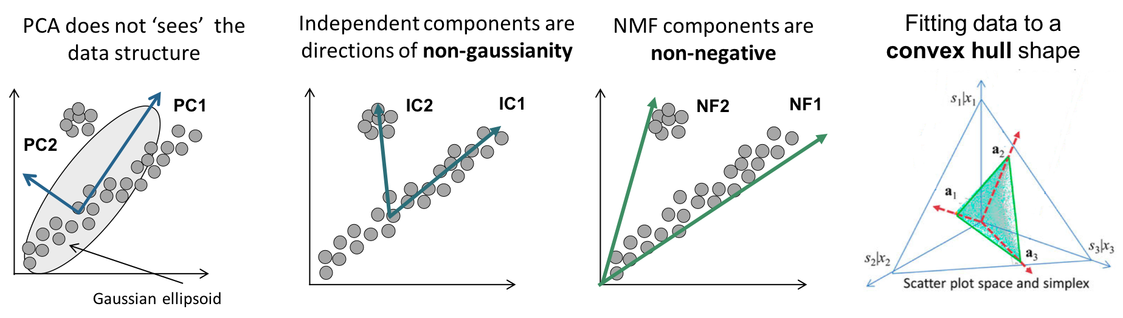
Fundamental Concept
PCA always uses orthogonal eigenvectors, making it difficult to find associations between data, but NMF can grasp the nature of the data.

Slide 4
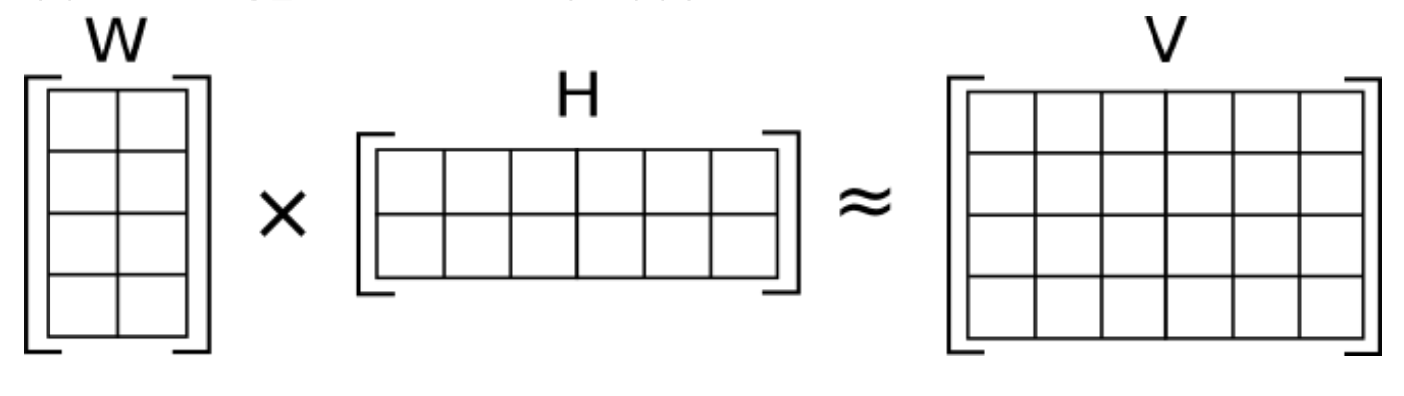
Fundamental Concept
NMF do dimensionality reduction by decompose original data to 2 matrix

Slide 5
Fundamental Concept
Calculation Process
  Initialize W, H as a positive value
  Treat H as a constant and renew W
  Treat W as a constant and renew H
  End calculation when W, H converges to the original matrix

Slide 6
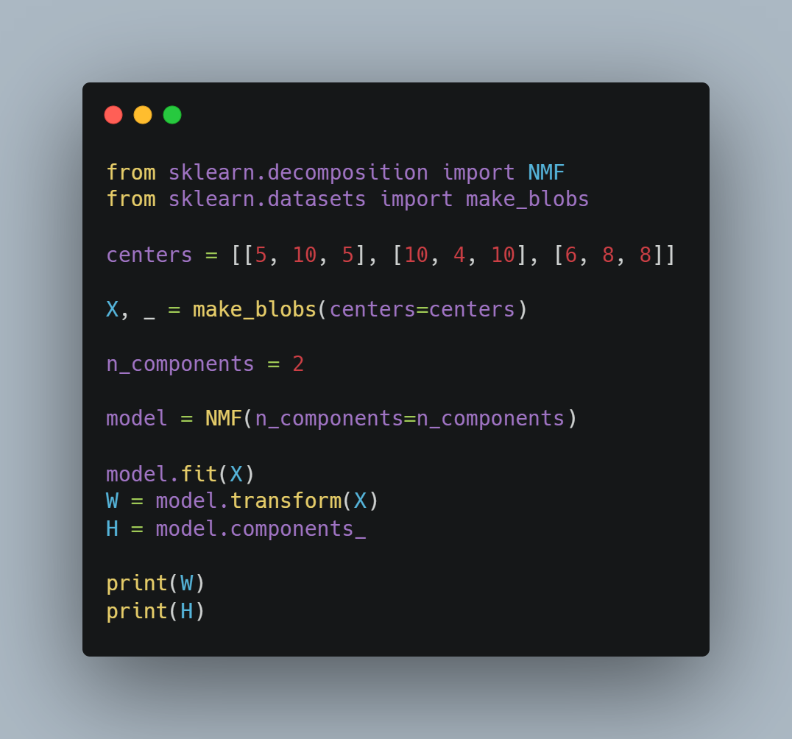
Sample Code
Imort libraries
Set data
Set dimension to reduce
Make model
Train data
Print W matrix and H matrix

