Slide 1

Unsupervised Learning
Gaussian mixture model
경희대학교 컴퓨터공학과
2019102191 신주영

Slide 2
Fundamental Concept
It is used in clustering
The data distribution is represented using the mean and variance of the data.
The Gaussian distribution is mixed to represent complex data consisting of several groups.

Slide 3
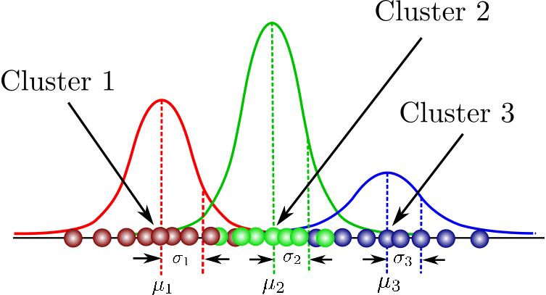
Fundamental Concept

Slide 4
Algorithm
The Gaussian mixture model calculates the mean and variance for each Gaussian distribution at the data point.
  Initialize the mean and variance of each Gaussian distribution
  Calculate the weight of each data point from group to group
  Recompute parameters with weights obtained in course 2
  Repeat Steps 2 and 3 until each change in the average updated in Course 3 is sufficiently small

Slide 5
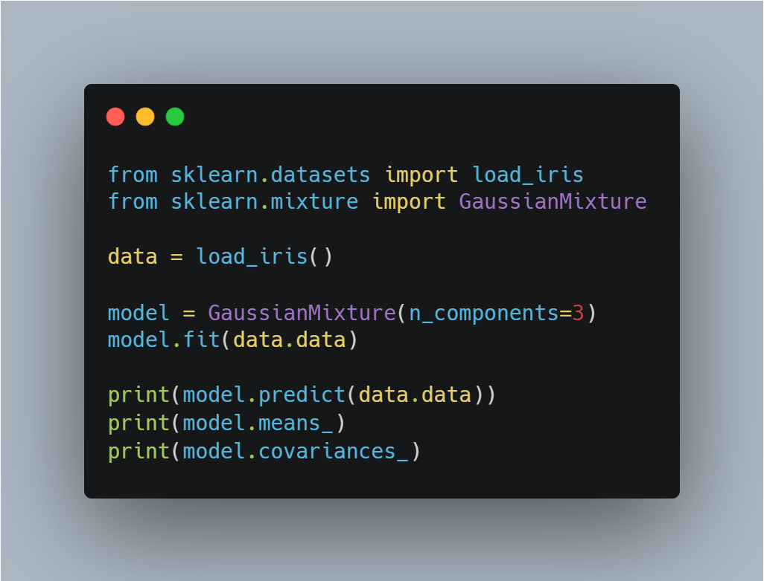
Sample Code
Import libraries
Make Gaussian mixture model instance
Train data
Print predicted data
Print means
Print covariances

