Slide 1

Evaluation Method and
Data Preprocessing
Evaluation Method
경희대학교 컴퓨터공학과
2019102191 신주영

Slide 2
Ways to evaluate supervised learning
The evaluation method of supervised learning varies depending on whether it is a classification problem or a regression problem.
Even if evaluation indicators are appropriately selected, a good model cannot be created if they are overfitting the learning data. This should be noted.
분류 문제 | 회귀 문제
혼동 행렬 (confusion matrix) | 평균제곱오차 (mean square error)
정확도 (accuracy) | 결정계수 (coefficient of determination)
정밀도 (precision)
재현율 (recall)
F값 (F1-score)
곡선아래면적 (AUC)

Slide 3
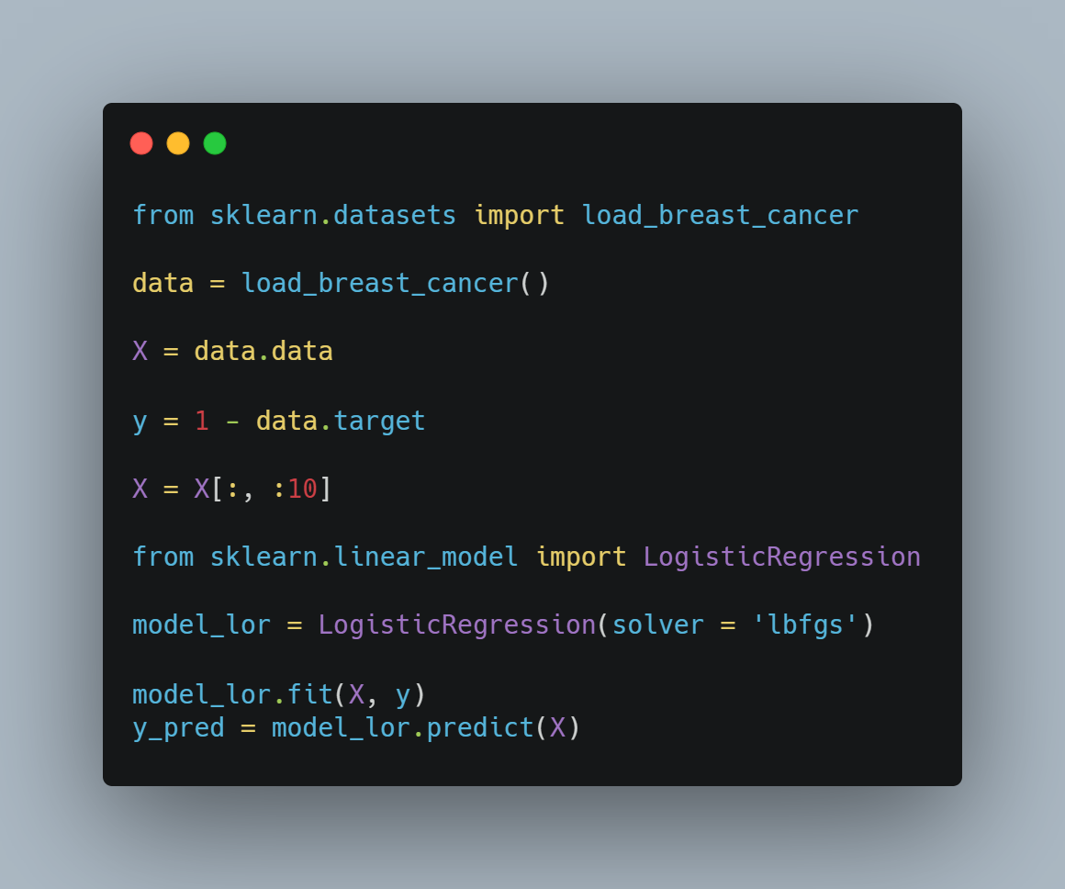
How to evaluate classification problems
Data preprocessing
We’re going to use dataset as a breast cancer diagnosis data

Slide 4
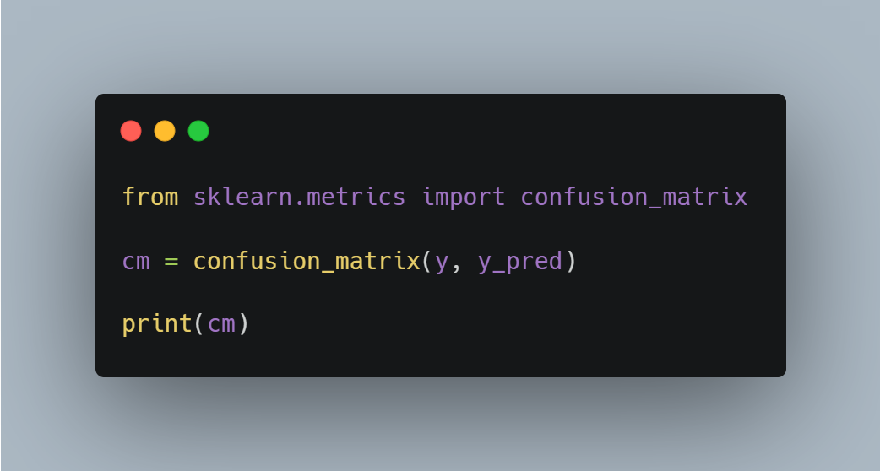

How to evaluate classification problems
Confusion Matrix
TN: Properly predict real negative data as negative
FP: Misleading prediction of real negative data as positive
FN: Misleading prediction of real positive data as negative
TP: Real Positive Data Predicts Positive

Slide 5

How to evaluate classification problems accuracy

Slide 6

How to evaluate classification problems precision

Slide 7

How to evaluate classification problems recall

Slide 8

How to evaluate classification problems
F1-score

Slide 9
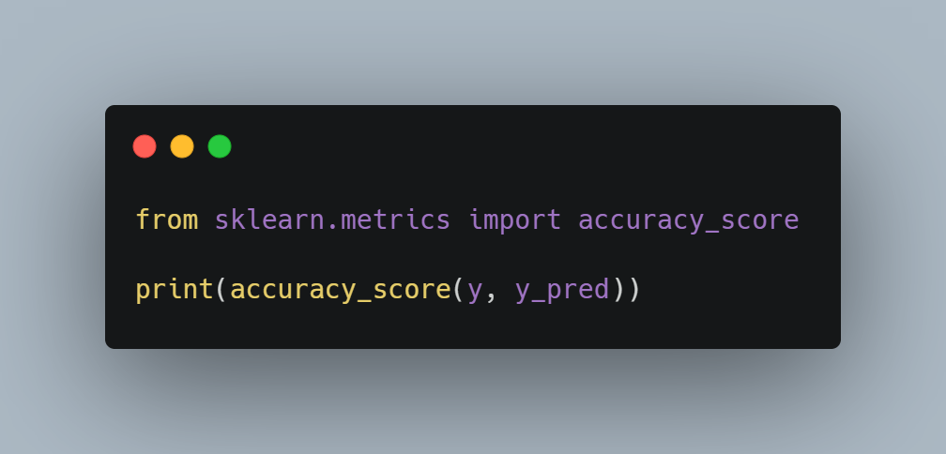
How to evaluate classification problems accuracy
Percentage of total forecast results correctly predicted

Slide 10
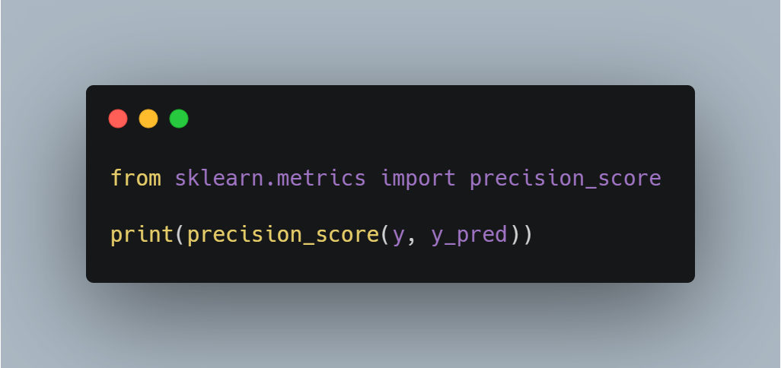
How to evaluate classification problems precision
The percentage of the actual positive results that you predicted was really positive

Slide 11
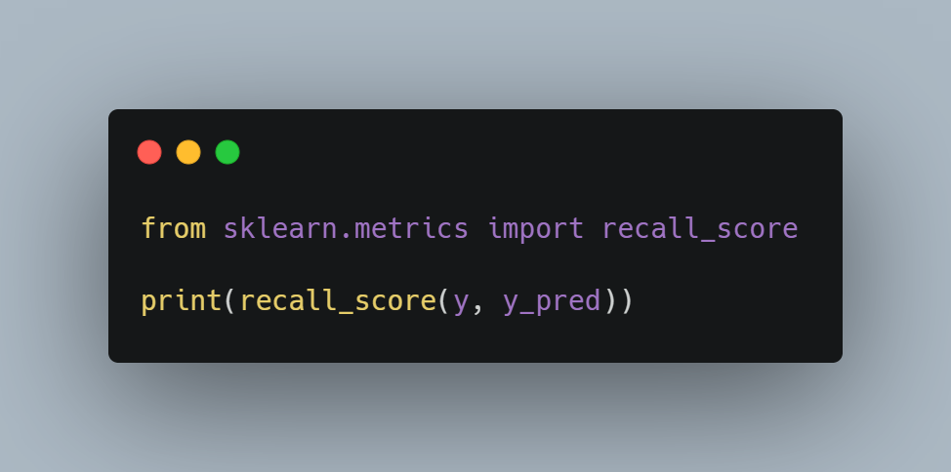
How to evaluate classification problems recall
Percentage correctly predicted as positive as actual positive

Slide 12
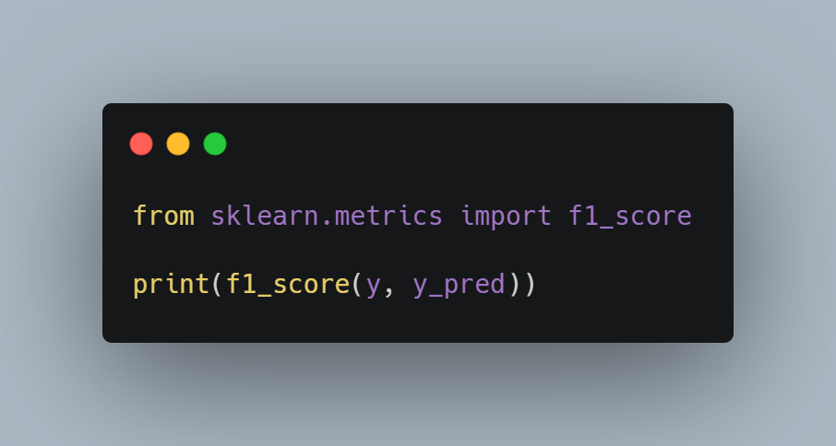
How to evaluate classification problems
F1-score
reflecting both precision and recall

Slide 13
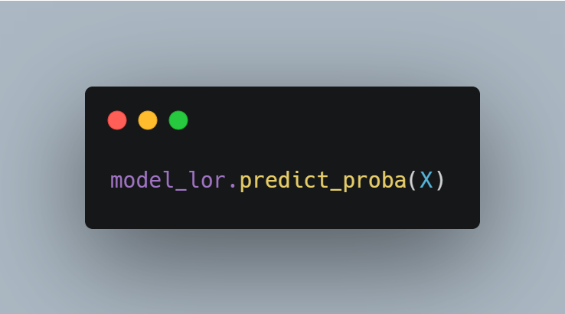
How to evaluate classification problems prediction probability
Calculate the probability of being classified as 0 and the probability of being classified as 1 respectively

Slide 14
How to evaluate classification problems
ROC curve and AUC
The ratio of FP is set to the horizontal axis and the ratio of TP is set to the vertical axis and displayed as a graph.
The change in the relationship between FP and TP can be seen graphically when the threshold is slightly lowered from 1 to be treated positive among the predicted probabilities.
If the area is up to 1 and the area under the curve is close to 1, the precision is high. On the other hand, around 0.5 is not well predicted.
The use of ROC is recommended when dealing with unbalanced data.

Slide 15
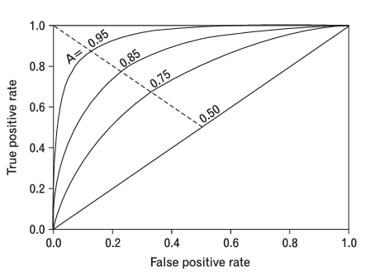


How to evaluate classification problems
ROC curve and AUC
$$FPR=\frac{FP}{FP+TN}$$
$$TPR=\frac{TP}{TP+FN}$$

Slide 16
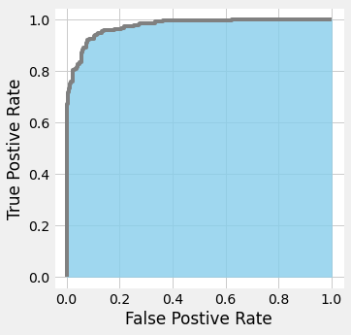
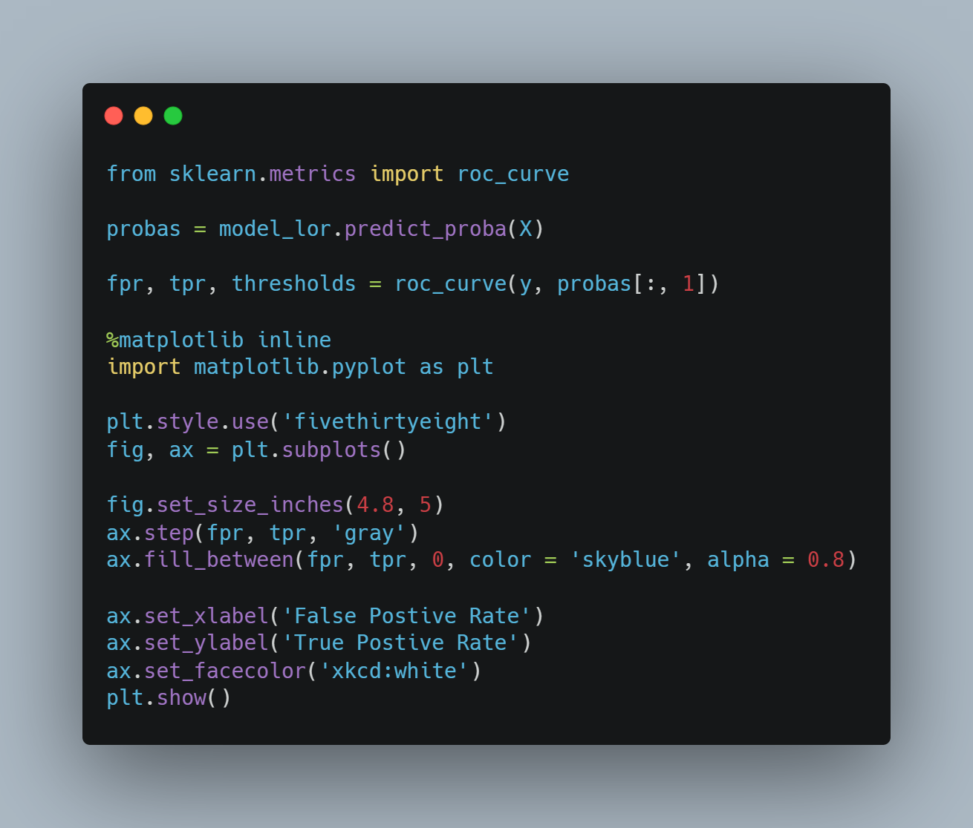
How to evaluate classification problems
ROC curve and AUC

Slide 17
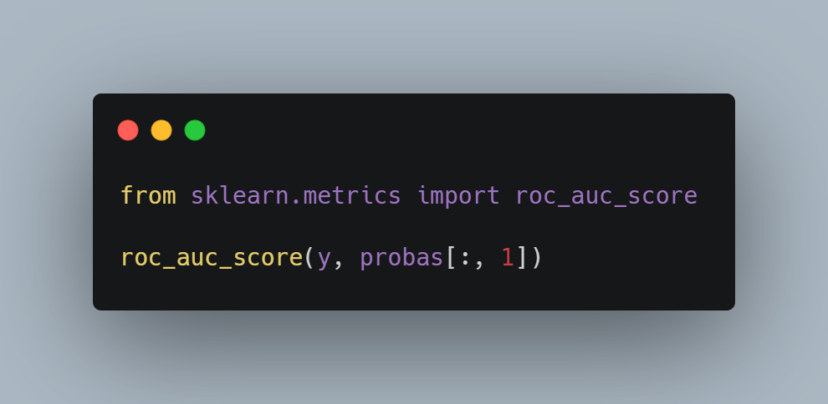
How to evaluate classification problems
ROC curve and AUC

Slide 18
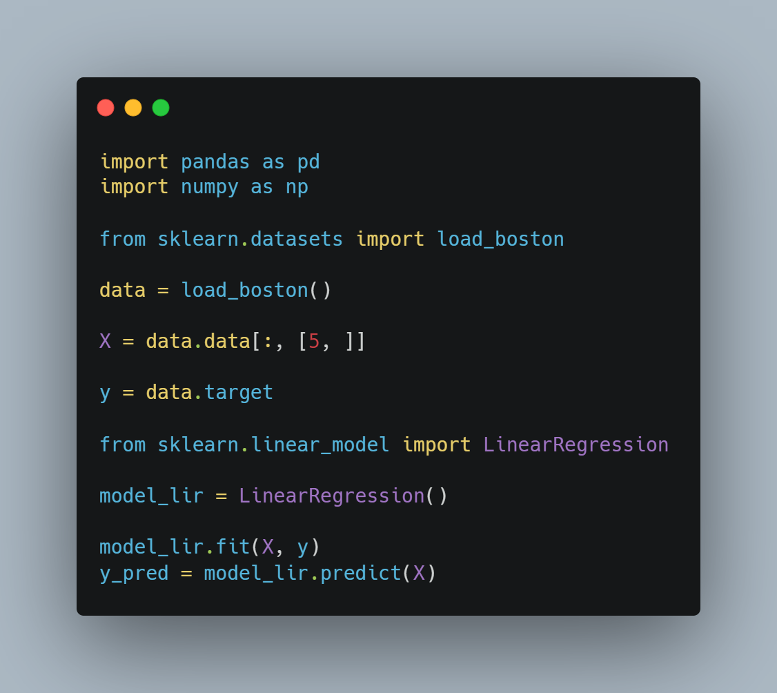
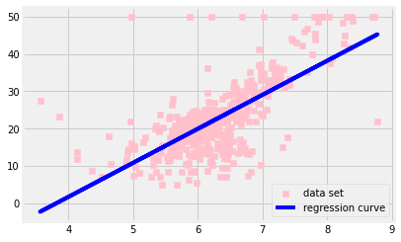
Evaluation method of Regression Problem

Slide 19
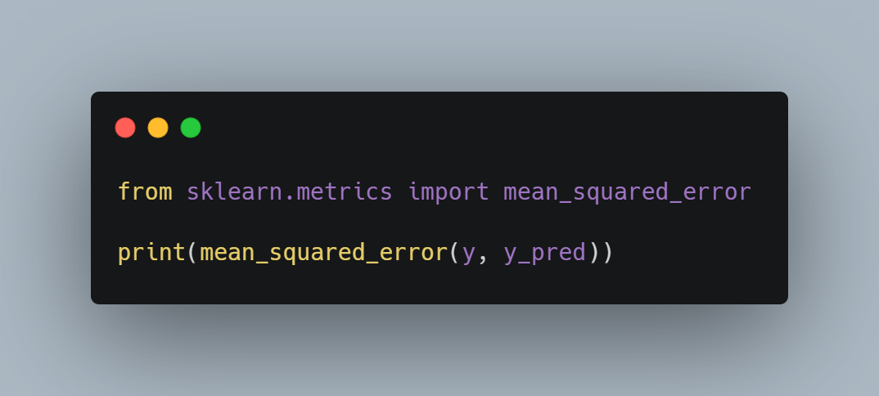
Evaluation method of Regression Problem mean square error
The mean square error is averaged after calculating both the square of error between the data to be evaluated and the predicted value.
The smaller the mean square error, the more correct the prediction is.

Slide 20

Evaluation method of Regression Problem coefficient of determination
It usually appears as a value between 0.0 and 1.0.
If the error between the predicted value and the actual data is too large, it may be expressed as a negative value.
The closer to 1.0, the more accurately the model represents the data point.

Slide 21
Compared to other algorithms difference between mean square error and coefficient of determination
If the variance of the dependent variable is large, the mean square error is also large.
The coefficient of determination may be expressed as a value between 0.0 and 1.0 without depending on the variance of the dependent variable.

Slide 22
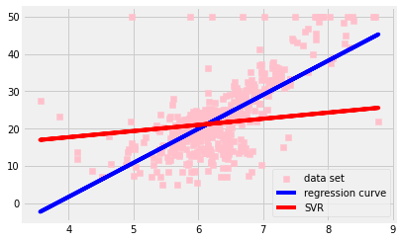
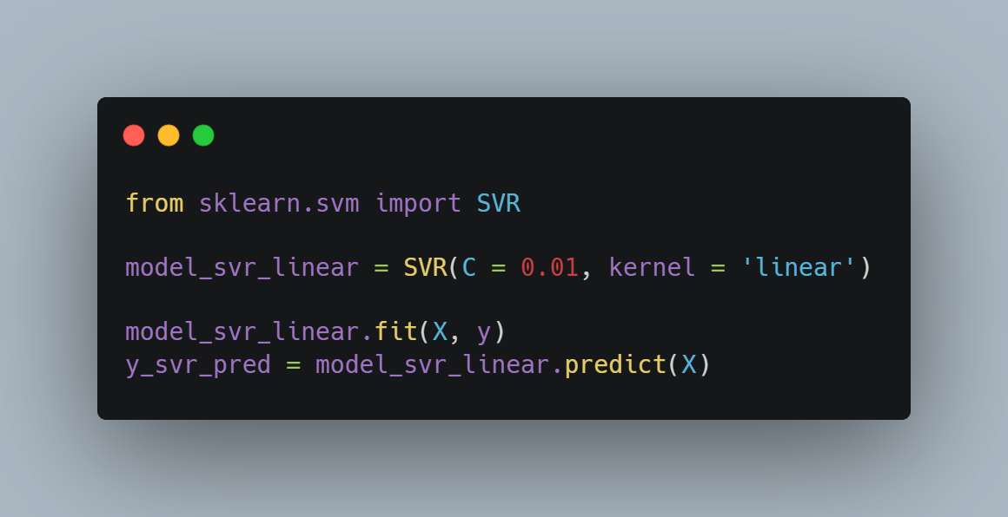
Compared to other algorithms difference with SVC and SVR
SVC shall contain as few data points as possible in margin.
SVR should contain as many data points as possible in margin.

Slide 23
Setting hyper parameter
The learning parameter is updated with the machine learning algorithm, but the hyperparameter must be set by the user before learning.
Failure to set appropriate hyperparameters results in poor model performance.

Slide 24
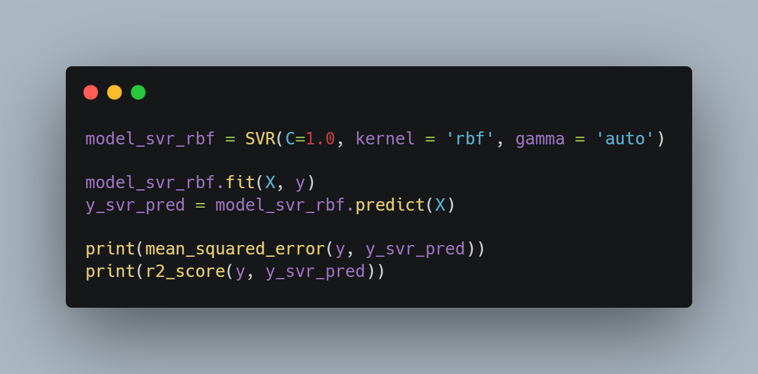
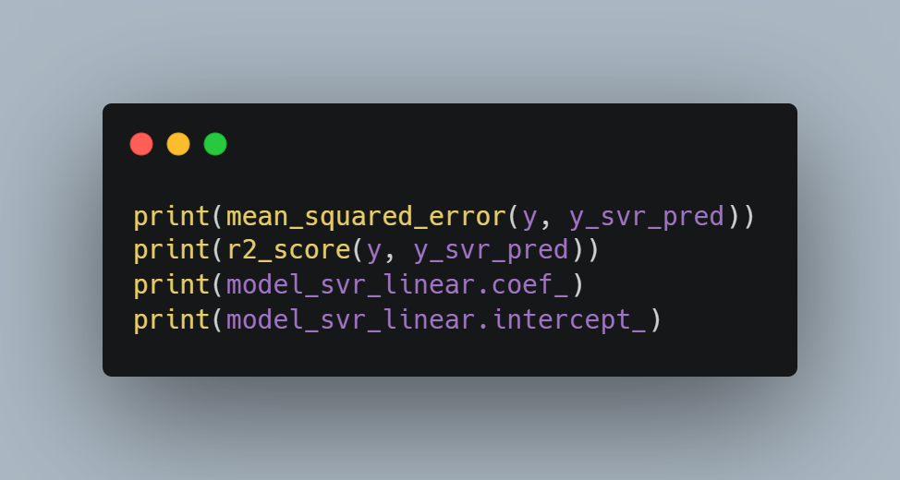


Setting hyper parameter

Slide 25
Over-fitting
The phenomenon in which good prediction results are shown as learning data, but bad prediction results are shown as test data that are not used for learning is called overfitting.
The model performance when using unknown data is called generalization performance.
Even if the mean square error is small when using the learning data, the generalization performance is low if it is an overfitting model.

Slide 26
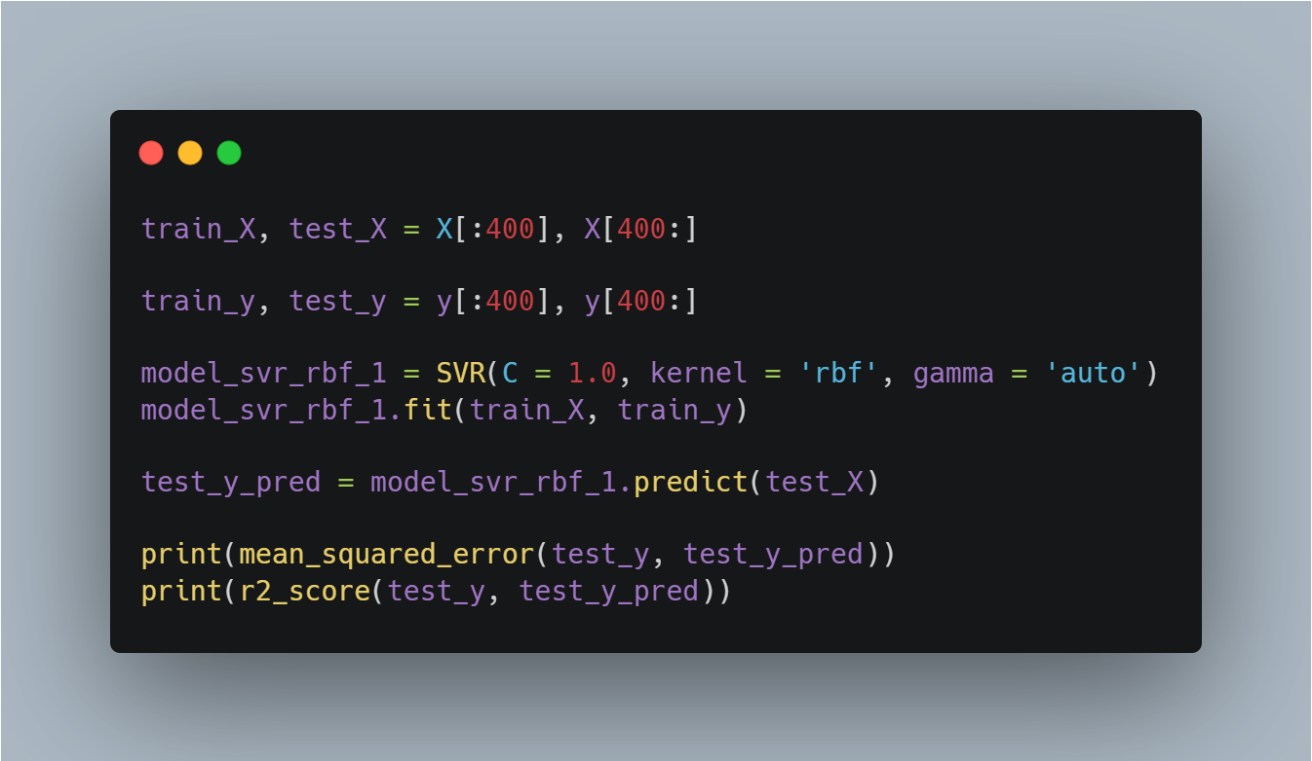

Over-fitting

Slide 27
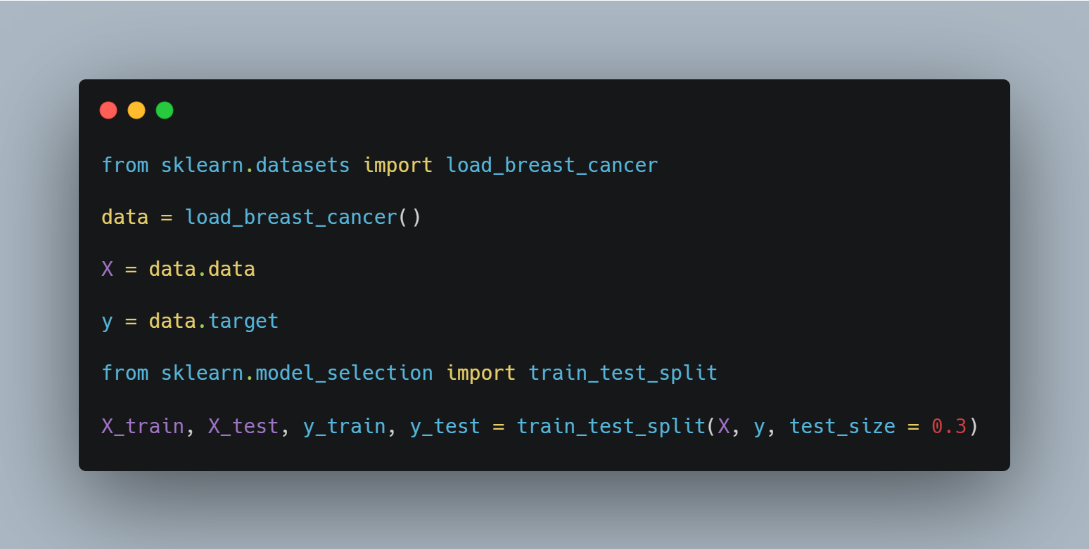
Ways to prevent over-fitting
1. split training data and test data

Slide 28
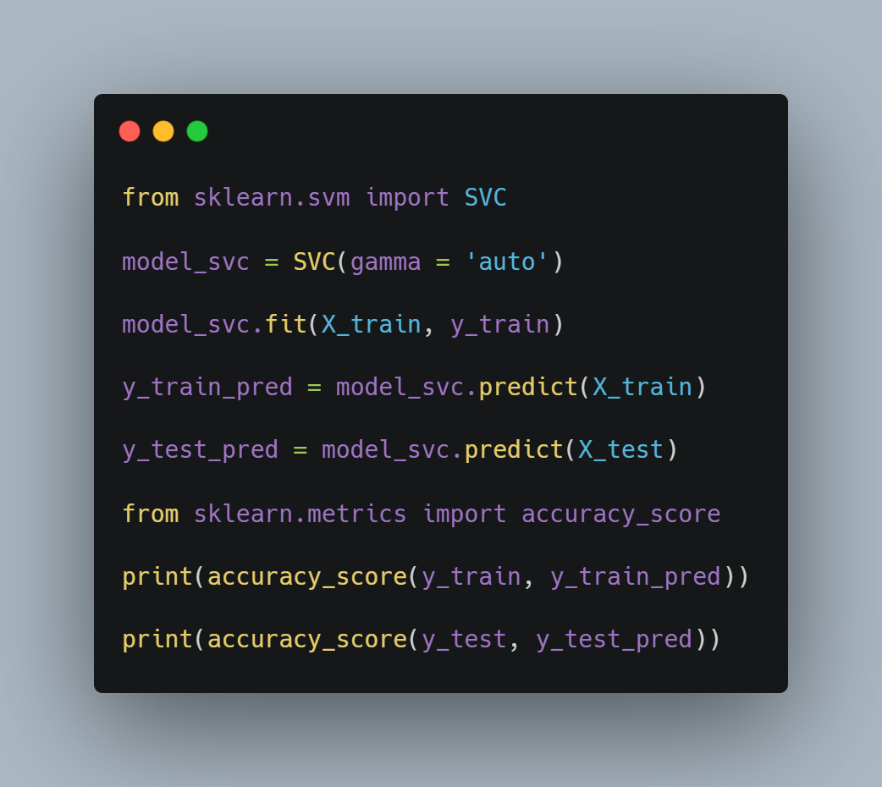
Ways to prevent over-fitting
Models that use learning data and test data to learn with SVR

Slide 29
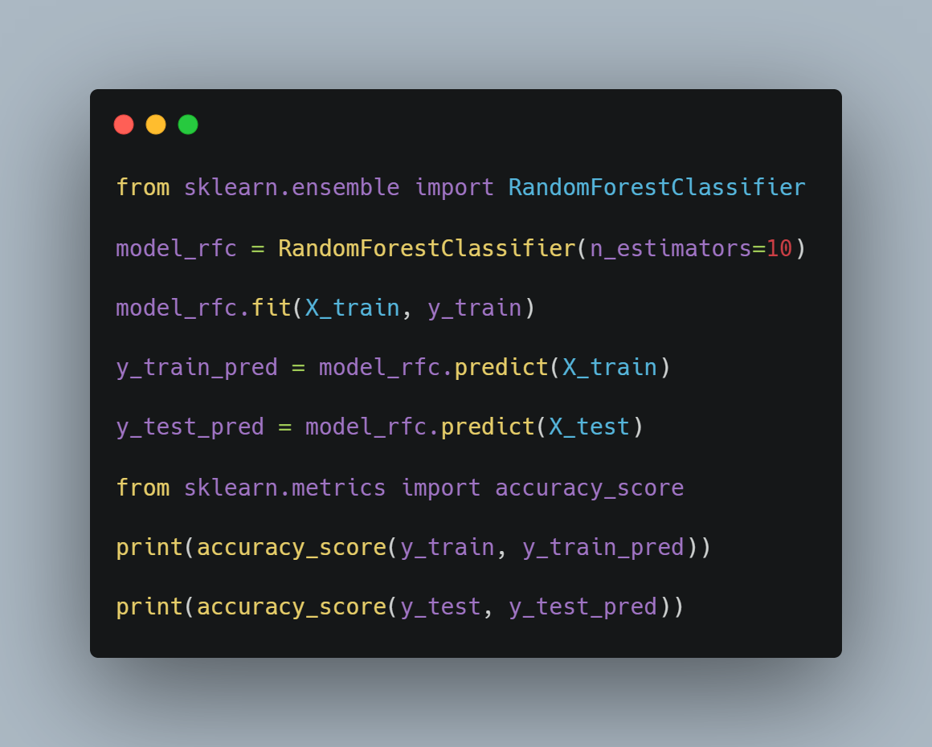
Ways to prevent over-fitting
Models that use learning data and test data to learn with RFC

Slide 30
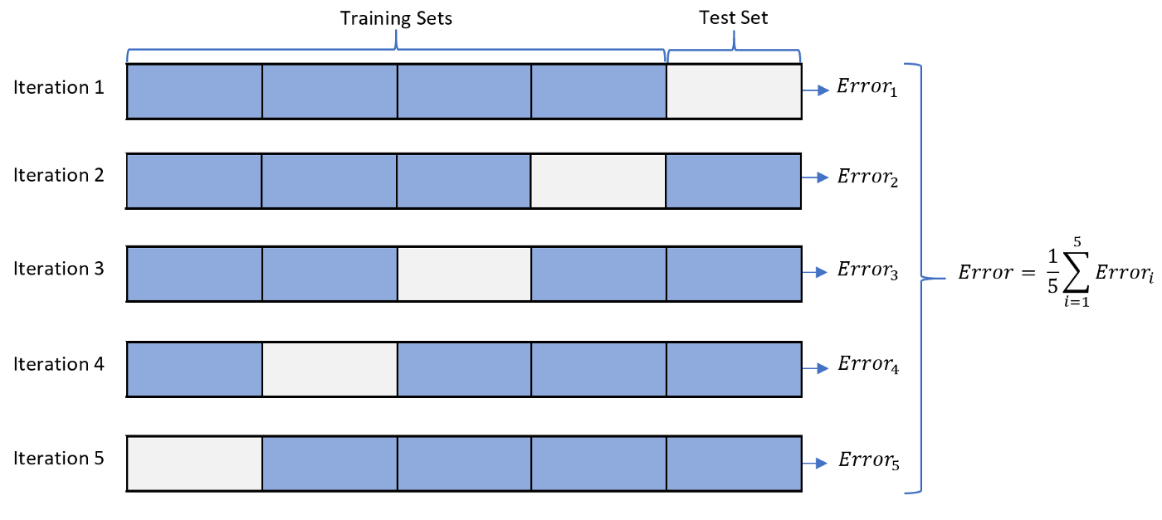
Ways to prevent over-fitting
Cross Validation

Slide 31
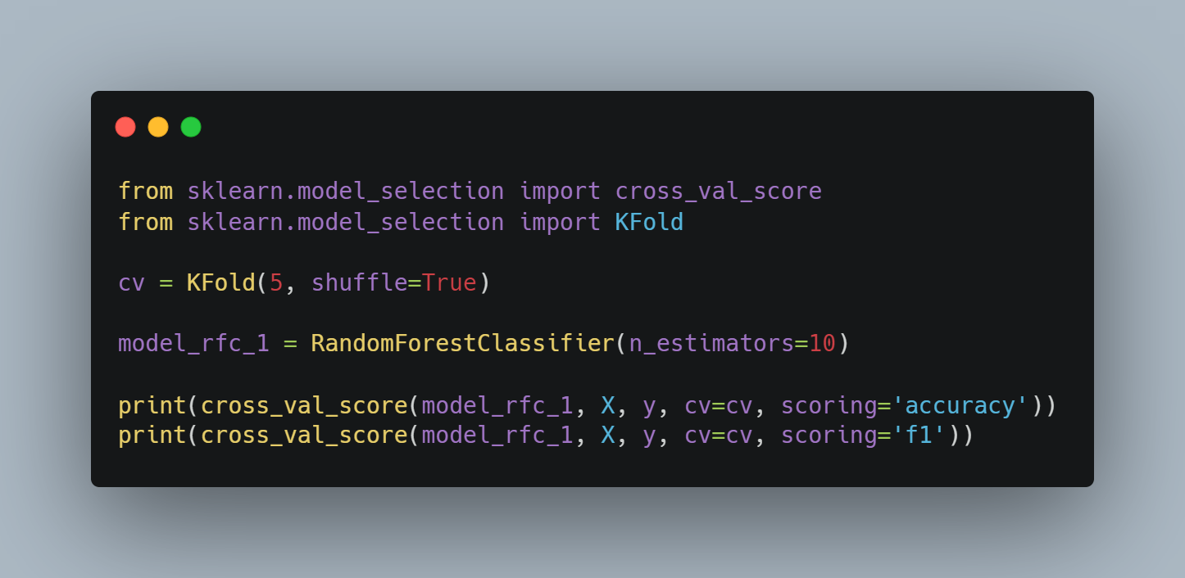

Ways to prevent over-fitting
Cross Validation

Slide 32
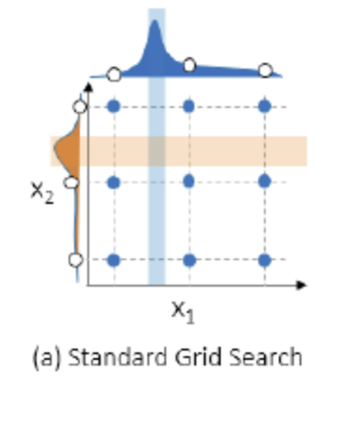
Searching hyper parameter greed search

Slide 33
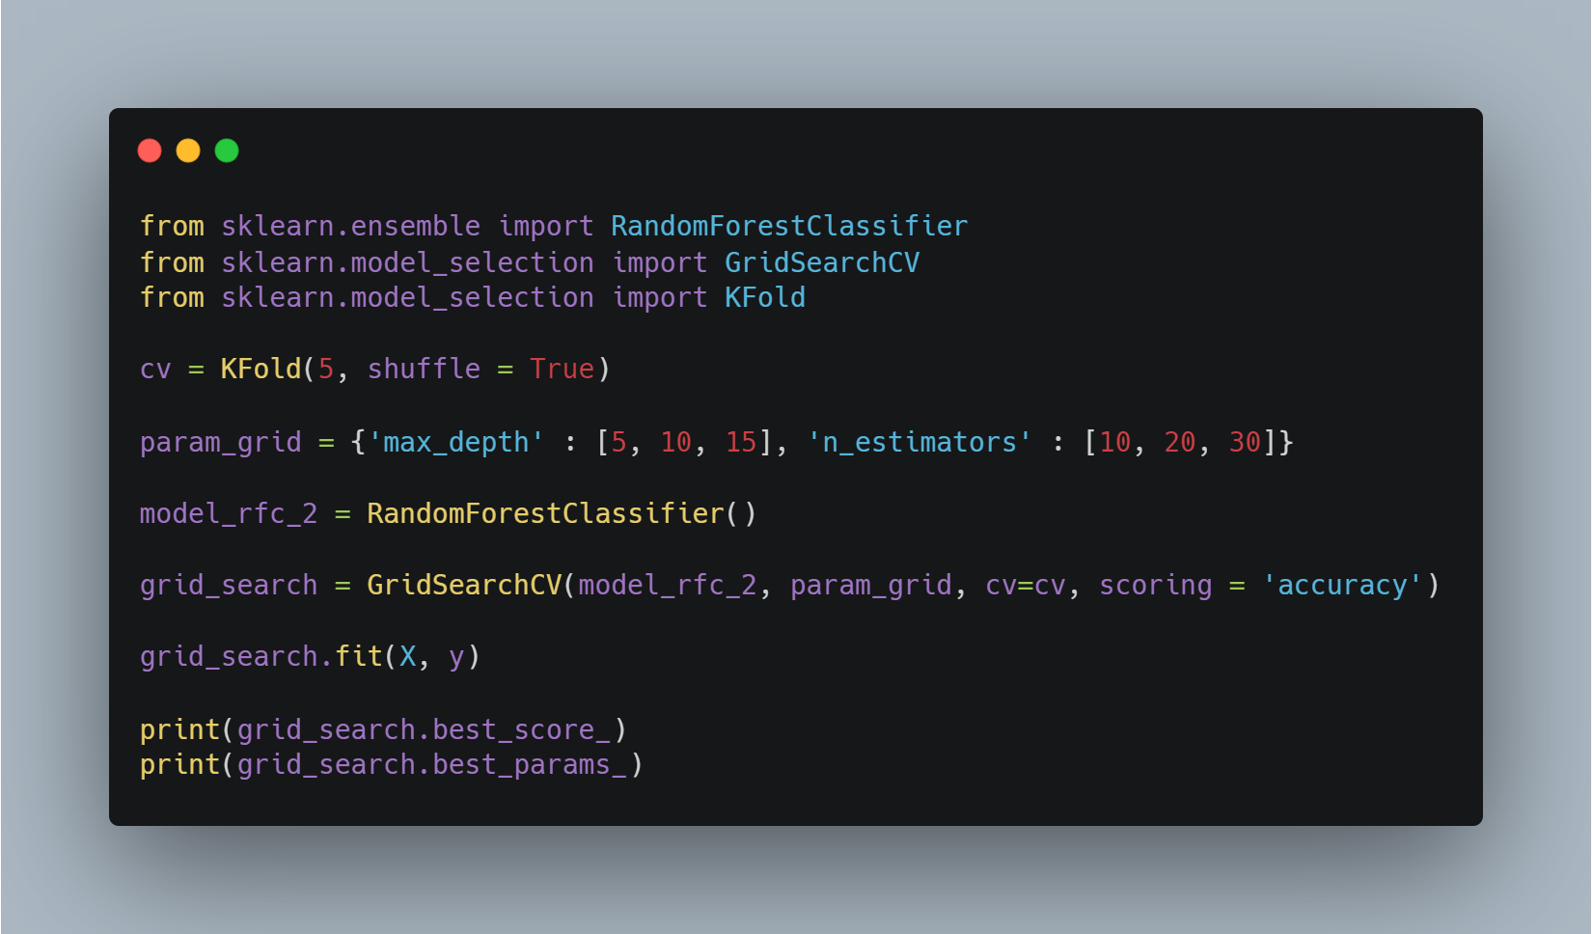

Searching hyper parameter greed search

