Slide 1

Evaluation Method and
Data Preprocessing
Data Preprocessing
경희대학교 컴퓨터공학과
2019102191 신주영

Slide 2
TF-IDF
Term Frequency – Inverse Document Frequency
TF-IDF is a weight used in information retrieval and text mining, and is a statistical value indicating how important a word is within a particular document when there are multiple document groups.
TF (Term frequency) is a value that indicates how often a particular word appears within a document, and the higher this value, the more important it is in the document.
However, if the word itself is frequently used within the document group, this means that the word appears frequently. This is called DF (document frequency), and the inverse of this value is called IDF (inverse document frequency).

Slide 3
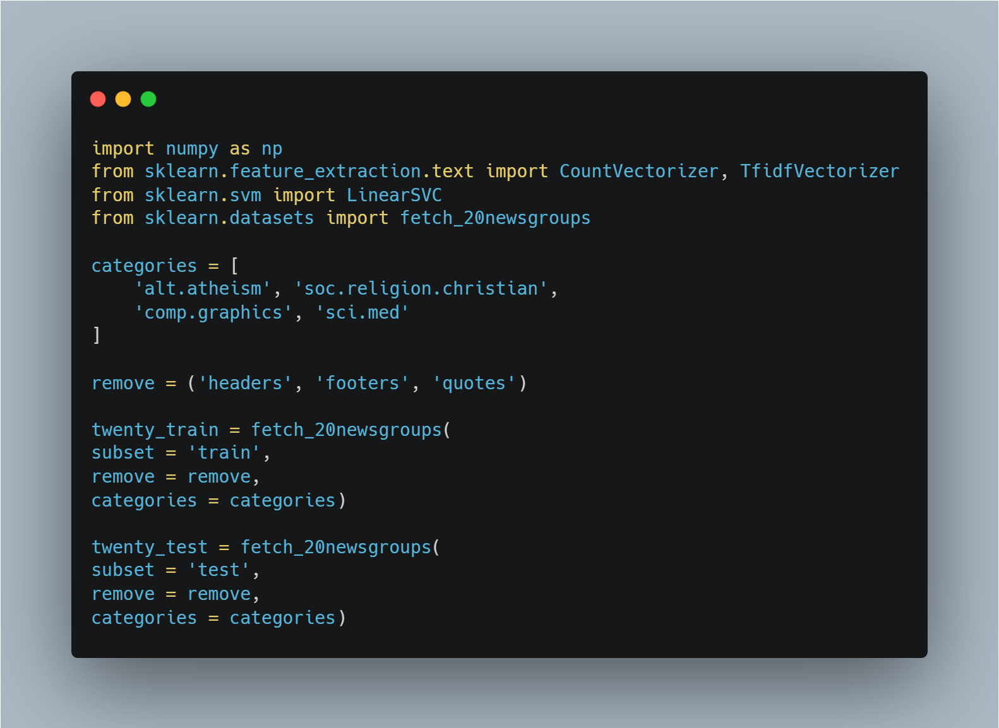
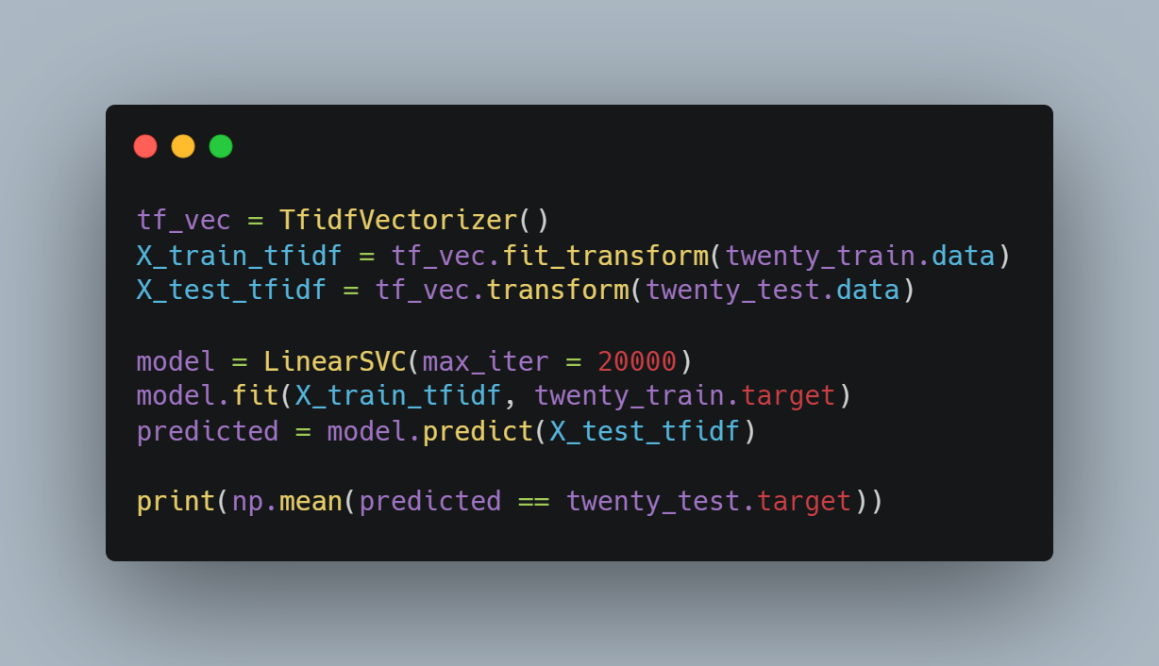
Sample Code

