Slide 1

Evaluation Method and
Data Preprocessing
Data Preprocessing
경희대학교 컴퓨터공학과
2019102191 신주영

Slide 2
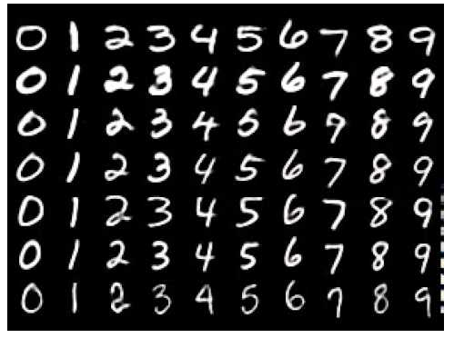
Converting Image Data
MNIST
The brightness value of the image data pixel of each number is converted into vector data and used.

Slide 3
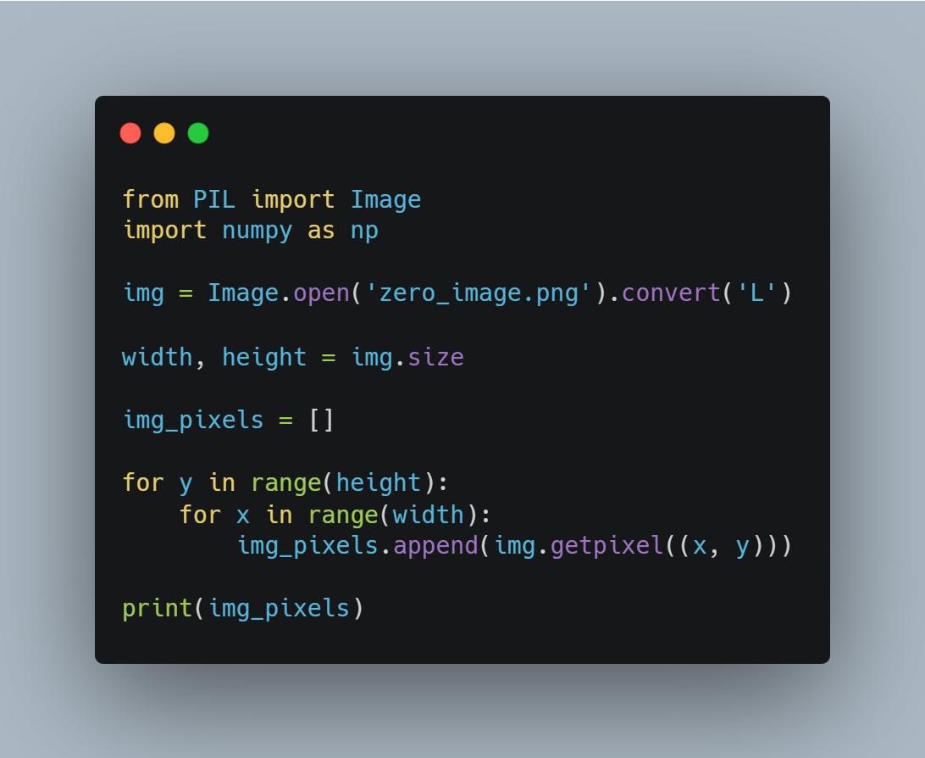
Sample Code

Slide 4
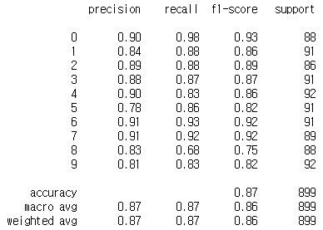
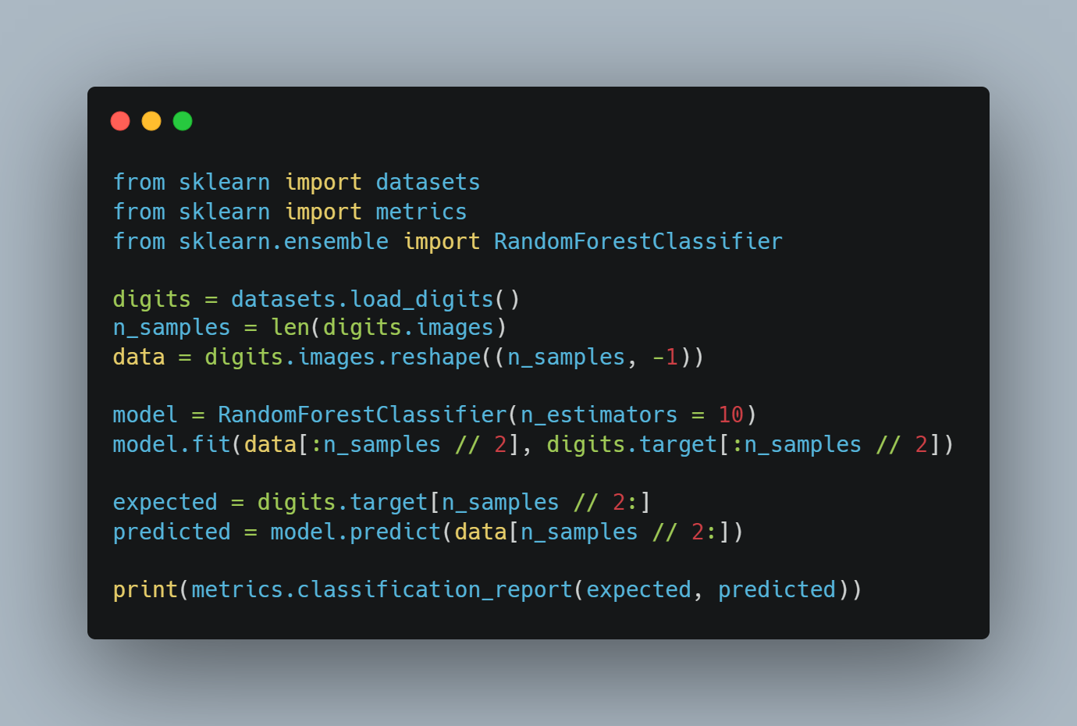
Sample Code

