Slide 1

Evaluation Method and
Data Preprocessing
Evaluation Method
경희대학교 컴퓨터공학과
2019102191 신주영

Slide 2
Table of Contents
Evaluation Method
Preprocessing of Documents
Converting Image Data

Slide 3
Ways to evaluate supervised learning
The evaluation method of supervised learning varies depending on whether it is a classification problem or a regression problem.
Even if evaluation indicators are appropriately selected, a good model cannot be created if they are overfitting the learning data. This should be noted.
분류 문제 | 회귀 문제
혼동 행렬 (confusion matrix) | 평균제곱오차 (mean square error)
정확도 (accuracy) | 결정계수 (coefficient of determination)
정밀도 (precision)
재현율 (recall)
F값 (F1-score)
곡선아래면적 (AUC)

Slide 4
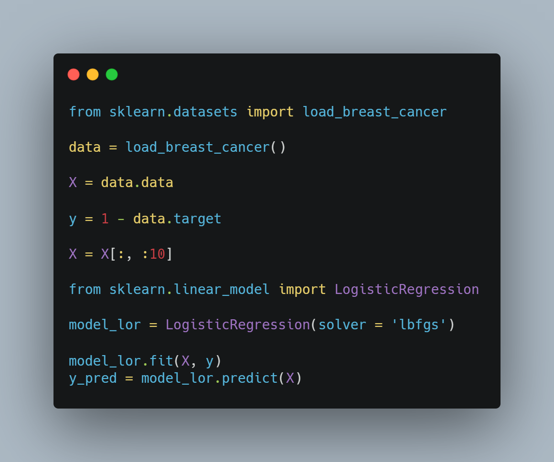
How to evaluate classification problems
Data preprocessing
We’re going to use dataset as a breast cancer diagnosis data

Slide 5
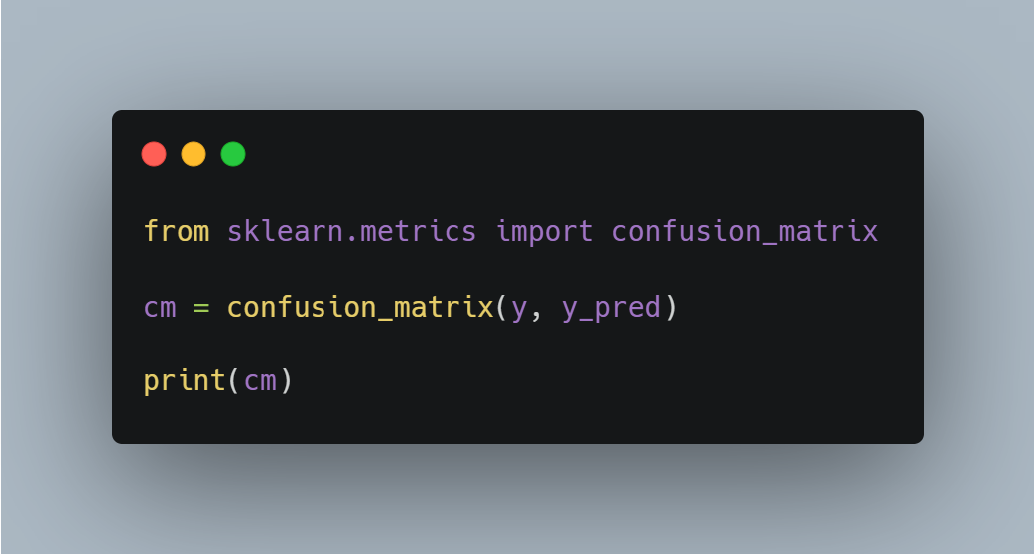

How to evaluate classification problems
Confusion Matrix
TN: Properly predict real negative data as negative
FP: Misleading prediction of real negative data as positive
FN: Misleading prediction of real positive data as negative
TP: Real Positive Data Predicts Positive

Slide 6

How to evaluate classification problems accuracy

Slide 7

How to evaluate classification problems precision

Slide 8

How to evaluate classification problems recall

Slide 9

How to evaluate classification problems
F1-score

Slide 10
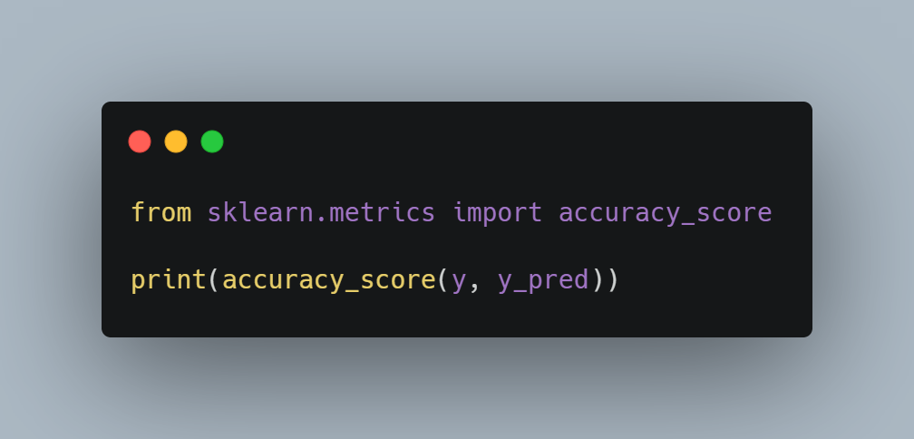
How to evaluate classification problems accuracy
Percentage of total forecast results correctly predicted

Slide 11
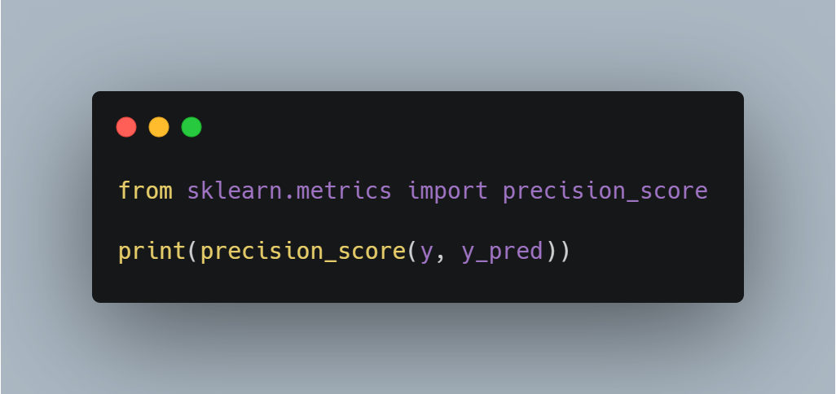
How to evaluate classification problems precision
The percentage of the actual positive results that you predicted was really positive

Slide 12
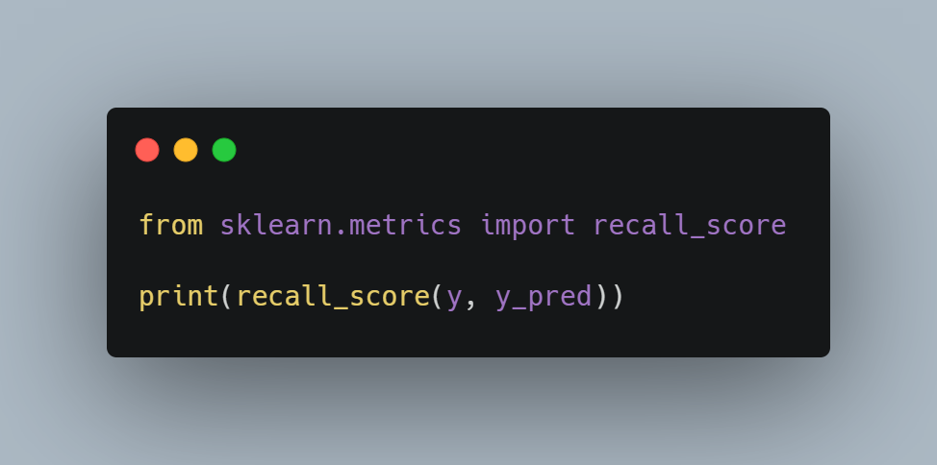
How to evaluate classification problems recall
Percentage correctly predicted as positive as actual positive

Slide 13
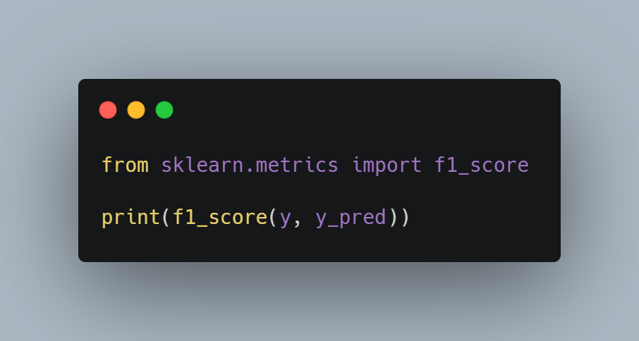
How to evaluate classification problems
F1-score
reflecting both precision and recall

Slide 14
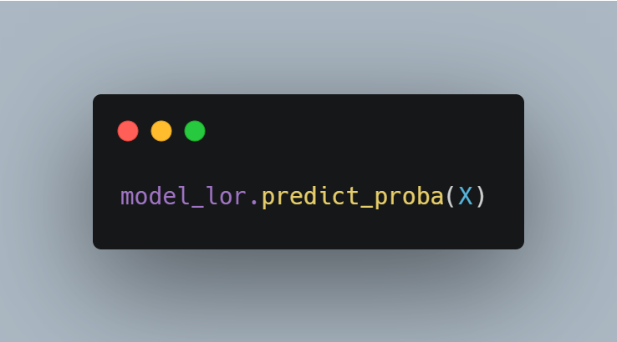
How to evaluate classification problems prediction probability
Calculate the probability of being classified as 0 and the probability of being classified as 1 respectively

Slide 15
How to evaluate classification problems
ROC curve and AUC
The ratio of FP is set to the horizontal axis and the ratio of TP is set to the vertical axis and displayed as a graph.
The change in the relationship between FP and TP can be seen graphically when the threshold is slightly lowered from 1 to be treated positive among the predicted probabilities.
If the area is up to 1 and the area under the curve is close to 1, the precision is high. On the other hand, around 0.5 is not well predicted.
The use of ROC is recommended when dealing with unbalanced data.

Slide 16
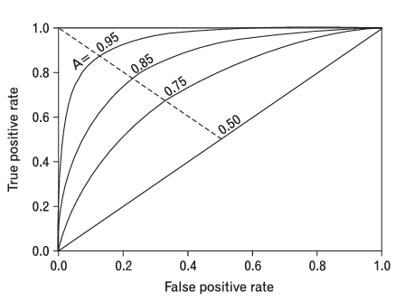
How to evaluate classification problems
ROC curve and AUC
$$FPR=\frac{FP}{FP+TN}$$
$$TPR=\frac{TP}{TP+FN}$$

Slide 17
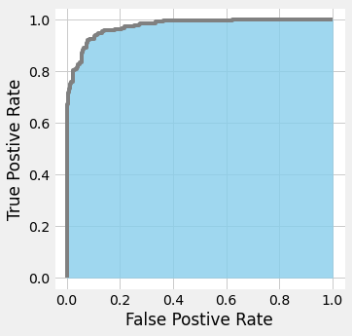
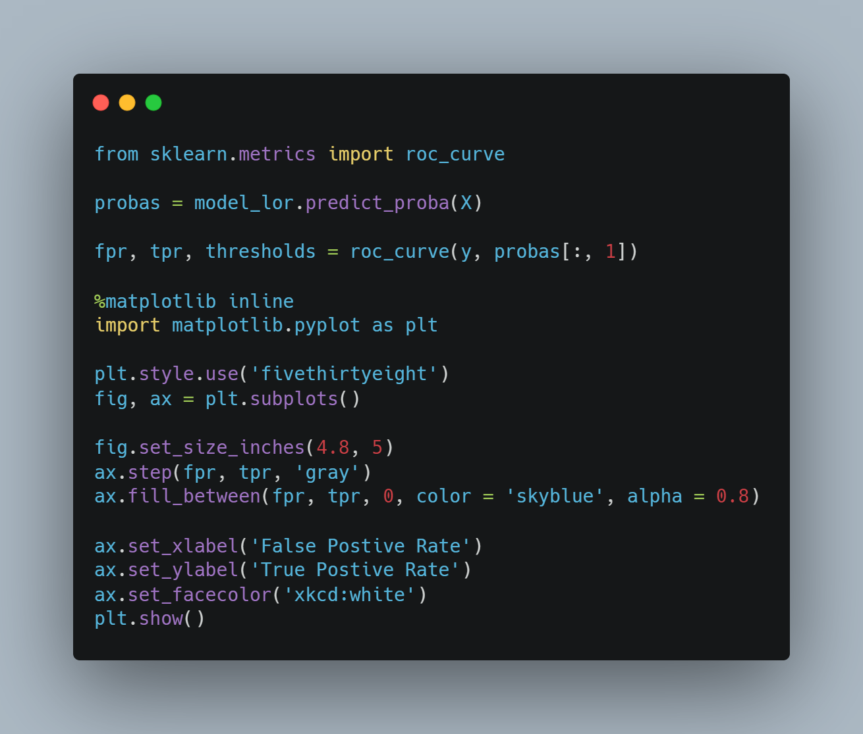
How to evaluate classification problems
ROC curve and AUC

Slide 18
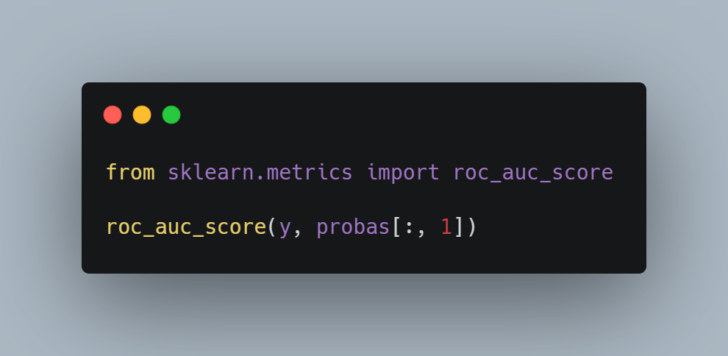
How to evaluate classification problems
ROC curve and AUC

Slide 19
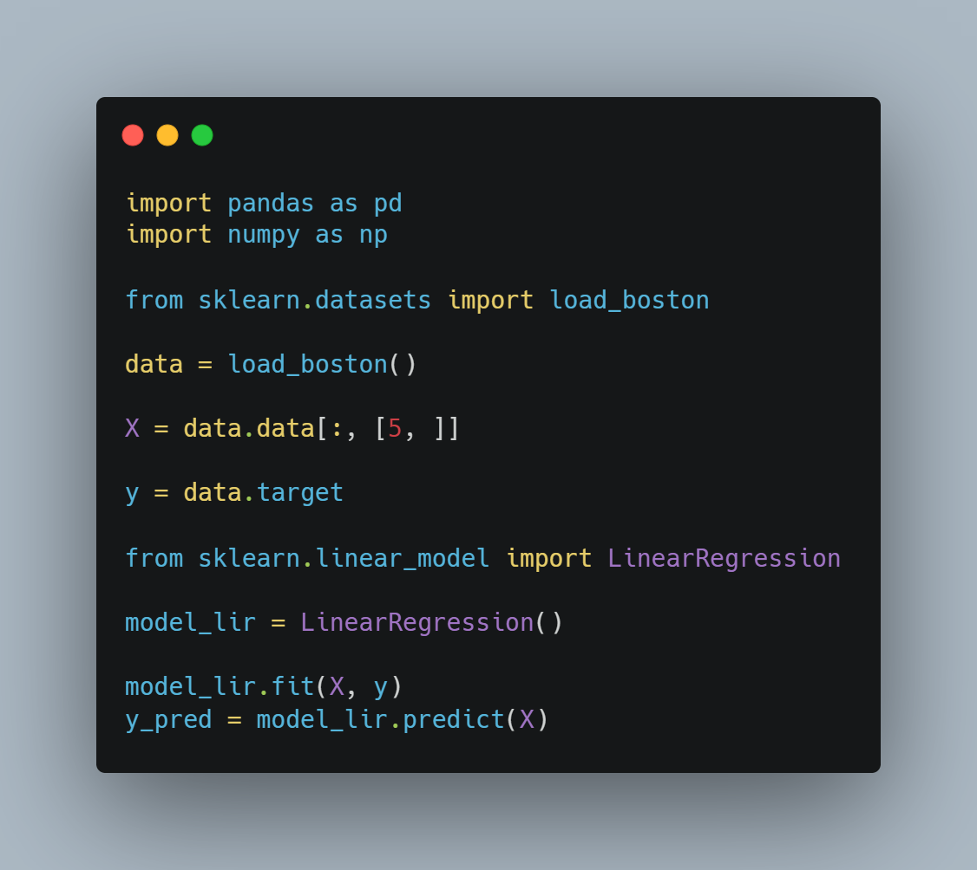
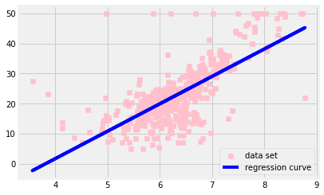
Evaluation method of Regression Problem

Slide 20
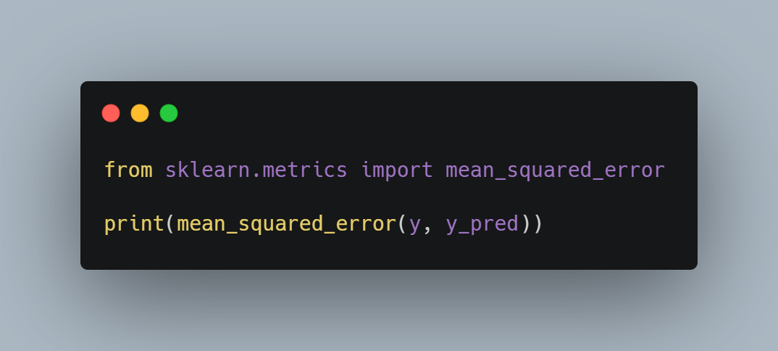
Evaluation method of Regression Problem mean square error
The mean square error is averaged after calculating both the square of error between the data to be evaluated and the predicted value.
The smaller the mean square error, the more correct the prediction is.

Slide 21

Evaluation method of Regression Problem coefficient of determination
It usually appears as a value between 0.0 and 1.0.
If the error between the predicted value and the actual data is too large, it may be expressed as a negative value.
The closer to 1.0, the more accurately the model represents the data point.

Slide 22
Compared to other algorithms difference between mean square error and coefficient of determination
If the variance of the dependent variable is large, the mean square error is also large.
The coefficient of determination may be expressed as a value between 0.0 and 1.0 without depending on the variance of the dependent variable.

Slide 23
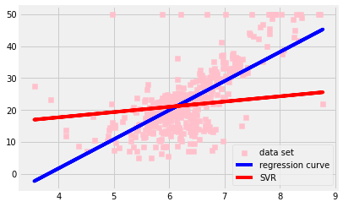
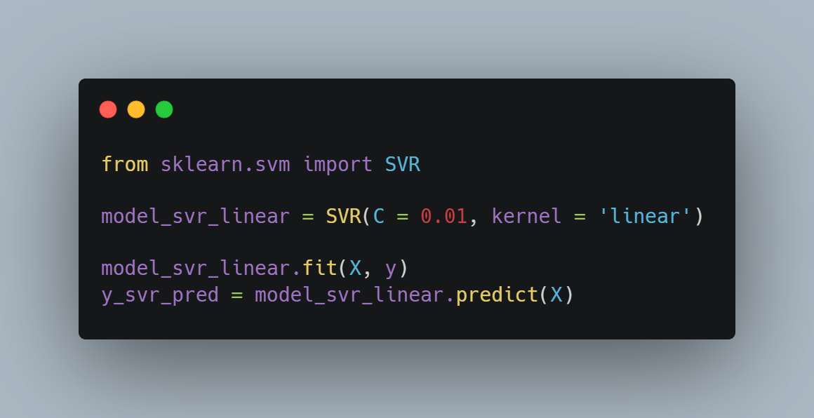
Compared to other algorithms difference with SVC and SVR
SVC shall contain as few data points as possible in margin.
SVR should contain as many data points as possible in margin.

Slide 24
Setting hyper parameter
The learning parameter is updated with the machine learning algorithm, but the hyperparameter must be set by the user before learning.
Failure to set appropriate hyperparameters results in poor model performance.

Slide 25
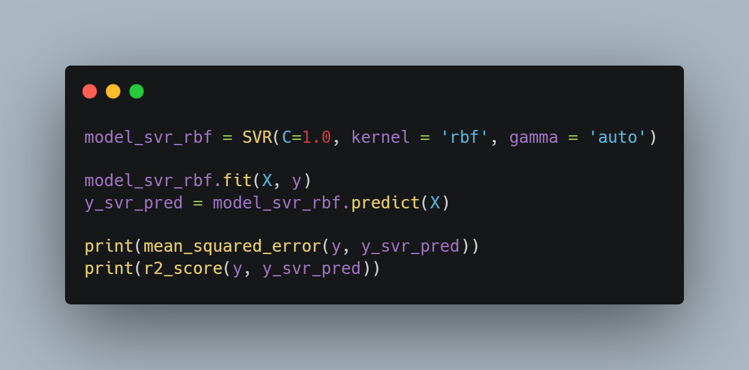
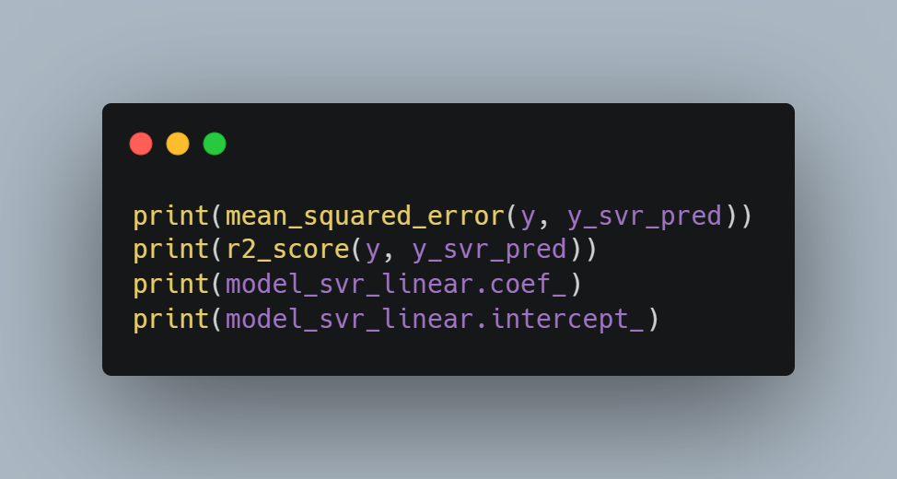


Setting hyper parameter

Slide 26
Over-fitting
The phenomenon in which good prediction results are shown as learning data, but bad prediction results are shown as test data that are not used for learning is called overfitting.
The model performance when using unknown data is called generalization performance.
Even if the mean square error is small when using the learning data, the generalization performance is low if it is an overfitting model.

Slide 27
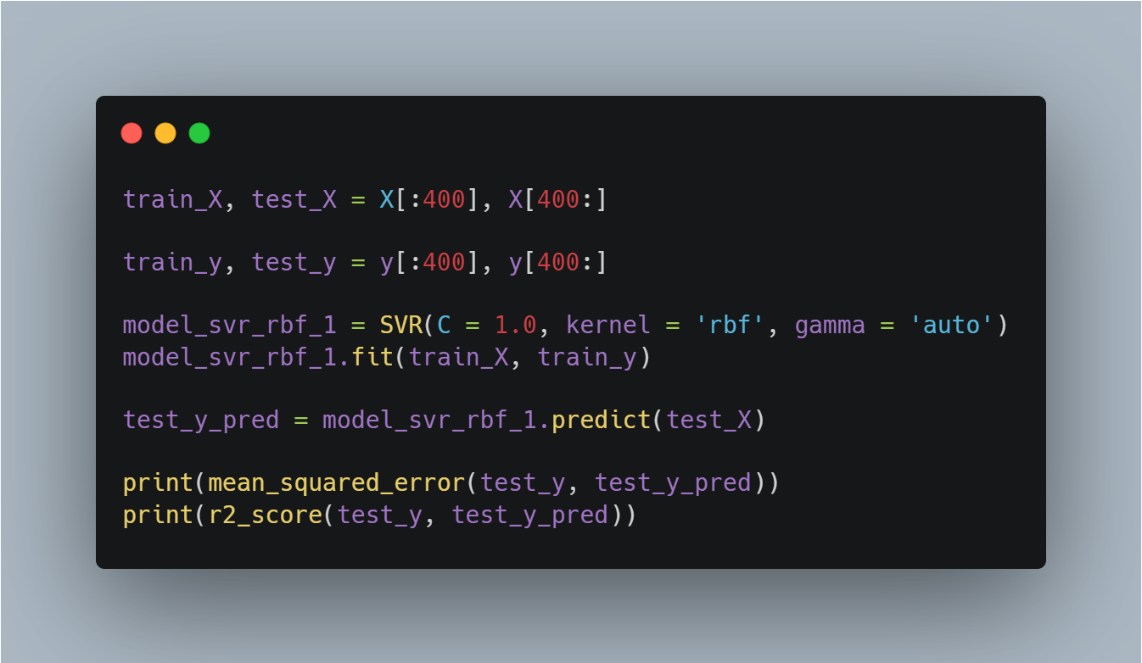

Over-fitting

Slide 28
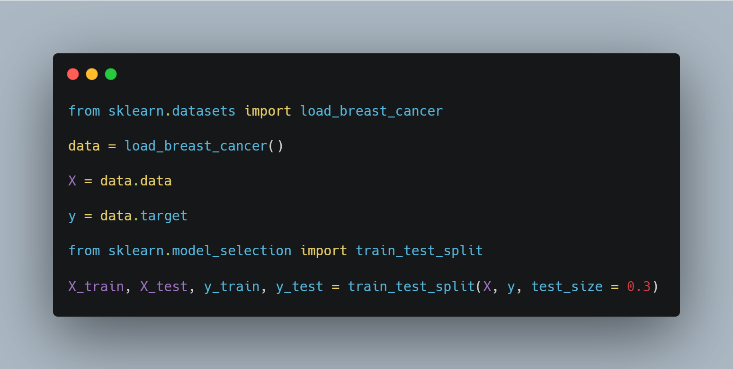
Ways to prevent over-fitting
1. split training data and test data

Slide 29
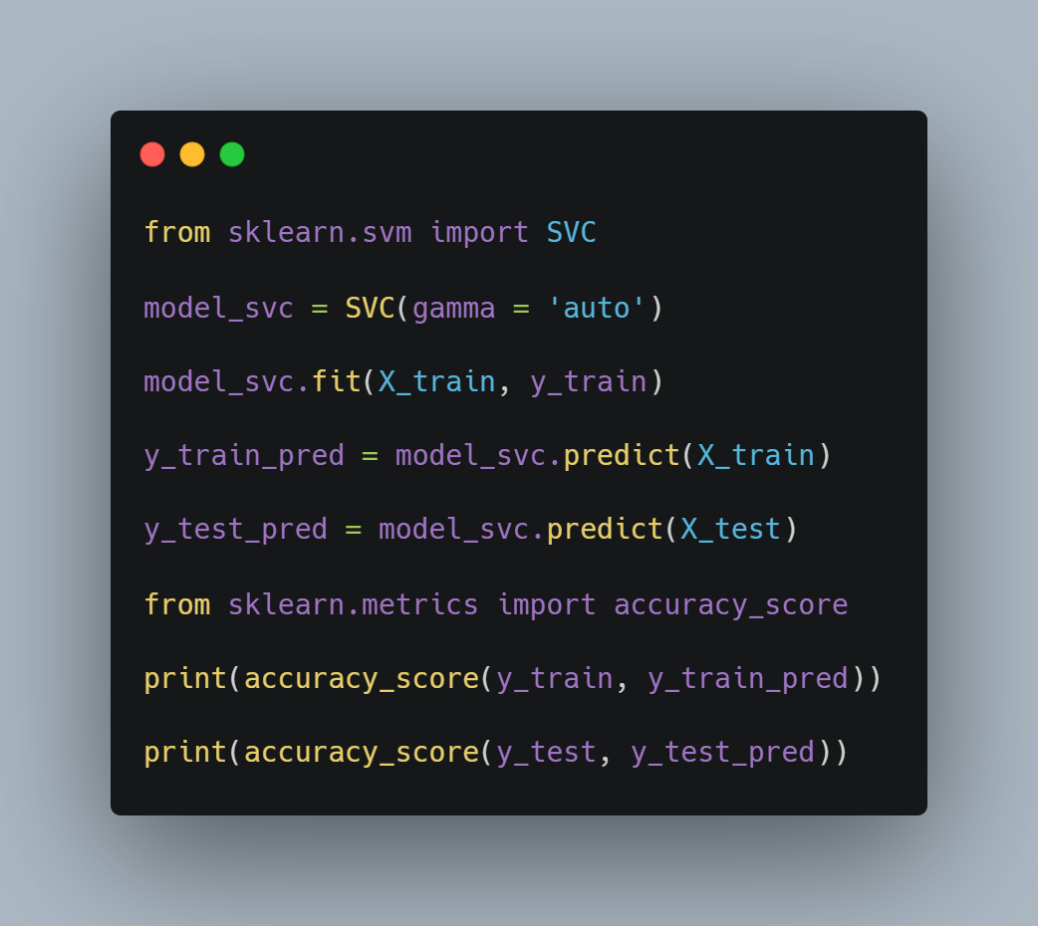
Ways to prevent over-fitting
Models that use learning data and test data to learn with SVR

Slide 30
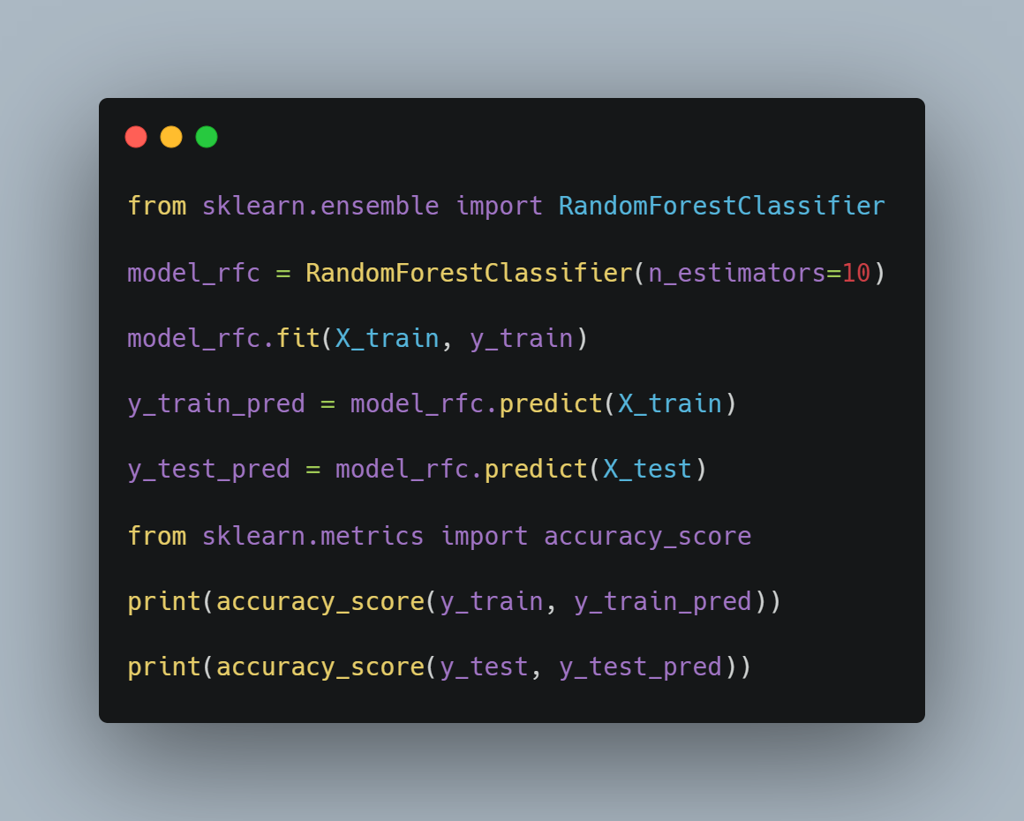
Ways to prevent over-fitting
Models that use learning data and test data to learn with RFC

Slide 31
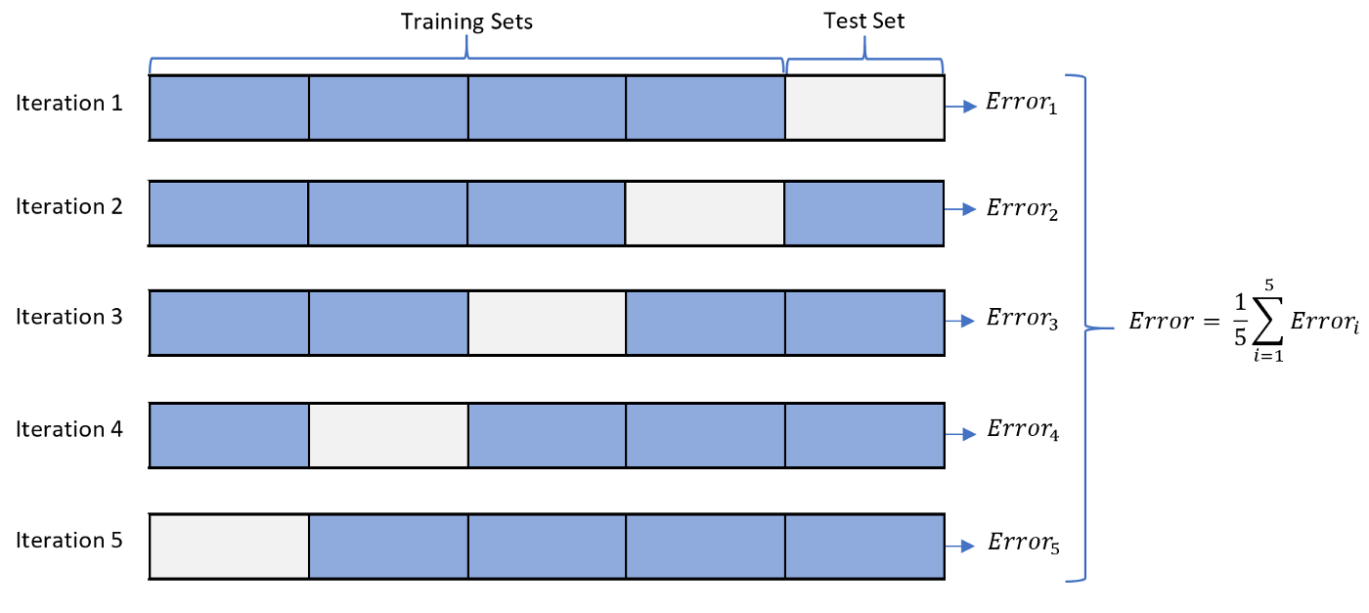
Ways to prevent over-fitting
Cross Validation

Slide 32
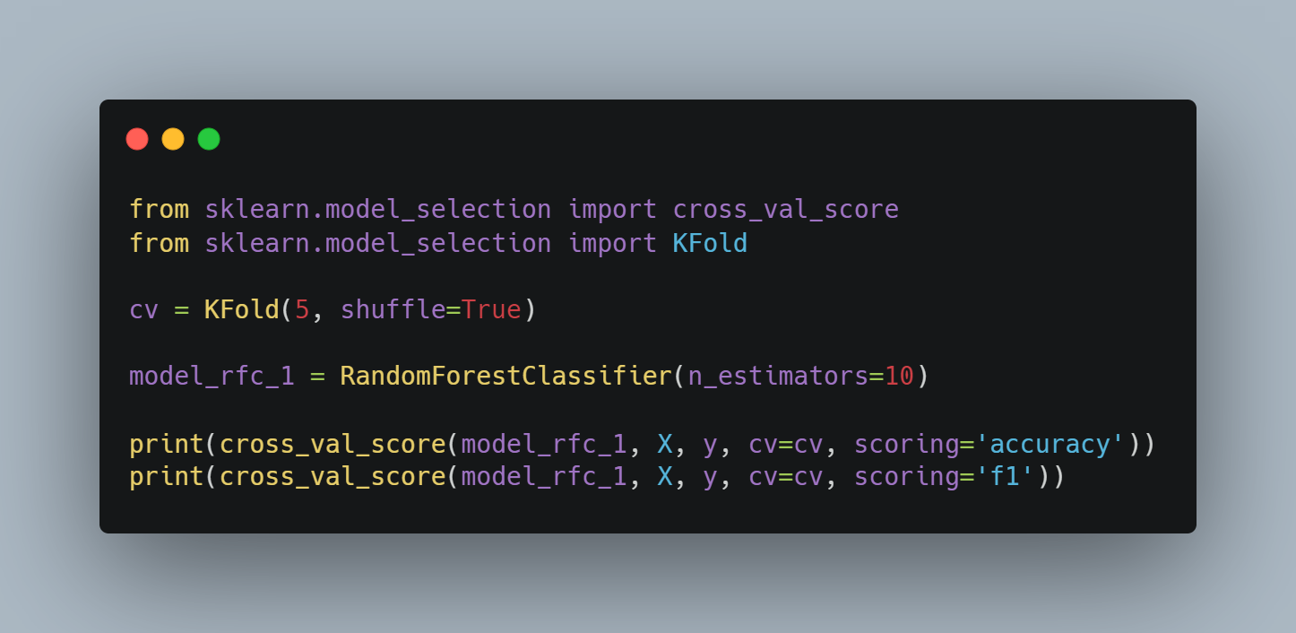

Ways to prevent over-fitting
Cross Validation

Slide 33
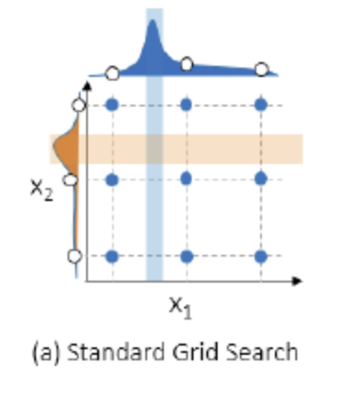
Searching hyper parameter greed search

Slide 34
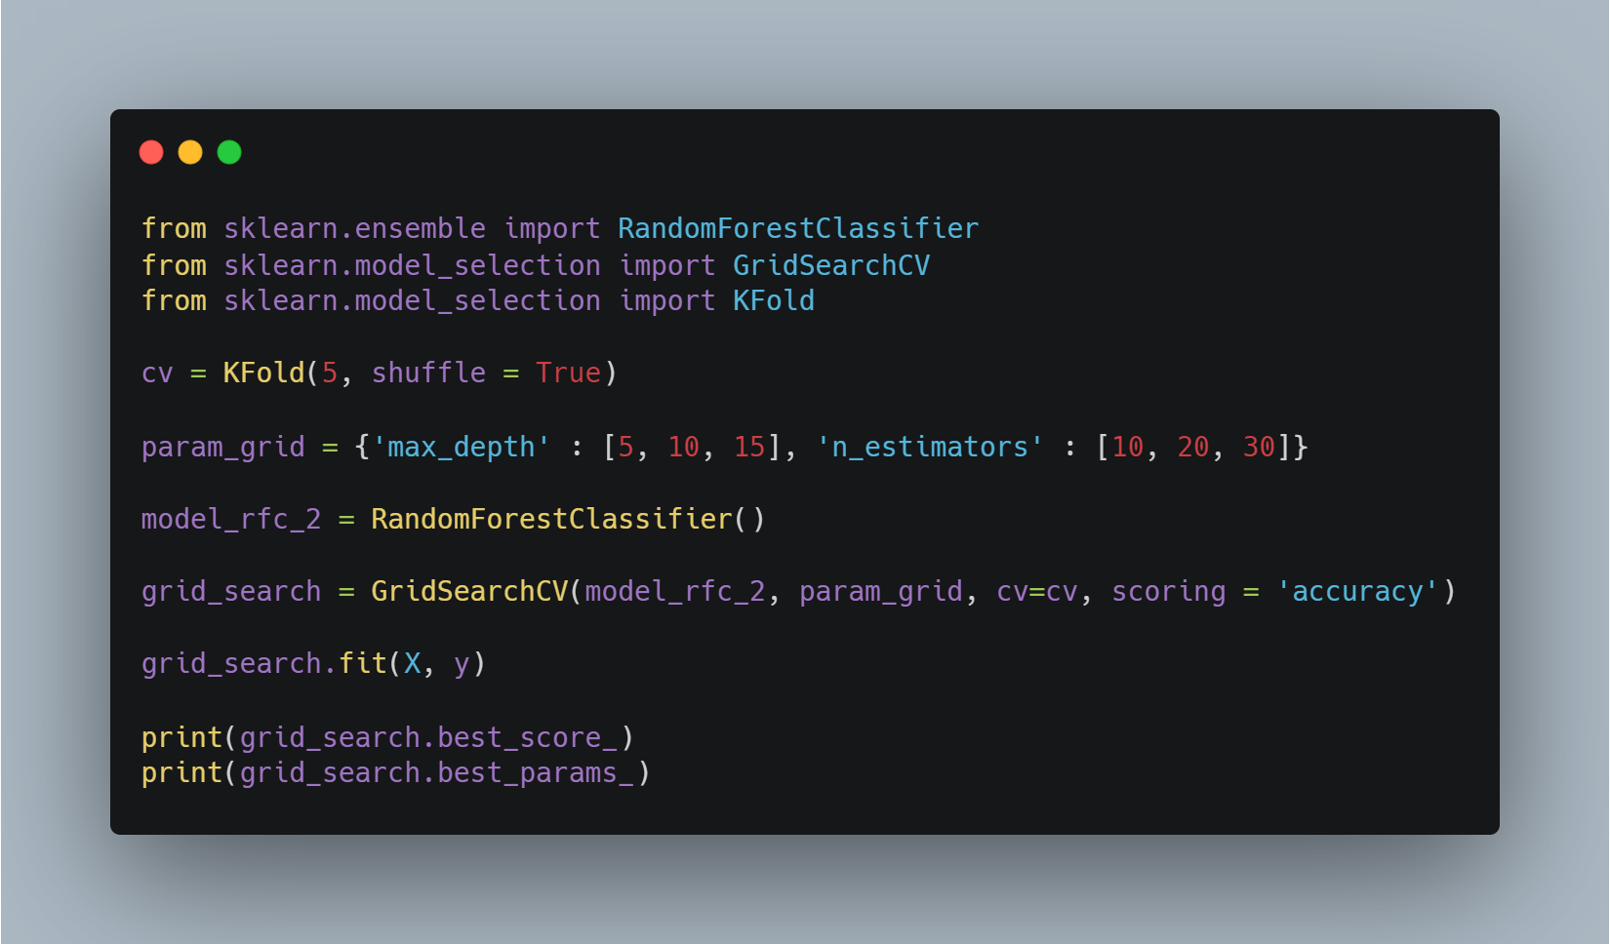

Searching hyper parameter greed search

Slide 35
Evaluation Method and
Data Preprocessing
Data Preprocessing
경희대학교 컴퓨터공학과
2019102191 신주영

Slide 36
TF-IDF
Term Frequency – Inverse Document Frequency
TF-IDF is a weight used in information retrieval and text mining, and is a statistical value indicating how important a word is within a particular document when there are multiple document groups.
TF (Term frequency) is a value that indicates how often a particular word appears within a document, and the higher this value, the more important it is in the document.
However, if the word itself is frequently used within the document group, this means that the word appears frequently. This is called DF (document frequency), and the inverse of this value is called IDF (inverse document frequency).

Slide 37
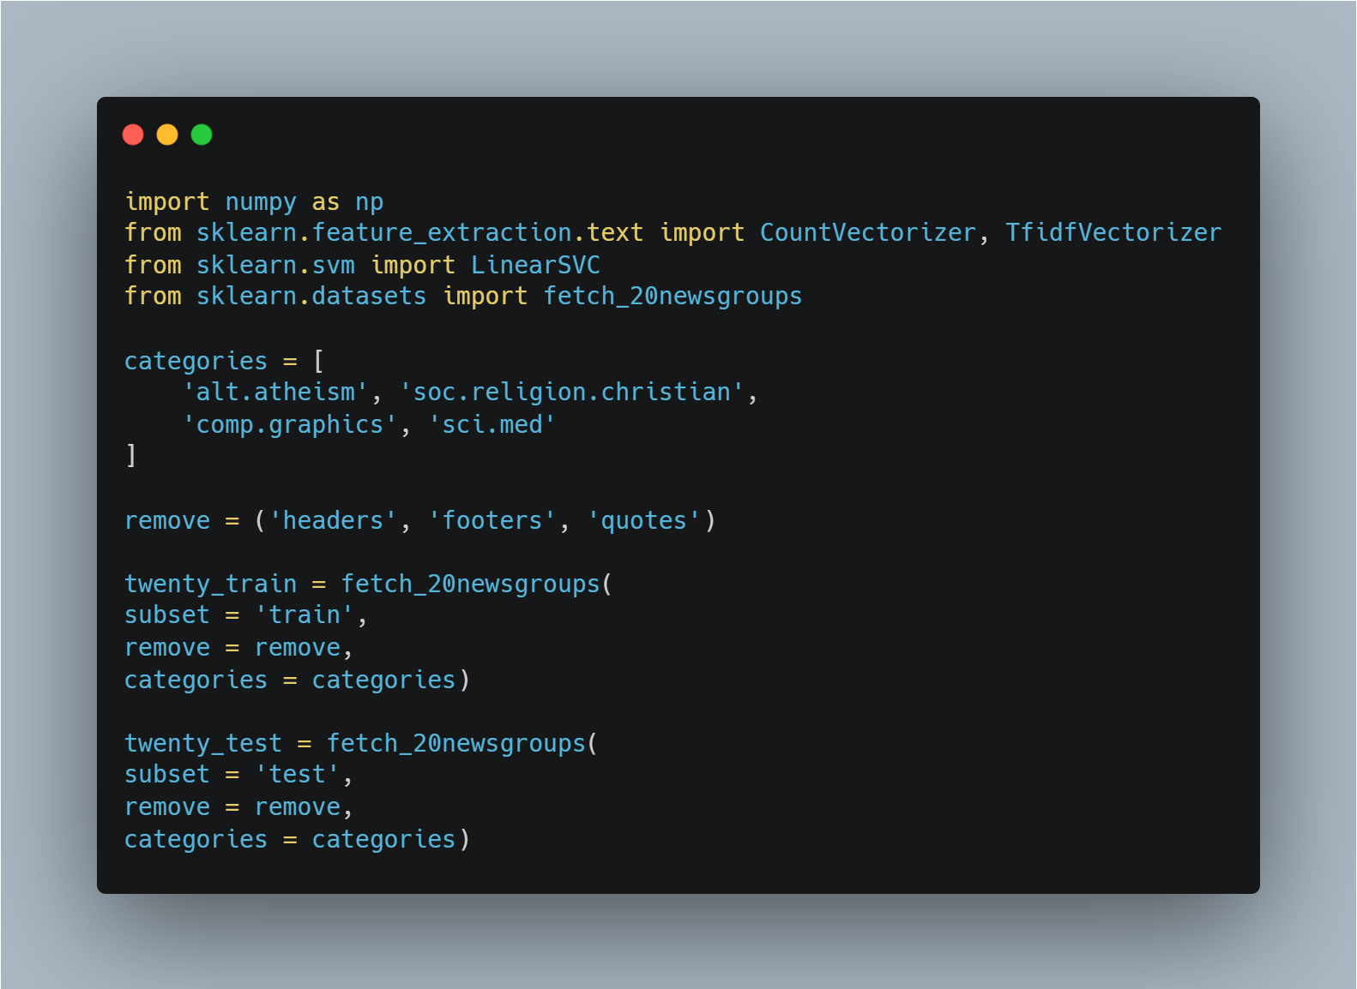
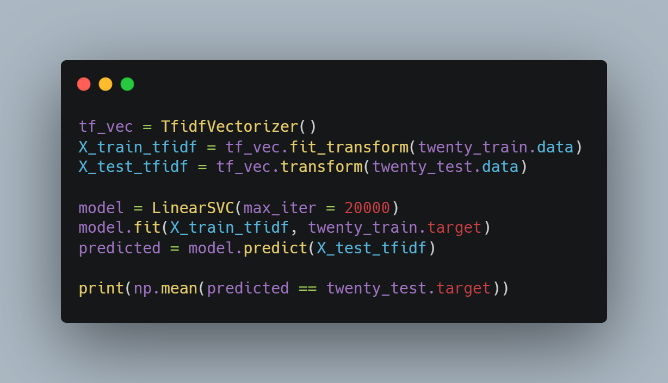
Sample Code

Slide 38
Evaluation Method and
Data Preprocessing
Data Preprocessing
경희대학교 컴퓨터공학과
2019102191 신주영

Slide 39
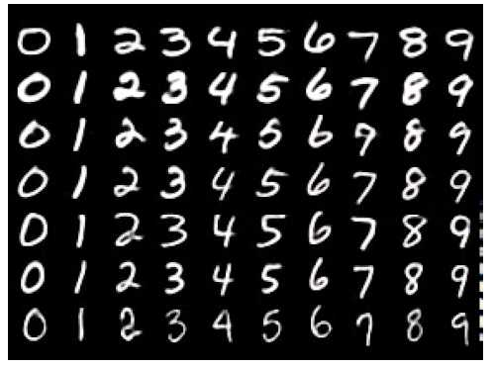
Converting Image Data
MNIST
The brightness value of the image data pixel of each number is converted into vector data and used.

Slide 40
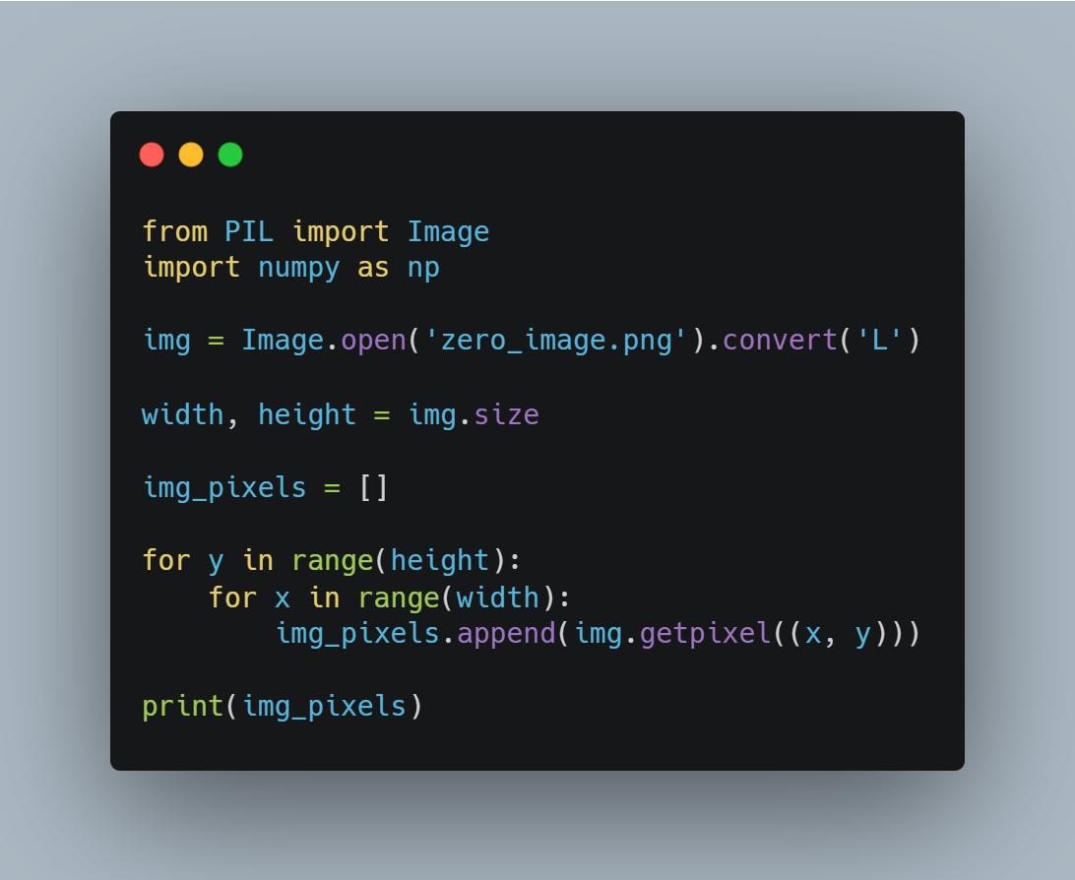
Sample Code

Slide 41
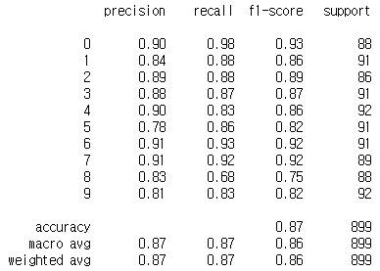
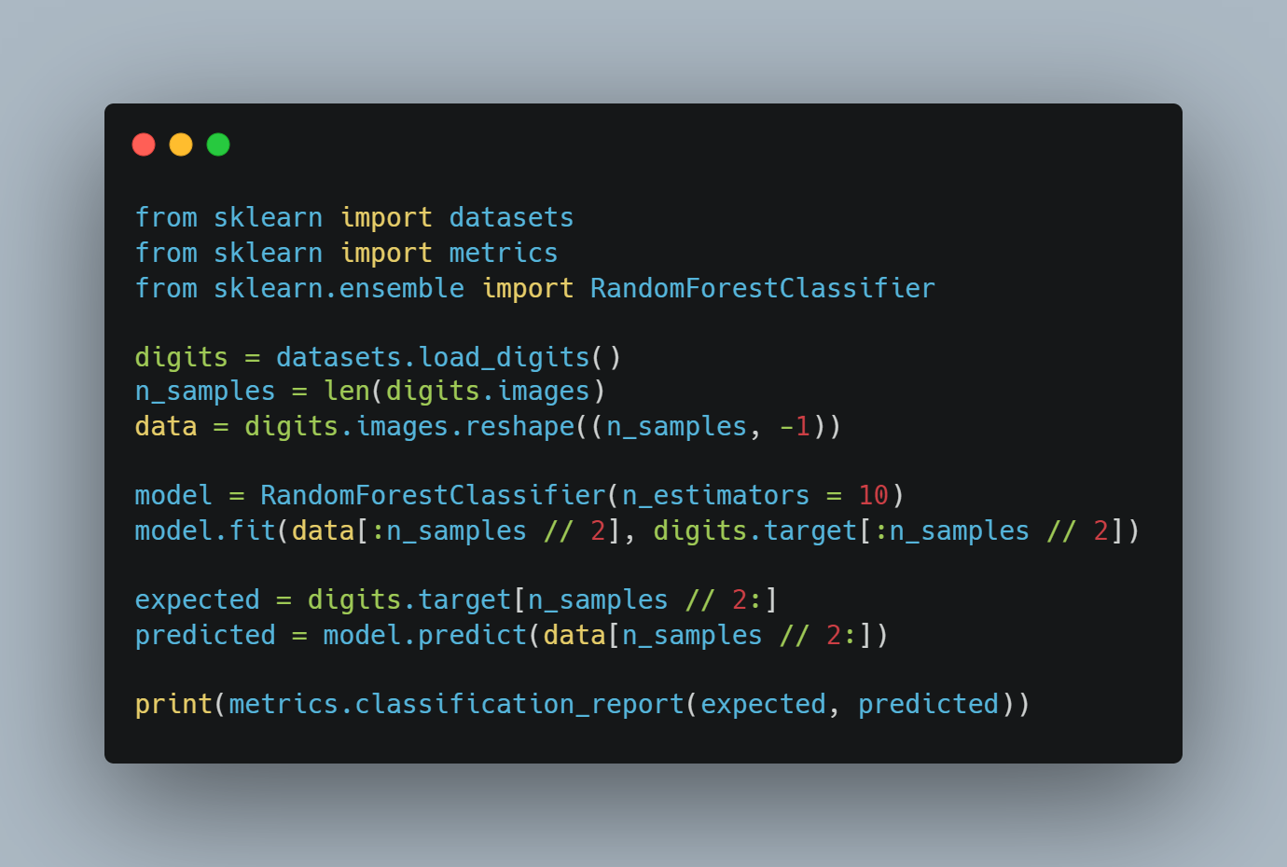
Sample Code

