Slide 1

Supervised Learning
Random Forest

Slide 2
Fundamental Concept
Random forest is a method of combining various models to create a high-performance model.
It can be used for both regression and classification problems.
Similar algorithms include gradient boosting.
Random forest uses multiple models called decision trees to increase accuracy than using a single decision tree.
Random forest is used for both classification and regression problems, but this section exemplifies the classification problem.

Slide 3
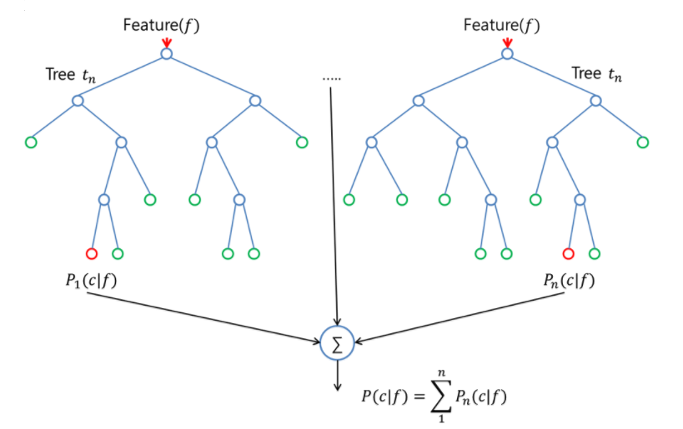
Fundamental Concept
The most predictive results are obtained as the final classification result by collecting the predictive results from each decision tree.
Random forest should be different for each decision tree.

Slide 4
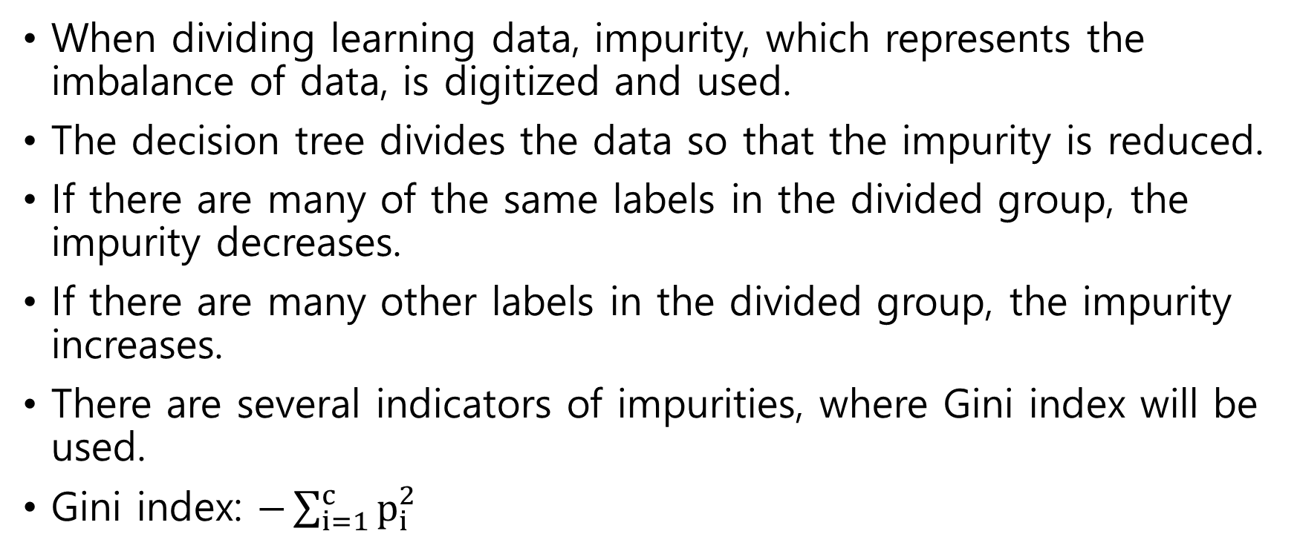
Algorithm
Decision Tree
When dividing learning data, impurity, which represents the imbalance of data, is digitized and used.
The decision tree divides the data so that the impurity is reduced.
If there are many of the same labels in the divided group, the impurity decreases.
If there are many other labels in the divided group, the impurity increases.
There are several indicators of impurities, where Gini index will be used.
Gini index: $−\sum_{i=1}^{c}{p_{i}^{2}}$

Slide 5
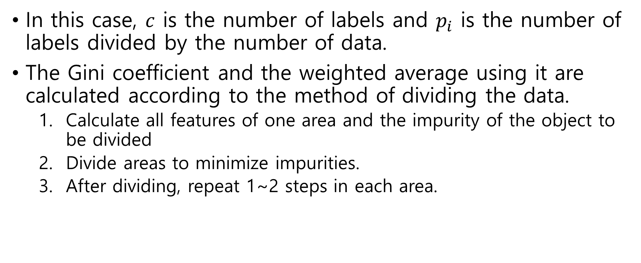
Algorithm
Decision Tree
In this case, $c$ is the number of labels and $p_{i}$ is the number of labels divided by the number of data.
The Gini coefficient and the weighted average using it are calculated according to the method of dividing the data.
  Calculate all features of one area and the impurity of the object to be divided
  Divide areas to minimize impurities.
  After dividing, repeat 1~2 steps in each area.

Slide 6
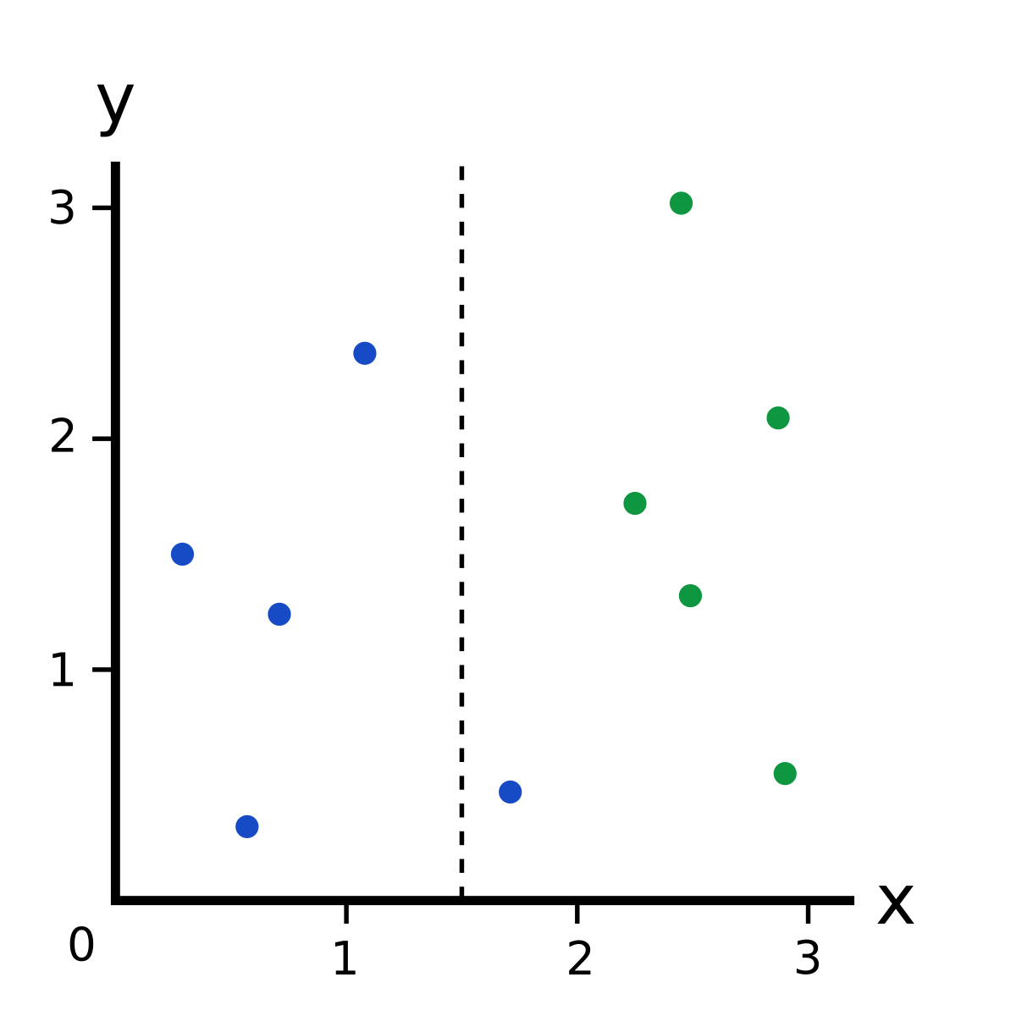
Algorithm
Decision Tree

Slide 7
Algorithm random forest
Bootstrap: A method of "increasing" learning data by performing random recovery extractions from learning data several times. In one learning data, several learning data with different contents are generated and the learning data placed in each decision tree is different.
Certain optional choices: Choose and use only a few features randomly when learning the decision tree with bootstrap learning data.
Random forest learns to have different classification results using the above method.

Slide 8
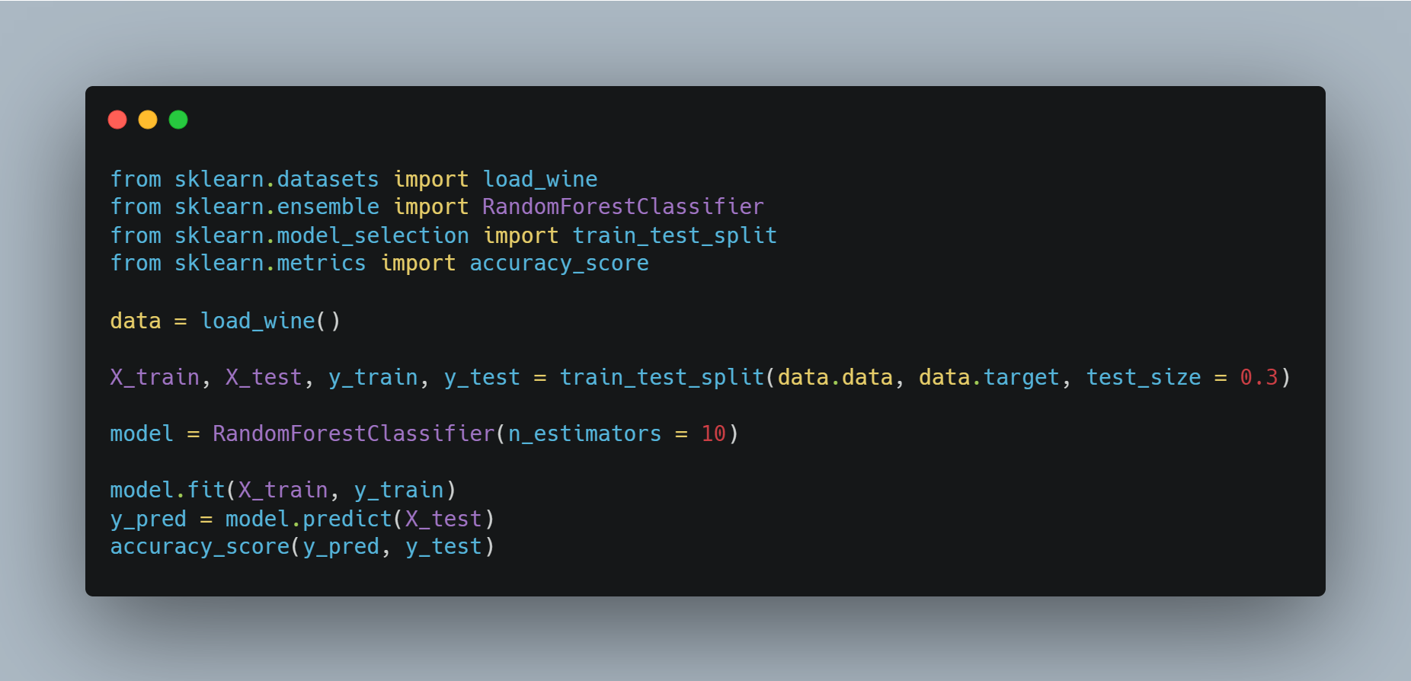
Sample Code
Import libraries
Make dataset
Set train and test datas
Make Random Forest model
Train data into model
Calculate accuracy

Slide 9
Importance of feature
Feature of high importance are expected to significantly reduce impurities by using them as criteria for dividing areas.
The feature of low importance is that it is difficult to reduce impurities even when used as a criterion for dividing areas.
In this way, attention should be paid to the importance of features and unnecessary features should be reduced.

