Slide 1





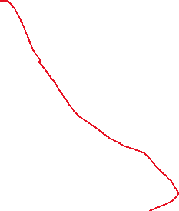





Fact Table
Fact_sales Fact_budget Fact_forecast Fact_inventory Fact_production Fact_shipment Fact_returns
Dim_date Dim_product Dim_customer Dim_region Dim_salesperson Dim_warehouse Dim_plant Dim_transport
Dimension Table
InvoiceNo
DateKey
ProductKey
CustomerKey
SalespersonKey
Quantity
SalesAmount
CostAmount
DiscountPct
Year
MonthNo
Region
BudgetSales
BudgetProfit
Year
MonthNo
ProductKey
Region
ForecastQty
DateKey
ProductKey
WarehouseKey
OpeningStock
ClosingStock
ReceivedQty
IssuedQty
DateKey
PlantKey
ProductKey
PlannedQty
ActualQty
DowntimeHours
RejectedQty
ShipmentID
ShipmentDateKey
DeliveryDateKey
CustomerKey
ProductKey
TransportKey
FreightCost
OnTimeFlag
ReturnID
DateKey
CustomerKey
ProductKey
ReturnQty
ReturnReason
DateKey
Date
Year
Quarter
MonthNo
MonthName
WeekNo
DayName
IsWeekend
ProductKey
ProductName
Brand
Category
SubCategory
SKU
UnitPrice
CostPrice
CustomerKey
CustomerName
Segment
City
Region
Channel
RegionKey
Region
SalesManager
SalespersonKey
SalespersonName
Region
ExperienceYears
WarehouseKey
WarehouseName
Capacity
PlantKey
PlantName
Location
TransportKey
TransportVendor
TransportType

