Slide 1
Welcome to Week-3
Advanced Programming in Python
By Engr. Imran Khan
Instructor

Slide 2
Previous Week
Python Basic and Some Problems
Functions (built-in functions/ create functions)
Loops
Decisions

Slide 3
Motivational Lecture
https://www.youtube.com/watch?v=PUaCQUal7rM&t=17s
https://www.youtube.com/watch?v=RszqwFyav34
Notes:
- showcase power of Python
- you're not expected to understand all of it

Slide 4

Introduction to
Notes:
Had a nice break and enjoyed yourselves so far.
moving to more complicated datatypes and concepts in programming.
Let us begin with higher level structures/containers
CC-BY Digital Skills Team at the University of Edinburgh www.ed.ac.uk/is/skills

Slide 5
This Week
Python Dates and Times
Motivational Lecture
List, Tuples, Sets and Dictionaries
Why Communication Skills
Reading and Writing CSV
Lambda and List Comprehensions
Advance Python Objects, map()
Numerical Python Library (Numpy)
Data Science
The series Data Structure and Querying a Series
The Data Frame Data Structure
Data Frame Indexing and Loading
Querying a Data Frame
Indexing Data frames
Missing Values
Success story

Slide 6
Why Communication Skills are Important?
Notes:
- showcase power of Python
- you're not expected to understand all of it

Slide 7
How to improve your Communication Skills?
Notes:
- showcase power of Python
- you're not expected to understand all of it

Slide 8
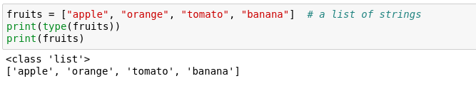
Lists
One of the most useful concepts
Group multiple variables together (a kind of container!)

Slide 9


Indexing a list
Indexing – accessing items within a data structure
Indexing a list is not very intuitive...
The first element of a list has an index 0
Notes:
How to access?
called indexing - not very intuitive.
get a particular item using square brackets

Slide 10
Quick quiz
What will fruits[3] return?

Slide 11
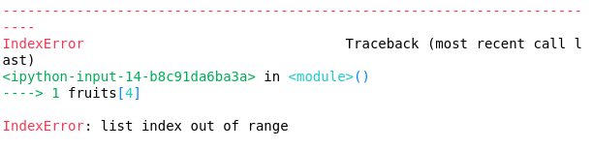
Quick quiz
What will this return?

Slide 12

Data structure sizes
Make sure you are always aware of the sizes of each variable!
This can easily be done using the len() function.
It returns the length/size of any data structure

Slide 13

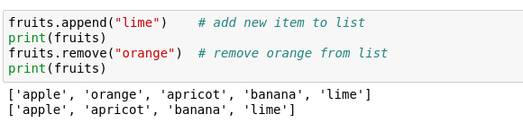
Is a tomato really a fruit?
Furthermore, we can modify lists in various ways
Notes:
serious questions! Is a tomato really a fruit?
Change it
Index item and change its values
we can also add/remove
Done using methods

Slide 14
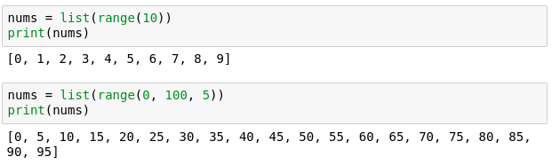
Lists with integers
range() - a function that generates a sequence of numbers as a list
Notes:
something more useful
Can we generate a list of numbers easily?
Yes, using the built in func. Range()
This is useful for generating plots for example.
Let us look at how we can make something with it

Slide 15
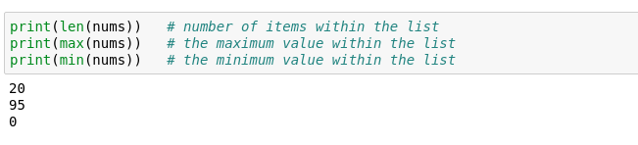
Lists – helpful functions
Makes them extremely useful and versatile
Notes:
Lists can also be put in other functions which might prove helpful.
*Give examples of the 3 methods*

Slide 16

Lists can be of different types
Not very useful, but possible

Slide 17
Mutability
Mutable object – can be changed after creation.
Immutable object - can NOT be changed after creation.

Slide 18
Quick quiz
Are lists mutable?

Slide 19
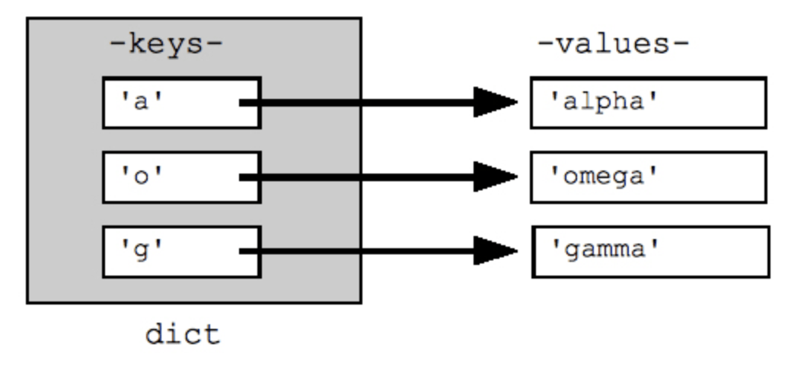
Dictionaries
Similar to actual dictionaries
They are effectively 2 lists combined – keys and values
We use the keys to access the values instead of indexing them like a list
Each value is mapped to a unique key
Notes:
similar to actual dictionaries.
effectively 2 lists combined - keys and values
Example - days of the week in Gaelic mapped to their English translations

Slide 20

Dictionary definition
Defined as comma separated key : value pairs:
Comma separated
Curly brackets
Notes:
Note curly brackets and colons

Slide 21
Dictionary properties
Values are mapped to a key
Values are accessed by their key
Key are unique and are immutable
Values cannot exist without a key

Slide 22
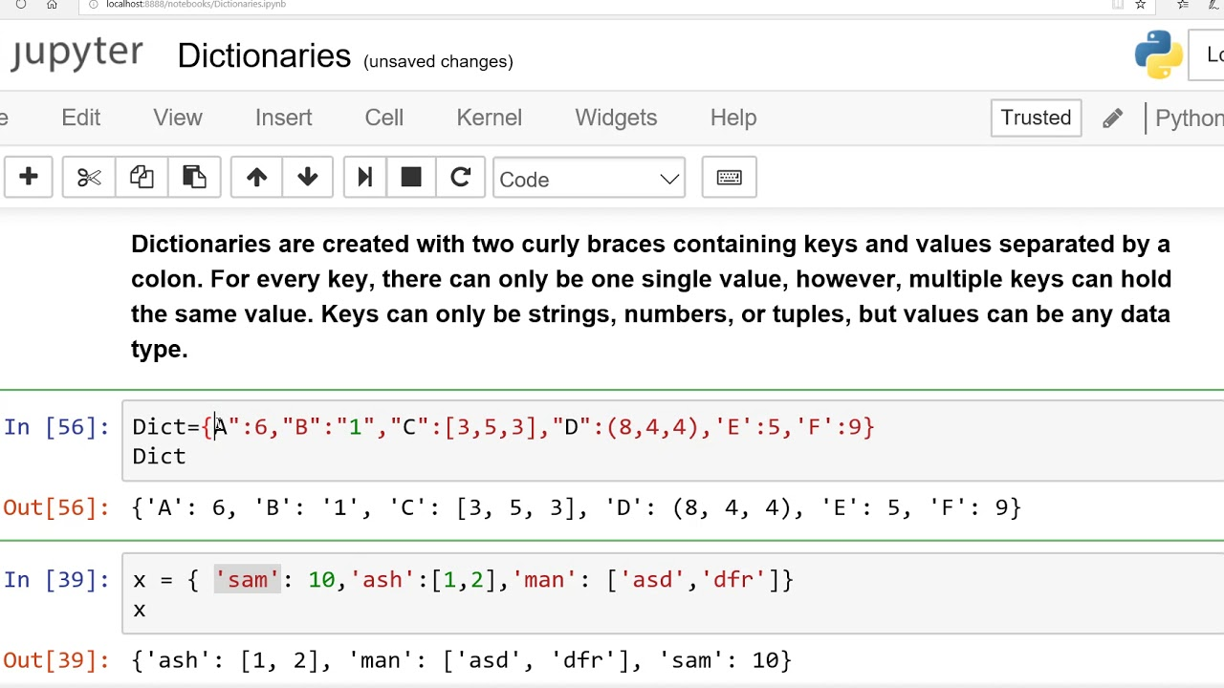
Dictionaries
Let us define the one from the previous image

Slide 23

Accessing a dictionary
Values are accessed by their keys (just like a dictionary)
Note that they can't be indexed like a list
Notes:
Give example of how you access a dictionary in real life.
Say we want to look up the Gaelic translation of Friday?

Slide 24
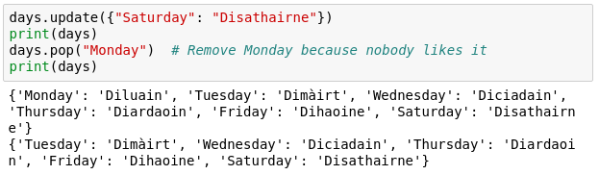
Altering a dictionary
Can be done via the dictionary methods
Notes:
Note that they are not the same as for lists for obvious reasons
We are not going to go over all methods for dicts
You can find them using the dir('dict')
Or simply by googling afterwards

Slide 25
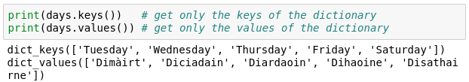
Keys and Values
It is possible to obtain only the keys or values of a dictionary.
This is useful for iteration.

Slide 26
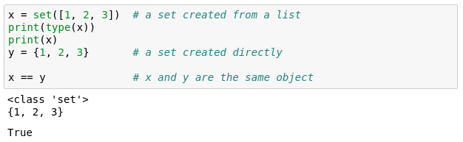
Sets
Effectively lists that can't contain duplicate items
Similar functionality to lists
Can't be indexed or sliced
Can be created with {} or you can convert a list to a set
Notes:
Essentially a list of unique items

Slide 27
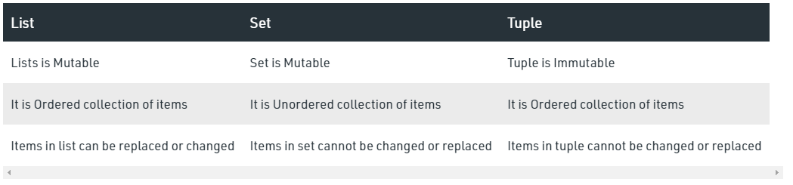
Notes:
Essentially a list of unique items

Slide 28
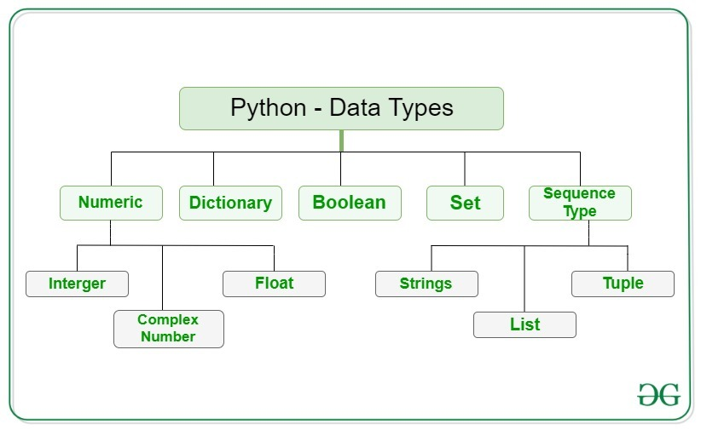
Notes:
You seen the # symbols in the slides.
I forget what I write; need to remind my future self
Programmers though it's better to write explanation in between the code
Show example

Slide 29
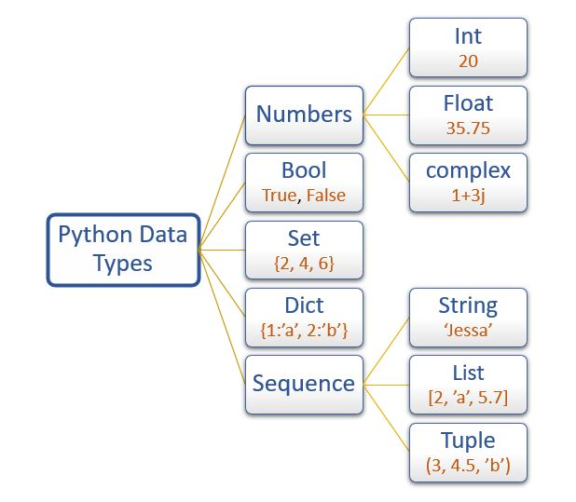
Notes:
You seen the # symbols in the slides.
I forget what I write; need to remind my future self
Programmers though it's better to write explanation in between the code
Show example

Slide 30
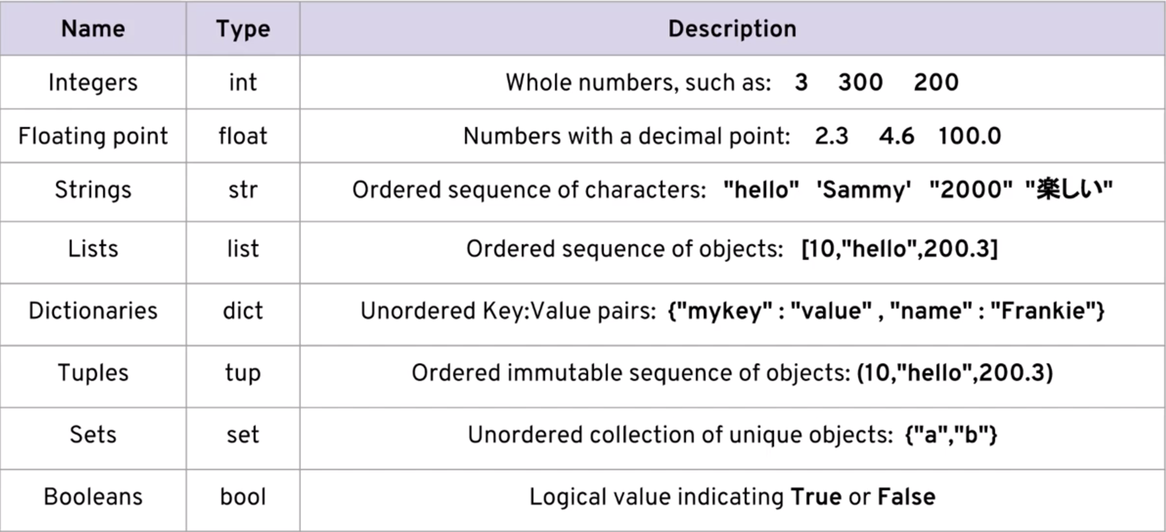
Notes:
You seen the # symbols in the slides.
I forget what I write; need to remind my future self
Programmers though it's better to write explanation in between the code
Show example

