Slide 1
Welcome to Week-2
Advanced Programming in Python
By Engr. Imran Khan
Instructor

Slide 2
Yesterday
Workplace/Institute Ethics
Printing
Reserved Words:
Commenting
Decisions ( if, else elseif)
Loops ( for and while)

Slide 3
Motivational Lecture
https://www.youtube.com/watch?v=u0BnobWU6CI
Notes:
- showcase power of Python
- you're not expected to understand all of it

Slide 4

Introduction to
Notes:
Had a nice break and enjoyed yourselves so far.
moving to more complicated datatypes and concepts in programming.
Let us begin with higher level structures/containers
CC-BY Digital Skills Team at the University of Edinburgh www.ed.ac.uk/is/skills

Slide 5
Today
Switch statement
Break and continue
Functions
Communications skills
Presentations

Slide 6
Break statement
Allows us to go(break) out of a loop preliminary.
Adds a bit of controllability to a while loop.
Usually used with an if.
Can also be used in a for loop.
Notes:
We can also get out of a while whenever we want with break.
Usually used with an if statement
Redo last example
Can also be used in for loops

Slide 7
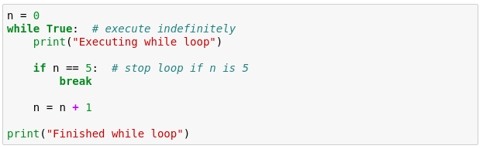
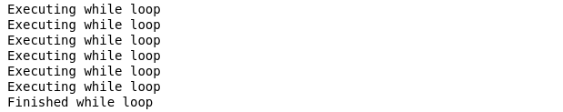
Quick quiz
How many times are we going to execute the while loop?

Slide 8
Continue statement
Allows us to skip the iteration in a loop.
It will automatically go to the next iteration.
Usually used with an for and while loop.
Notes:
We can also get out of a while whenever we want with break.
Usually used with an if statement
Redo last example
Can also be used in for loops

Slide 9
Quick quiz
How many times are we going to execute the while loop?
for i in range(1, 50):
if i%2==0:
continue
else:
print(i)

Slide 10
Why Communication Skills are Important?
Notes:
- showcase power of Python
- you're not expected to understand all of it

Slide 11
How to improve your Communication Skills?
Notes:
- showcase power of Python
- you're not expected to understand all of it

Slide 12
Functions
Allow us to package functionality in a nice and readable way
reuse it without writing it again
Make code modular and readable
Rule of thumb - if you are planning on using very similar code more than once, it may be worthwhile writing it as a reusable function.
Notes:
Print() is actually a function that we have been using

Slide 13
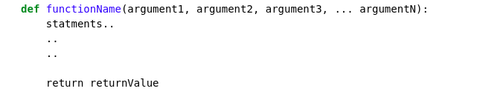
Function declaration
keyword
Any number of arguments
[Optional] Exits the function and returns some value
Functions accept arguments and execute a piece of code
Often they also return values (the result of their code)
Notes:
Go through the declaration

Slide 14
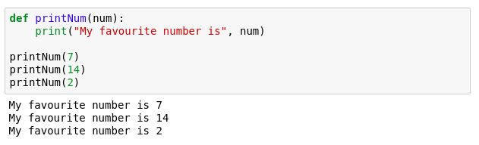
Function example
Notes:
Quick print statement

Slide 15
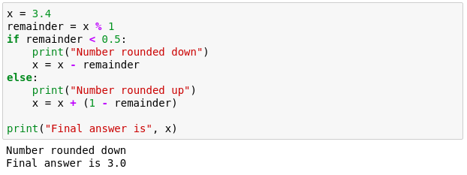
Function example 2
We want to make a program that rounds numbers up or down.
Try to pack the following into a function.
Notes:
more complex problem - rounding a number.
nice an desirable functionality
How can we bundle it and reuse it?

Slide 16
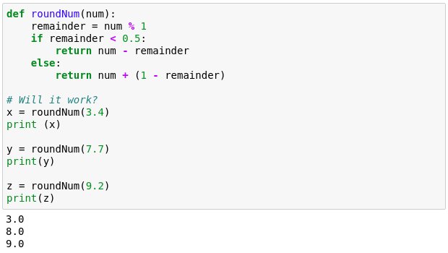
Function example 2
Notes:
Multiline indentation

Slide 17
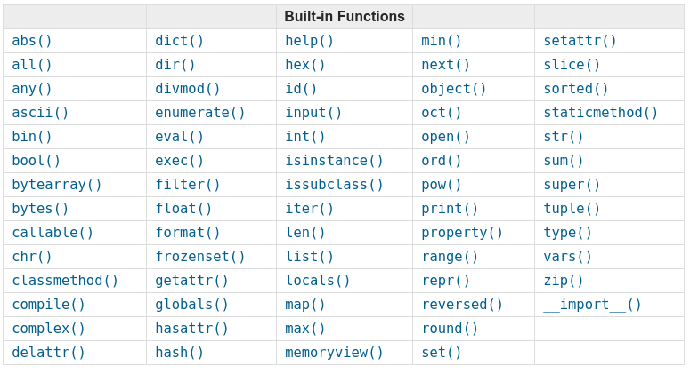
Python built-in functions
To find out how they work: https://docs.python.org/3.3/library/functions.html
Notes:
Every python3 version has these built in functions that you can use however you wish

Slide 18
I HOPE YOU LEARN A LOT & ENJOY THE TRAINING! THANK YOU ☺

