Slide 1
Welcome to Week-2
Advanced Programming in Python
By Engr. Imran Khan
Instructor

Slide 2
Yesterday
Functions and Tasks

Slide 3
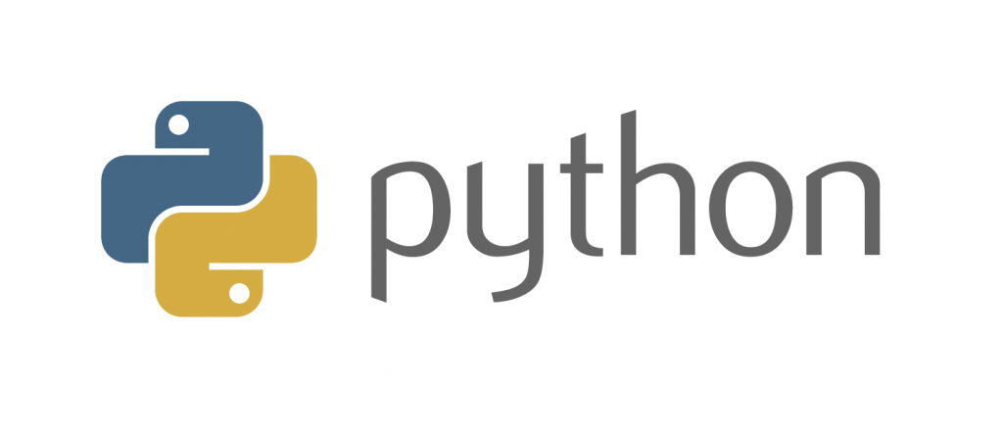
Advanced Programming in
Notes:
Had a nice break and enjoyed yourselves so far.
moving to more complicated datatypes and concepts in programming.
Let us begin with higher level structures/containers
CC-BY Digital Skills Team at the University of Edinburgh www.ed.ac.uk/is/skills

Slide 4
Today
Functions Examples
Practical Tasks
Python Dates and Times
Lists

Slide 5
Functions
Allow us to package functionality in a nice and readable way
reuse it without writing it again
Make code modular and readable
Rule of thumb - if you are planning on using very similar code more than once, it may be worthwhile writing it as a reusable function.
Notes:
Print() is actually a function that we have been using

Slide 6
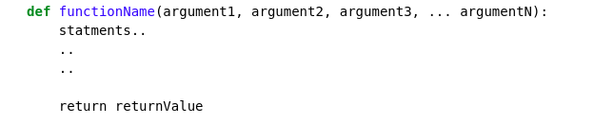
Function declaration
keyword
Any number of arguments
[Optional] Exits the function and returns some value
Functions accept arguments and execute a piece of code
Often they also return values (the result of their code)
Notes:
Go through the declaration

Slide 7
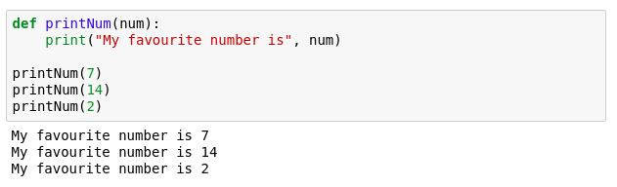
Function example
Notes:
Quick print statement

Slide 8
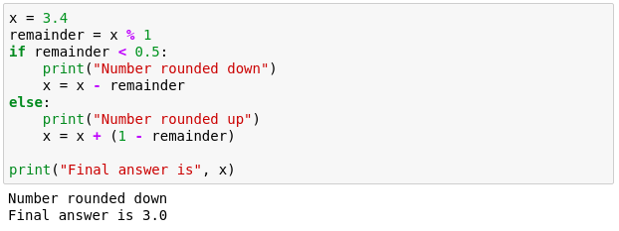
Function example 2
We want to make a program that rounds numbers up or down.
Try to pack the following into a function.
Notes:
more complex problem - rounding a number.
nice an desirable functionality
How can we bundle it and reuse it?

Slide 9
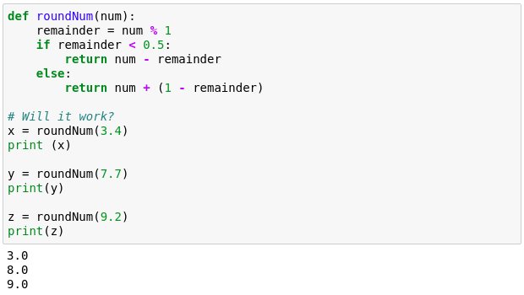
Function example 2
Notes:
Multiline indentation

Slide 10
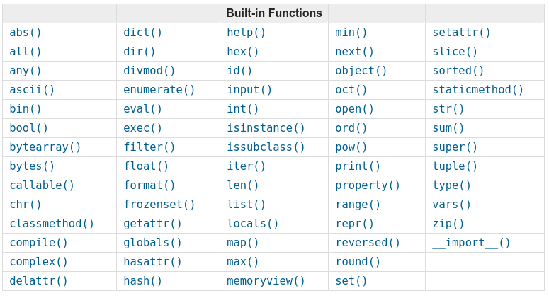
Python built-in functions
To find out how they work: https://docs.python.org/3.3/library/functions.html
Notes:
Every python3 version has these built in functions that you can use however you wish

Slide 11
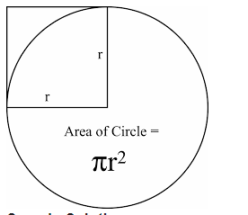
Tasks
Create a function which takes two variables initially, multiplies, add, and divides it.
Write a Python program which accepts the radius of a circle from the user and compute the area.
Notes:
Print() is actually a function that we have been using

Slide 12
Tasks
Write a function that will find Fibonacci Series upto certain number
The Fibonnaci seqence is a sequence of numbers where the next number in the sequence is the sum of the previous two numbers in the sequence. The sequence looks like this: 1, 1, 2, 3, 5, 8, 13, …
Notes:
Print() is actually a function that we have been using

Slide 13
Python DatesTime
Date is not a data type.
We need to import module named
You can use it by writing “import datetime”
x = datetime.datetime.now()
It has different methods which can be used on requirement
Notes:
Print() is actually a function that we have been using

Slide 14
Python DatesTime
Display the name of the month:
import datetime x = datetime.datetime(2018, 6, 1) print(x.strftime("%B"))
Notes:
Print() is actually a function that we have been using

Slide 15
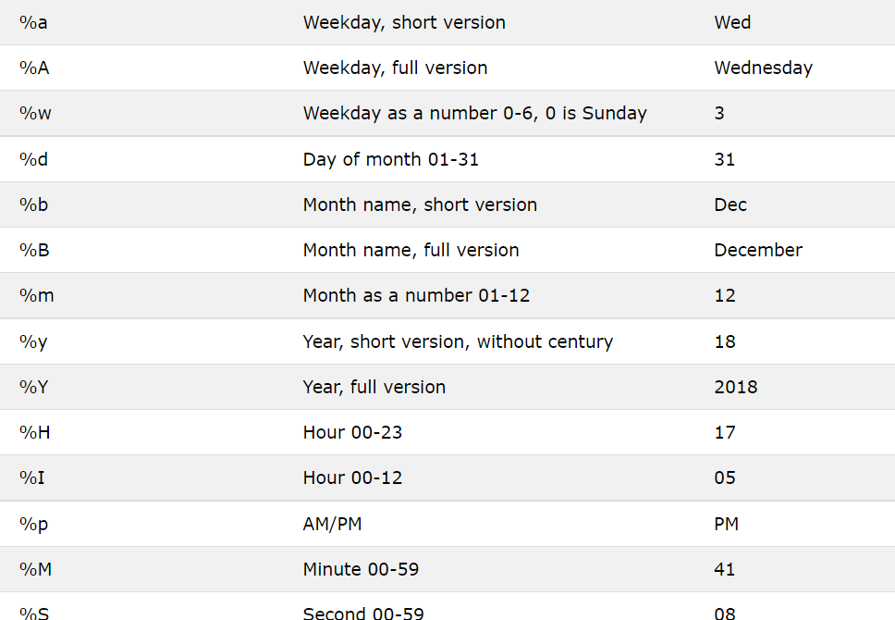
Python DatesTime
Notes:
Print() is actually a function that we have been using

Slide 16
I HOPE YOU LEARN A LOT & ENJOY THE TRAINING! THANK YOU ☺

