Slide 1
Design

Slide 2
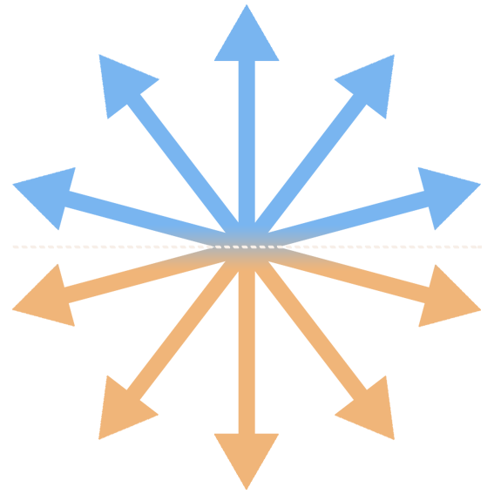
a
a
s
Press either key to continue

Slide 3
a
a
s
Press either key to continue

Slide 4
a
s
a
Press either key to continue

Slide 5
a
a
s
Press either key to continue

Slide 6


Slide 7
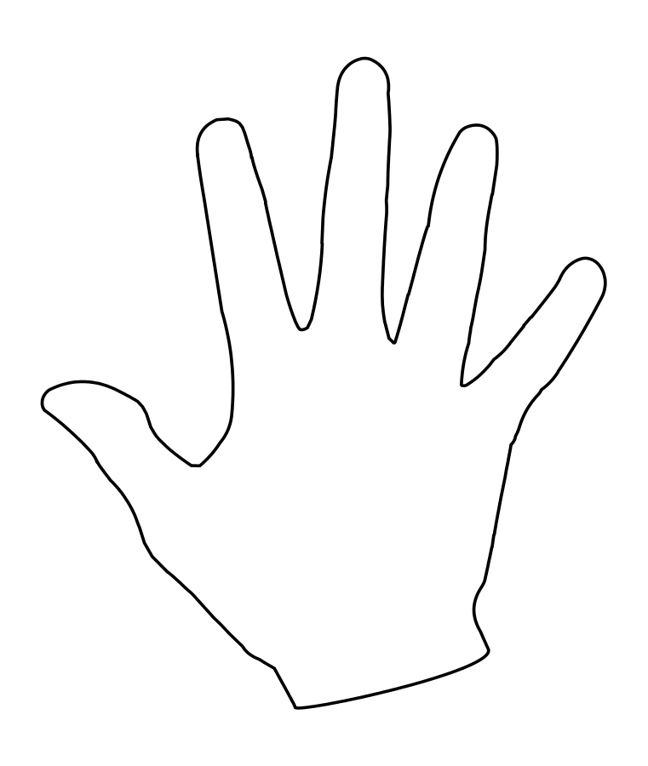
Button 1
Button 2
s
a

Slide 8
Detail

Slide 9
a
a
s
Press either key to continue

Slide 11
a
a
s
Press either key to continue

Slide 13
Going in the direction of blue
Going in the direction of orange
s
a

Slide 14
Example one

Slide 15
a
a
s
Press either key to continue

Slide 18
s
a

Slide 19
s
a

Slide 20
Example two

Slide 21
a
a
s
Press either key to continue

Slide 24
s
a

Slide 25
s
a

Slide 26
Coherence testing

Slide 27
press a for BLUE
press s for ORANGE

Slide 32
Angle testing

Slide 33
press a for BLUE
press s for ORANGE

Slide 36
press a for BLUE
press s for ORANGE

Slide 39
Some final points

Slide 41
Always answer!
(even if you aren’t sure)
try to be as accurate and as fast as possible but
always answer

Slide 42
Ready?

Slide 43
Experiment
Mapping the information in accumulating activity

Slide 44

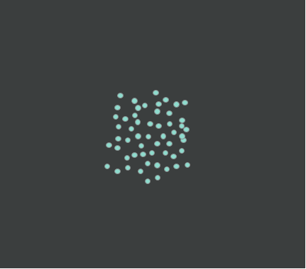
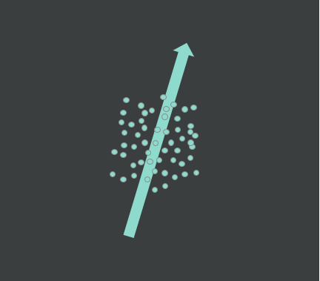
Comparator
Stimulus
500ms
Going in the direction of orange
500ms
Going in the direction of blue
Gradual increase in motion coherence
500ms

Slide 45

Comparator

Slide 46
Stimulus

Slide 47
Matching difficulty
Comparator Axis
‘Harder’
‘Easier’
c
Possible Coherence Direction

