Slide 1
Design

Slide 2

s
a
Press either key to continue

Slide 4
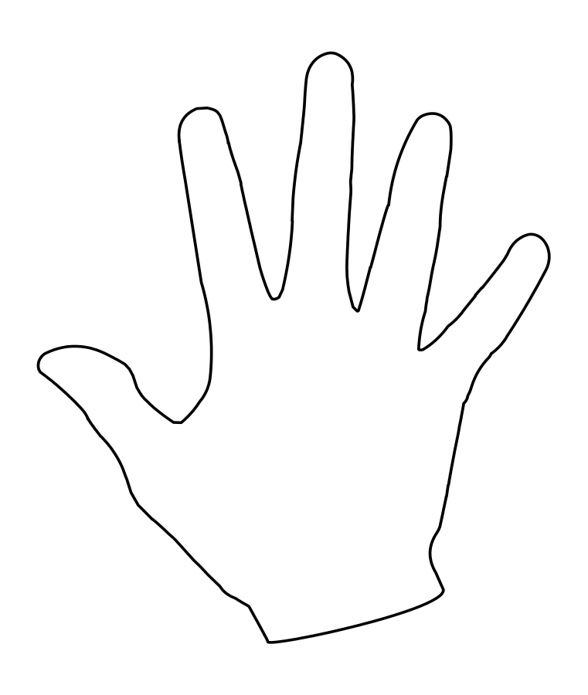
Button 1
Button 2
s
a

Slide 5
Detail

Slide 6
s
a
Press either key to continue

Slide 7
Press ‘s’

Slide 8
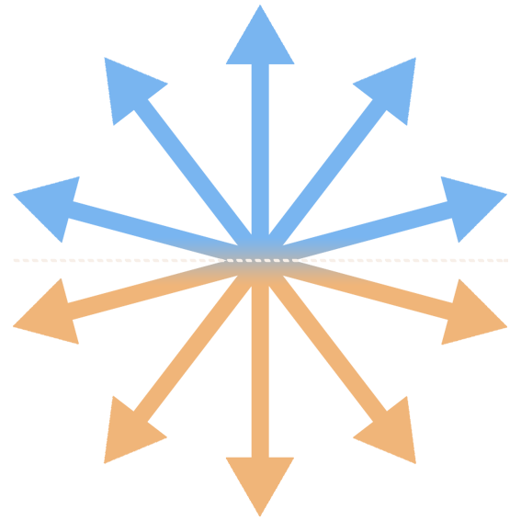
s
a
Press either key to continue

Slide 10
Going in the direction of orange
Going in the direction of blue
s
a

Slide 11
Example one

Slide 12
s
a
Press either key to continue

Slide 13


Slide 15
s
a

Slide 16
s
a

Slide 17
Example two

Slide 18
s
a
Press either key to continue

Slide 21
s
a

Slide 22
s
a

Slide 23
Coherence testing

Slide 24
s
a
Press either key to continue

Slide 29
Angle testing

Slide 30
press a for BLUE
press s for ORANGE

Slide 33
press a for BLUE
press s for ORANGE

Slide 36
Some final points

Slide 38
Always answer!
(even if you aren’t sure)
try to be as accurate and as fast as possible but
always answer

Slide 39
Ready?

Slide 40
Experiment
Mapping the information in accumulating activity

Slide 41

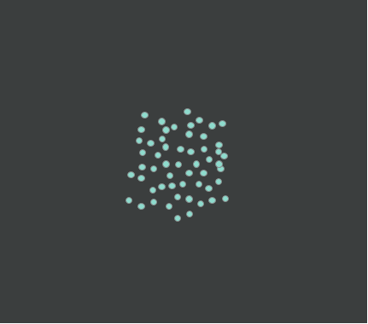
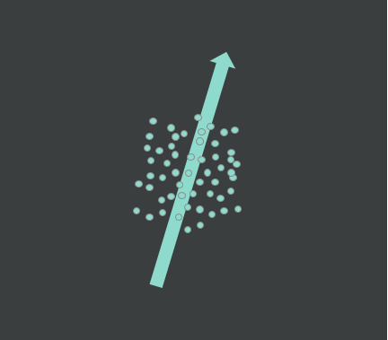
Comparator
Stimulus
500ms
Going in the direction of orange
500ms
Going in the direction of blue
Gradual increase in motion coherence
500ms

Slide 42

Comparator

Slide 43
Stimulus

Slide 44
Matching difficulty
Comparator Axis
‘Harder’
‘Easier’
c
Possible Coherence Direction

