Slide 1
Milestone 1 Path Analysis-Machine Learning February-April

Slide 2
Agenda
Goals
Data
Path analysis
Machine learning
Dimension reduction
CausalML

Slide 3
Goals
Water Retention/Purification
Water Storage
Nitrate Retention
Phosphorus Retention
Sediment Retention
Feature Importance Analysis
Identify important features (OF/F/S)
Feature Reduction
Reduce unnecessary features

Slide 4
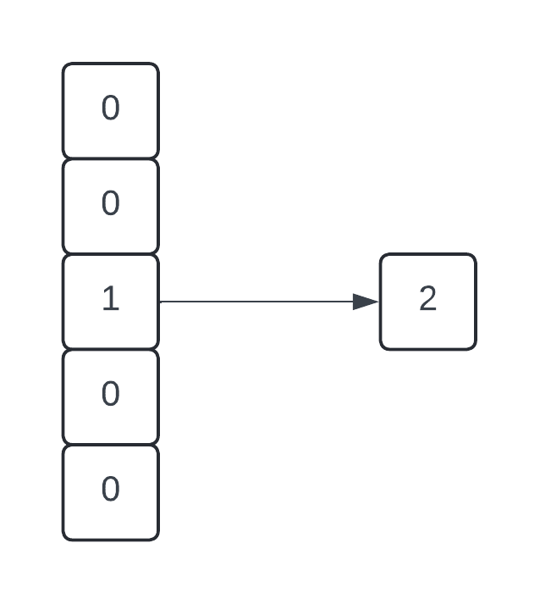
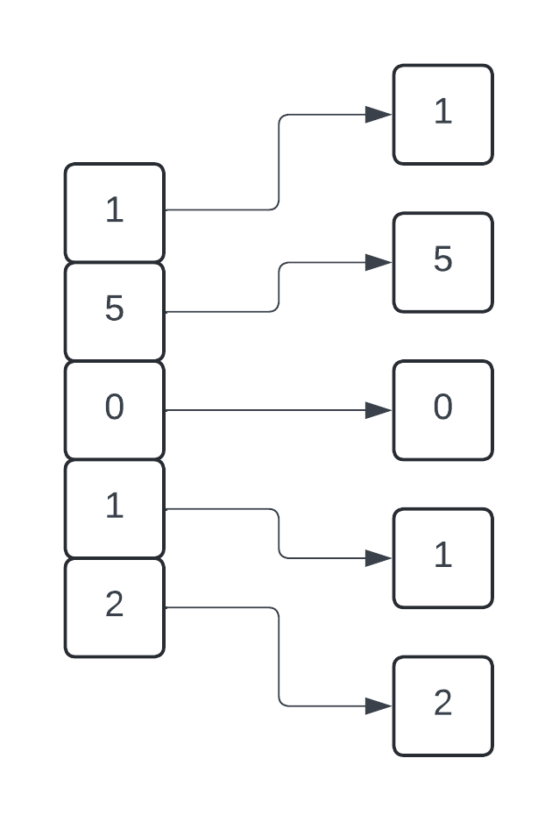
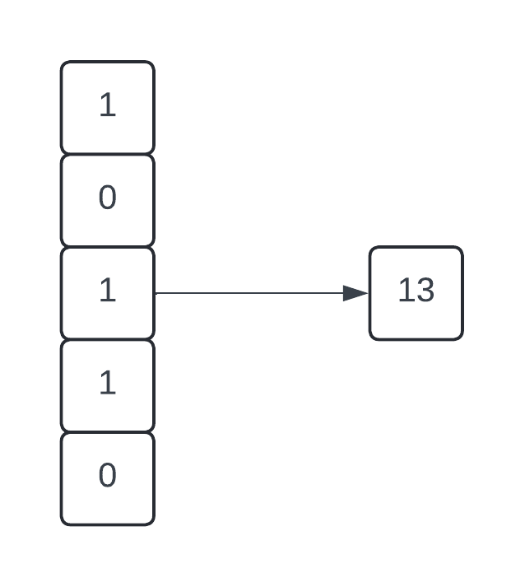
Data
Hot one encoded
Feature Separation
OF, F, S, Extra features
Function/Benefit results
Scores
Ratings
Data Transformation
Hot one encoded vector
Binary encoding
Separation of features
Binary encoding

Slide 5
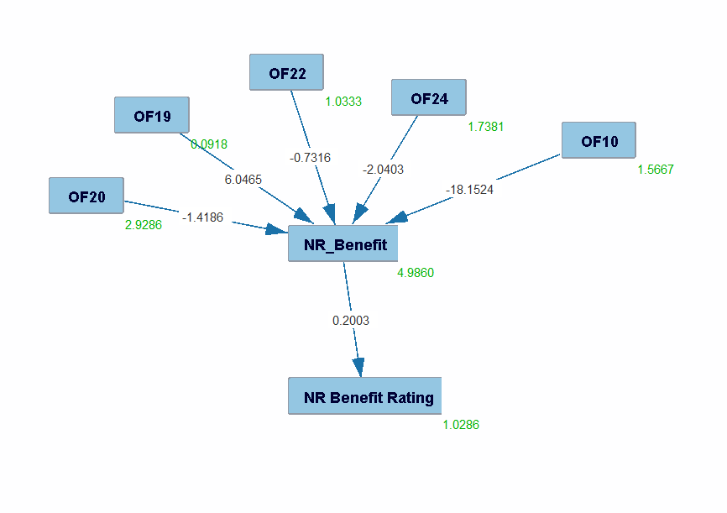
Path Analysis
Statistical technique
Relationship modeling
Find important features
Tetrad tool
Goal
Find important OF/F/S features
Find/Eliminate redundancy
Reduce unnecessary variables
Results
Data does not fit the models
Further exploration required

Slide 6
Machine Learning
Artificial intelligence
Data-based
Less intuitive
Various Algorithms
Ridge, Decision Tree, Gradient Boost, Random Forest, AdaBoost, K-nearest, MLP, Elastic, SGD, SVR, Bayesian Ridge, Kernel Ridge, Linear Regression, RANSAC, TheilSen, Neural Network
Optimizations
Grid search
Data variation (All, specific)

Slide 7
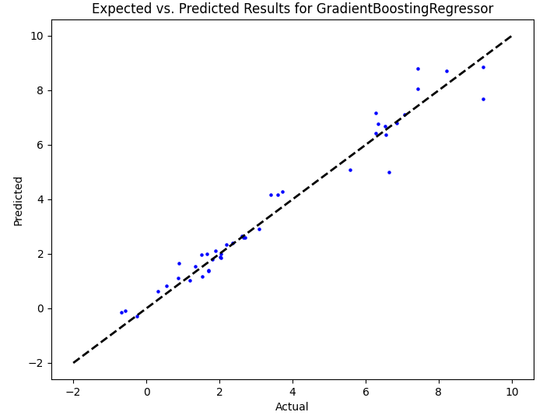
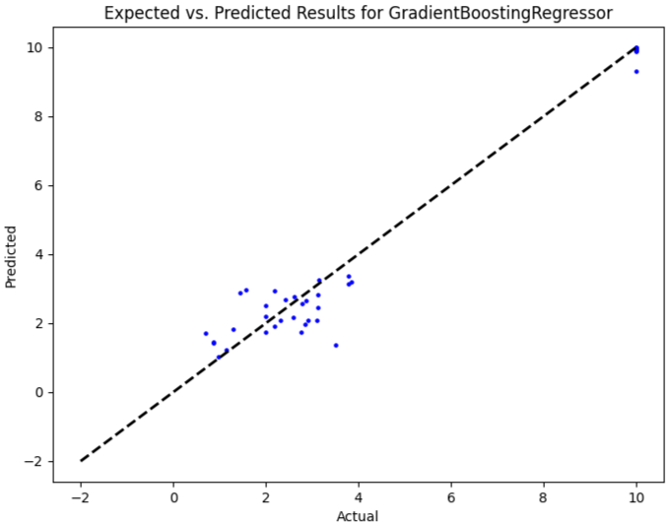
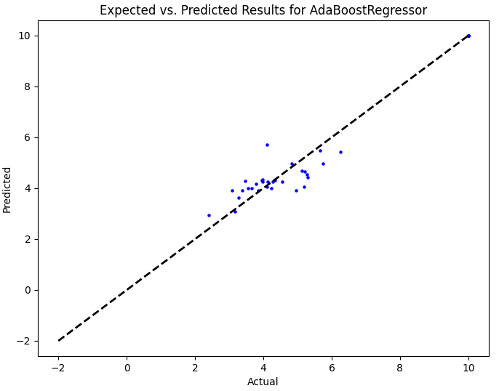
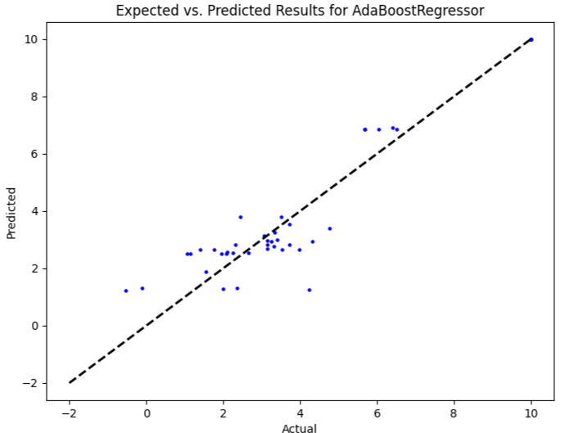
WS
NR
PR
SR

Slide 8
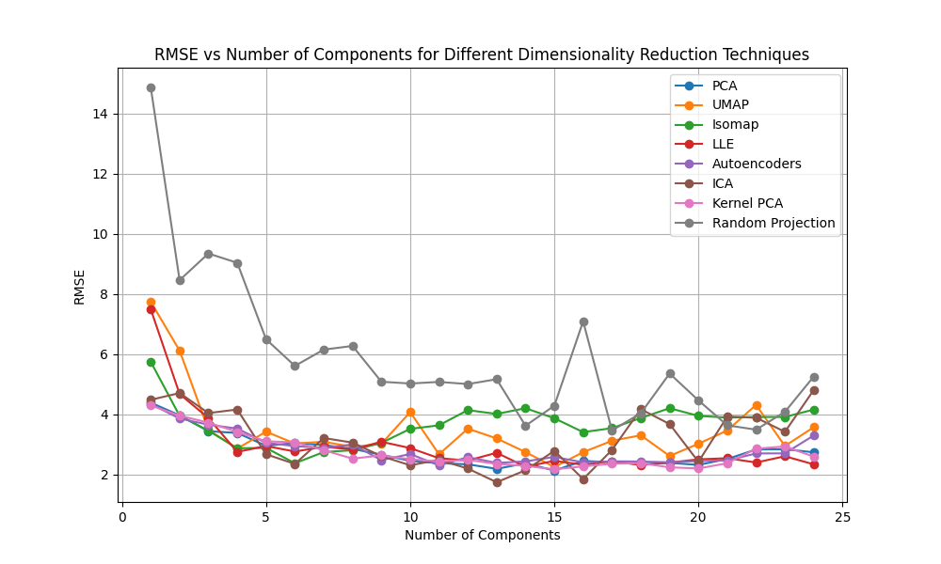
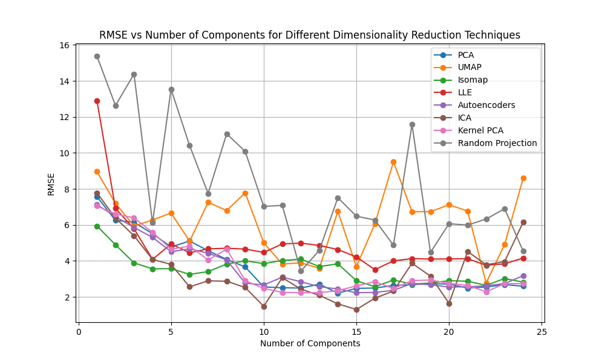
Dimension Reduction
Feature reduction
Remove unnecessary features
Achieve similar results
Machine learning-based approaches
PCA, t-SNE, UMAP, Isomap, LLE, ICA, Autoencoders, Kernel PCA, Random projection
Results
Differences in algorithms
5 Features vs 15 Features vs 25 Features

Slide 9
CausalML
Causal Inference
ML-Based (Various algorithms)
Estimating effect of variables (treatment)
Accounting of confounding variables
Approach
Set each feature as treatment
Compare importance of features
Results
Preliminary
WS
Ridge Regression | Decision Tree | Gradient Boosting | Random Forest
'F48': 0.19474891027688837 'F41': 0.1873442207855662 'F44': 0.12057217616733026 | 'F41': 0.831380186133945 'F31': 0.44218190627748594 'F21': 0.4232167376234584 | 'F41': 0.2624876911421128 'F31': 0.13098117823078811 'F44': 0.08023063165155067 | 'F41': 0.540114519202654 'F31': 0.21343532054264133 'F44': 0.16773638919239883
AdaBoost | K-Nearest | MLP Regressor | Elastic Net
'F31': 0.20184279052478626 'F44': 0.08844283560346898 'F41': 0.07147117098073795 | 'F31': 0.12369846291120663 'F3_7': 0.0935140569462221 'F3_4': 0.07634656134668377 | 'F41': 0.13349271409616123 'F48': 0.08461378644838362 'F3_2': 0.08090283311535969 | 'F3_5': 0.06828032929627752 'F3_4': 0.0644627311695240 'OF26':0.02931274297057200
SGD Regressor | Support Vector | Bayesian Ridge | Kernel Ridge
'F48': 0.17238807489020064 'F41': 0.14010474759435396 'F44': 0.10596502953726043 | 'F3_7': 0.07892854450285108 'F3_4': 0.0733931593336509 'F31': 0.06958107612079197 | 'F48': 0.1636716850445002 'F41': 0.1524418102975325 'F44': 0.1091390833604844 | 'F48': 0.20654426037299564 'F41': 0.18122240776030965 'F44': 0.11460499367700433
Linear Regression | RANSAC | TheilSen
'F48': 0.20128411836315818 'F41': 0.19186870219993202 'F44': 0.12076600276299451 | 'F41': 0.6934779925500207 'F49': 0.33618598168274133 'F31': 0.17061070186601177 | 'F41': 0.24758177499677156 'F48': 0.1663842684380163 'F44': 0.13393640370058243

Slide 10
Next steps
Analyze data
Confirm excel functions
Retrain models
Benefit scores
Dimension Reduction + ML
Compare results
Create graphs
CausalML
Analyze results
Create new Approaches

