Slide 1
Configure ADCS for DSC Credential Encryption
Missy Januszko
Sr. Automation Engineer

Slide 2
Why a PKI for DSC?
LCM runs as LOCALSYSTEM
Sometimes its privileges aren’t enough
Need to ENCRYPT alternate credentials

Slide 3
Terminology and Acronyms
PKI – Public Key Infrastructure
CA – Certification Authority / Certificate Authority
Root CA – “trust anchor” for PKI
Issuing CA – issues certificates to end entities

Slide 4
Terminology and Acronyms
CSP
AIA – Authority Information Access
CRL – Certificate Revocation List
CDP – CRL Distribution Point
Standalone CA
Enterprise CA

Slide 5

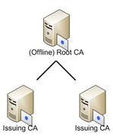
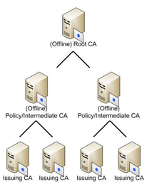
CA Tiering Options
Single-tier CA
Two-tier CA
Three-tier CA
https://blogs.technet.microsoft.com/askds/2009/09/01/designing-and-implementing-a-pki-part-i-design-and-planning/

Slide 6
Best Practices for PKI Infrastructure
One-tier PKI NOT recommended for production
3-tier infrastructure is now overkill
Strong physical access controls for PKI artifacts
And seriously, so much more!!
https://technet.microsoft.com/en-us/library/dn786443.aspx

Slide 7
Challenges of PKI DSC Config
Many “moving parts”
Offline root
Enterprise Issuing – Chicken vs. Egg
Lack of PowerShell cmdlets

Slide 8
General Config Flow
Root | Domain Controller | Subordinate
Build ADCS and share root cert ->
 | Publish root in AD ->
 |  | Import root, configure IIS for CDP, install ADCS ->
Issue the issuing cert. END
 |  | Install cert, start ADCS, configure CRLs ->
 | AutoEnroll GPO, create DSC template. END
 |  | Publish DSC Template. END

Slide 9
Demo
Two-Tier PKI
Offline, Standalone Root CA
Online, Enterprise Subordinate (Issuing) CA
https://technet.microsoft.com/en-us/library/hh831348(v=ws.11).aspx

Slide 10
DSC Template Requirements
Key Usage: Key Encipherment, Data Encipherment
Should not contain Digital Signature
Enhanced Key Usage: Document Encryption
Should not contain Server Auth, Client Auth
Provider: Microsoft RSA SChannel Cryptographic Provider

Slide 11
THANK YOU!!!
Additional Resources:
https://leanpub.com/the-dsc-book
Follow me on Twitter! @thedevopsdiva
Github.com/majst32/pkidsc

