Slide 1
Web scraper app for product search:
Code change details in the web scrapper..
Optimized the web scrapping process to maximize the data gain.
Autocreation of Chat GPT / GROK compliant prompt.
Usability Changes in the UI.
Final inference from LLM through manual approach, as we don not have the LLM API subscriptions.

Slide 2
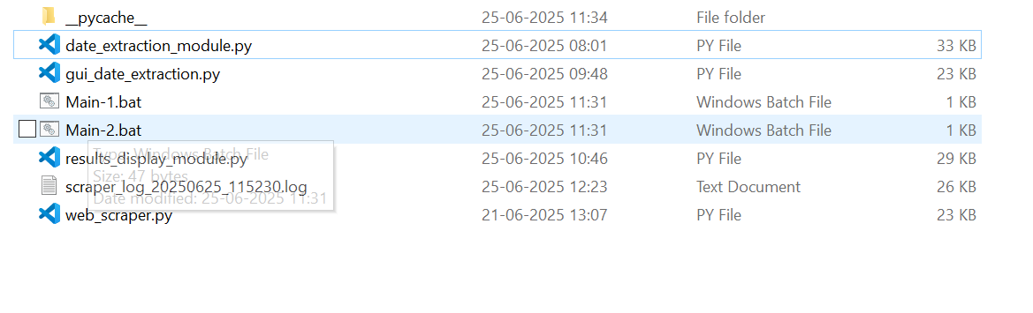
Start the web scraper application by double clicking the Main-1 bat file.
Once you restore the zip file on your local system.
Before running the UI ensure to run pip install tiktoken

Slide 3
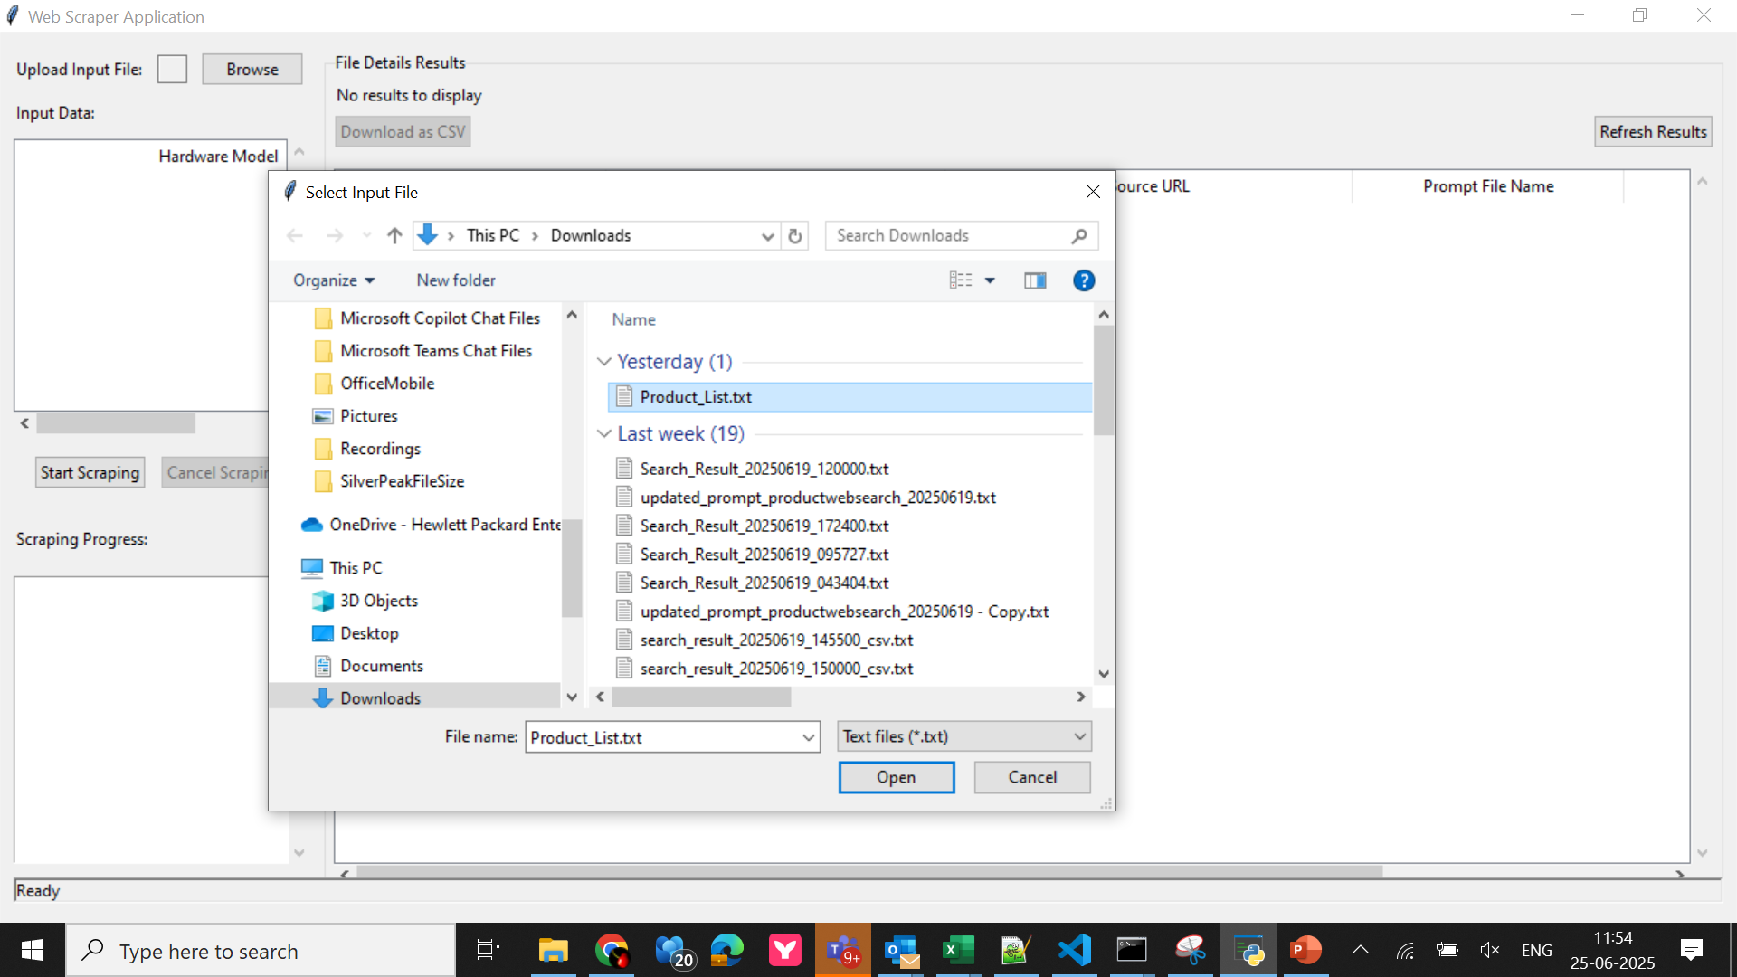
Select Your Product List File
Step-1

Slide 4
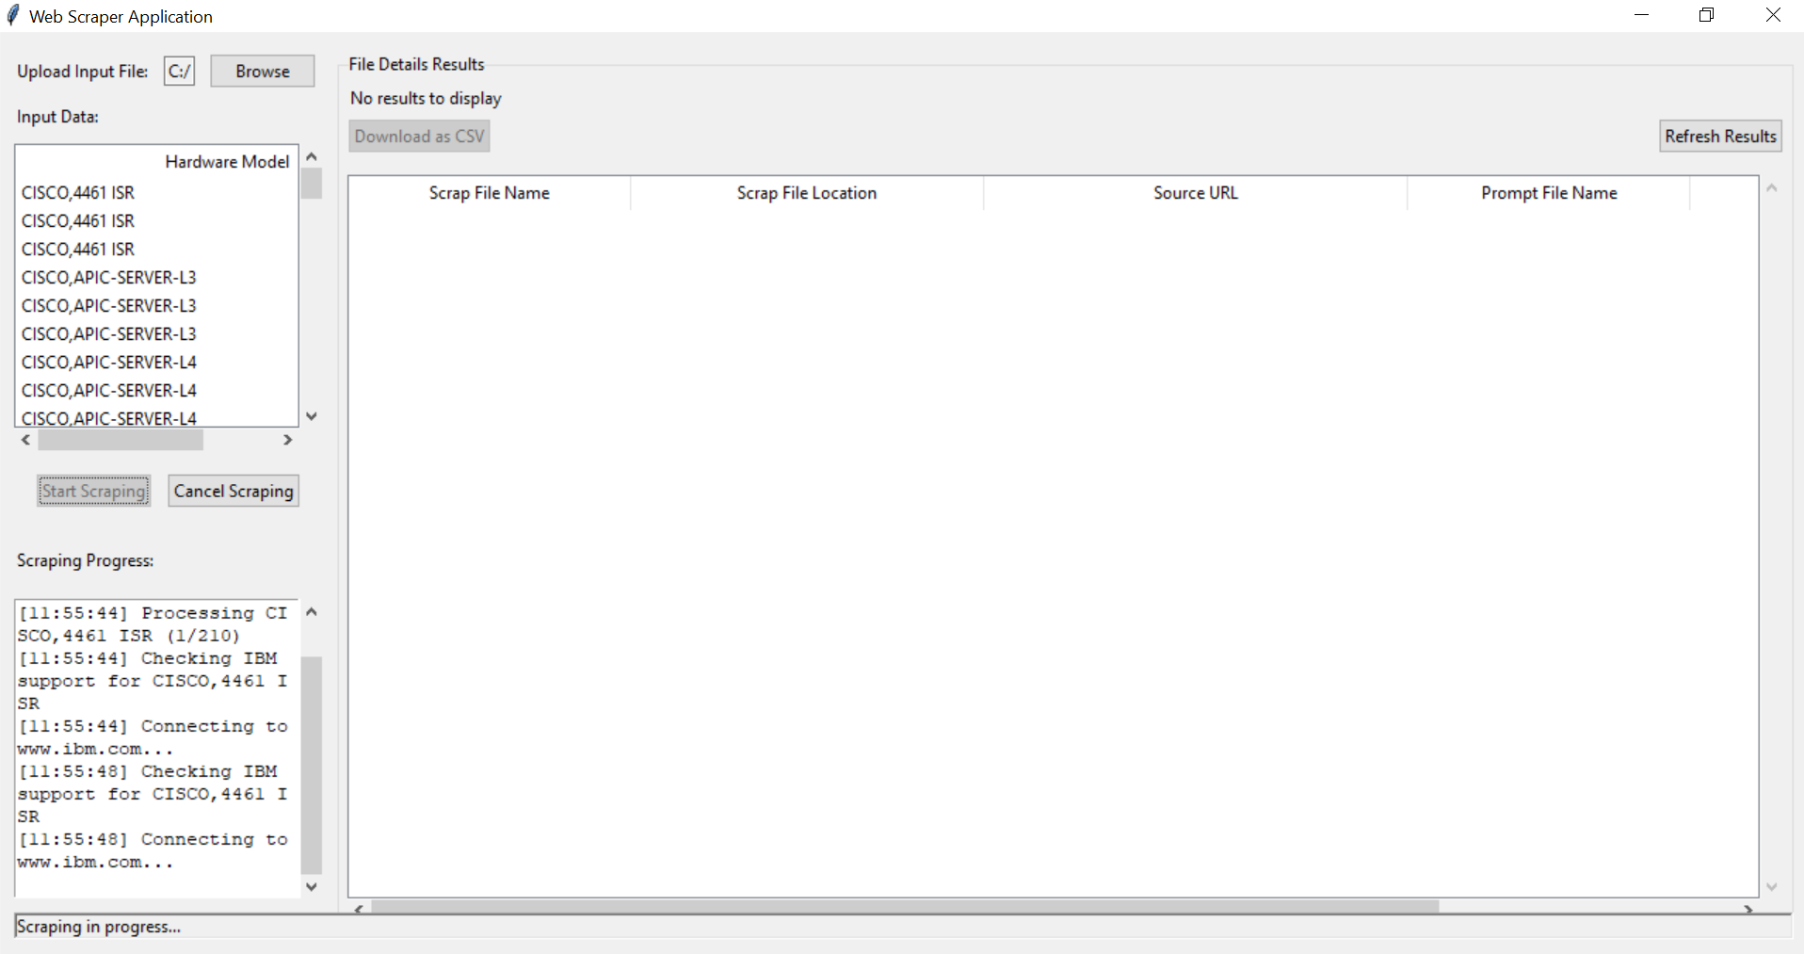
Start Scrapping Process
You will see Scrapping progress.
Step-2

Slide 5
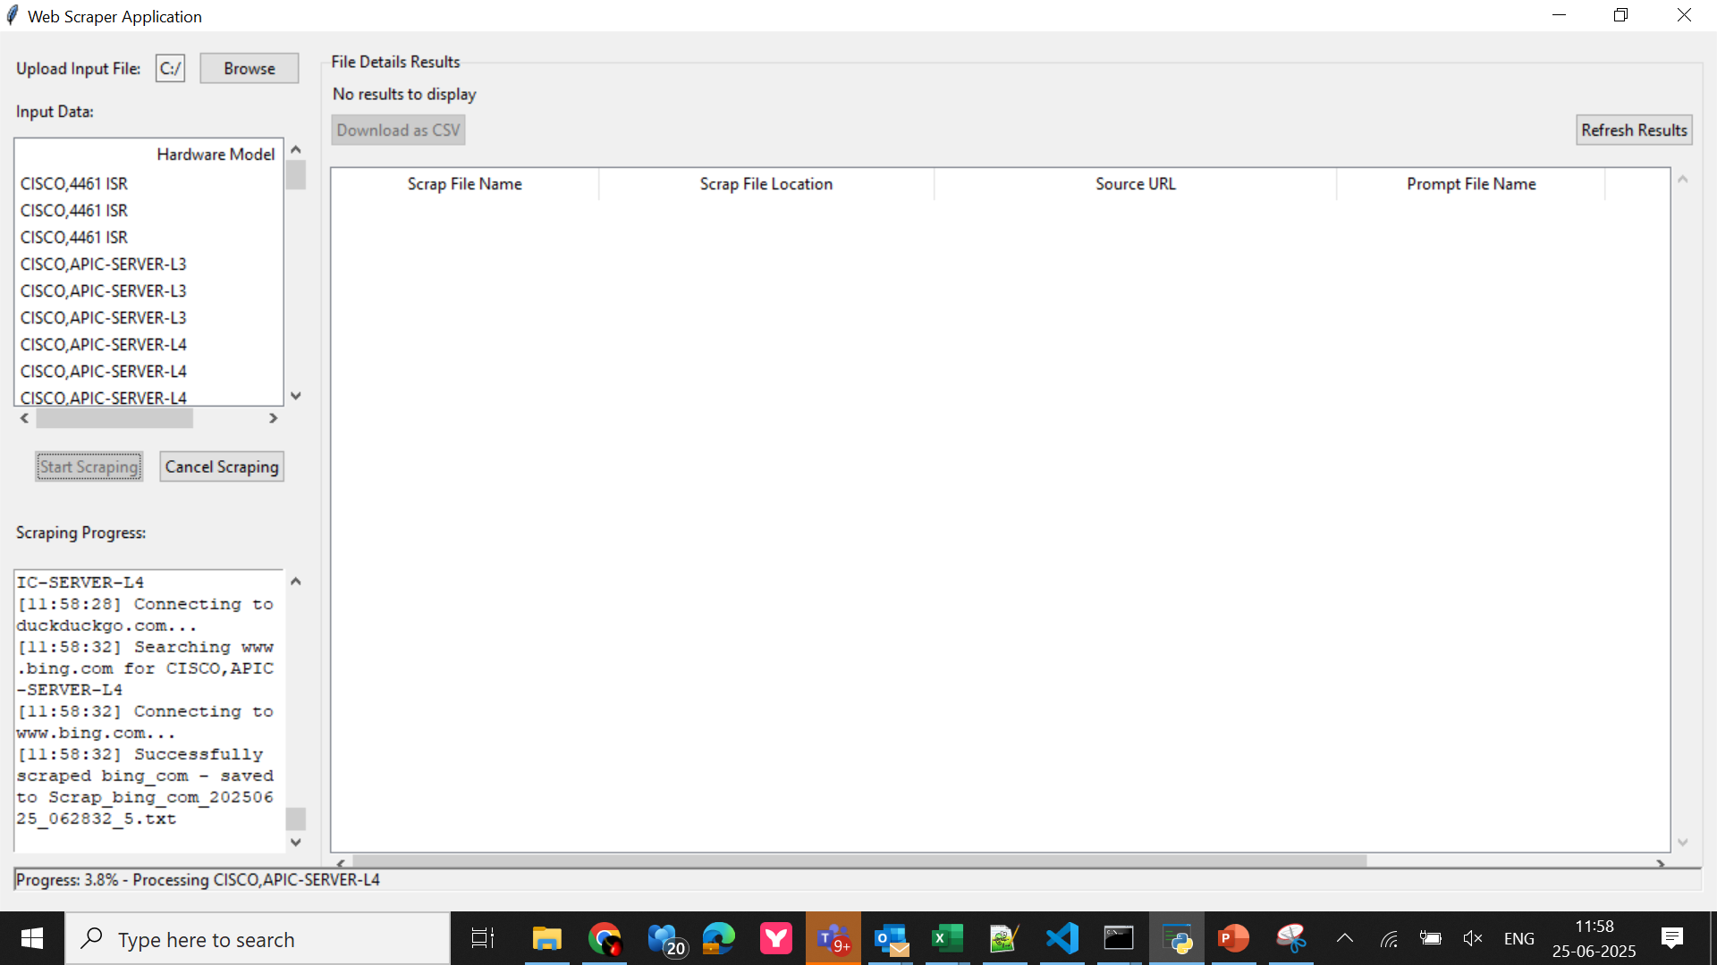
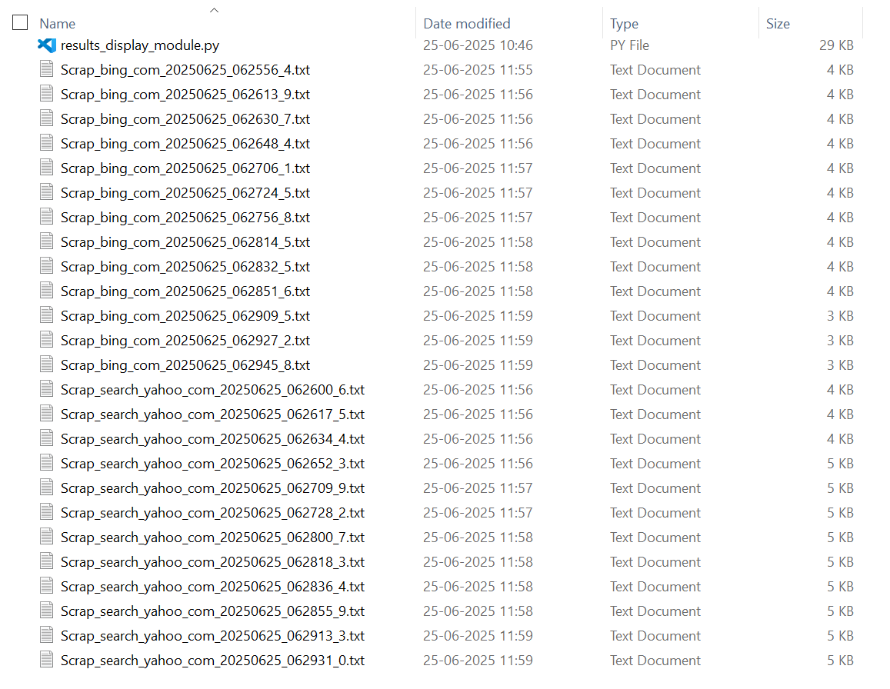
You should be able to see all the progress details and
Back end scrap files getting created In the current location.
Let the process complete.
Step-3

Slide 6
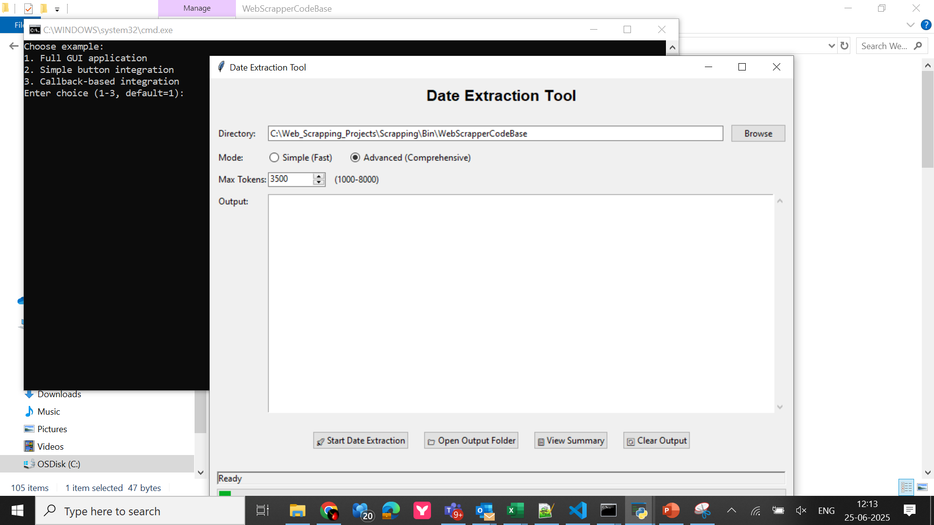

Step-4
Initiate Prompt File Creation by double clicking the Main-2.bat file.
In the current folder. This UI will come up. Click Start Data Extraction Button

Slide 7
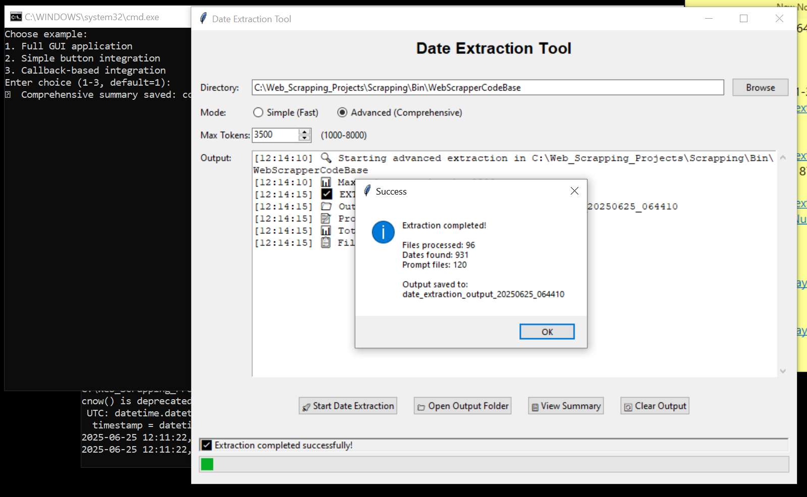
Step-5
Once the prompt file creation is complete. You will see message as this.

Slide 8
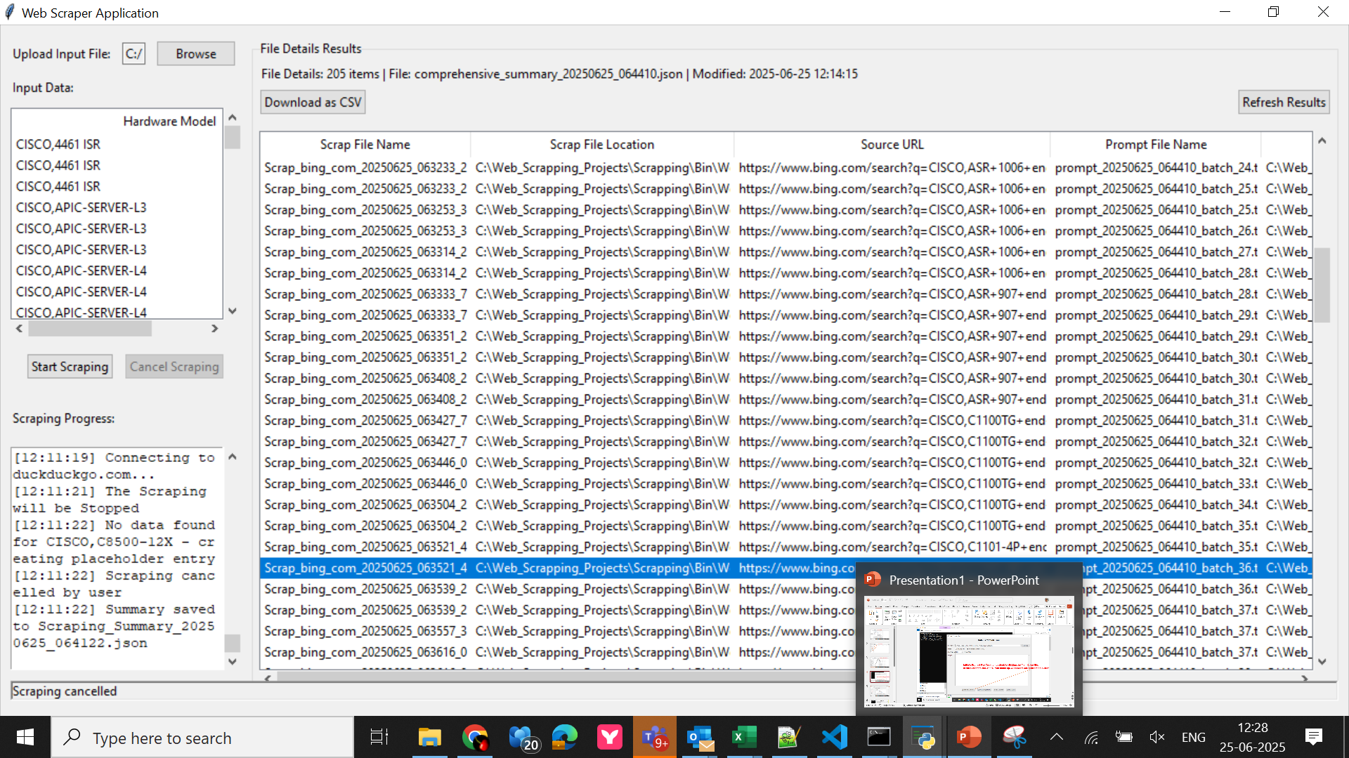
Step-6
Once the Prompt files creation are completed , hit the refresh result button on the main UI.
You wil see data grid populated.

Slide 9
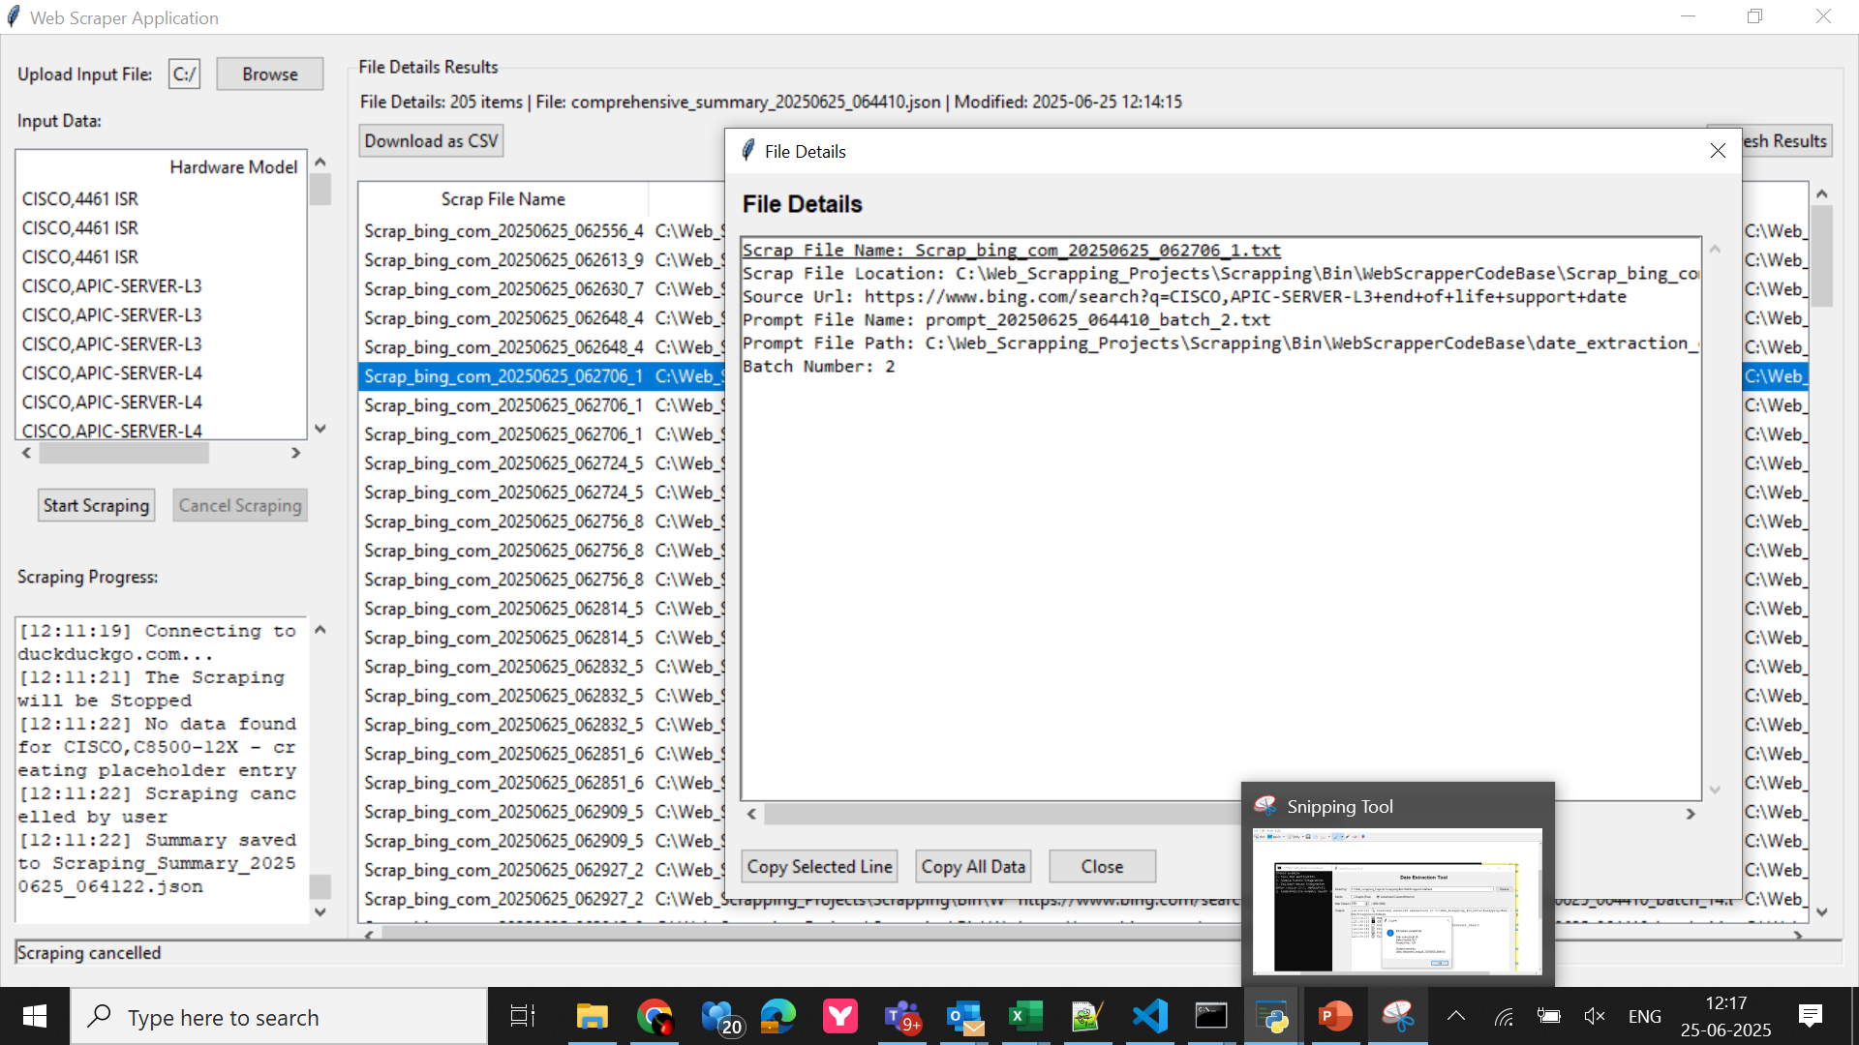
Step-7
Double Click on any record , you should see the pop up as this.
Double click on the red boxed once in the pop up.
Prompt File Path:

Slide 10
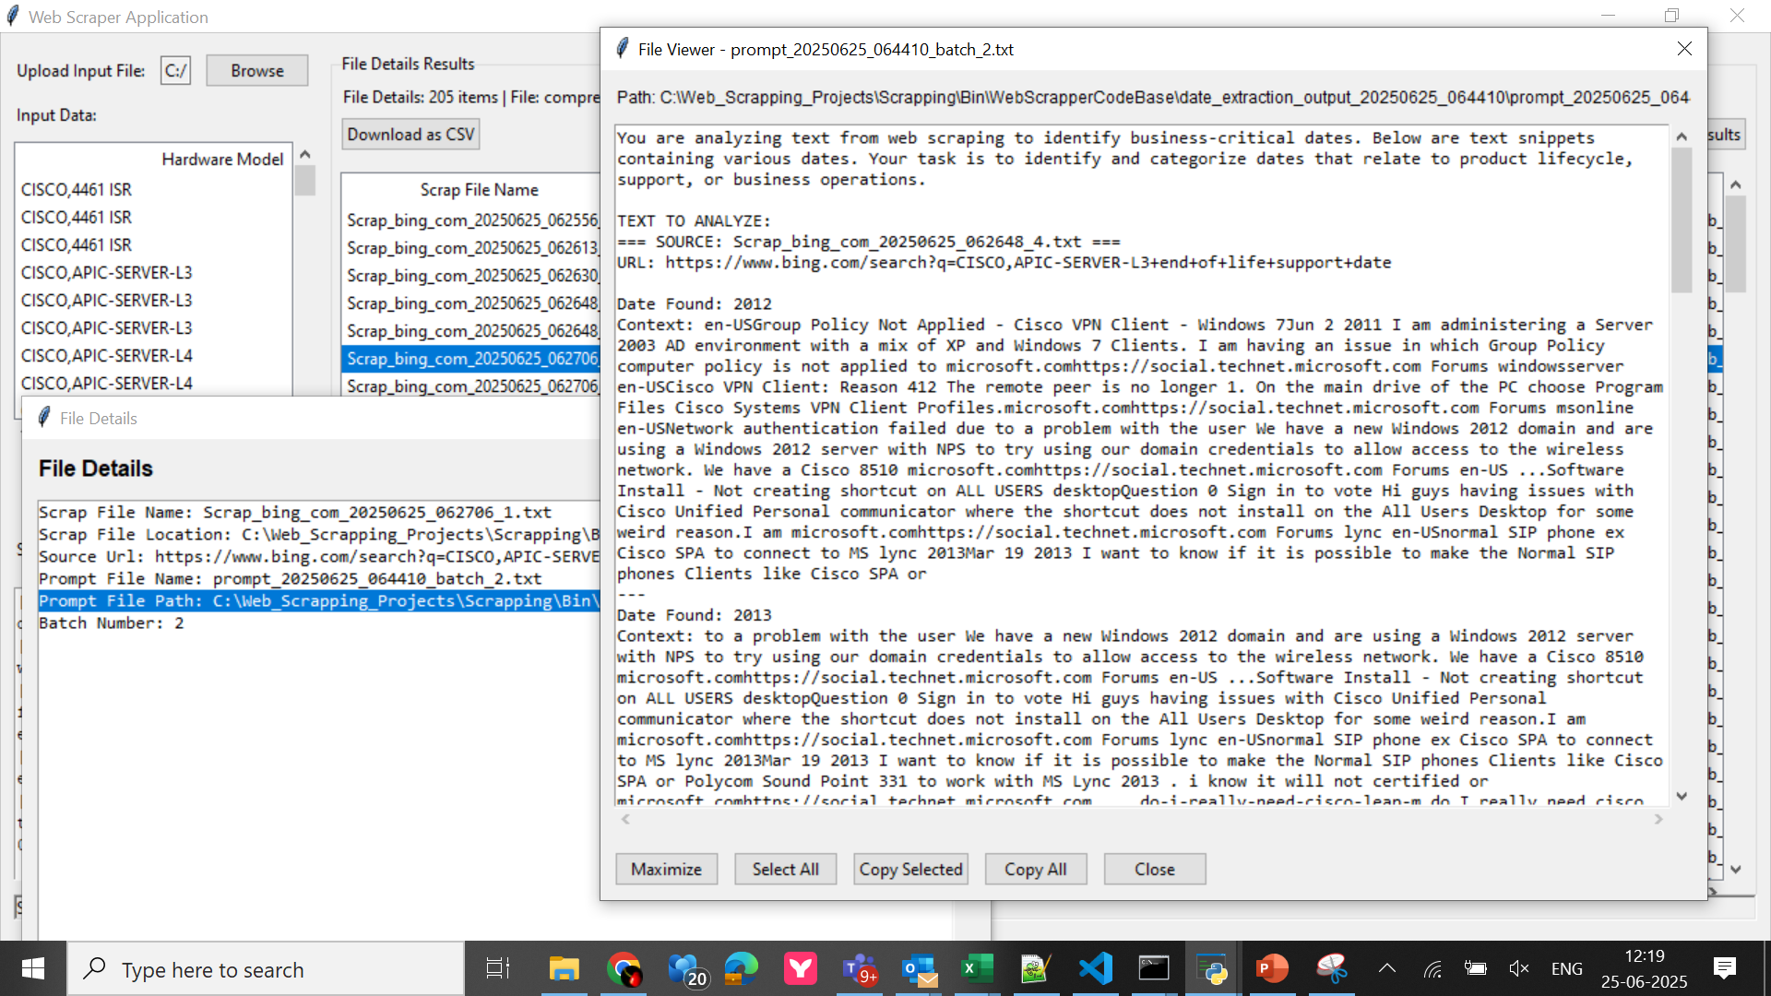
Step-8
1`
You should see this note pad like window showing the actual prompts file created in back end.
You can copy the prompt to manually paste in CHAT GPT for analysis.
2`
3`

Slide 11
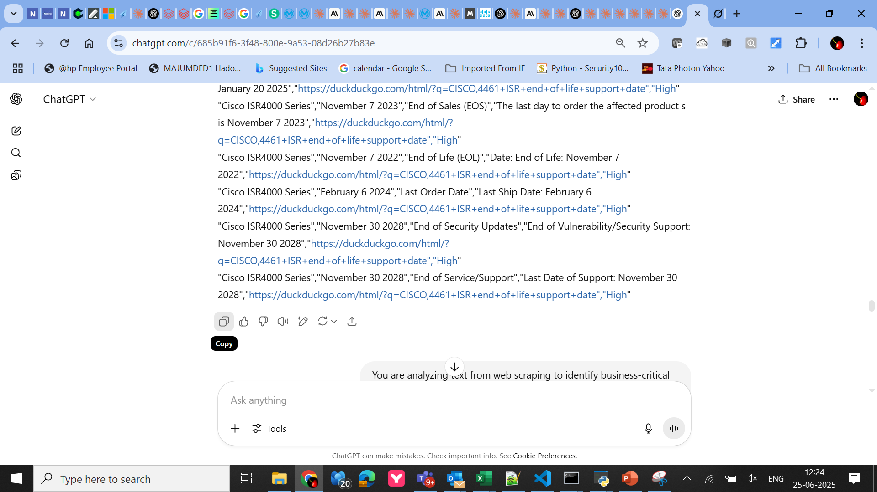
Step-9
Paste the prompt in CHAT GPT, you should see the inference of Chat GPT.
Copy and paste the reply in a CSV file for your analysis.

