Slide 1
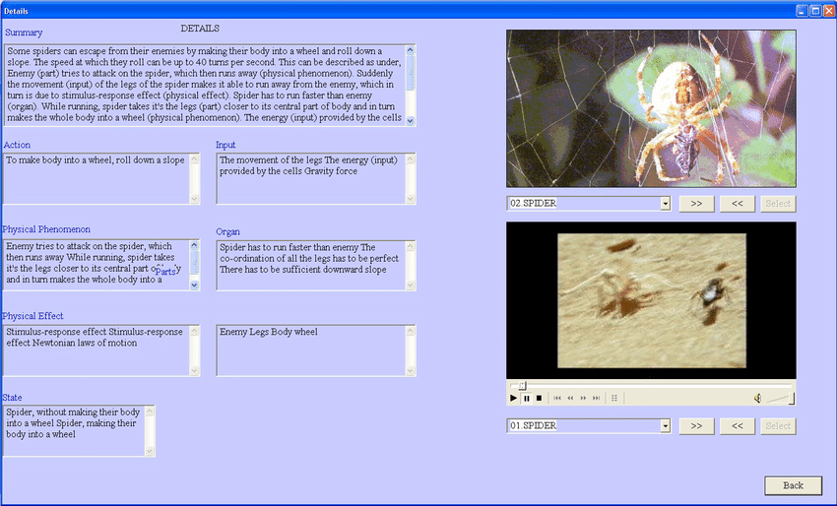

Slide 2
IDEA-INSPIRE

Slide 3
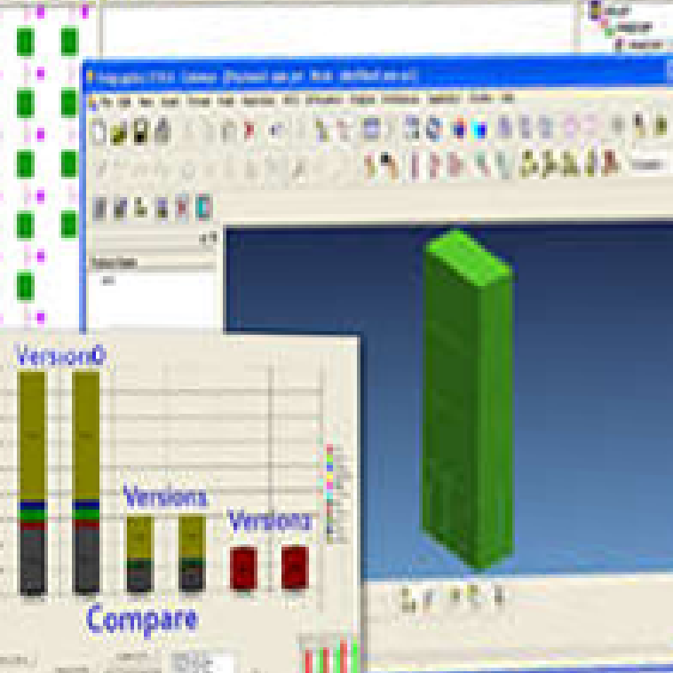

Slide 5
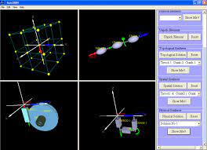

Slide 6
FuncSION

Slide 7
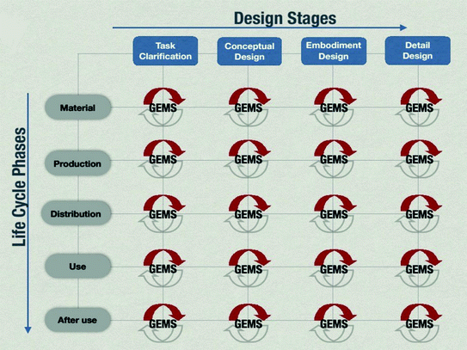

Slide 8
InDeaTe

Slide 9
