Slide 1
Hospital Information System Final Presentation
Group: Not at all
Jun ma 001080796
Yu Chen 001385622
Qiushi Zhang 001057253

Slide 2
Background
General hospitals & Specialist hospital
Transfer hospital (the inconvenience of paper record)
Research on special case
Drug Information Disclosure
Electronic medical record
Notes:
As today there are a lot of requirements make electronic medical record become popular. Our design focus on 4 points of the electronic medical record and combined with the business management. This system will help both hospital, medical enterprise and patient.

Slide 3
Background: Global
China: template
Development country: suitable
Developed country: already have but still need to Improve
Notes:
Conclusion: those system are global Globalization. However we need to change some part of the system for different national conditions. Also, it is good for human beings when we get enough record in one database: we can find the best way by big data to cure one disease in Different situation.

Slide 4
Problem Statement
How to connect and react between different organizations in different enterprise.
Handle the method with a linkage of more than two entities.
Handle with the interaction to reduce coupling for more extension.

Slide 5
Solution to the problem
Utilize work request to connect between interaction entities.
Separate different roles in different layers

Slide 6

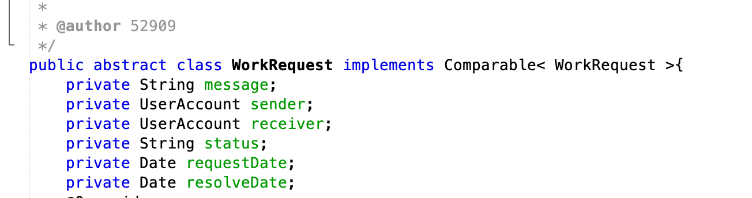
Work Request
Work Request serves as a transmission between different roles.
We have a basic Work Request template and different request extend from this one

Slide 7
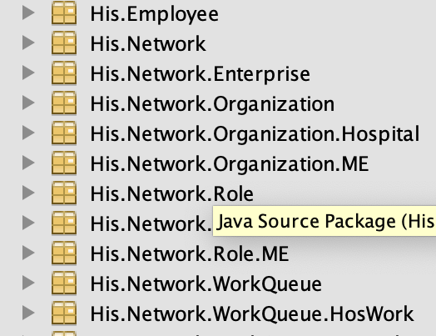
Separate roles in different layers
Much easier to locate the class we need
More sense of depth when approaching.

Slide 8
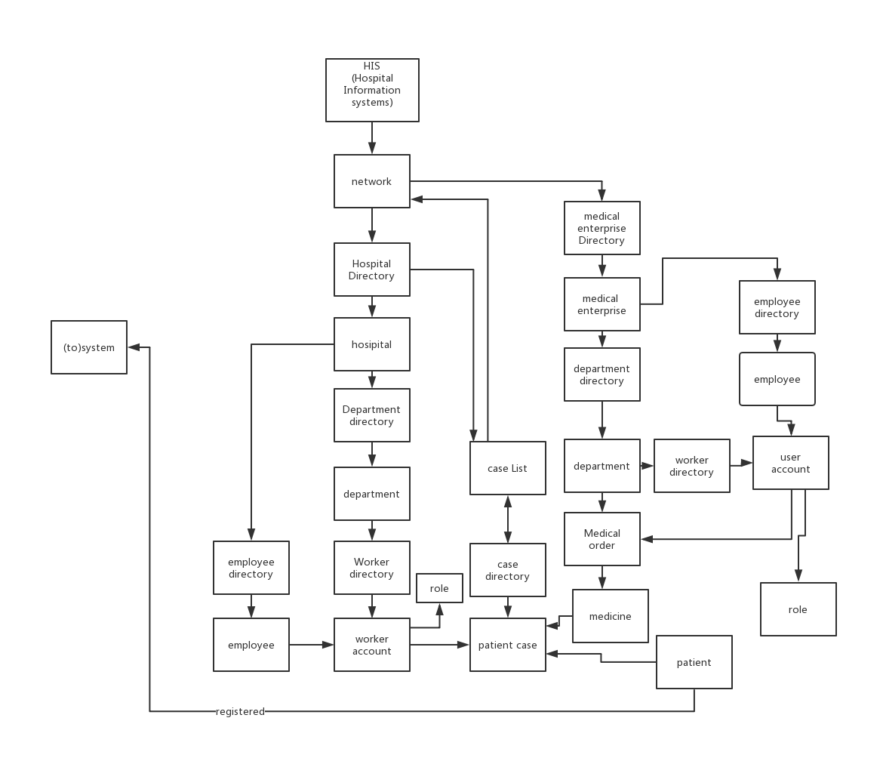
Design Model
Notes:
Basic demo model

Slide 9
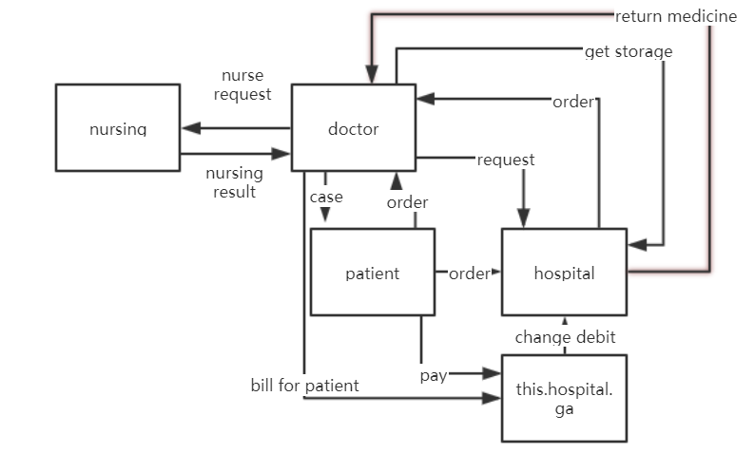
Design Model(important work flow)

Slide 10
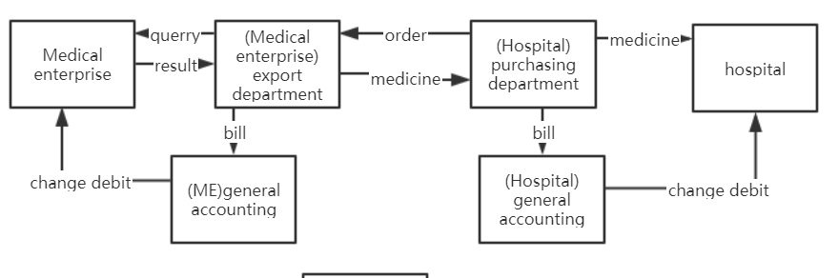
Design Model(important work flow)

Slide 11
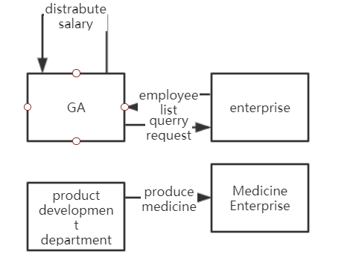
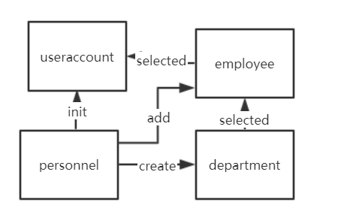
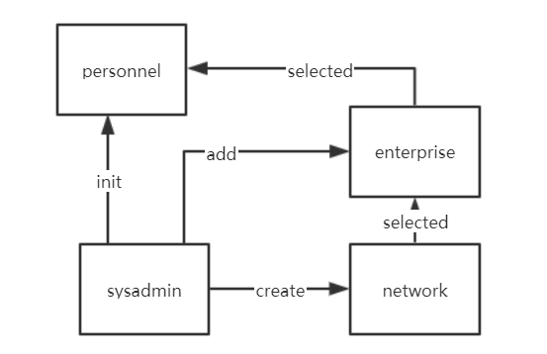
Design Model(important work flow)

Slide 12
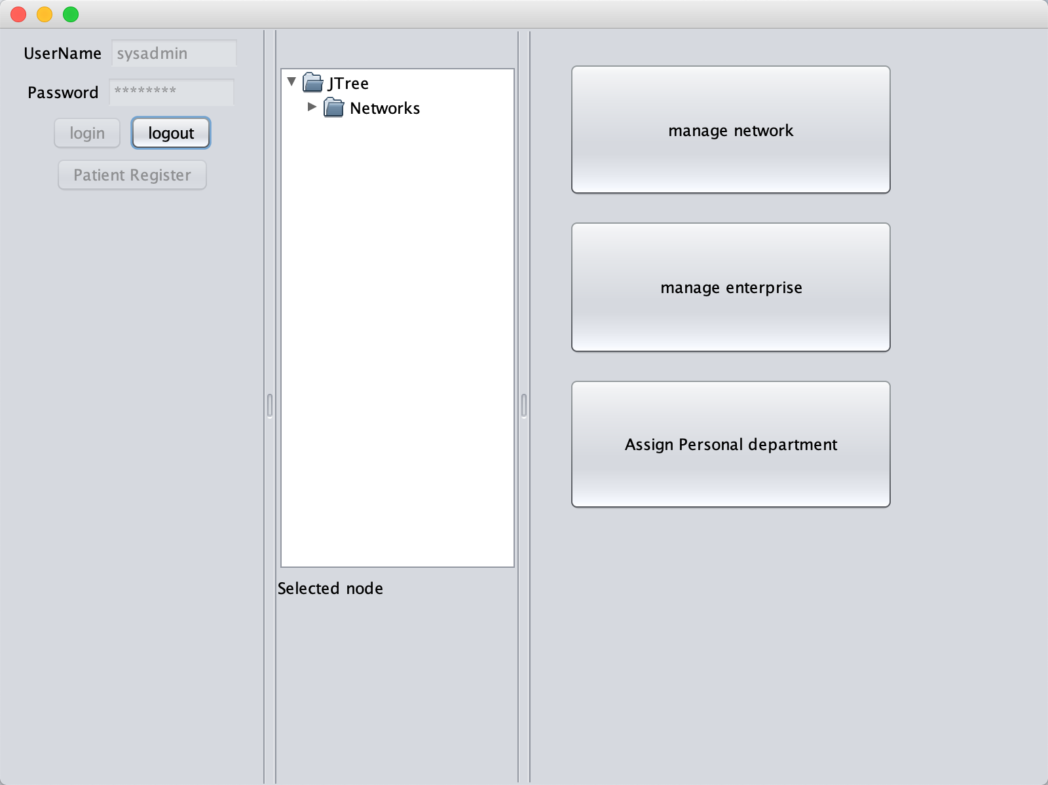
Demo Mode(Management)
Login as a System Administrator
Manage network
Manage enterprise
Assign the first Personnel staff

Slide 13
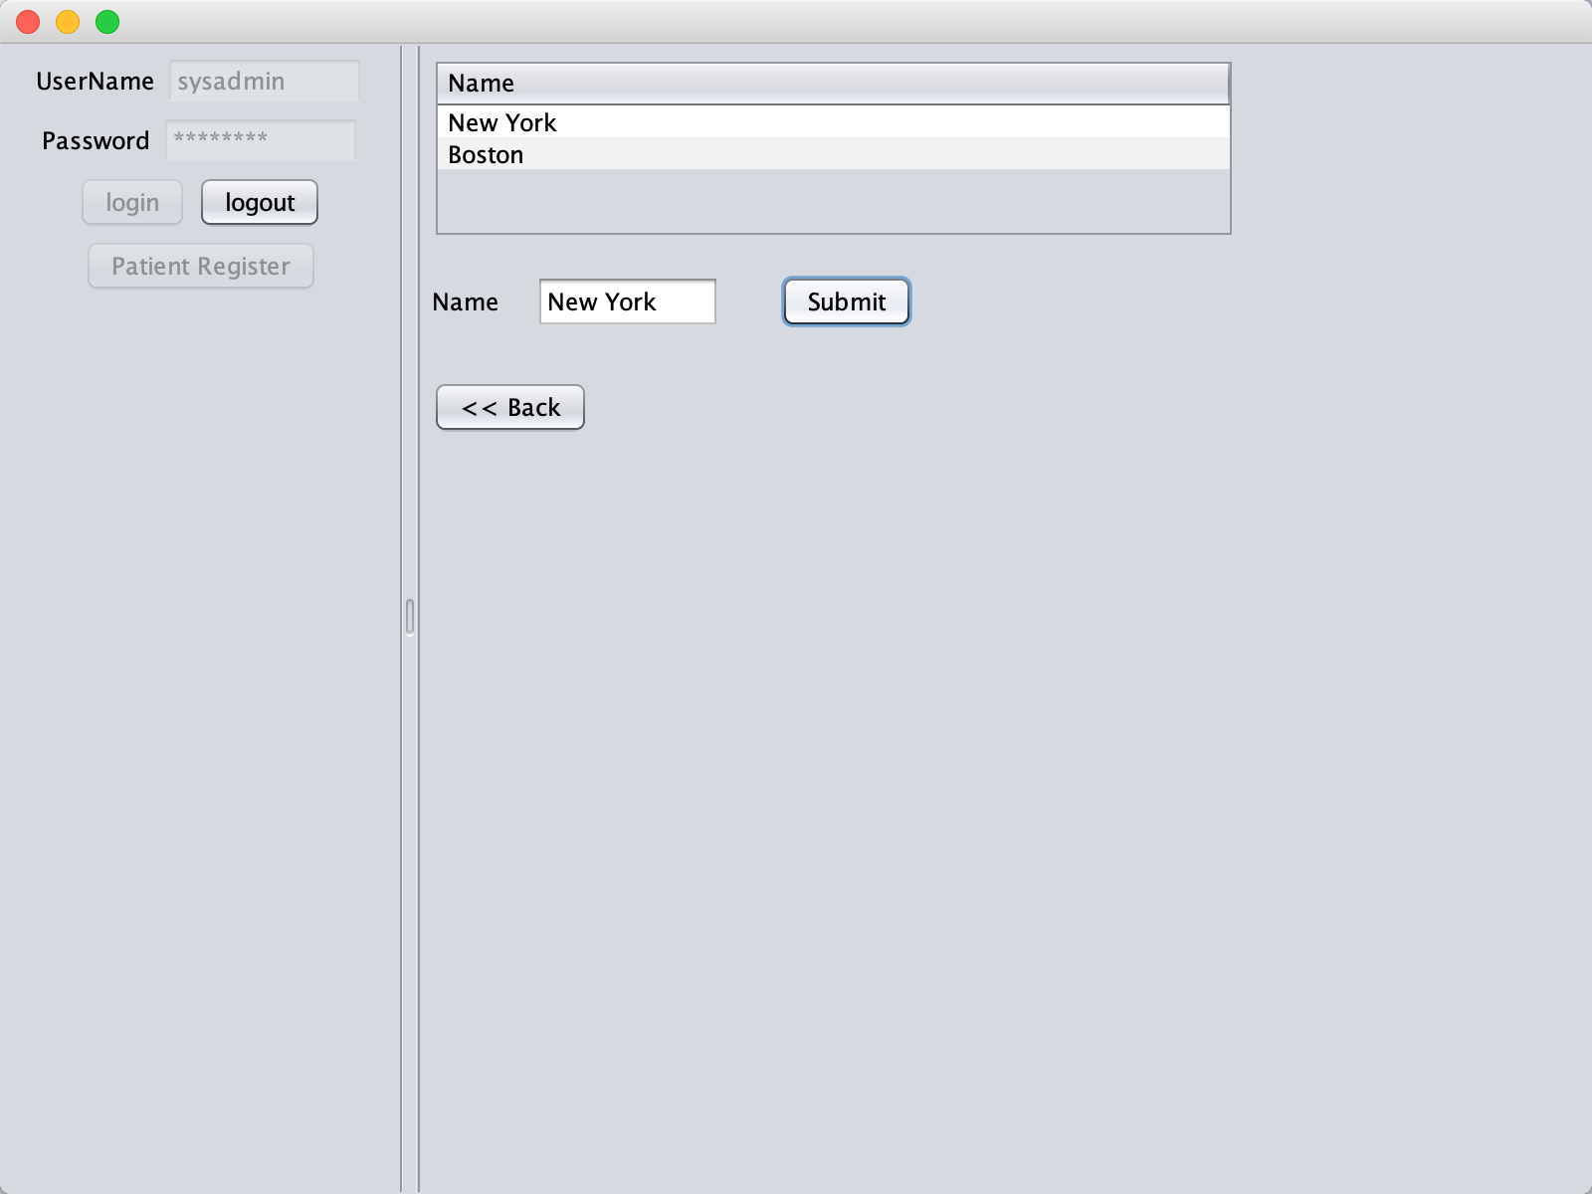
Demo Mode
Add new network

Slide 14
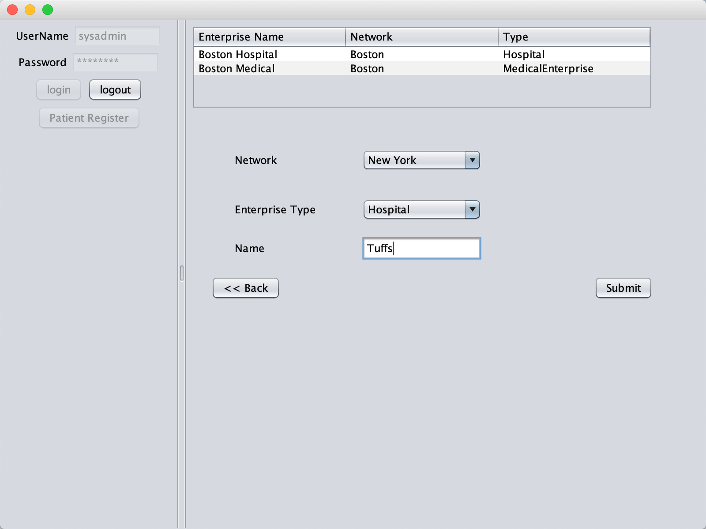
Demo Model
Add Enterprise in the Network
Choose Hospital/Medical Enterprise

Slide 15
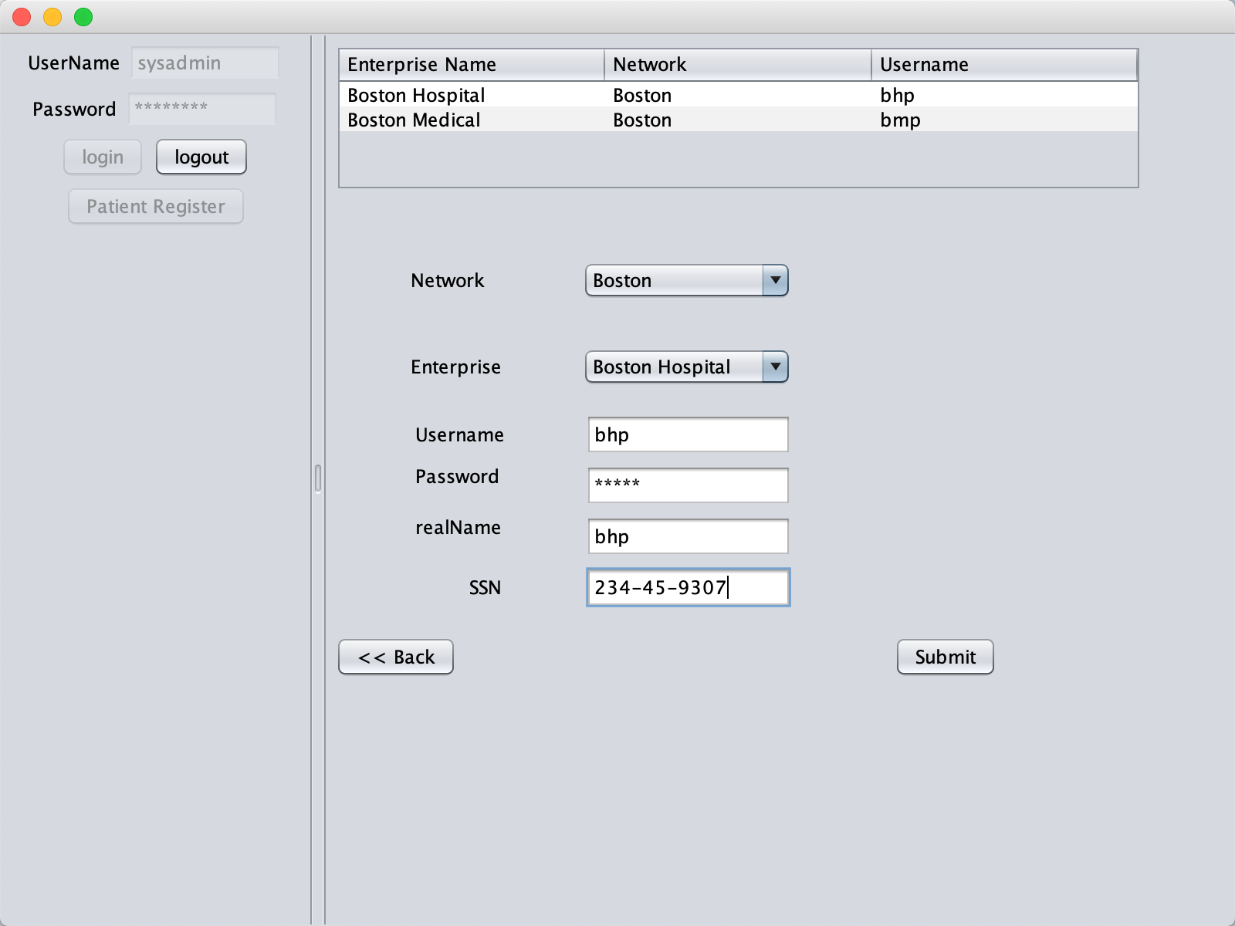
Demo Model
Assign Personal Department first
Personal Department helps manage Organization/Employee/User in the Enterprise

Slide 16
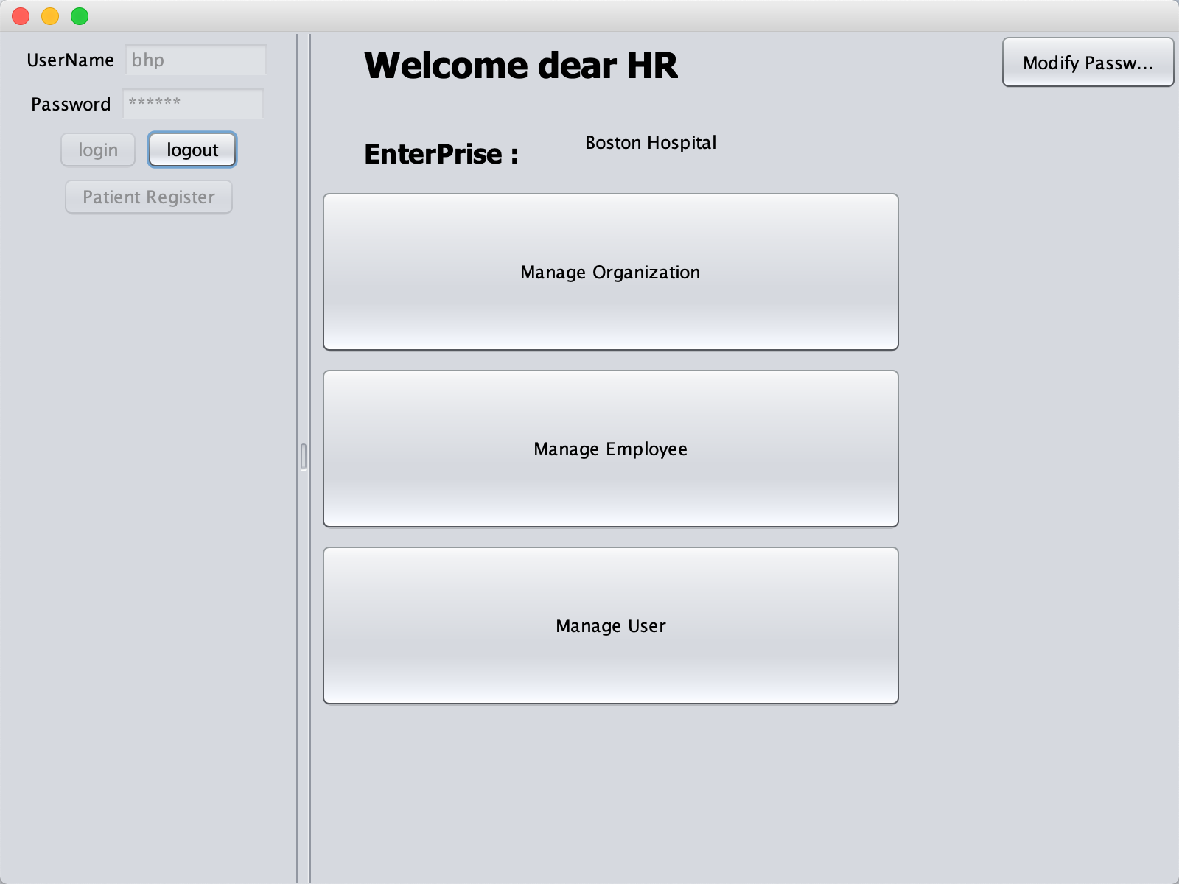
Demo Model
Login as a HR in Personal Department

Slide 17
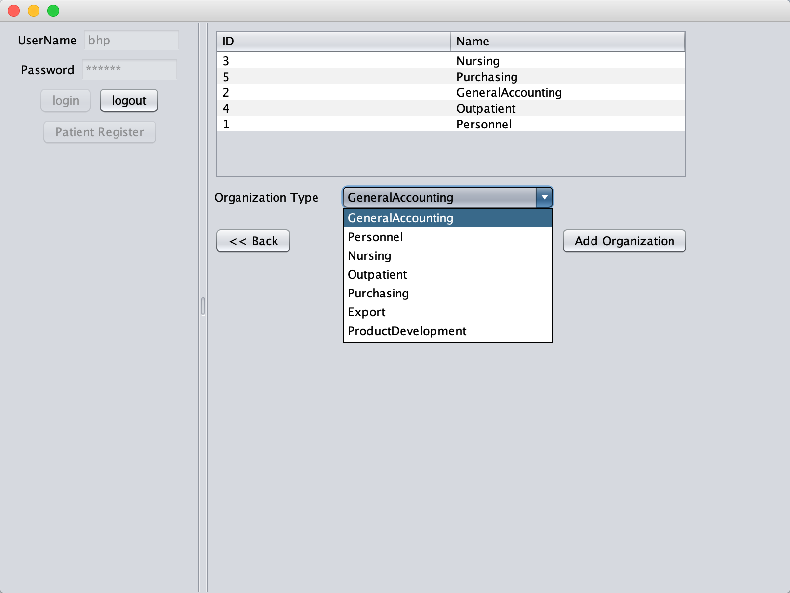
Demo Model
Add Organization in the enterprise

Slide 18
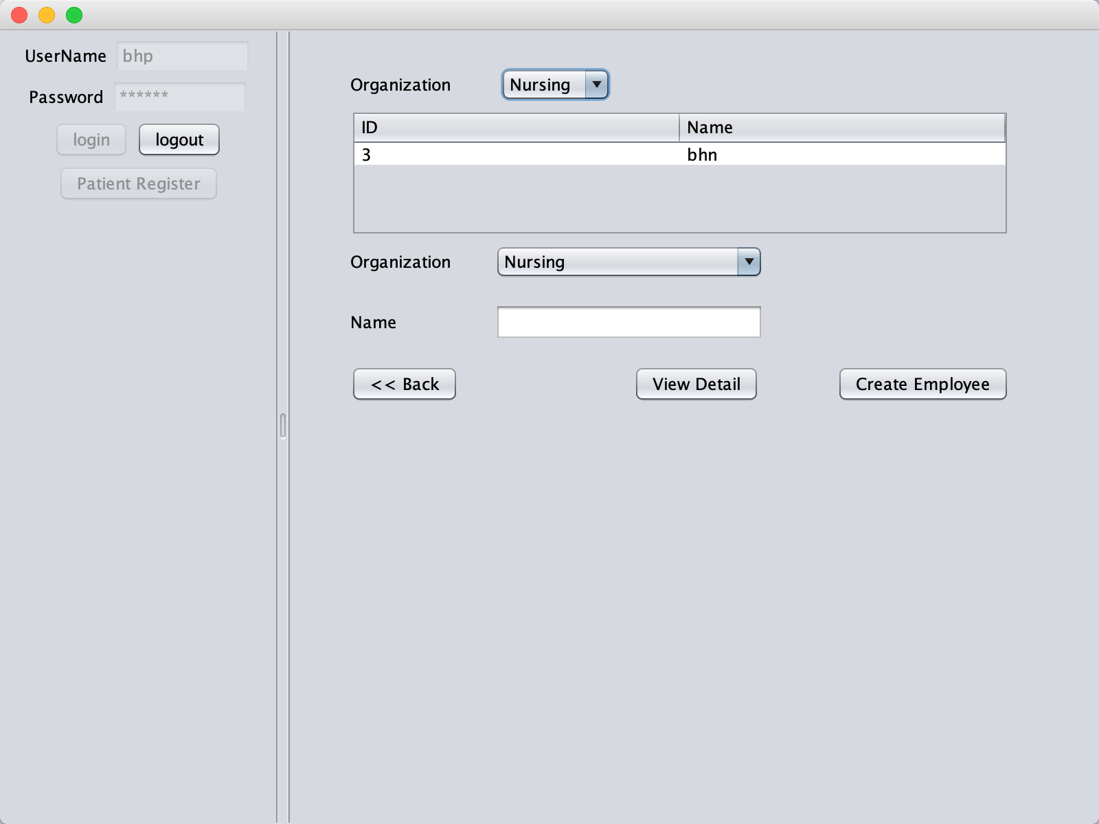
Demo Model
Check employees in different organizations
Add more employees

Slide 19
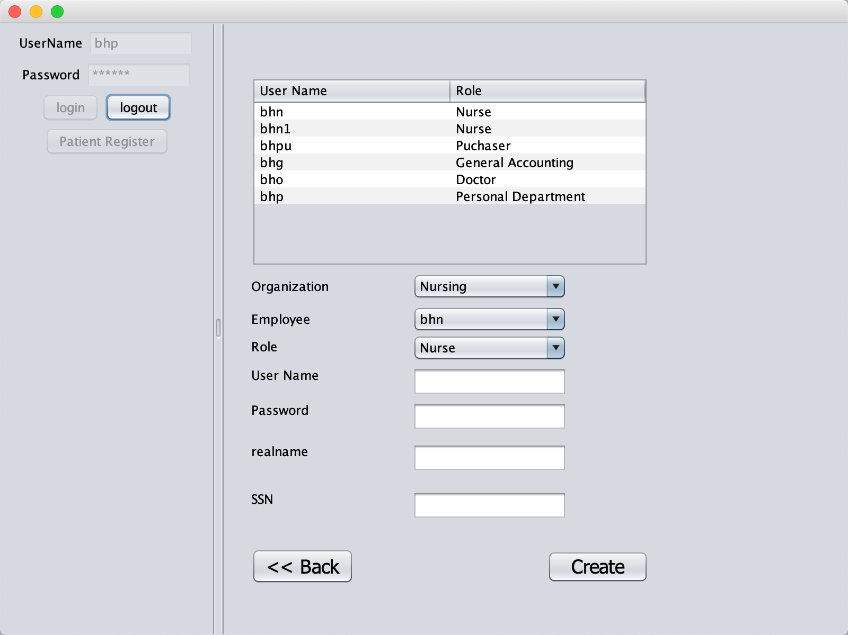
Demo Model
When employees added, allocate user account to each users.

Slide 20
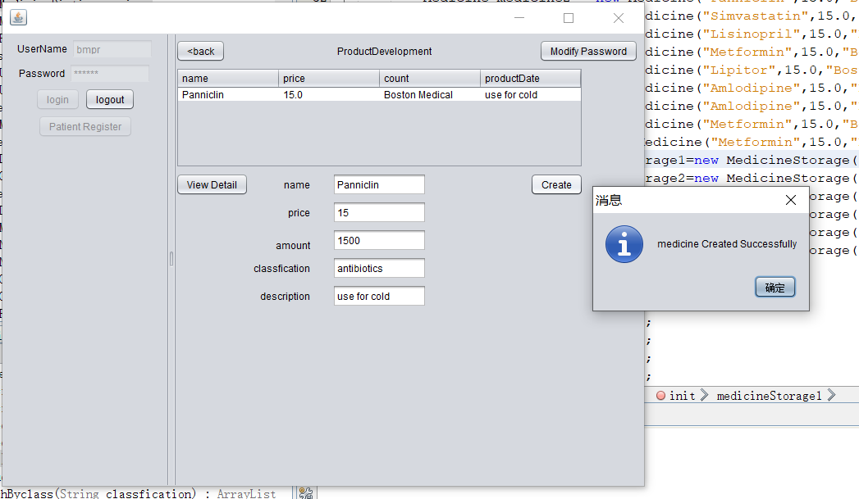
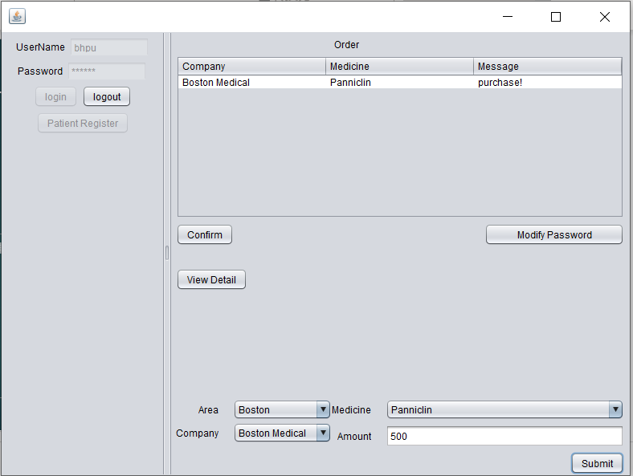
Demo Model(purchase & medicine)
Produce medicine(product development from Medical enterprise)
purchase medicine(purchasing from hospital)

Slide 21
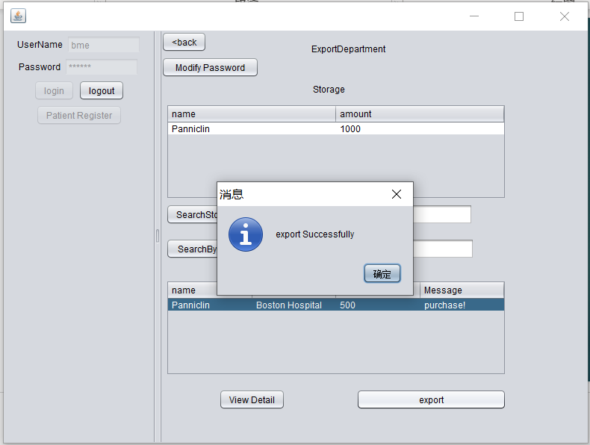
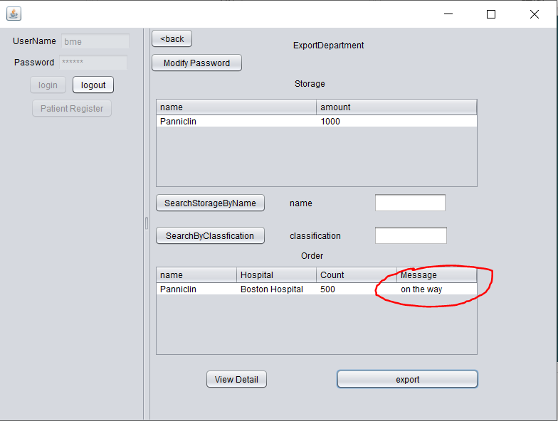
Demo Model
export
Status changed

Slide 22
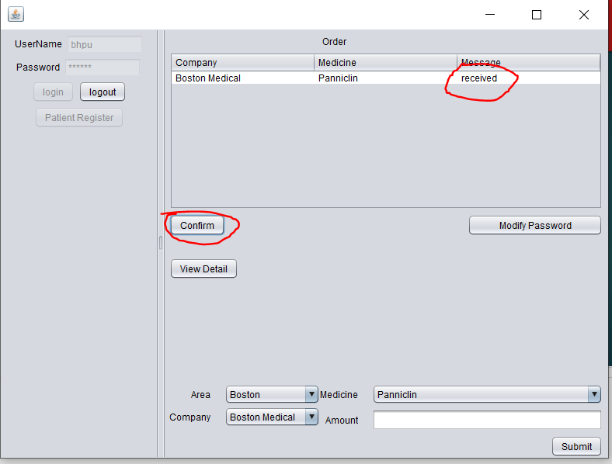
Demo Model
Hospital confirm

Slide 23
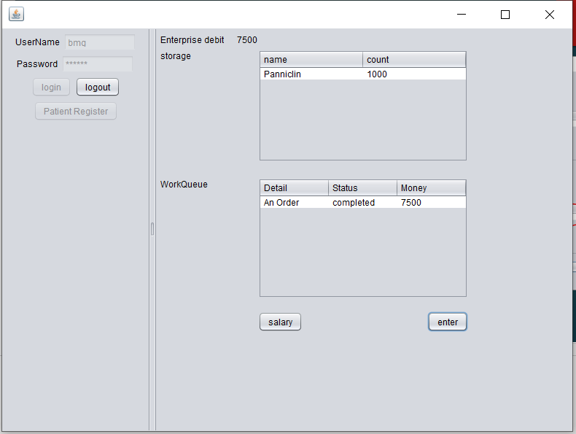
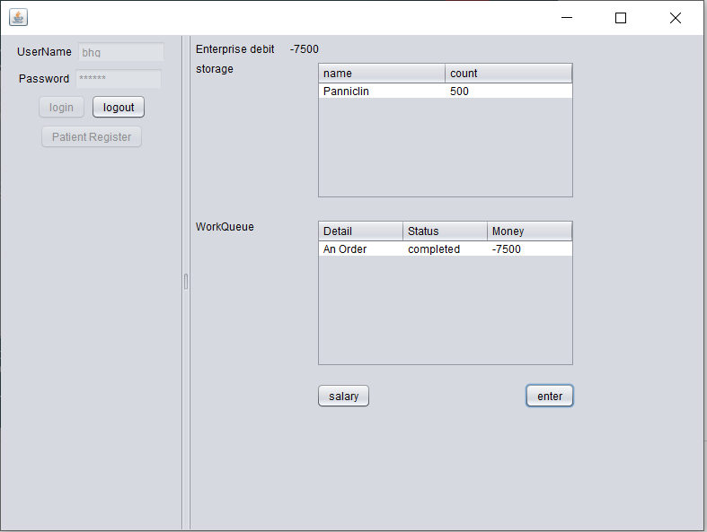
Demo Model
Storage and Debit changed when confirm the order by GA department(this is medical enterprise version)
Storage and Debit changed when confirm the order by GA department(this is hospital version)

Slide 24
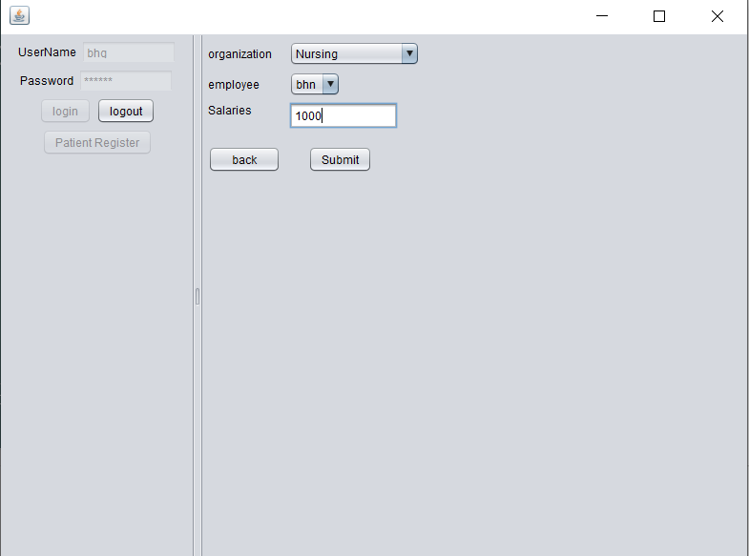
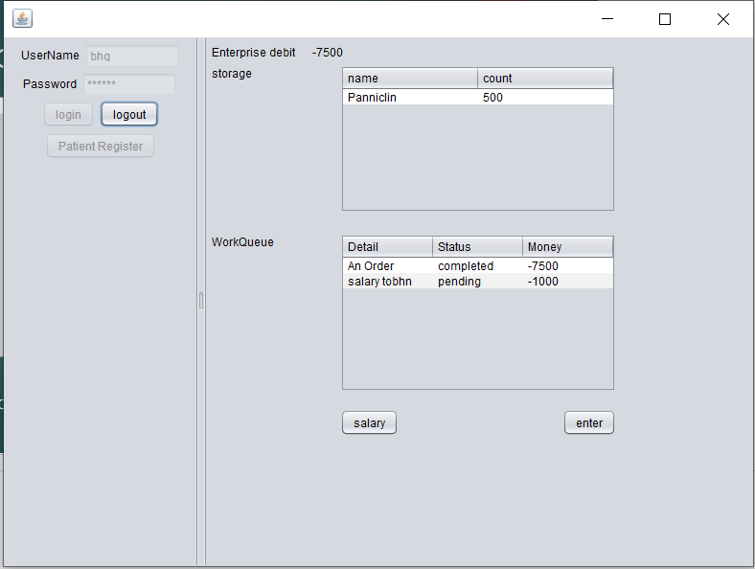
Demo Model
Also we can distribute salaries by generate accounting (debit not changed since this is pending request)

Slide 25
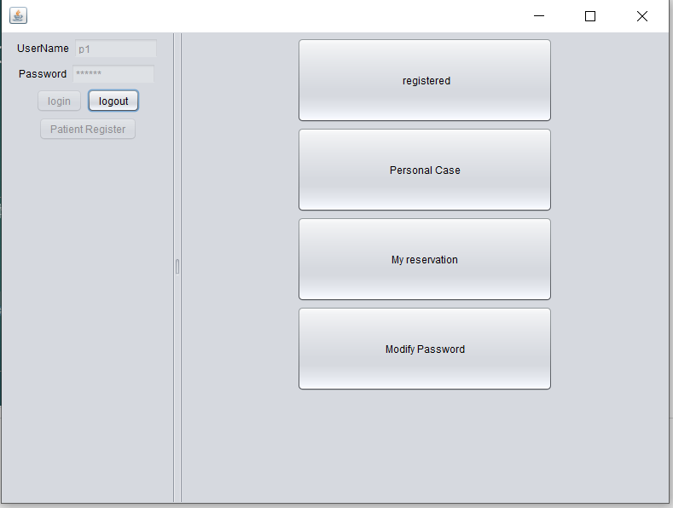
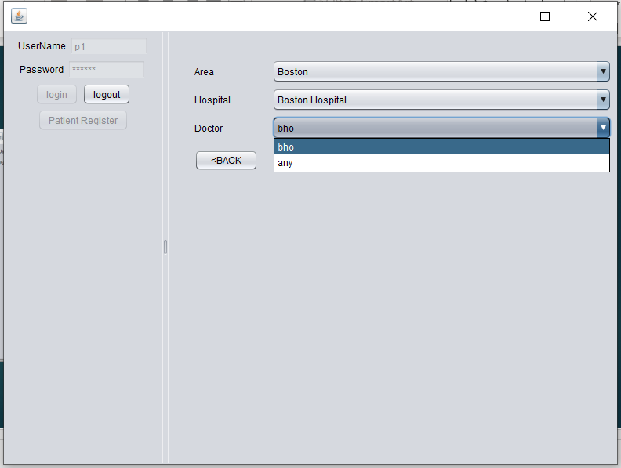
Demo Model(see a doctor)
Main panel of patient
Reserve a doctor

Slide 26
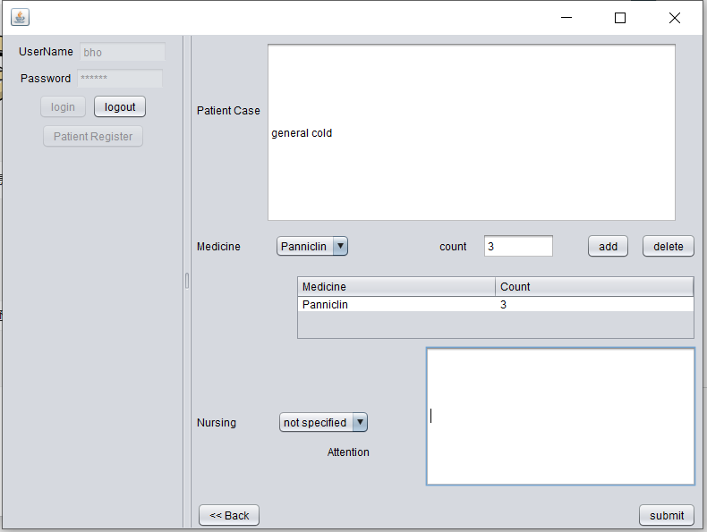
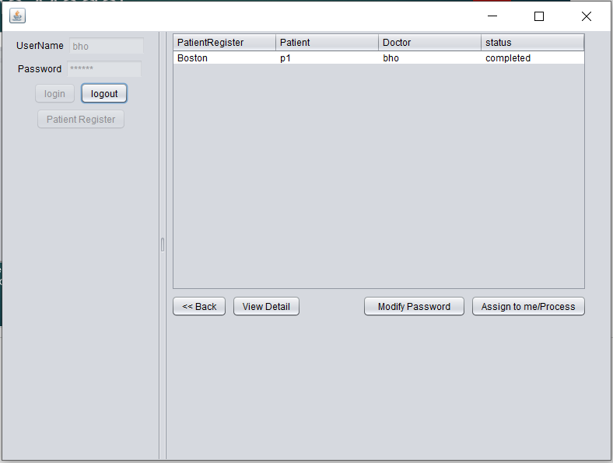
Demo Model
Create a patient case in outpatient by doctor

Slide 27
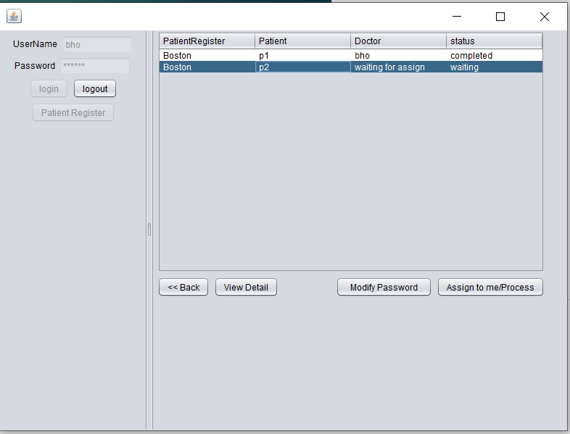
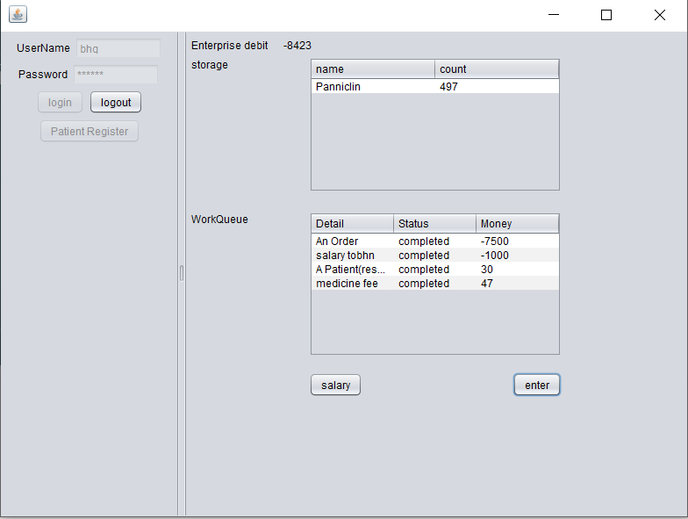
Demo Model
Get bill and confirm it, the price of the medicine(default) is import price*1.0625, and changed storage
Second demo for nursing and not assign the doctor

Slide 28
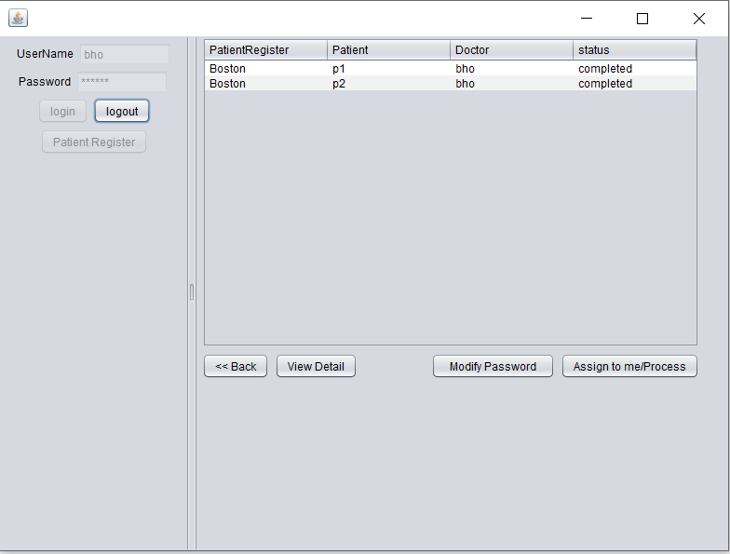
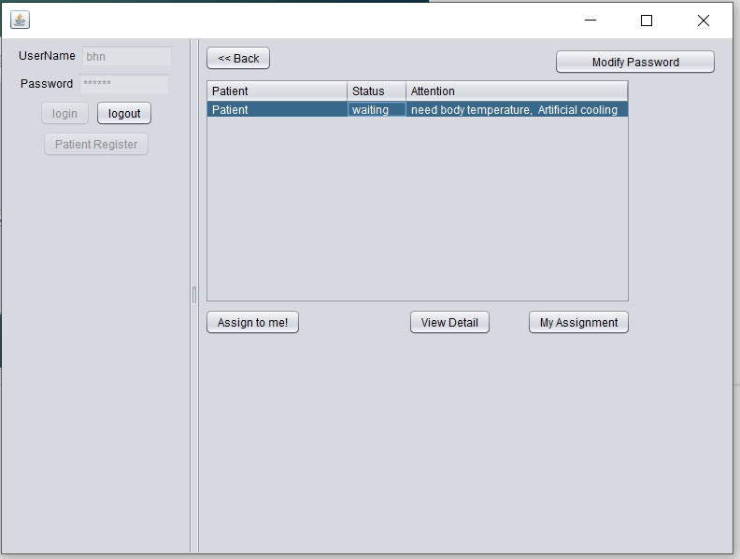
Demo Model
Nursing request
After treatment record the doctor

Slide 29
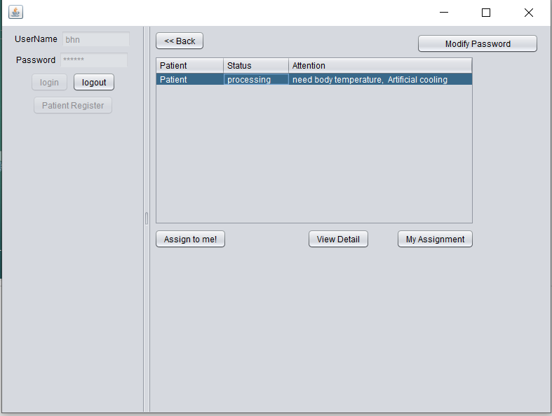
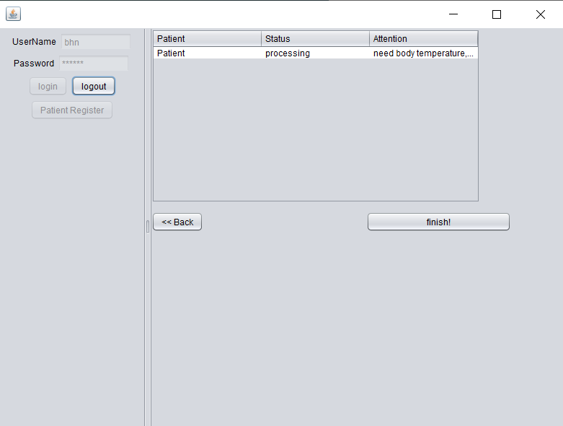
Demo Model
When assign to a nursing, the status changed to processing
And in assigned nurse panel, we can see the assignment and finish it.

Slide 30
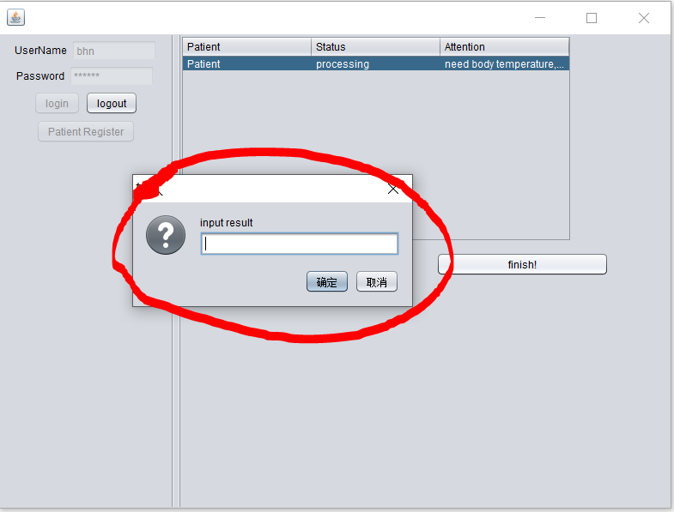
Demo Model
We can input the treatment result in box

Slide 31
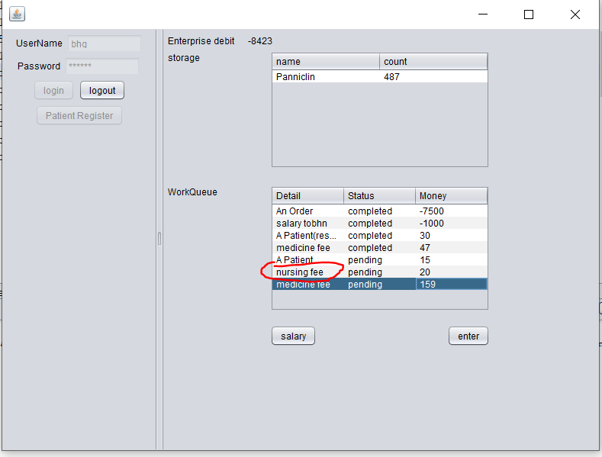
Demo Model
Also it will generate nursing fee

