Slide 1
V-Playground
001305818 xuliang mei 001080796 Jun ma
001304250 yuchen bao yu chen

Slide 2
Contents
1.project description
2.use case
3.data structure
4.feature

Slide 3
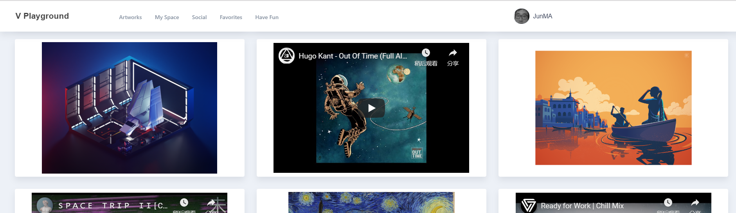
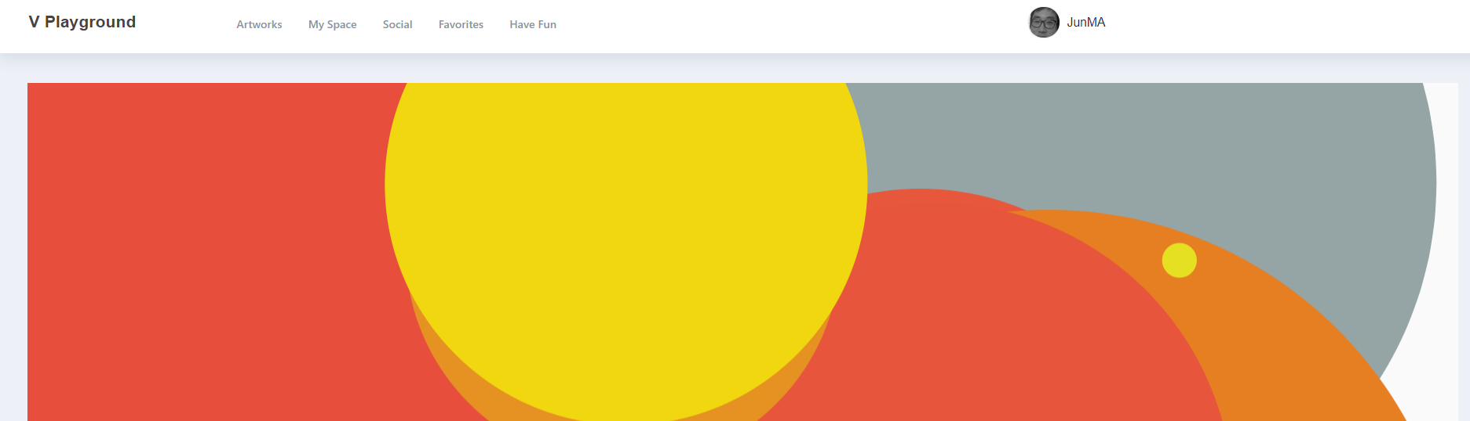
project description
Share artwork-oriented entertainment homepage
Video from YouTube URL
Picture from user’s computer
A patatap (game) platform
Instant comment in artwork’s detail page

Slide 4
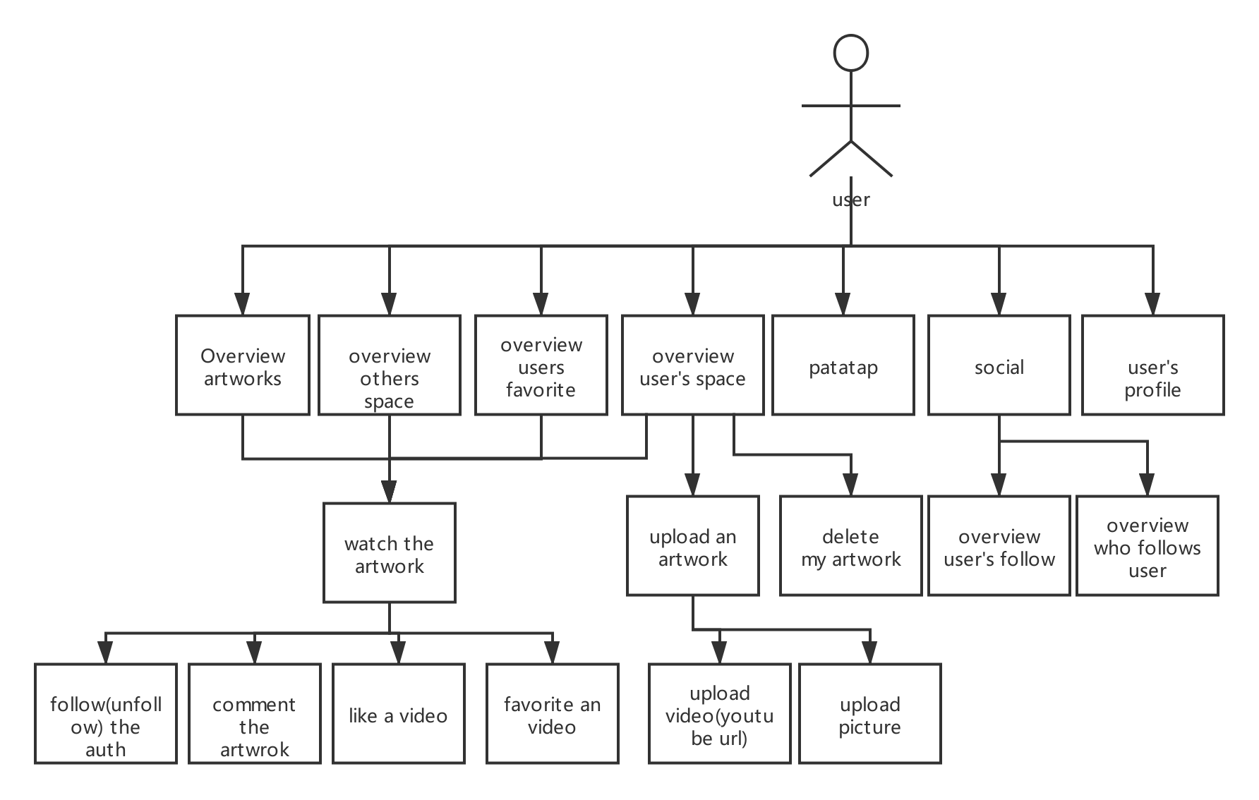
Use case

Slide 5
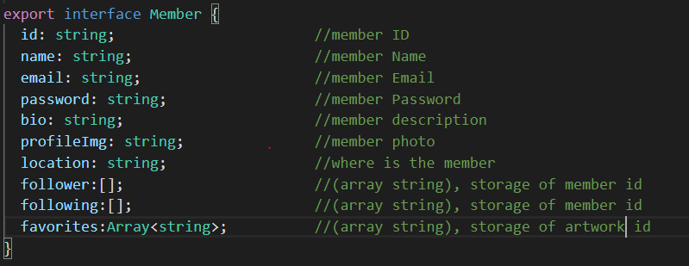
Data structure(member data)

Slide 6
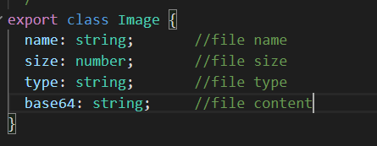
File Data

Slide 7
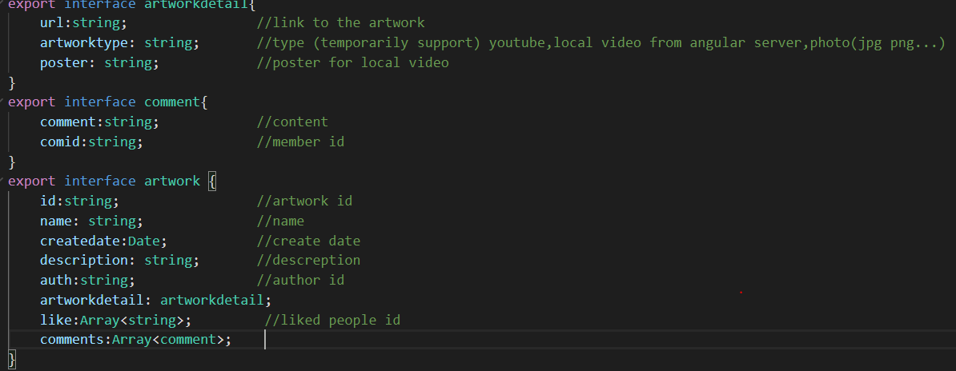
Artwork data

Slide 8
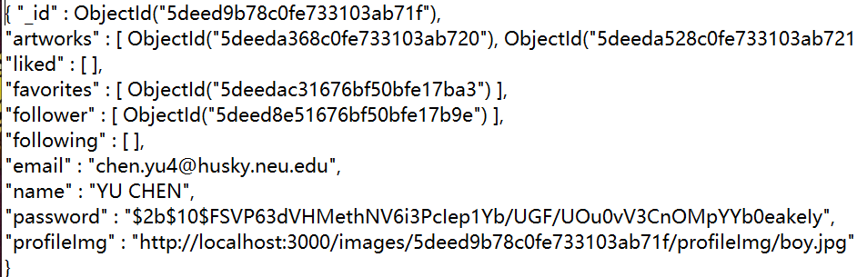
Feature(indirectly show in demo)
1.Password is Encrypted, the origin password for this account is “final”
2.Delete remote file when user have delete action through the web.
3.Only Specified file(the last selected file) will upload successfully.

