Slide 2
Taming Unbounded Resources with Node Feature Discovery
Mark Abrams
Notes:
Welcome to Taming Unblounded Resources with Node Feature Discovery
My name is Mark Abrams
I am a Field Engineer and Edge Specialist at SUSE/Rancher
First of all, I just want to take a minute to say that the edge means different things to different stakeholders.
For some, the edge is the edge of the cloud - it functions like cloud but it’s slightly closer to where data is generated.
In this presentation, I am talking about the compute and Kubernetes at the edge of the network
For example we see this edge use case
in Factories
in Retail
in Energy
in the Automotive and Aerospace industries
in Smart cities
There are many other industries
This is really about the leaf clusters at the edge of the network.
With that, lets take a look at Node Feature Discovery

Slide 3
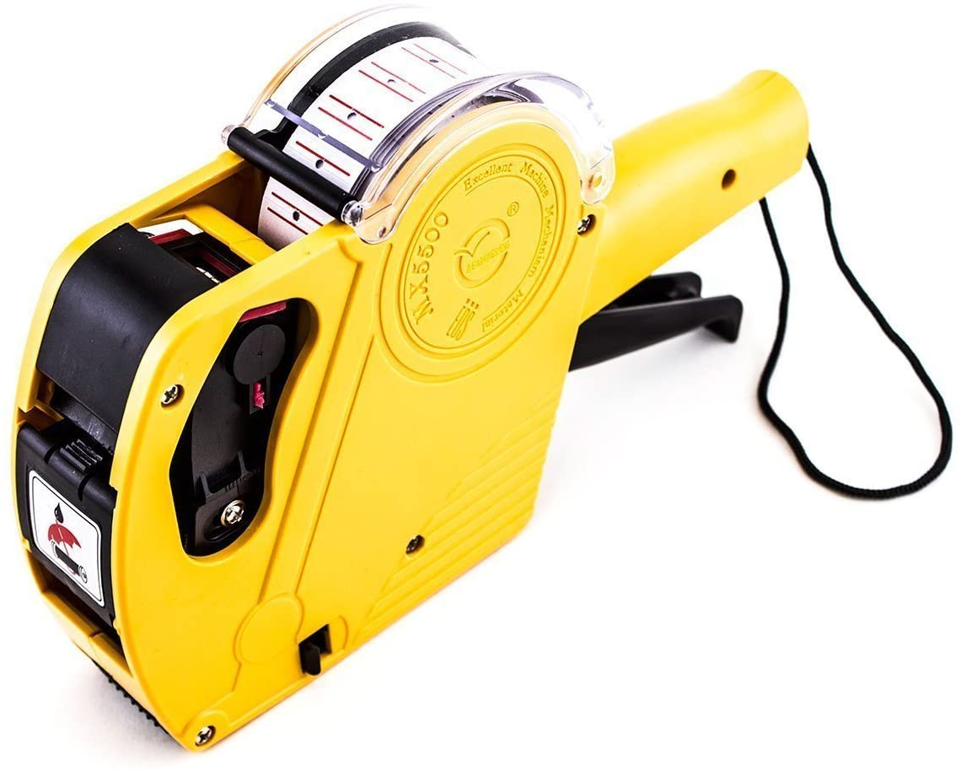
What is Node Feature Discovery (NFD)
NFD is simply a fancy labeler
K8s node labels
Notes:
Node Feature Discovery is simply a fancy labeler.
You can use it to label kubernetes nodes

Slide 4
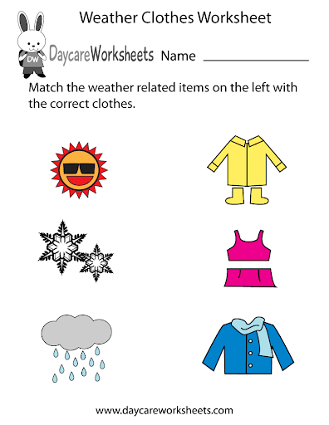
Why do I need a labeler
Mapping workloads to appropriate resources
Resources
Workloads
Notes:
Why do I need a labeler?
The number one benefit is for the ease of mapping workloads to resources

Slide 5
Why do I need a labeler
Because we are delivering cattle not pets
Volume - a large number of devices
Efficiency
Accuracy
Resources at the Edge
Are not just CPU and RAM
Are Unbounded
Notes:
In addition, I would say that
With massive numbers of devices, we must automate.
The resource types we are targeting don’t fall neatly into the CPU and RAM category
And additionally, we have the challenge that Edge resource capabilities are unbounded

Slide 6
Unbounded Resources?
K8s is designed to schedule workloads against resources
In the data center (first class features of k8s)
CPU
RAM
GPU
At the edge (not schedulable by default)
Unlimited number of I/O devices are possible
Sensors
Actuators
Notes:
What do I mean by unbounded resources?
I say unbounded because these unique resources are not infinite, but there is really no limit to what device might be attached to your nodes.
Within your individual use case, there is a finite set of target resources.
That’s good because labels can be used to classify and give logical boundaries relevant to each individual enterprise
At the edge, resource examples are
USB
GPU
NICs
FPGA
Video IN/OUT
Radios like (LoRA/BLE/WiFi)
I2C or other Serial interfaces
ETC.

Slide 7


w/o NFD - Childs Play
Do you have any 3’s
Go fish
Notes:
Without NFD and large numbers of clusters it could be like playing a game of go fish.
I don’t know if you are familiar with this game
basically you take turns with your opponents asking if they have the resource you need
it’s a guessing game
eventually you can use cache and history to make more accurate guesses
Obviously, In the real world, we shouldn’t guess which devices have the right resources
NFD takes the guesswork out of it

Slide 8
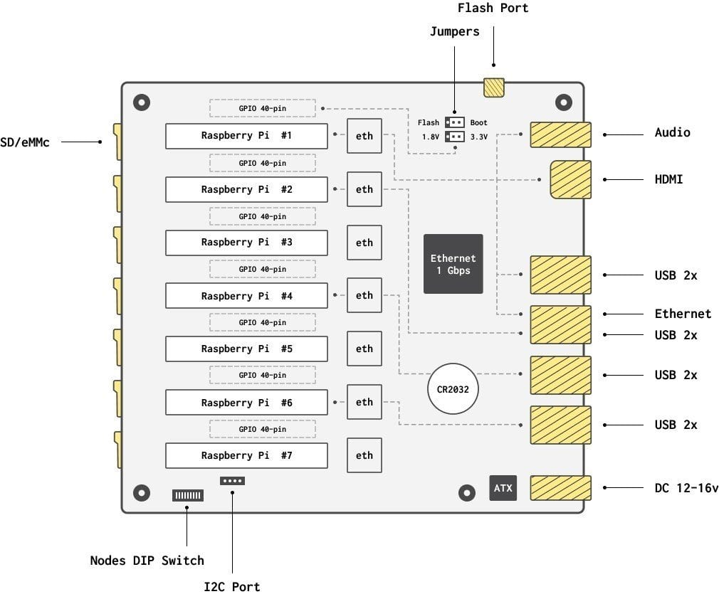
Demo Infrastructure - turingpi v1
7 RaspberryPi CM3+ modules
1GB RAM
4 CPU
8 USB ports
Map to only 4 devices
I2C interface
Maps to all devices
Communication between devices
GPIO
40 pins for each device

Slide 9
Demo Infrastructure - turingpi v1
7 RaspberryPi CM3+ modules
1GB RAM
4 CPU
8 USB ports
Map to only 4 devices
I2C interface
Maps to all devices
Communication between devices
GPIO
40 pins for each device
Notes:
I am going to demonstrate the power of NFD. First I want to show my cluster architecture for the demo.
This is a turingpi v1 board
It has 7 raspberry pi compute modules
Each module is a Raspberry Pi CM 3 plus with 1 gig RAM and 4 CPU per device
On device node 7, I run the master and the remaining 6 devices are workers.

Slide 10
Demo Infrastructure - turingpi v1
7 RaspberryPi CM3+ modules
1GB RAM
4 CPU
8 USB ports
Map to only 4 devices
I2C interface
Maps to all devices
Communication between devices
GPIO
40 pins for each device
7
1
Hostname: turingpi02
2
3
4
5
6
Notes:
This is not terribly relevant to the demo but I’m sure someone will notice
The node numbers and host names do not match up with the device numbers in this diagram.
Here you can see that the host named turingpi02 is actually in device slot 3

Slide 11
Demo Infrastructure - turingpi v1
7 RaspberryPi CM3+ modules
1GB RAM
4 CPU
8 USB ports
Map to only 4 devices
I2C interface
Maps to all devices
Communication between devices
GPIO
40 pins for each device
Notes:
That’s the compute aspect. Let’s look at the attached devices and peripherals.
Here are a bunch of USB ports.
There are 8 ports which map to only 4 of the 7 compute modules

Slide 12
Demo Infrastructure - turingpi v1
7 RaspberryPi CM3+ modules
1GB RAM
4 CPU
8 USB ports
Map to only 4 devices
I2C interface
Maps to all devices
Communication between devices
GPIO
40 pins for each device
Notes:
For example
The compute module at device slot 2 has access to the set of usb connectors shown here

Slide 13
Demo Infrastructure - turingpi v1
7 RaspberryPi CM3+ modules
1GB RAM
4 CPU
8 USB ports
Map to only 4 devices
I2C interface
Maps to all devices
Communication between devices
GPIO
40 pins for each device
Notes:
There is also an I2C hub on the turingpi
Every compute module has access to the i2c hub
Out of the box,
the hub exposes a real time clock,
the ethernet hub and
power management for all 7 devices

Slide 14
Demo Infrastructure - turingpi v1
7 RaspberryPi CM3+ modules
1GB RAM
4 CPU
8 USB ports
Map to only 4 devices
I2C interface
Maps to all devices
Communication between devices
GPIO
40 pins for each device
Notes:
This board also offers up 40 pins of general purpose input output for each individual device
I’d like to show you now how we can use Node Feature Discovery to access these three different resource types

Slide 15
Demo
Notes:
Let’s kick off the demo

Slide 16
How does it work
Two Kubernetes Resources
NFD Master (Deployment)
NFD Worker (DaemonSet)
Notes:
Very simply
The NFD worker is a daemonset and scans the nodes for capabilities based on configuration. It reports what it finds to the NFD master.
The NFD master is a deployment and it issues the api commands to label the nodes

Slide 17
How does it work
Operations team responsibilities
Know your devices
Create configuration defining known resources
NFD does the rest
Notes:
From a human perspective,
The operations team needs to know their devices and
Create configuration to expose resources
NFD does the rest

Slide 18
Install Node Feature Discovery
CRDs
K8s templates (yaml config)
Helm Chart
Operator
NFD does what it does based on a configuration file
Configmap is the key to the labeling
Notes:
How do we install it?
Using your standard Kubernetes install techniques
Kubernetes resource configs
Helm chart
Operator
When the underlying configmap changes, the worker reloads it.

Slide 19
Example ConfigMap
#core:
# labelWhiteList:
# noPublish: false
# sleepInterval: 60s
# sources: [all]
# klog:
# addDirHeader: false
# alsologtostderr: false
# logBacktraceAt:
# logtostderr: true
# skipHeaders: false
# stderrthreshold: 2
# v: 0
# vmodule:
# logDir:
# logFile:
# logFileMaxSize: 1800
# skipLogHeaders: false
sources:
# cpu:
# cpuid:
## NOTE: whitelist has priority over blacklist
# attributeBlacklist:
# - "BMI1"
# attributeWhitelist:
# kernel:
# kconfigFile: "/path/to/kconfig"
# configOpts:
# - "NO_HZ"
# - "X86"
# - "DMI"
usb:
deviceClassWhitelist:
- "03"
deviceLabelFields:
- "class"
- "vendor"
- "device"
Notes:
Here is a snippet of the configmap I used.
* on the left side, you can see at the bottom, my usb device class zero three
This is all pretty simple, I run NFD with my unique configuration and labeling happens.
There is one non-trivial issue for use at the edge.
At the edge, we are managing not one single massive cluster but a multitude of smaller clusters.
We are also adding, removing and changing the resources on these clusters over time.
How can NFD be managed across hundreds or thousands of clusters?
Let’s look at some architectures as we consider this problem.

Slide 20
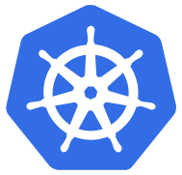
Practical NFD - Architecture Review
Data Center / Cloud
dev
test
staging
prod
Notes:
Here is a typical data center and cloud deployment of Kubernetes.
It is application lifecycle focused with one kubernetes cluster per development environment.
Red lines represent the cluster boundaries.
My little turingpi cluster represents something akin to just one of these environments
I showed you how to manage differences on 6 nodes with changes to a single NFD configuration.

Slide 21
Practicatl NFD - Architecture Review
Data Center / Cloud
dev
test
staging
prod
Edge - Its all production
Notes:
Compare the data center with the edge scenario
Here are 32 edge clusters
Each cluster is a production cluster.
Also, In most of the edge scenarios I’ve come across, we’re talking easily 10 or 100x the number of clusters shown here.
Should we play Go Fish?
No, I don’t think so

Slide 22
GitOps for Apps and NFD at the Edge
Rancher Fleet
Argo CD
Flux
Notes:
I believe that the current work on gitops tooling can help us solve this scale problem
Of these 3 tools, I am really only familiar with Fleet
In Fleet, it is possible to manage large numbers of clusters and target workloads and custom configs to the clusters based on matching.
Fleet has been tested with one million clusters for example
Despite the large scale that Fleet can handle, there is still a gap
Fleet does not have an auto cluster labeler at this time.
The concept of Cluster is a CRD in fleet but not in Kubernetes.
Currently each gitops tool may be offering a different solution for centralized node label management
I believe the Kubernetes SIG Cluster API may hold the answer.
This is perhaps a topic for another day.

Slide 23
Example gitops workflow
Install NFD via the gitops pipeline into every cluster
Setup NFD configmap and commit to pipeline
The system managing the clusters should automatically
recognize changes in downstream cluster node labels and
update the cluster labels accordingly
Notify developers
of the node labels available
and what resource it maps to
Repeat steps 2 - 4 on changes, hardware updates, etc.
Notes:
Here is what I envision the gitops pipeline would look like
First install NFD using the gitops pipeline itself.
Second - Of course, setup your configuration.
I would then configure Fleet to automatically update node labels (this is a feature enhancement request)
Finally, notify developers what labels they should target resources using nodeSelectors
As resources change, we can repeat step 2-4 as needed.

Slide 24
Security
Mutual TLS capable between nfd-master and nfd-worker
Risk: Allowing Local - user specific features
will execute arbitrary files located in
/etc/kubernetes/node-feature-discovery/source.d on the host
Limit features discovered by specifying exact sources
Whilelist/Blacklist features
nfd-worker.conf:
set only specific sources
e.g. sources: [usb,custom,local]
Notes:
Of course, every tech talk needs to address security
With Node Feature Discovery, it is currently possible to configure TLS between the NFD services
I belive the local - user specific features, such as how I enabled gpio is a security risk.
NFD will execute any script or binary in the directory used for this feature.
The operation is happening inside the container so there might be ways to mitigate this by using non-privileged containers.
I have not fully explored the NFD worker container host access requirements
It is also possible to reduce the attack surface by limiting what features are usable in the configuration file
for example by not allowing local - user specific features

Slide 25
NFD Summary
Label nodes in a cluster
NFD configuration is cluster scoped
The edge will be thousands of single node or small clusters
External tooling is needed to find groups of the same feature (gitops)
Feature discovery can be specified via configuration file
Limited features types
Non kernel module features can be added using the local option
Compare with Kubernetes device plugins
Notes:
A quick summary of Node Feature Discovery
labels are applied to nodes in a cluster
gitops may be useful in labeling many clusters
features are unlocked using configuration
NFD has a limited number of out of the box feature types including kernel module discovery
The local type can be used when no default type is available
One thing to note is that when using the local option,
at what point does it make more sense to use device plugins instead.

Slide 26
NFD Summary
NFD allows drop in configmaps to another location
Vendors can/should provide configs for their devices
The NVIDIA GPU operator currently takes advantage of NFD
NFD is not “just” a labeler.
It is a dynamic labeler
It is a configurable labeler
Notes:
I didn’t show this but there is a mount in the container for uniquely named configuration files instead of the default nfd-worker-conf
This functionality lends itself to having vendors provide configurations for. their own devices
In the beginning I said NFD is just a labeler.
It is both dynamic and configurable and can be a very powerful asset to Kubernetes edge deployments

Slide 27
NFD Summary - Pitfalls
Kernel module existence is not a guarantee of functionality
Kernel models can be loaded that have no physical counterpart
K8s health checks may add value here
Hot plugging devices works but it is not immediate
Kubernetes will need some cycles to label
Re-labeling may also require redeployment of workloads
Notes:
One last thing. Pitfalls
Just because I discovered a kernel module is loaded, does not mean there is a device on the other end.
I have for example a node that has the i2c capability but when I physically unplug the device, this wont work.
Using Kubernetes healthchecks should be used as part of the feature discovery process.
It might be prudent to create scout processes that maintain liveness and readiness on removable devices.
Speaking of removable devices
Hot plugging is possible as I showed by moving the usb device however it is not immediate
re-labeling takes time and Kubernetes will take some time to redeploy workloads.

Slide 28
Links
https://kubernetes-sigs.github.io/node-feature-discovery/v0.8/get-started/
https://kubernetes-sigs.github.io/node-feature-discovery/v0.8/get-started/features.html
https://www.usb.org/defined-class-codes
https://k3s-io/k3s
https://github.com/mak3r/nfd-demo
Notes:
Here are some links to the content I showed today.
I didn’t mention it before but my Kubernetes distro is k3s and
you can download this presentation and the my prep notes on github at mak3r/nfd-demo

Slide 29
Thank you
Mark Abrams - Field Engineer and Edge Specialist SUSE
Notes:
My name is Mark Abrams,
I contribute to open source and you can too.
Thank you

Slide 30
Setting up USB detection
Configmap now has
feature.node.kubernetes.io/usb-ff_0424_ec00.present:true
Notes:
Notice, on the first output line, that’s the Ethernet adapter.
This is a turingpi with 7 RasberryPi CM3+ modules attached.
Let’s see if we can detect something plugged into one of the hubs on device 002 or 001

Slide 31
Setting up USB detection
Turingpi v1
Notes:
Here’s a diagram of the device.
My master node is on the last one labeled #7 in this diagram
I plugged a device into the usb port that’s connected to #4 (which is named turingpi03 in my cluster)

Slide 32
Setting up USB detection
Turingpi v1

Slide 33
Setting up USB detection
cluster node 3
markabrams@mak3r:~/dev/nfd-demo$ ssh tp3 lsusb
Warning: Permanently added the ECDSA host key for IP address 'fe80::d6d1:e799:44cf:e359%en13' to the list of known hosts.
Bus 001 Device 004: ID 0c45:7603 Microdia
Bus 001 Device 003: ID 0424:ec00 Standard Microsystems Corp. SMSC9512/9514 Fast Ethernet Adapter
Bus 001 Device 002: ID 0424:9514 Standard Microsystems Corp. SMC9514 Hub
Bus 001 Device 001: ID 1d6b:0002 Linux Foundation 2.0 root hub
markabrams@mak3r:~/dev/nfd-demo$ ssh tp6 lsusb
Bus 001 Device 003: ID 0424:ec00 Standard Microsystems Corp. SMSC9512/9514 Fast Ethernet Adapter
Bus 001 Device 002: ID 0424:9514 Standard Microsystems Corp. SMC9514 Hub
Bus 001 Device 001: ID 1d6b:0002 Linux Foundation 2.0 root hub
Notes:
Comparing it to the other node we looked at,
we can see now a microdia device

Slide 34
Setting up USB detection
cluster node 3 - usb labels
feature.node.kubernetes.io/usb-ff_0424_ec00.present:true
Notes:
But it still doesn’t show up as a label on our node
Let’s find out the configuration we need to set up

Slide 35
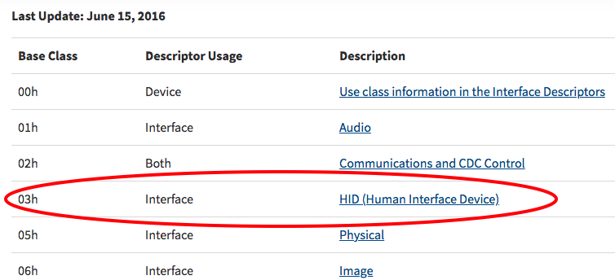
Setting up USB detection
Class=Human Interface Device
https://www.usb.org/defined-class-codes
markabrams@mak3r:~/dev/nfd-demo$ ssh tp3 lsusb -t
/: Bus 01.Port 1: Dev 1, Class=root_hub, Driver=dwc_otg/1p, 480M
|__ Port 1: Dev 2, If 0, Class=Hub, Driver=hub/5p, 480M
|__ Port 1: Dev 3, If 0, Class=Vendor Specific Class, Driver=smsc95xx, 480M
|__ Port 3: Dev 4, If 0, Class=Human Interface Device, Driver=usbhid, 1.5M
|__ Port 3: Dev 4, If 1, Class=Human Interface Device, Driver=usbhid, 1.5M
Notes:
We need more info and we’ll cross reference the device specs at usb.org
hex 03 is what we’re looking for.

Slide 36
Setting up USB detection
Default for usb configuration in NFD
# usb:
# deviceClassWhitelist:
# - "0e"
# - "ef"
# - "fe"
# - "ff"
# deviceLabelFields:
# - "class"
# - "vendor"
# - "device"

Slide 37
Setting up USB detection
Modified usb configuration in NFD
usb:
deviceClassWhitelist:
- "03”
# - ”0e"
# - "ef"
# - "fe"
# - "ff"
deviceLabelFields:
- "class"
- "vendor"
- "device"
Notes:
I do not know how it found the USB ethernet device

