Slide 1

Kotlin for Android #1
Maxim Leykin (maxim.leykin@gmail.com)

Slide 2





What is Kotlin ?
Statically-typed programming language
Targets JVM, Android and Javascript
Fully interoperable with Java
Developed by Jetbrains
https://kotlinlang.org/
Kotlin-class destroyer

Slide 3
Kotlin Resources
https://kotlinlang.org/
https://m.signalvnoise.com/kotlin-its-the-little-things-8c0f501bc6ea
https://www.jetbrains.com/
https://www.slideshare.net/intelliyole/kotlin-why-do-you-care
https://github.com/ReactiveX/RxKotlin
https://spring.io/blog/2016/02/15/developing-spring-bootapplications-with-kotlin
https://www.slideshare.net/makingx/spring-kotlin
https://kotlin.link/

Slide 4

Kotlin History
Announced in 2011 by JetBrains
Version 1.0 released in 2016
Android adopted Kotlin as a “first-class” language in 2017
Kotlin v1.2 was released on 28 November 2017. Sharing code between JVM and Javascript platforms feature was newly added to this release.
Kotlin v1.3 was released on 29 October 2018, bringing coroutines for asynchronous programming.
On 7 May 2019, Google announced that the Kotlin programming language is now its preferred language for Android app developers.
The current version is Kotlin 2.0.20

Slide 5
What’s wrong with Java (6)?
NullPointerException
Tons of boilerplate code
No type inference
No lambdas
No streams
No string interpolation
Inconvenient working with embedded DSL
Inconsistent exceptions (checked vs unchecked)
No pattern matching

Slide 6
Which of them are solved by Kotlin?
NullPointerException
Tons of boilerplate code
No type inference
No lambdas
No streams
No string interpolation
Inconvenient working with embedded DSL
Inconsistent exceptions (checked vs unchecked)
No pattern matching

Slide 7

And what’s wrong with Kotlin?
Most part of mature languages have stable specification (“Bible”):
Source of truth
If something works incorrect we can find root cause of the problem
Kotlin Language Specification (https://kotlinlang.org/spec/introduction.html) is still in progress and has experimental stability level, meaning no compatibility should be expected between even incremental releases, any functionality can be added, removed or changed without warning.

Slide 8
Hello, Kotlin!
fun main(args: Array<String>) {
println(”Hello, Kotlin!”)
}
Kotlin allows functions as compilation modules without classes
Type goes after the name
No ;
No System.out

Slide 9
val vs. var
fun main(args: Array<String>) {
require(args.size > 0)
val firstName: String = args[0]
var lastName = args[args.lastIndex]
lastName = ”Leykin”
println(”Hello, $firstName $lastName”)
}
require() - precondition from standard library, if main() is called with empty argument throws IllegalArgumentException
val – immutable variable (like final)
var – mutable variable
type can be omitted (type inference works in Kotlin)
$ stands for string interpolation, substitutes by value

Slide 10
Nullability
fun getFirstName(args: Array<String>): String? {
if (args.size > 0) return args[0]
else return null
}
fun getLastName(args: Array<String>): String? {
if (args.size > 1) return args[args.lastIndex]
else return null
}
String? – can be null, otherwise – can’t be null (non-nullable type)

Slide 11
If is an expression and has value
fun getFirstName(args: Array<String>): String? {
return if (args.size > 0) args[0]
else null
}
fun getLastName(args: Array<String>): String? {
return if (args.size > 1) args[args.lastIndex]
else null
}

Slide 12
Function Body
fun getFirstName(args: Array<String>): String? =
if (args.size > 0) args[0]
else null
fun getLastName(args: Array<String>): String? =
if (args.size > 1) args[args.lastIndex]
else null

Slide 13
Add Type Inference
fun getFirstName(args: Array<String>) =
if (args.size > 0) args[0]
else null
fun getLastName(args: Array<String>) =
if (args.size > 1) args[args.lastIndex]
else null

Slide 14

“Elvis” operator
fun main(args: Array<String>) {
val firstName = getFirstName(args) ?: ”John”
val lastName = getLastName(args) ?: ”Doe”
println(”Hello, $firstName $lastName”)
}

Slide 15
Safe Calls
fun shorten(name: String?): String {
if (true == name?.isNotEmpty()) {
return name!!.get(0) + ”.”
} else {
return ””
}
}
If an object has nullable type T? you can’t call method on it.
Instead use “safe call” operator name?.isNotEmpty(), returns null if caller is null
You can use chain of “safe calls”
name!! - “I’m sure it is not null, trust me ☺”
converts T? -> T (NullPointerException can occur here)

Slide 16
Smart Casts
fun shorten(name: String?): String {
if (true == name?.isNotEmpty()) {
return name[0] + ”.”
} else {
return ””
}
}
Compiler converts T? -> T automatically analyzing if condition

Slide 17
+ Function body + String interpolation
fun shorten(name: String?) =
if (true == name?.isNotEmpty()) ”${name[0]}.”
else ””

Slide 18
Get back to main()
fun main(args: Array<String>) {
val firstName = getFirstName(args) ?: ”John”
val lastName = getLastName(args) ?: ”Doe”
println(”Hello, ${shorten(firstName)} $lastName”)
}

Slide 19
When clause
when (a) {
b -> x = 1
is String -> x = 1
is String? -> x = 1
!is String -> x = 1
in 1..10 -> x = 1
!in 1..10 -> x = 1
}
when {
x.isOdd() -> print("x is odd")
y.isEven() -> print("y is even")
else -> print("x+y is odd.")
}

Slide 20
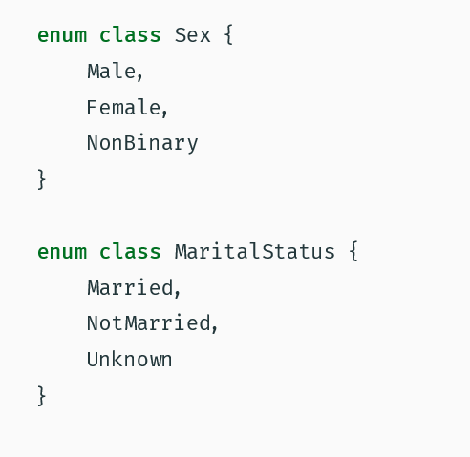
Enums in Kotlin

Slide 21
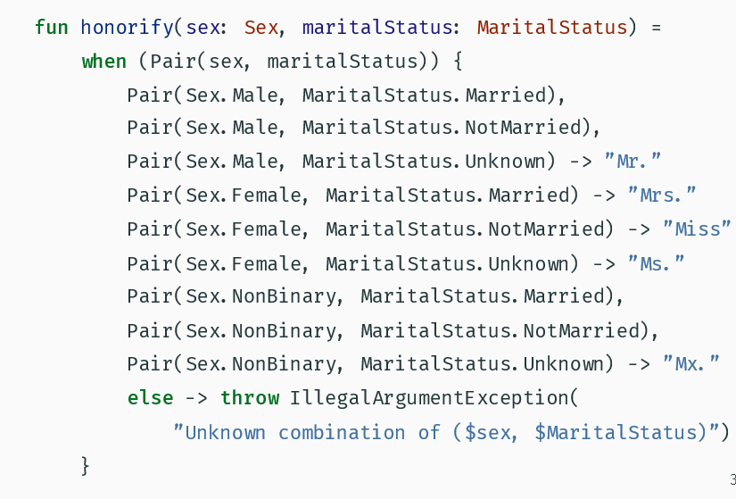
When

Slide 22
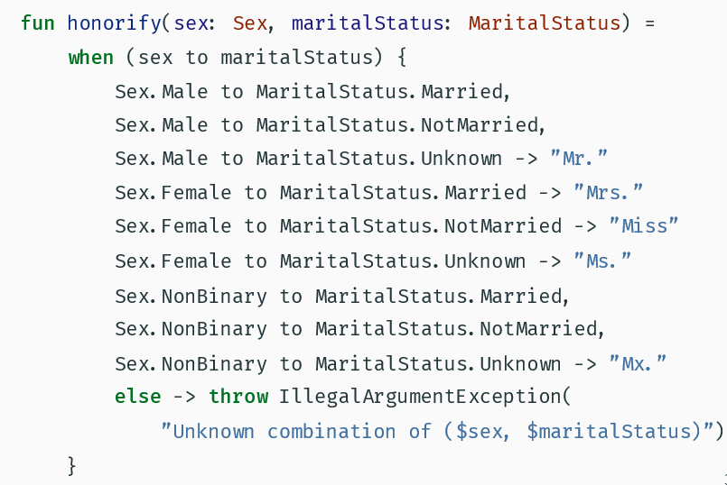
When

Slide 23
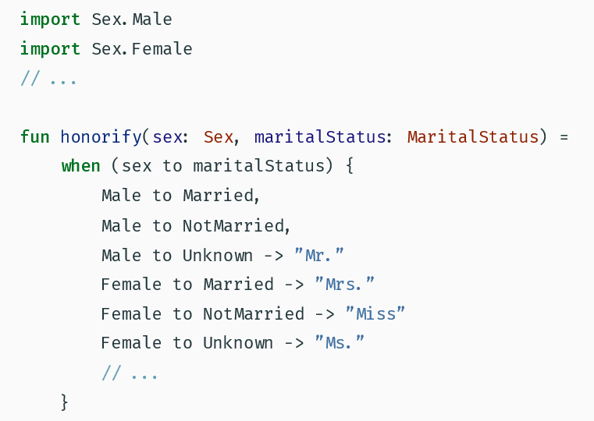
When

Slide 24
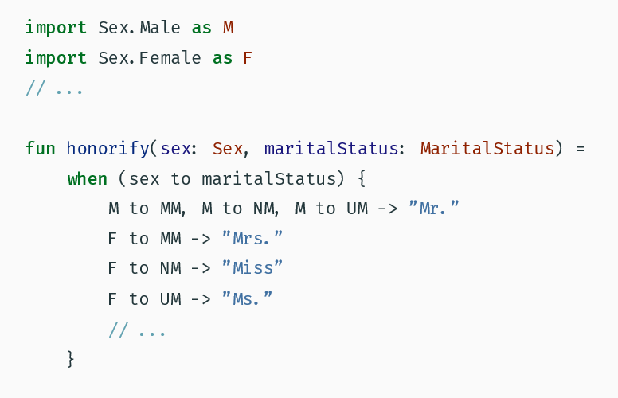
When

Slide 25
Get back to main()
fun main(args: Array<String>) {
val firstName = getFirstName(info) ?: ”John”
val lastName = getLastName(info) ?: ”Doe”
val maritalStatus = getMaritalStatus(info)
val sex = guessSex(info)
println(”Hello, ${honorify(sex, maritalStatus)} ” + ”${shorten(firstName)} $lastName”)
}

Slide 26
Loops: for…each
fun main(args: Array<String>) {
for (arg in args) {
val info = arg.split(” ”)
println(buildGreeting(info))
}
}
fun buildGreeting(info: Array<String>): String {
val firstName = getFirstName(info) ?: ”John”
val lastName = getLastName(info) ?: ”Doe”
val maritalStatus = getMaritalStatus(info)
val sex = guessSex(info)
return ”Hello, ${honorify(sex, maritalStatus)} ” + ”${shorten(firstName)} $lastName”
}

Slide 27
Loops: for with index
fun main(args: Array<String>) {
for (i in 0..args.lastIndex) {
val info = args[i].split(” ”)
println(buildGreeting(info))
}
}
fun main(args: Array<String>) {
for (i in 0 until args.size) {
val info = args[i].split(” ”)
println(buildGreeting(info))
}
}
fun main(args: Array<String>) {
for (i in args.indices) {
val info = args[i].split(” ”)
println(buildGreeting(info))
}
}

Slide 28
Loops: while
while (x > 0) {
x--
}
do {
val y = retrieveData()
} while (y != null) // y is visible here!

Slide 29
Kotlin data types
In Kotlin, everything is an object in the sense that we can call member functions and properties on any variable. Some of the types can have a special internal representation - for example, numbers, characters and booleans can be represented as primitive values at runtime - but to the user they look like ordinary classes.
Type | Size (bits) | Min value | Max value
Byte | 8 | -128 | 127
Short | 16 | -32768 | 32767
Int | 32 | -2,147,483,648 (-2³¹) | 2,147,483,647 (2³¹ - 1)
Long | 64 | -9,223,372,036,854,775,808 (-2⁶³) | 9,223,372,036,854,775,807 (2⁶³ - 1)
Type | Size (bits) | Significant bits | Exponent bits | Decimal digits
Float | 32 | 24 | 8 | 6-7
Double | 64 | 53 | 11 | 15-16
Characters are represented by the type Char. They can not be treated directly as numbers.
The type Boolean represents booleans, and has two values: true and false.

Slide 30
Equality
Kotlin allows to use == instead of equals(), in this case nulls are handled correctly.
a == b <-> a?.equals(b) ?: (b == null)
Reference equality is checked via === operator
In Kotlin there is no implicit conversions. Need to use toByte()/toShort()/toInt()/toLong()

Slide 31
Strings in Kotlin
Strings are represented by the type String. Strings are immutable.
Kotlin supports string interpolation
Escaped strings: val regularString = ”This \”string\” \be funky”
Raw strings: val rawString = ”””This awesome ”string” \should be printed as-is”””
Raw strings with interpolation: val dollarString = ”””${'$'}tring templates shall not pass!”””

Slide 32
Arrays in Kotlin
val fibs = arrayOf(1, 1, 2, 3, 5, 8, 13)
val arr = kotlin.ArrayOfNulls(10)
val sqrs = Array(7) { i -> i * i }
val fastFibs = intArrayOf(1, 1, 2, 3, 5, 8, 13)
Kotlin arrays are invariant.
final String[] oops = { ”only”, ”strings”, ”here” };
final Object[] yeah = oops; // Impossible in Kotlin

