Slide 1
MezoGig
Milestone escrow for freelance work, settled in MUSD
The client locks the whole gig budget up-front in MUSD. Each milestone is released on delivery;
a silent client cannot block payment forever, and a disputed milestone is split by an arbiter.
AKINDO “Build with MUSD and MEZO” · Wave 1 · Mezo Testnet (chainId 31611)
Live demo
https://mak777uh.github.io/mezogig/
Repo: github.com/mak777uh/mezogig
Contract (Mezo Testnet)
0x247b313d0eD3C532B16c7E5f9eA760272361600F
Sourcify exact_match · 90 tests · no owner, no fee
MezoGig · milestone escrow in MUSD on Mezo · AKINDO “Build with MUSD and MEZO”, Wave 1
1/10

Slide 2
PROBLEM
Freelancers work first and get paid later — or not at all
For the freelancer
• Deliver first → the client can disappear with the work.
• No small-claims court for a $300 gig across borders.
• Clients who do pay upfront invert the risk the other way.
For the client
• Pay first → the freelancer can disappear with the money.
• No neutral, cheap way to hold funds per milestone.
Why stablecoin, why now
• Crypto clients can pay instantly — but a volatile budget is unusable for real work.
• MUSD is a Bitcoin-backed stablecoin: the client keeps BTC exposure, the freelancer gets a stable unit.
• Existing escrow contracts are all-or-nothing: no milestones, no review window, no refunds, no arbiter.
• Result: crypto-native work still runs on trust and screenshots.
MezoGig · milestone escrow in MUSD on Mezo · AKINDO “Build with MUSD and MEZO”, Wave 1
2/10

Slide 3
SOLUTION
One escrow contract, four exits, zero admin keys
1
1 · Fund
Client deposits the full budget in MUSD (approve, or one-tx EIP-2612 permit).
2
2 · Deliver
Freelancer submits a milestone with a proof link before its deadline.
3
3 · Release
Client approves → paid instantly. Silence → freelancer claims after 148 s review window.
4
4 · Exit
Missed deadline → refund. Disagreement → arbiter splits. Both agree → mutual cancel.
No owner role · no platform fee · no upgradeability · token address immutable
MezoGig · milestone escrow in MUSD on Mezo · AKINDO “Build with MUSD and MEZO”, Wave 1
3/10

Slide 4
INTEGRATION (30 % OF THE SCORE)
How MUSD is used — not decoration, settlement
Money flows
• Deposit: safeTransferFrom(client → escrow) of the full milestone sum, or createGigWithPermit (EIP-2612) with no separate approve.
• Payout: escrow → freelancer on approve, or on claim after the review period.
• Refund: escrow → client after a missed deadline, or on mutual cancel.
• Dispute: arbiter splits the milestone by basis points; the remainder returns to the client.
• Accounting invariant: paidOut + refunded ≤ funded, each milestone settles exactly once.
Facts on-chain
• MUSD 0x118917a40FAF1CD7a13dB0Ef56C86De7973Ac503 — 18 decimals, permit supported.
• Contract bound to that token by an immutable address.
• Deployed on Mezo Testnet, block 16247351.
• Honest gap: MEZO token is not integrated.
The rules allow “MUSD and/or MEZO”; MEZO utility (fee discounts, staked arbiters) is on the roadmap and is not claimed as done.
MezoGig · milestone escrow in MUSD on Mezo · AKINDO “Build with MUSD and MEZO”, Wave 1
4/10

Slide 5
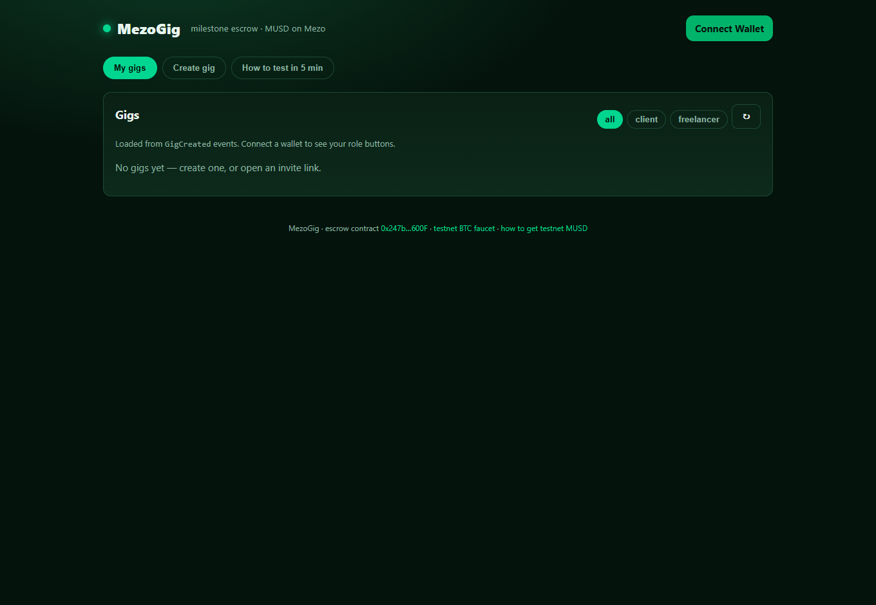
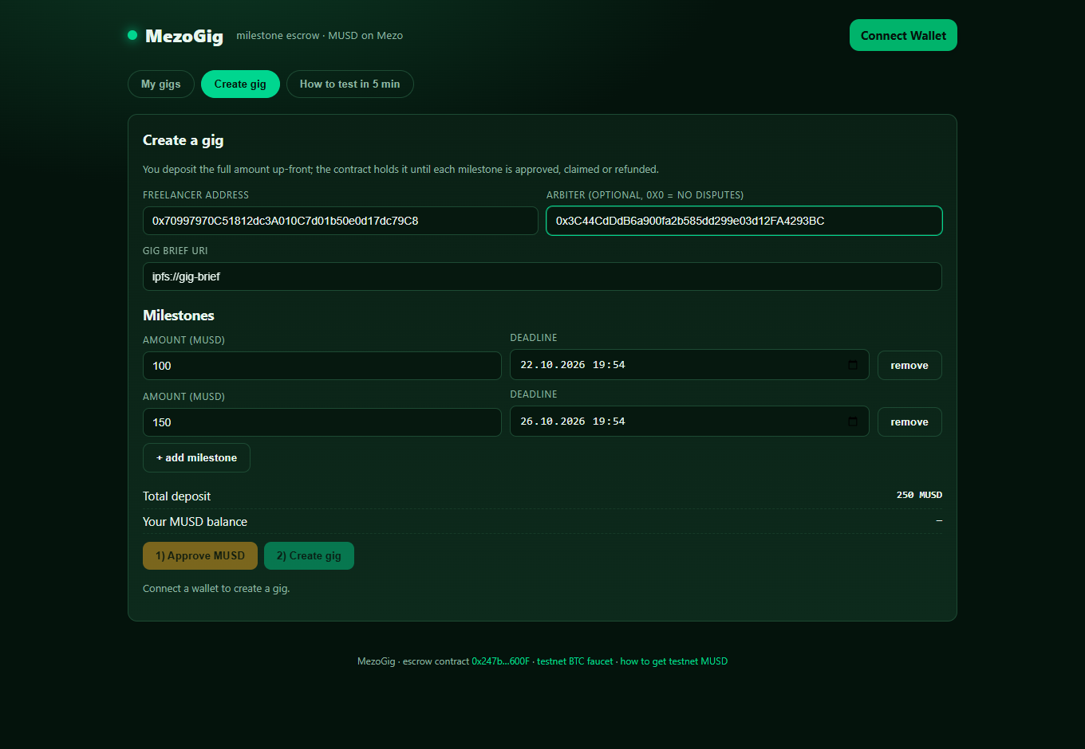
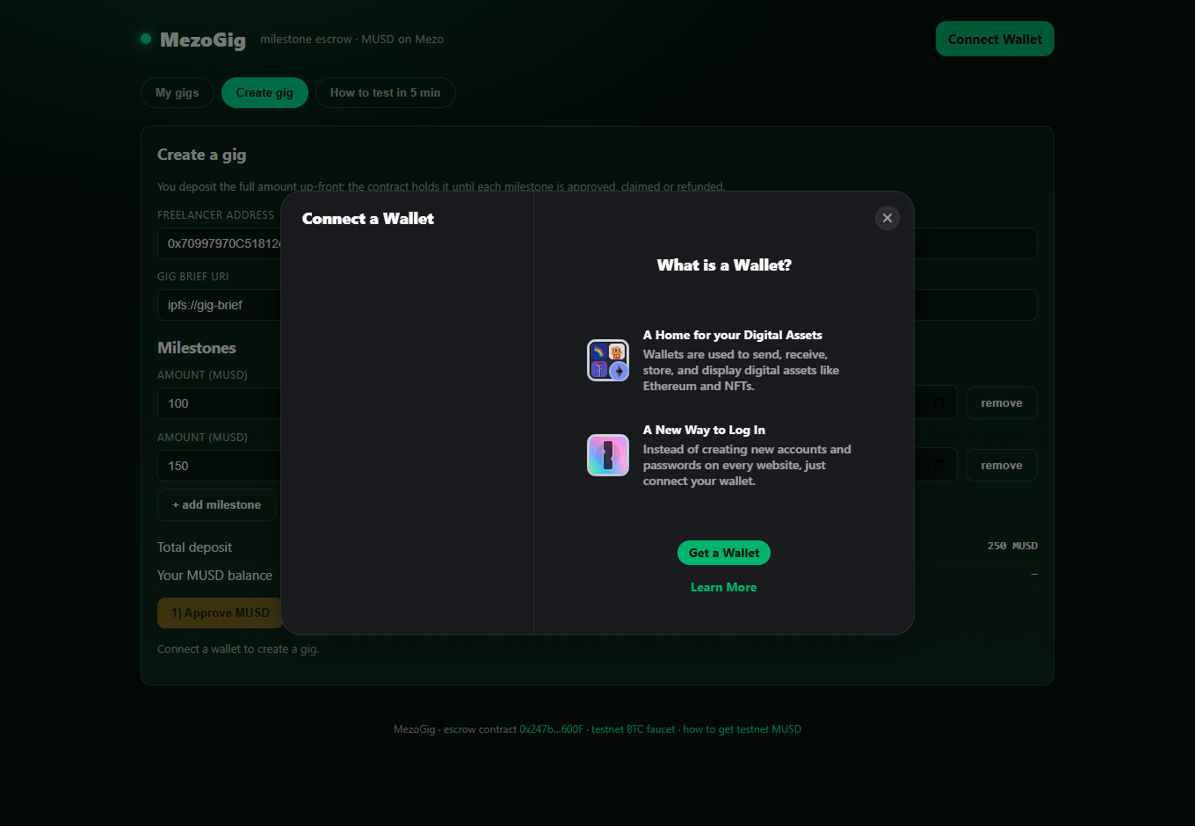
DEMO (10 % UX + 10 % MATERIALS)
What a judge sees in the first five minutes
Gigs list, role filters, live contract link
Create: two milestones, deadlines, deposit
Wallet connect — Mezo Testnet only
Create → submit → approve → claim → dispute → refund
Live: https://mak777uh.github.io/mezogig/ · contract: https://explorer.test.mezo.org/address/0x247b313d0eD3C532B16c7E5f9eA760272361600F
MezoGig · milestone escrow in MUSD on Mezo · AKINDO “Build with MUSD and MEZO”, Wave 1
5/10

Slide 6
TECHNICAL (20 %)
Small contract, boring security, checkable evidence
90 tests
Verify in one command
ESCROW_ADDRESS=0x247b…600F \
node scripts/check-musd.js
→ musd(), reviewPeriod()=148, gigCount()=0
npm test # 90 passing
npm run coverage
npm run verify:sourcify
lifecycle, guards, terminal states, fuzz invariants
100 % / 92 %
statements / branches of the escrow contract
6 attacks
malicious ERC-20 reentrancy attempts, all rejected
6 Slither findings
Security model
No owner, no withdrawal path, no delegatecall
CEI + nonReentrant + SafeERC20, immutable token
Payouts bounded per milestone, settle once
every one dispositioned, no high/medium
Sourcify exact_match
creation + runtime bytecode, chain 31611
MezoGig · milestone escrow in MUSD on Mezo · AKINDO “Build with MUSD and MEZO”, Wave 1
6/10

Slide 7
BUSINESS (30 %)
Why the market pays for this
Who is the customer
Why Mezo
How it makes money
• Freelancers and small agencies serving crypto-native clients
• DAOs outsourcing bounded tasks (design, audits, content)
• BTC holders in the Mezo economy who need to pay for work without selling BTC
• MUSD is a BTC-backed stable unit — the missing piece for work payments
• Mezo’s audience already holds BTC and wants to spend without exiting
• Escrow makes MUSD a settlement rail, not just a savings asset
• No fee in v1 (adoption); v2: optional arbiter marketplace and MEZO fee discounts
• Distribution through Mezo Discord / AKINDO builders and freelance communities
• Each gig is a repeatable on-chain flow: more MUSD volume, more wallets
Positioning: every 1 MUSD that moves through MezoGig is MUSD used for real work — the exact utility Mezo is building toward.
MezoGig · milestone escrow in MUSD on Mezo · AKINDO “Build with MUSD and MEZO”, Wave 1
7/10

Slide 8
ROADMAP & TEAM
Three milestones, and what we are honest about
M1 · 2 weeks
Hosted frontend polish, wallet UX, gig templates, docs video
Team
Operator (human): product, registration, payments
AI agent team: contract, tests, frontend, docs
Built during Wave 1; code, tests and deployment are public
M2 · 4 weeks
Mezo mainnet deployment, third-party review, incident runbook
M3 · 8 weeks
Dispute v2: staked arbiters, reputation, MEZO fee discounts
Links
github.com/mak777uh/mezogig
mak777uh.github.io/mezogig
MezoGig · milestone escrow in MUSD on Mezo · AKINDO “Build with MUSD and MEZO”, Wave 1
8/10

Slide 9
NEW · 23 OCT 2026
The same escrow, operable by an agent
Machine-readable CLI
scripts/agent-console.js — no UI, no keys printed
• CLI: status / jobs list / job get / watch / verify
• MCP: create_gig / fund_gig / submit / approve / dispute / status
• lifecycle commands build calldata; --dry-run is the default
• exit codes 0/1/2/3 = ok / input / network / revert
• 21 new tests (CLI + MCP + pin); npm test = 90 passing
• commit fbf6fb8; contract unchanged
• Sourcify exact_match · creation + runtime
Read-only calls checked against the deployed contract; no transaction sent.
$ npm run agent -- verify --json
{
"chainId": 31611,
"escrow": "0x247b313d0eD3C532B16c7E5f9eA760272361600F",
"musd": "0x118917a40FAF1CD7a13dB0Ef56C86De7973Ac503",
"musdMatches": true,
"reviewPeriodSeconds": 148,
"ok": true
}
$ npm test
90 passing
MezoGig · milestone escrow in MUSD on Mezo · AKINDO “Build with MUSD and MEZO”, Wave 1
9/10

Slide 10
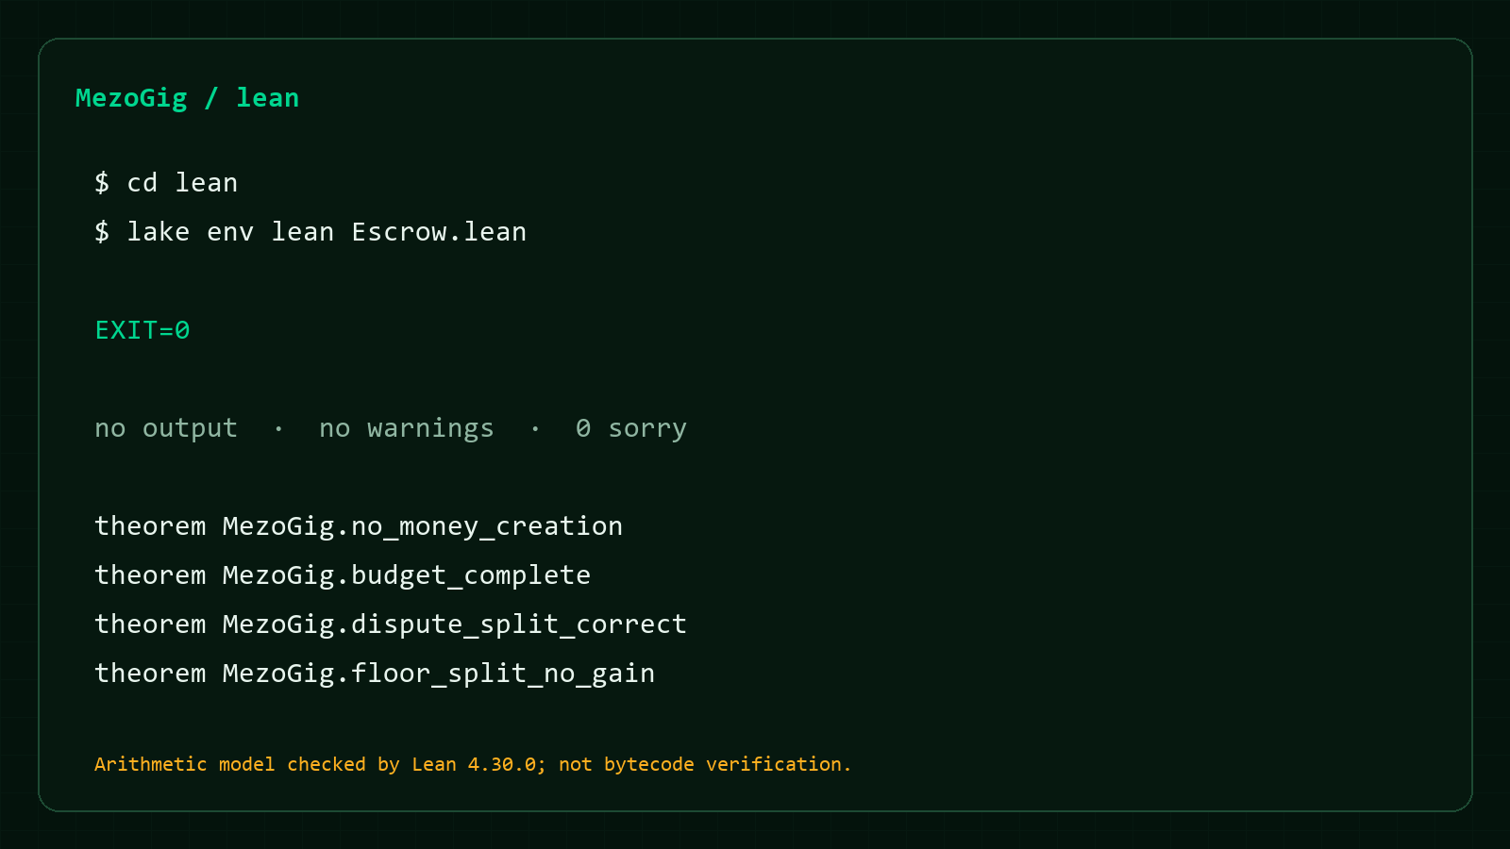
FORMAL ACCOUNTING · LEAN 4
Machine-checked invariants, honest scope
Pinned Lean 4.30.0 · 0 sorry
An arithmetic model of the ledger, not a verification of Solidity bytecode.
No money creation
paidOut + refunded ≤ funded
MezoGig.no_money_creation
Budget completeness
milestones.sum = funded
MezoGig.budget_complete
Dispute exactness
a + b = amount
MezoGig.dispute_split_correct
Floor rounding never creates money
Σ (total / n) ≤ total
MezoGig.floor_split_no_gain
lake env lean Escrow.lean → exit 0
CI: .github/workflows/lean.yml · 0 sorry
Scope: arithmetic model only; uint128 overflow, tokens and weighted splits are out of scope.
MezoGig · milestone escrow in MUSD on Mezo · AKINDO “Build with MUSD and MEZO”, Wave 1
10/10

