Slide 1
Cloud Computing Foundations
Dr. Md Alamgir Kabir
Assistant Professor, CSE and Program Coordinator MSc in MIS
Daffodil International University
Kabir.cse@diu.edu.bd

Slide 2
Topic
Service models
IaC (Infrastructure as Code)
Elastic Beanstalk
Google App Engine, and
AWS Lambda

Slide 3
Overview of Cloud Computing
Cloud computing can use “near-infinite” resources and leverage SaaS platforms built on those resources
Advantages: company can focus on its strengths instead of building low-level services
Economies of Scale; in the case of a large cloud provider, they can generate cost savings that pass down to the customer
Ability to “pay for what you need,” much like a utility company versus paying the up-front cost of infrastructure and hardware

Slide 4

Cloud Service Model
SaaS
SaaS (Software as a Service) is a hosted software product: Google Docs or Office 365
Software products are hosted on cloud platforms and sold via a subscription model
PaaS
PaaS (Platform as a Service) is a higher-level abstraction for developing software: HeroKu
This process allows a developer in a language like Ruby, Python, PHP, or Go to focus mostly on their application’s business logic
A real-world scenario comparison would be a self-service car wash versus a drive-through car wash.

Slide 5
Cloud Service Model
IaaS
IaaS (Infrastructure as a Service) refers to services that provide low-level resources: Compute, Storage, and Networking.
Services are low cost to use but require more setup and expertise.
Scenario: A real-world comparison would be buying grain or beans in bulk from a company like Costco, then using those resources to create a meal. The cost would be much lower than purchasing a full meal from a restaurant but requires time and skill to convert to a meal.

Slide 6
Cloud Service Model
MaaS
MaaS (Metal as a Service) is the ability to rent actual physical servers vs. virtualized servers.
Specialized scenarios like training deep learning models
Scenario: A compute operation may require the highest amount of resources available. Virtualization causes some overhead, and eliminating it will allow these specialized operations to fully access the “metal.”

Slide 7
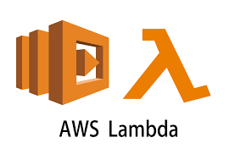
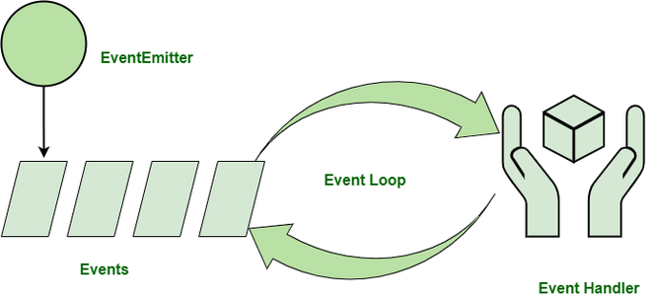
Cloud Service Model
“Serverless” refers to running without thinking about servers.
Example: AWS Lambda
Advantages:
ability to focus on writing functions vs. managing servers
ability to use new paradigms like event-driven programming against cloud-native resources
Event-Driven Programming in Node.js

Slide 8

Continuous Delivery and Continuous Deployment
leverages several powerful tools continuous integration, IaC, and Cloud Computing.
Continuous Delivery lets the cloud infrastructure be defined as code and allows for near real-time changes of both code and new environments.
Example: Hugo - popular static site generator.
Assignment1: Continuous Delivery for Hugo Static Site from Zero

