Slide 1
A feasibility study on concept drift in Empirical Software Engineering
Supervisor:
Dr. Jacky Keung
Department of Computer Science CityU
Presenter:
Md Alamgir Kabir

Slide 2
Outline
Motivation
Concept Drift
Concept Drift Approaches
Drift Detection Method (DDM)
Statistical Test
Experiment Setup
Discussion on Experiment Results
Future works

Slide 3
Motivation
Rahul et al. [1] cautions that if the prediction model changes because of the changing of historical data, managers will unable to faith on the predictions models causing to fail the proper use of testing resources.
According to Dong et al. [2], a well-trained prediction model could give more inaccurate results if the upcoming data starts to drift in times.
[1] R. Krishna and T. Menzies, ”Bellwethers: A Baseline Method For Transfer Learning,” in IEEE Transactions on Software Engineering. doi: 10.1109/TSE.2018.2821670
[2] Dong, J. Lu, K. Li and G. Zhang, ”Concept drift region identification via competence-based discrepancy distribution estimation,” 2017 12th International Conference on Intelligent Systems and Knowledge Engineering (ISKE), Nanjing, 2017, pp. 1-7. doi: 10.1109/ISKE.2017.8258734

Slide 4
Concept Drift
Streaming data: Incoming data changes over time
Concept drift: The changes in the distributions over time
Concepts are not often stable but change with time such as weather prediction and customers’ preference

Slide 5

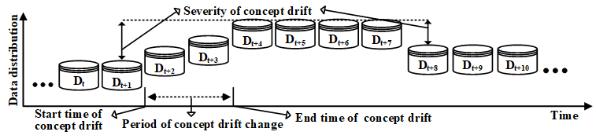
Concept Drift
J. Lu, A. Liu, F. Dong, F. Gu, J. Gama and G. Zhang, ”Learning under Concept Drift: A Review,” in IEEE Transactions on Knowledge and Data Engineering. doi: 10.1109/TKDE.2018.2876857

Slide 6
Concept drift approaches
By monitoring data distributions
By monitoring error-rate of learning algorithms
(N. Lu et al. @ Artif. Intell.’2014) ; J. Lu et al. @ TKDE’2018)
(J. Gama @’2004 ; J. Lu et al. @ TKDE’2018)

Slide 7
Drift Detection Method (DDM)
Monitor the error-rate of learning algorithms
When the distribution changes, the error-rate will increase
While the distribution stationary, the error-rate will decrease
Good performance detecting drift and learning new concept
J. Gama, P. Medas, G. Castillo, and P. Rodrigues, ”Learning with Drift Detection,” In: Bazzan A.L.C., Labidi S. (eds) Advances in Artificial Intelligence SBIA 2004. Lecture Notes in Computer Science, pp. 286 - 295, 2004

Slide 8


Experiment Setup
Learners: Naïve Bayes and Decision Tree
Statistical Method (STEPD): Chi-square test with Yates’s continuity correction
Significant decrease or increase comparing to recent accuracy suggests that the concept is changing
If the p-value is less than significant level, the null hypothesis rejected and alternative hypothesis is accepted
K. Nishida and K. Yamauchi, “Detecting Concept Drift Using Statistical Testing,” Discov. Sci. DS 2007. Lect. Notes Comput. Sci., vol. 4755, pp. 264–269, 2007.

Slide 9
Experiment Setup
ro = number of correct classifications
no = overall examples
rr = number of correct classification in recent examples
nr = recent examples
K. Nishida and K. Yamauchi, “Detecting Concept Drift Using Statistical Testing,” Discov. Sci. DS 2007. Lect. Notes Comput. Sci., vol. 4755, pp. 264–269, 2007.

Slide 10
Experiment Setup
Datasets
Tim Menzies datasets
Uses the CK OO metrics
Project Name | Release | Module | # Defects
Jm1 | 1 | 7782 | 1672
Jm1 | 1.2 | 9593 | 1759
Jm1 | 1.3 | 7782 | 1672

Slide 11
Experiment Setup
Datasets
Marian Jureckzo datasets – 27 versions of Prop project
Uses the CK OO metrics
Project Name | Version | Module
Prop-1 | 4, 40, 85, 121, 157, 185 | 18471
Prop-2 | 9, 44, 92, 128, 164, 192 | 23014
Prop-3 | 225, 236, 245, 256, 265 | 10274
Prop-4 | 285, 292, 305, 318 | 8718
Prop-5 | 347, 355, 362 | 8516
Prop-6 | 452, 453, 454 | 660

Slide 12
Discussion/1
jm-naïve bayes | Training set | precision | pd | fmeasure | gmean | balance | accuracy
500 |  | 0.538 | 0.226 | 0.318 | 0.461 | 0.451 | 0.775
 | 1000 | 0.279 | 0.246 | 0.261 | 0.45 | 0.452 | 0.696
 | 1500 | 0.35 | 0.193 | 0.249 | 0.418 | 0.425 | 0.758
 | 2000 | 0.336 | 0.305 | 0.32 | 0.503 | 0.494 | 0.716
 | 2500 | 0.345 | 0.318 | 0.331 | 0.515 | 0.504 | 0.725
 | 3000 | 0.675 | 0.558 | 0.611 | 0.621 | 0.619 | 0.62
 | 3500 | 0.048 | 0.013 | 0.02 | 0.113 | 0.302 | 0.965
 | 4000 | 0.172 | 0.178 | 0.175 | 0.41 | 0.417 | 0.9
 | 4500 | 0.342 | 0.422 | 0.378 | 0.572 | 0.561 | 0.699
 | 2657 | 0.343 | 0.313 | 0.328 | 0.513 | 0.501 | 0.728
Jm-decision tree | Training set | precision | pd | fmeasure | gmean | balance | accuracy
 | 500 | 0.255 | 0.151 | 0.189 | 0.361 | 0.392 | 0.7
 | 1000 | 0.237 | 0.126 | 0.164 | 0.334 | 0.377 | 0.72
 | 1500 | 0.166 | 0.1 | 0.125 | 0.295 | 0.357 | 0.708
 | 2000 | 0.256 | 0.117 | 0.16 | 0.325 | 0.372 | 0.732
 | 2500 | 0.24 | 0.147 | 0.183 | 0.359 | 0.39 | 0.718
 | 3000 | 0.599 | 0.661 | 0.628 | 0.568 | 0.566 | 0.581
 | 3500 | 0.065 | 0.038 | 0.048 | 0.195 | 0.32 | 0.958
 | 4000 | 0.176 | 0.079 | 0.109 | 0.277 | 0.348 | 0.923
 | 4500 | 0.225 | 0.117 | 0.154 | 0.322 | 0.37 | 0.722
 | 2657 | 0.24 | 0.124 | 0.164 | 0.334 | 0.376 | 0.731

Slide 13
Discussion/2
 | Overall Examples | Recent Examples | t-value
jm-naïve bayes | 500 | 1000 | 0.263804
 | 1000 | 1500 | 0.248608
 | 1500 | 2000 | 0.295549
 | 2000 | 2500 | 0.717368
 | 2500 | 3000 | 0.10155
 | 3000 | 3500 | 0.027421
 | 3500 | 4000 | 0.121493
 | 4000 | 4500 | 0.041416
 | 4500 | 2657 | 0.312574
 | Overall Examples | Recent Examples | t-value
jm-decision tree | 500 | 1000 | 0.68734
 | 1000 | 1500 | 0.746536
 | 1500 | 2000 | 0.47504
 | 2000 | 2500 | 0.603108
 | 2500 | 3000 | 0.078384
 | 3000 | 3500 | 0.025408
 | 3500 | 4000 | 0.221955
 | 4000 | 4500 | 0.040859
 | 4500 | 2657 | 0.656246

Slide 14
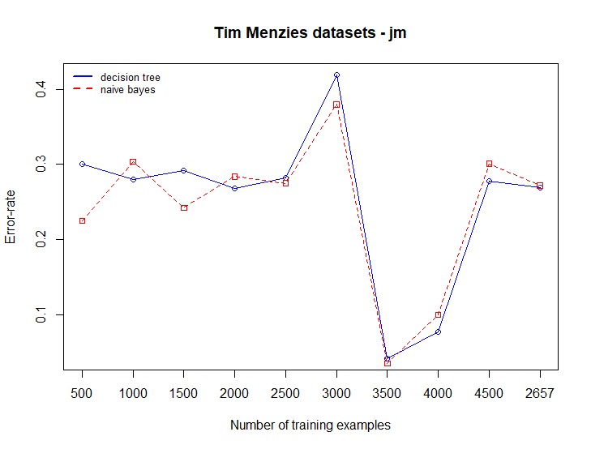
Discussion/3

Slide 15
Discussion/4
 | Training Examples | precision | pd | fmeasure | gmean | balance | accuracy
prop-naïve bayes | 500 | 0.083 | 0.029 | 0.043 | 0.169 | 0.313 | 0.89
 | 1000 | 0.071 | 0.018 | 0.029 | 0.134 | 0.306 | 0.916
 | 1500 | 0.378 | 0.283 | 0.324 | 0.518 | 0.492 | 0.882
 | 2000 | 0.702 | 0.711 | 0.707 | 0.828 | 0.794 | 0.939
 | 2500 | 0.298 | 0.199 | 0.239 | 0.429 | 0.431 | 0.819
 | 3000 | 0.579 | 0.507 | 0.541 | 0.65 | 0.632 | 0.731
 | 3500 | 0.33 | 0.203 | 0.251 | 0.436 | 0.434 | 0.84
 | 4000 | 0.304 | 0.275 | 0.289 | 0.504 | 0.484 | 0.854
 | 4500 | 0.303 | 0.267 | 0.284 | 0.509 | 0.482 | 0.936
 | 5000 | 0.403 | 0.38 | 0.391 | 0.599 | 0.56 | 0.892
 | 5500 | 0.451 | 0.617 | 0.521 | 0.671 | 0.669 | 0.7
 | 6000 | 0.277 | 0.255 | 0.265 | 0.491 | 0.472 | 0.895
 | 6500 | 0.175 | 0.192 | 0.183 | 0.429 | 0.428 | 0.925
 | 7000 | 0.267 | 0.421 | 0.327 | 0.583 | 0.569 | 0.753
 | 7500 | 0.254 | 0.339 | 0.29 | 0.551 | 0.527 | 0.843
 | 8000 | 0.294 | 0.482 | 0.365 | 0.613 | 0.602 | 0.732
 | 2053 | 0.26 | 0.187 | 0.217 | 0.422 | 0.424 | 0.89

Slide 16
Discussion/5
 | Overall Examples | Recent Examples | t-value
prop-naïve bayes | 500 | 1000 | 0.571133
 | 1000 | 1500 | 0.382681
 | 1500 | 2000 | 0.206242
 | 2000 | 2500 | 0.090992
 | 2500 | 3000 | 0.118753
 | 3000 | 3500 | 0.086954
 | 3500 | 4000 | 0.511022
 | 4000 | 4500 | 0.094793
 | 4500 | 5000 | 0.163062
 | 5000 | 5500 | 0.029752
 | 5500 | 6000 | 0.027926
 | 6000 | 6500 | 0.207741
 | 6500 | 7000 | 0.03753
 | 7000 | 7500 | 0.06989
 | 7500 | 8000 | 0.060321
 | 8000 | 2053 | 0.063944

Slide 17
Discussion/6
 | Training Examples | precision | pd | fmeasure | gmean | balance | accuracy
prop-naïve bayes | 500 | 0.083 | 0.029 | 0.043 | 0.169 | 0.313 | 0.89
 | 1000 | 0.071 | 0.018 | 0.029 | 0.134 | 0.306 | 0.916
 | 1500 | 0.378 | 0.283 | 0.324 | 0.518 | 0.492 | 0.882
 | 2000 | 0.702 | 0.711 | 0.707 | 0.828 | 0.794 | 0.939
 | 2500 | 0.298 | 0.199 | 0.239 | 0.429 | 0.431 | 0.819
 | 3000 | 0.579 | 0.507 | 0.541 | 0.65 | 0.632 | 0.731
 | 3500 | 0.33 | 0.203 | 0.251 | 0.436 | 0.434 | 0.84
 | 4000 | 0.304 | 0.275 | 0.289 | 0.504 | 0.484 | 0.854
 | 4500 | 0.303 | 0.267 | 0.284 | 0.509 | 0.482 | 0.936
 | 5000 | 0.403 | 0.38 | 0.391 | 0.599 | 0.56 | 0.892
 | 5500 | 0.451 | 0.617 | 0.521 | 0.671 | 0.669 | 0.7
 | 6000 | 0.277 | 0.255 | 0.265 | 0.491 | 0.472 | 0.895
 | 6500 | 0.175 | 0.192 | 0.183 | 0.429 | 0.428 | 0.925
 | 7000 | 0.267 | 0.421 | 0.327 | 0.583 | 0.569 | 0.753
 | 7500 | 0.254 | 0.339 | 0.29 | 0.551 | 0.527 | 0.843
 | 8000 | 0.294 | 0.482 | 0.365 | 0.613 | 0.602 | 0.732
 | 2053 | 0.26 | 0.187 | 0.217 | 0.422 | 0.424 | 0.89

Slide 18
Discussion/7
 | Overall Examples | Recent Examples | T-value
prop-decision tree | 500 | 1000 | 0.519514
 | 1000 | 1500 | 0.497514
 | 1500 | 2000 | 0.151435
 | 2000 | 2500 | 0.084665
 | 2500 | 3000 | 0.065097
 | 3000 | 3500 | 0.0562
 | 3500 | 4000 | 0.315242
 | 4000 | 4500 | 0.089983
 | 4500 | 5000 | 0.145608
 | 5000 | 5500 | 0.033338
 | 5500 | 6000 | 0.029807
 | 6000 | 6500 | 0.147845
 | 6500 | 7000 | 0.04183
 | 7000 | 7500 | 0.079372
 | 7500 | 8000 | 0.074134
 | 8000 | 2053 | 0.095129

Slide 19
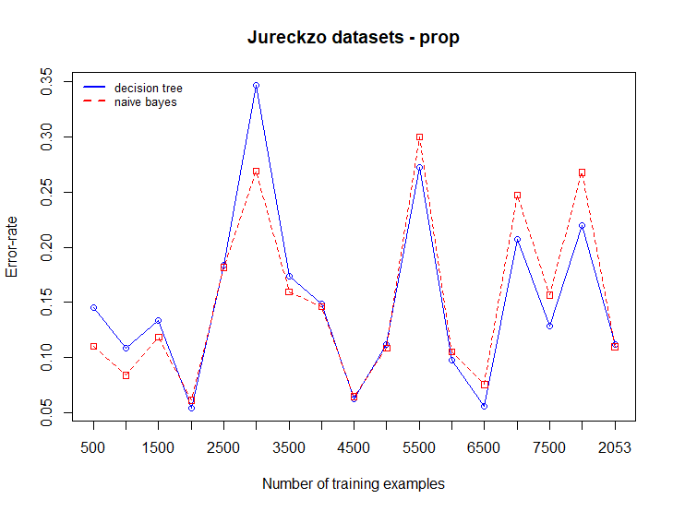
Discussion/8

Slide 20
Future Work
Explore the concept drift detection methods by monitoring the parameters of learners
Being the environments non-stationary, it exhibits class imbalance. Our plan is also to explore the techniques that handle class imbalance in streaming data.
Compare with the methods of bellwether with concept drift to produce a better prediction models

Slide 21
Thanks for listening

