Slide 1
A feasibility study on concept drift in Empirical Software Engineering
Supervisor:
Dr. Jacky Keung
Department of Computer Science, CityU
Presenter:
Md Alamgir Kabir

Slide 2
Outline
Concept Drift
Implications in Software Engineering
Current Studies
Motivation
Concept Drift Approach
Drift Detection Method (DDM)
Experiment Setup
Discussion on Experiment Results
Future works
Conclusions

Slide 3
Concept Drift
Streaming data: Incoming data changes over time
Concept drift: The changes in the distributions over time
Concepts are not often stable but change with time such as weather prediction and customers’ preference

Slide 4

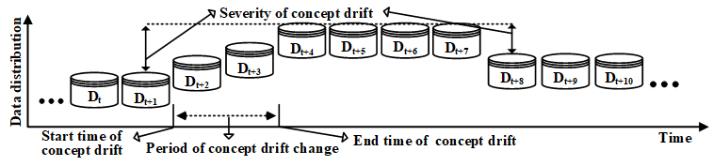
Concept Drift
J. Lu, A. Liu, F. Dong, F. Gu, J. Gama and G. Zhang, ”Learning under Concept Drift: A Review,” in IEEE Transactions on Knowledge and Data Engineering. doi: 10.1109/TKDE.2018.2876857

Slide 5
Implications in Software Engineering/1
Prediction model are developed by using historical datasets (i.e., fixed distributions)
Proposed models to predict the number and the location of future bugs in software source codes
Such predictions can help the project manager to lead the project by proper utilizing the testing resources
The prediction model may not work if the historical datasets changes overtime
(Ekanayake @ MSR’2009)

Slide 6
Implications in Software Engineering/2
Ekanayake et al. observed that the change in number of author editing a file and a number of defects fixed by them introduce the concept drift.
They have also observed that the prediction quality significantly varies over time.
(Ekanayake @ ESM’ 2012)

Slide 7
Current Studies
Bernstein, A., Ekanayake, J., & Pinzger, M. (2007, September). Improving defect prediction using temporal features and nonlinear models. In Ninth international workshop on Principles of software evolution: in conjunction with the 6th ESEC/FSE joint meeting (pp. 11-18). ACM.
Ekanayake, J., Tappolet, J., Gall, H. C., & Bernstein, A. (2009, May). Tracking concept drift of software projects using defect prediction quality. In Mining Software Repositories, 2009.MSR’09. 6th IEEE International Working Conference on (pp.51 -60). IEEE.
Ekanayake, J., Tappolet, J., Gall, H. C., & Bernstein, A. (2012).Time variance and defect prediction in software projects. Empirical Software Engineering, 17(4-5), 348-389.
Finlay, J., Pears, R., & Connor, A. M. (2014). Data stream mining for predicting software build outcomes using source code metrics. Information and Software Technology, 56(2), 183-198.

Slide 8
Motivation
Rahul et al. [1] cautions that if the prediction model changes because of the changing of historical data, managers will unable to faith on the predictions models causing to fail the proper use of testing resources.
According to Dong et al. [2], a well-trained prediction model could give more inaccurate results if the upcoming data starts to drift in times.
[1] R. Krishna and T. Menzies, ”Bellwethers: A Baseline Method For Transfer Learning,” in IEEE Transactions on Software Engineering. doi: 10.1109/TSE.2018.2821670
[2] Dong, J. Lu, K. Li and G. Zhang, ”Concept drift region identification via competence-based discrepancy distribution estimation,” 2017 12th International Conference on Intelligent Systems and Knowledge Engineering (ISKE), Nanjing, 2017, pp. 1-7. doi: 10.1109/ISKE.2017.8258734

Slide 9
Concept drift approaches
By monitoring data distributions
By monitoring error-rate of learning algorithms
(N. Lu et al. @ Artif. Intell.’2014) ; J. Lu et al. @ TKDE’2018)
(J. Gama @’2004 ; J. Lu et al. @ TKDE’2018)

Slide 10
Drift Detection Method (DDM)
Monitor the error-rate of learning algorithms
When the distribution changes, the error-rate will increase
While the distribution stationary, the error-rate will decrease
Good performance detecting drift and learning new concept
J. Gama, P. Medas, G. Castillo, and P. Rodrigues, ”Learning with Drift Detection,” In: Bazzan A.L.C., Labidi S. (eds) Advances in Artificial Intelligence SBIA 2004. Lecture Notes in Computer Science, pp. 286 - 295, 2004

Slide 11


Experiment Setup
Learners: Naïve Bayes and Decision Tree
Statistical Method: Chi-square test with Yates’s continuity correction
Significant decrease or increase comparing to recent accuracy suggests that the concept is changing
If the p-value is less than significant level, the null hypothesis rejected and alternative hypothesis is accepted
K. Nishida and K. Yamauchi, “Detecting Concept Drift Using Statistical Testing,” Discov. Sci. DS 2007. Lect. Notes Comput. Sci., vol. 4755, pp. 264–269, 2007.

Slide 12
Experiment Setup
ro = number of correct classifications
no = overall examples
rr = number of correct classification in recent examples
nr = recent examples
K. Nishida and K. Yamauchi, “Detecting Concept Drift Using Statistical Testing,” Discov. Sci. DS 2007. Lect. Notes Comput. Sci., vol. 4755, pp. 264–269, 2007.

Slide 13
Experiment Setup
Datasets
Tim Menzies datasets
Uses the CK OO metrics
Project Name | Release | Module | # Defects
Jm1 | 1 | 7782 | 1672
Jm1 | 1.2 | 9593 | 1759
Jm1 | 1.3 | 7782 | 1672

Slide 14
Experiment Setup
Datasets
Marian Jureckzo datasets – 27 versions of Prop project
Uses the CK OO metrics
Project Name | Version | Module
Prop-1 | 4, 40, 85, 121, 157, 185 | 18471
Prop-2 | 9, 44, 92, 128, 164, 192 | 23014
Prop-3 | 225, 236, 245, 256, 265 | 10274
Prop-4 | 285, 292, 305, 318 | 8718
Prop-5 | 347, 355, 362 | 8516
Prop-6 | 452, 453, 454 | 660
Notes:
OO metrics suite is the Chidamber and Kemerer (CK) metrics

Slide 15
Discussion/1
jm-naïve bayes | Training set | precision | pd | fmeasure | gmean | balance | accuracy
500 |  | 0.538 | 0.226 | 0.318 | 0.461 | 0.451 | 0.775
 | 1000 | 0.279 | 0.246 | 0.261 | 0.45 | 0.452 | 0.696
 | 1500 | 0.35 | 0.193 | 0.249 | 0.418 | 0.425 | 0.758
 | 2000 | 0.336 | 0.305 | 0.32 | 0.503 | 0.494 | 0.716
 | 2500 | 0.345 | 0.318 | 0.331 | 0.515 | 0.504 | 0.725
 | 3000 | 0.675 | 0.558 | 0.611 | 0.621 | 0.619 | 0.62
 | 3500 | 0.048 | 0.013 | 0.02 | 0.113 | 0.302 | 0.965
 | 4000 | 0.172 | 0.178 | 0.175 | 0.41 | 0.417 | 0.9
 | 4500 | 0.342 | 0.422 | 0.378 | 0.572 | 0.561 | 0.699
 | 2657 | 0.343 | 0.313 | 0.328 | 0.513 | 0.501 | 0.728
Jm-decision tree | Training set | precision | pd | fmeasure | gmean | balance | accuracy
 | 500 | 0.255 | 0.151 | 0.189 | 0.361 | 0.392 | 0.7
 | 1000 | 0.237 | 0.126 | 0.164 | 0.334 | 0.377 | 0.72
 | 1500 | 0.166 | 0.1 | 0.125 | 0.295 | 0.357 | 0.708
 | 2000 | 0.256 | 0.117 | 0.16 | 0.325 | 0.372 | 0.732
 | 2500 | 0.24 | 0.147 | 0.183 | 0.359 | 0.39 | 0.718
 | 3000 | 0.599 | 0.661 | 0.628 | 0.568 | 0.566 | 0.581
 | 3500 | 0.065 | 0.038 | 0.048 | 0.195 | 0.32 | 0.958
 | 4000 | 0.176 | 0.079 | 0.109 | 0.277 | 0.348 | 0.923
 | 4500 | 0.225 | 0.117 | 0.154 | 0.322 | 0.37 | 0.722
 | 2657 | 0.24 | 0.124 | 0.164 | 0.334 | 0.376 | 0.731

Slide 16
Discussion/2
 | Overall Examples | Recent Examples | p-value
jm-naïve bayes | 500 | 1000 | 0.263804
 | 1000 | 1500 | 0.248608
 | 1500 | 2000 | 0.295549
 | 2000 | 2500 | 0.717368
 | 2500 | 3000 | 0.10155
 | 3000 | 3500 | 0.027421
 | 3500 | 4000 | 0.121493
 | 4000 | 4500 | 0.041416
 | 4500 | 2657 | 0.312574
 | Overall Examples | Recent Examples | p-value
jm-decision tree | 500 | 1000 | 0.68734
 | 1000 | 1500 | 0.746536
 | 1500 | 2000 | 0.47504
 | 2000 | 2500 | 0.603108
 | 2500 | 3000 | 0.078384
 | 3000 | 3500 | 0.025408
 | 3500 | 4000 | 0.221955
 | 4000 | 4500 | 0.040859
 | 4500 | 2657 | 0.656246

Slide 17
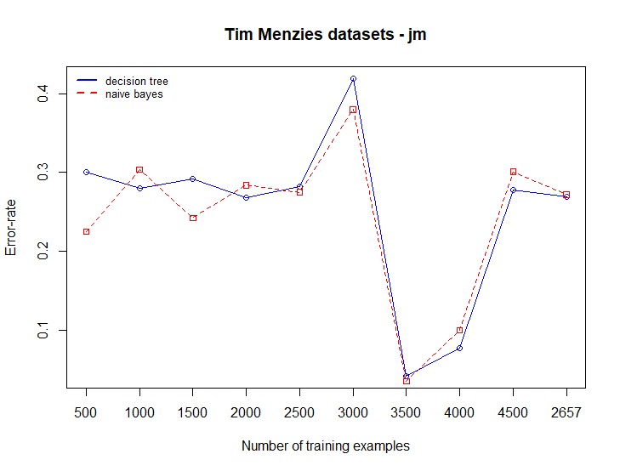
Discussion/3

Slide 18
Discussion/4
 | Training Examples | precision | pd | fmeasure | gmean | balance | accuracy
prop-naïve bayes | 500 | 0.083 | 0.029 | 0.043 | 0.169 | 0.313 | 0.89
 | 1000 | 0.071 | 0.018 | 0.029 | 0.134 | 0.306 | 0.916
 | 1500 | 0.378 | 0.283 | 0.324 | 0.518 | 0.492 | 0.882
 | 2000 | 0.702 | 0.711 | 0.707 | 0.828 | 0.794 | 0.939
 | 2500 | 0.298 | 0.199 | 0.239 | 0.429 | 0.431 | 0.819
 | 3000 | 0.579 | 0.507 | 0.541 | 0.65 | 0.632 | 0.731
 | 3500 | 0.33 | 0.203 | 0.251 | 0.436 | 0.434 | 0.84
 | 4000 | 0.304 | 0.275 | 0.289 | 0.504 | 0.484 | 0.854
 | 4500 | 0.303 | 0.267 | 0.284 | 0.509 | 0.482 | 0.936
 | 5000 | 0.403 | 0.38 | 0.391 | 0.599 | 0.56 | 0.892
 | 5500 | 0.451 | 0.617 | 0.521 | 0.671 | 0.669 | 0.7
 | 6000 | 0.277 | 0.255 | 0.265 | 0.491 | 0.472 | 0.895
 | 6500 | 0.175 | 0.192 | 0.183 | 0.429 | 0.428 | 0.925
 | 7000 | 0.267 | 0.421 | 0.327 | 0.583 | 0.569 | 0.753
 | 7500 | 0.254 | 0.339 | 0.29 | 0.551 | 0.527 | 0.843
 | 8000 | 0.294 | 0.482 | 0.365 | 0.613 | 0.602 | 0.732
 | 2053 | 0.26 | 0.187 | 0.217 | 0.422 | 0.424 | 0.89

Slide 19
Discussion/5
 | Overall Examples | Recent Examples | p-value
prop-naïve bayes | 500 | 1000 | 0.571133
 | 1000 | 1500 | 0.382681
 | 1500 | 2000 | 0.206242
 | 2000 | 2500 | 0.090992
 | 2500 | 3000 | 0.118753
 | 3000 | 3500 | 0.086954
 | 3500 | 4000 | 0.511022
 | 4000 | 4500 | 0.094793
 | 4500 | 5000 | 0.163062
 | 5000 | 5500 | 0.029752
 | 5500 | 6000 | 0.027926
 | 6000 | 6500 | 0.207741
 | 6500 | 7000 | 0.03753
 | 7000 | 7500 | 0.06989
 | 7500 | 8000 | 0.060321
 | 8000 | 2053 | 0.063944

Slide 20
Discussion/6
 | Training Examples | precision | pd | fmeasure | gmean | balance | accuracy
prop-naïve bayes | 500 | 0.083 | 0.029 | 0.043 | 0.169 | 0.313 | 0.89
 | 1000 | 0.071 | 0.018 | 0.029 | 0.134 | 0.306 | 0.916
 | 1500 | 0.378 | 0.283 | 0.324 | 0.518 | 0.492 | 0.882
 | 2000 | 0.702 | 0.711 | 0.707 | 0.828 | 0.794 | 0.939
 | 2500 | 0.298 | 0.199 | 0.239 | 0.429 | 0.431 | 0.819
 | 3000 | 0.579 | 0.507 | 0.541 | 0.65 | 0.632 | 0.731
 | 3500 | 0.33 | 0.203 | 0.251 | 0.436 | 0.434 | 0.84
 | 4000 | 0.304 | 0.275 | 0.289 | 0.504 | 0.484 | 0.854
 | 4500 | 0.303 | 0.267 | 0.284 | 0.509 | 0.482 | 0.936
 | 5000 | 0.403 | 0.38 | 0.391 | 0.599 | 0.56 | 0.892
 | 5500 | 0.451 | 0.617 | 0.521 | 0.671 | 0.669 | 0.7
 | 6000 | 0.277 | 0.255 | 0.265 | 0.491 | 0.472 | 0.895
 | 6500 | 0.175 | 0.192 | 0.183 | 0.429 | 0.428 | 0.925
 | 7000 | 0.267 | 0.421 | 0.327 | 0.583 | 0.569 | 0.753
 | 7500 | 0.254 | 0.339 | 0.29 | 0.551 | 0.527 | 0.843
 | 8000 | 0.294 | 0.482 | 0.365 | 0.613 | 0.602 | 0.732
 | 2053 | 0.26 | 0.187 | 0.217 | 0.422 | 0.424 | 0.89

Slide 21
Discussion/7
 | Overall Examples | Recent Examples | p-value
prop-decision tree | 500 | 1000 | 0.519514
 | 1000 | 1500 | 0.497514
 | 1500 | 2000 | 0.151435
 | 2000 | 2500 | 0.084665
 | 2500 | 3000 | 0.065097
 | 3000 | 3500 | 0.0562
 | 3500 | 4000 | 0.315242
 | 4000 | 4500 | 0.089983
 | 4500 | 5000 | 0.145608
 | 5000 | 5500 | 0.033338
 | 5500 | 6000 | 0.029807
 | 6000 | 6500 | 0.147845
 | 6500 | 7000 | 0.04183
 | 7000 | 7500 | 0.079372
 | 7500 | 8000 | 0.074134
 | 8000 | 2053 | 0.095129

Slide 22
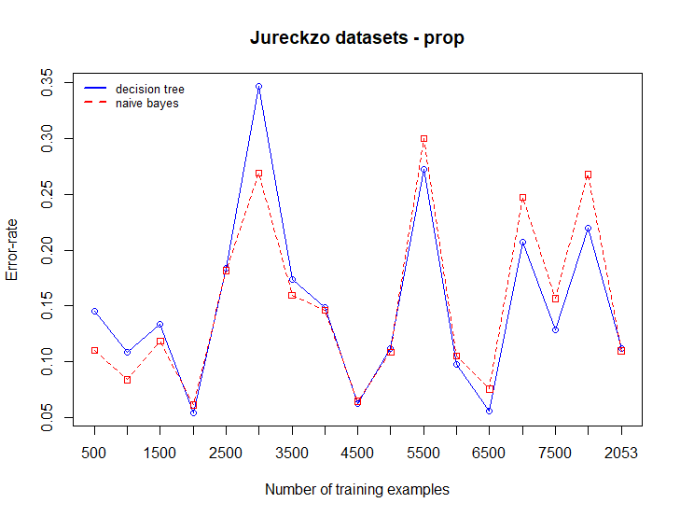
Discussion/8

Slide 23
Future Work
Explore the concept drift detection methods by monitoring the parameters of learners and data distributions
Being the environments non-stationary, it exhibits class imbalance. Our plan is also to explore the techniques that handle class imbalance in streaming data.
Compare with the methods of bellwether moving window with concept drift to produce a better prediction models

Slide 24
Conclusions
The target of our experiment is to investigate to check the concept drift existence in software defect datasets.
Based on our experiment, we observe that the concept drift exits in the defect datasets.
The prediction models would not give accurate results if the training examples are taken from these datasets.

Slide 25
Thanks for listening!

