Slide 1

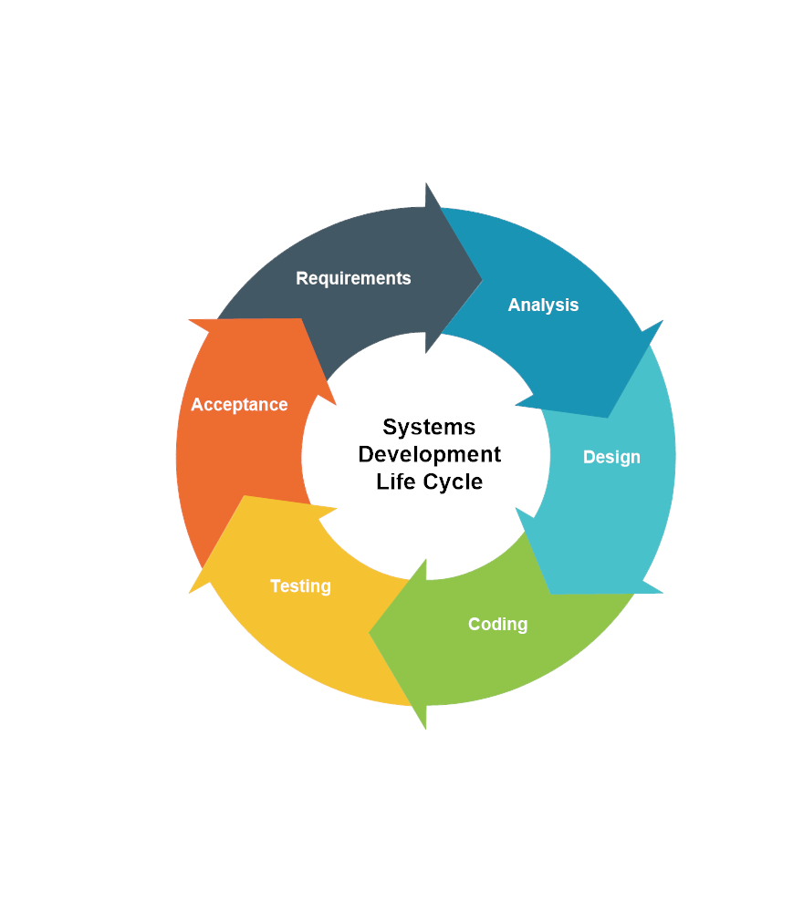
Software Development Life Cycle (SDLC)
Presenter:
Md Alamgir Kabir
ID: 55340650
Department of Computer Science
City University of Hong Kong

Slide 2
Topics
Intended learning outcomes
Software development life cycle
Waterfall Model
Prototyping Model
Assessment
2

Slide 3
Intended Learning Outcomes
Upon completion of this lecture the audience should able to:
Explain software development life cycle (SDLC)
Identify the characteristics of SDLC models
Describe the advantages and disadvantages of SDLC models
Apply the knowledge in real-life scenarios
3

Slide 4
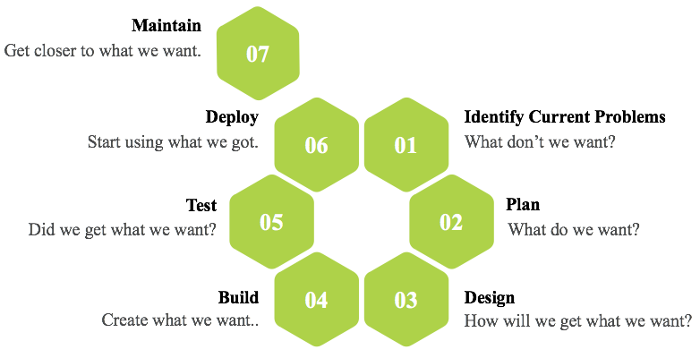
Software Development Life Cycle (SDLC)
4

Slide 5
SDLC Models
Waterfall and Prototyping

Slide 6
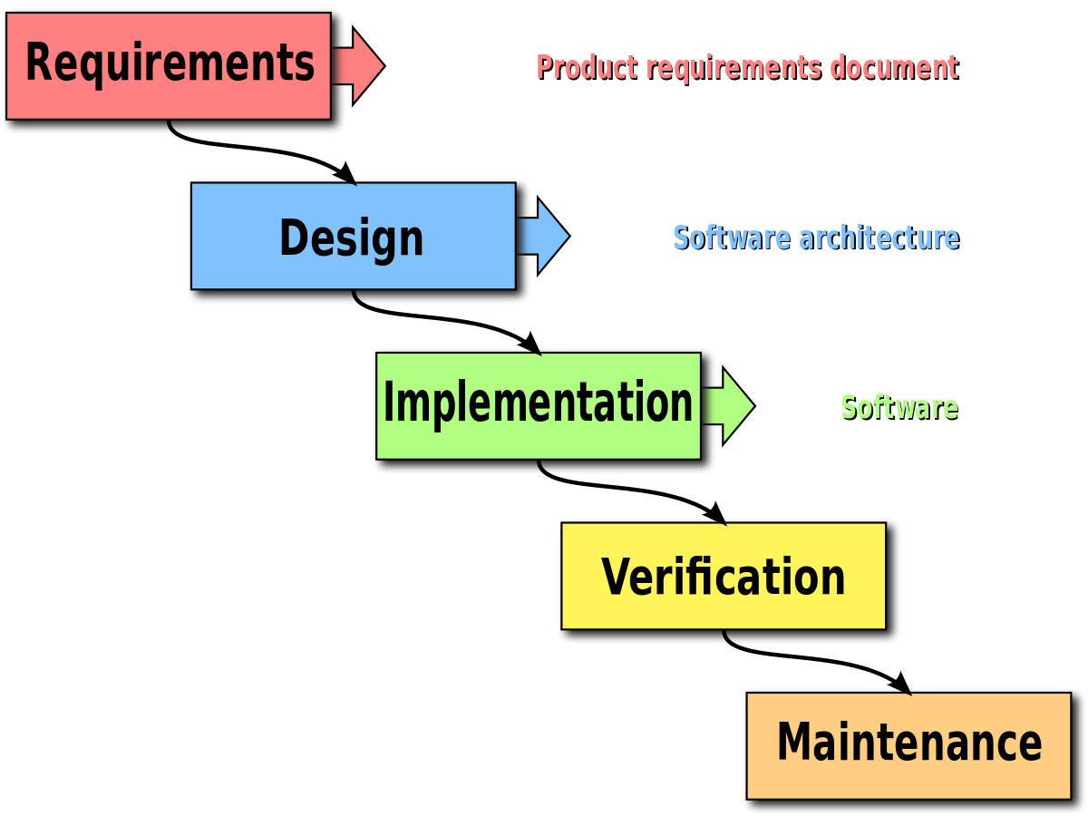
Waterfall Model
6

Slide 7
Strength and Weakness of Waterfall Model
Strength
Easy to understand
Weakness
All requirements must be known upfront
Provides structure
Milestones are well understood
Good for management control
Works well when quality is more important than cost or schedule
Deliverables created for each phase are considered frozen – inhibits flexibility
Integration is one big bang at the end
Little opportunity for customer to preview the system
7

Slide 8
When to Use the Waterfall Model
Requirements are very well known
Product definition is stable
Technology is understood
New version of an existing product
Porting an existing product to a new platform
8

Slide 9
Prototyping Model
Developers build a prototype after getting all the requirements
Prototype is evaluated by end users
Users give corrective feedback
Developers further refine the prototype
When the user is satisfied, the prototype code is brought up to the standards needed for a final product
9

Slide 10
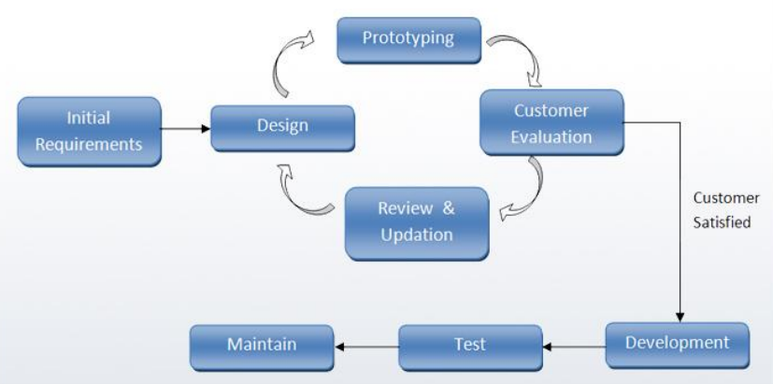
Prototyping Model
10

Slide 11
Strength and Weakness of Prototyping Model
Strength
Customers can “see” the system requirements as they are being gathered
Weakness
Bad reputation for “quick-and-dirty”
Overall maintainability may be overlooked
The customer may want the prototype delivered
Developers learn from customers
Process may continue forever
A more accurate end product
Unexpected requirements accommodated
Allows for flexible design and development
Steady, visible signs of progress produced
Additional needed functionality
11

Slide 12
When to Use the Prototyping Model
Requirements are unstable or have to be clarified
As the requirements clarification stage of a waterfall model
Develop user interfaces
Short-lived demonstrations
New, original development
12

Slide 13
“You’ve got to be very careful if you don’t know where you’re going, because you might not get there.”
Yogi Berra

Slide 14
Scenario - Assessment
Let as take a Example for making a website for shopping mall which contains many shops. Making a website for a shopping mall is not a easy task because it require lots of time. It is also not possible to gather all the requirements of all the shops at once.
Which SDLC model is perfect for developing this system?
14

Slide 15
Scenario – Answer
Developing a website for a mall the waterfall model is not appropriate
15

Slide 16
Sources for Further Studies
Book: The Software Development Lifecycle - A Complete Guide by Richard Murch
Sommerville, I. (2011). Software engineering 9th Edition. ISBN-10, 137035152.
Davis, A. M., Bersoff, E. H., & Comer, E. R. (1988). A strategy for comparing alternative software development life cycle models. IEEE Transactions on software Engineering, 14(10), 1453-1461.
16

Slide 17
Question?
17

Slide 18
Thanks for Listening!

