Slide 1


Zero Trust Architecture
Sanam Makadia

Slide 2
Zero Trust Architecture
Quick Google search on Zero Trust
Designing a Zero Trust Network – Improve your network security.
Zero Trust Network Access – VPN is dead.
Death of Passwords…
Adopt a Zero Trust Strategy – Deliver Modern Remote Access.
Is Zero Trust a network security? Hybrid Cloud Security? VPN replacement?
Remote Access Solution? Offerings from vendors? Methodologies?

Slide 3
Zero Trust Architecture
Why is this Required?
Network architecture is changing, there is a surge in the use of Software as a Service (SaaS).
Users are embracing flexible working in a variety of locations. The traditional network perimeter is disappearing and with it, the value of traditional defences.
Commonly seen in breaches; an attacker gains a foothold in a network and is able to move laterally because everything on the network is trusted.

Slide 4
Zero Trust Architecture
How this can be done?
Remove inherent trust, treat network as hostile.
Gain confidence / Build trust in the authentication (user's identity ), verification (device verification) and authorization of users and services.
Each connection to a service should be authenticated and the device and connection authorized against Access policy.
Device verification should be based on defined policies (such as encryption, patch levels, etc).

Slide 5
Zero Trust Architecture
What does this guidance do?
Principles are intended to help design and deploy a secure end-to-end, zero trust architecture.
Provides clear understanding of the zero-trust model, the benefits it brings, and the risks need to consider.
Helps in developing a plan on how one can implement them on a journey to a zero-trust architecture.
Stretches from users, devices, services and data they are accessing.

Slide 6
Zero Trust Architecture
Who is this guidance for?
Technical audience such as Solution & Security Architects, and CISOs.
Reviewing architectures when carrying out security assessments or assurance activities.
Companies or open source projects implementing zero trust related technologies can also use these principles to guide their development and assess which part of the zero trust puzzle they fit into.

Slide 7
Zero Trust Architecture
The principles
Know your architecture (ASSET) - In zero trust network model it’s more important than ever to know about assets.
Create a single strong user identity (Single User Directory / Identity) - Organization should use a single user directory and create accounts that are linked to individuals.
Create a strong device identity (Single Device Directory) - Each device owned by organization should be uniquely identifiable in a single device directory.
Authenticate everywhere (All Connections need Auth) - In zero trust architecture assume the network is hostile, authenticate all connections.

Slide 8
Zero Trust Architecture
The principles
Know the health of your devices and services (Monitoring Health of Devices & Services) - The health of devices and services is one of the most important signals used to gain confidence in them.
Focus your monitoring on devices and services - Given that devices and services are more exposed to network attack than in traditional architectures it’s important that comprehensive monitoring for attacks is carried out.
Set policies according to the value of services or data (Access Policy) - The power of zero trust architecture comes from the access policies defined.
Control access to your services and data (Authorization of all request against Policy) - Each request to a service should be authorized against a policy.

Slide 9
Zero Trust Architecture
The principles
Don’t trust the network, including the local network (No trust = Build Trust in devices & Services) - In order to remove trust from the network one need to build trust into the devices and services.
Choose services designed for zero trust - Prefer services with built-in support for zero trust network architectures.

Slide 10
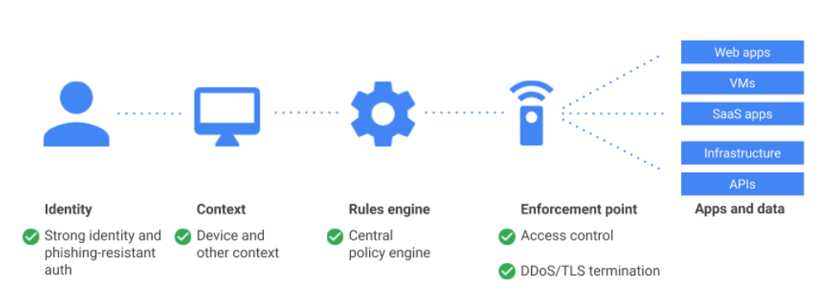
Zero Trust Architecture
Google: BeyondCorp - Google's implementation of the zero-trust security model
BeyondCorp has three core principles:
Connecting from a particular network does not determine which service you can access.
Access to services is granted based on what the infrastructure knows about you and your device.
All access to services must be authenticated, authorized and encrypted for every request (not just
the initial access).

Slide 11
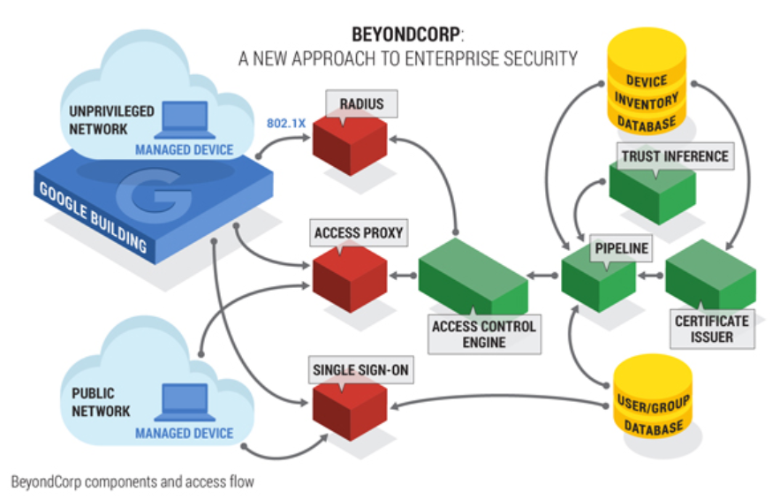
Zero Trust Architecture
BeyondCorp architecture design principles

Slide 12
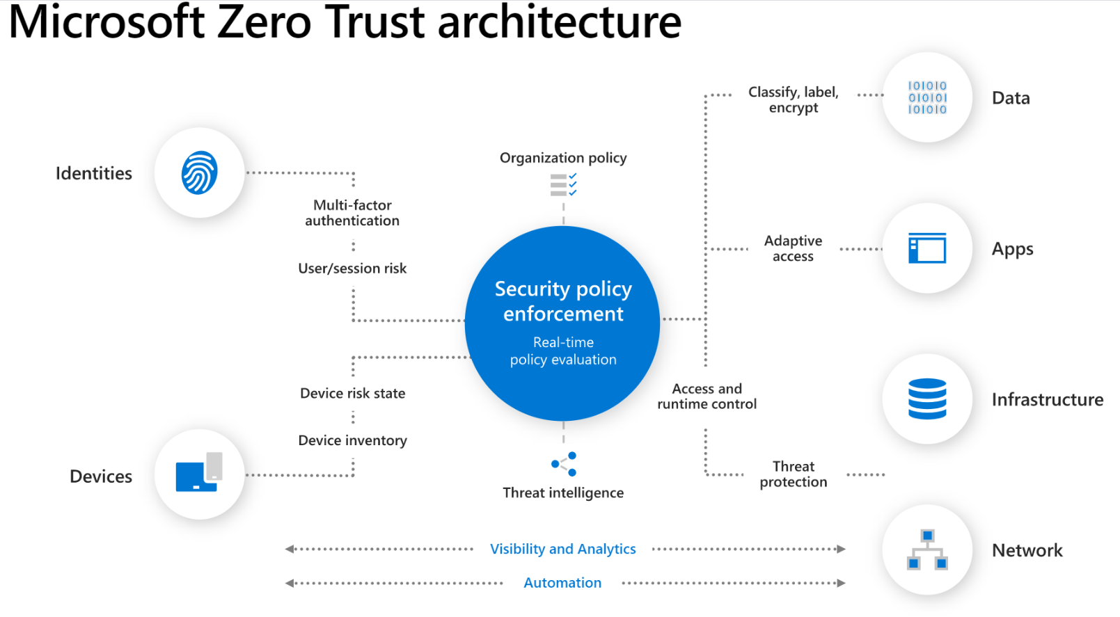
Zero Trust Architecture

Slide 13
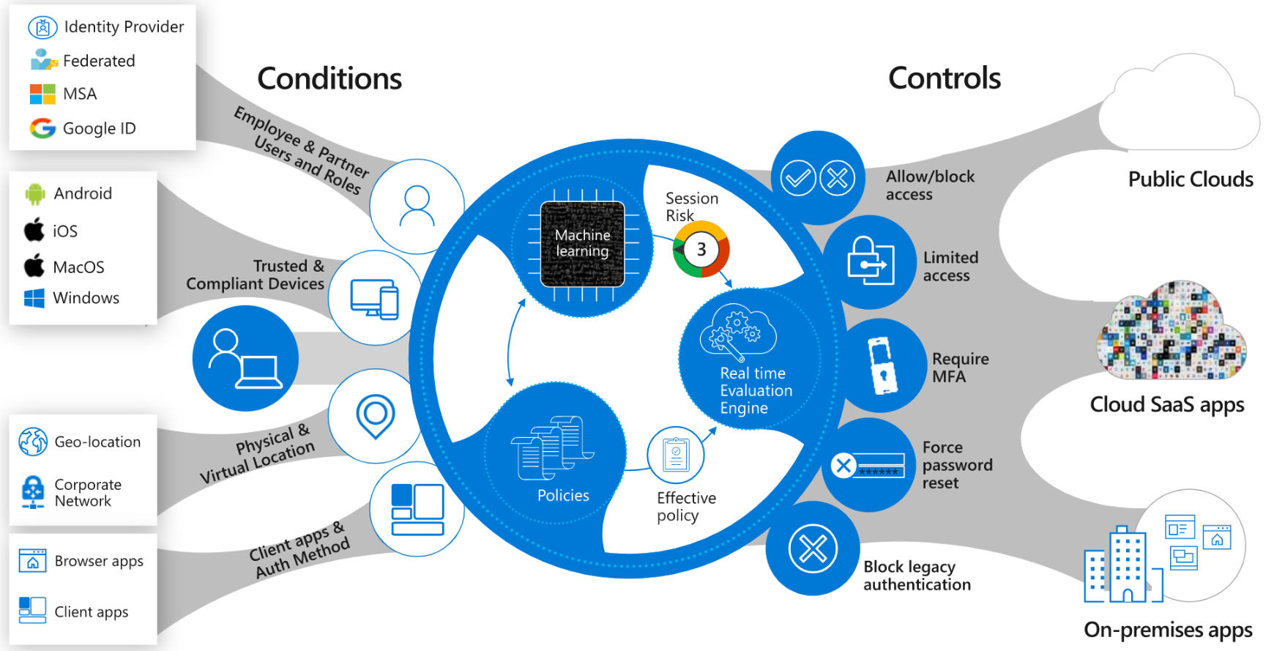
Zero Trust Architecture

Slide 14
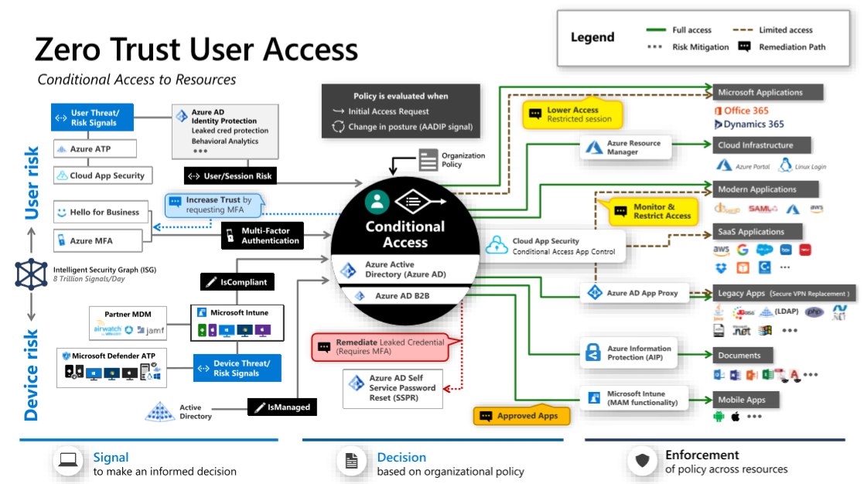
Zero Trust Architecture

Slide 15
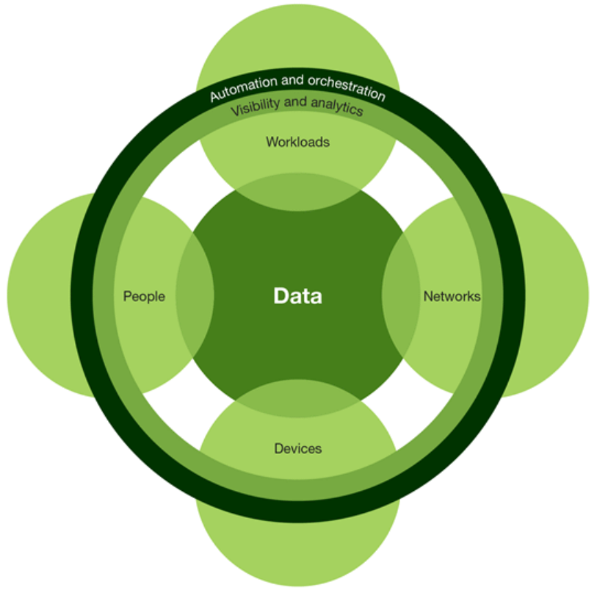
Zero Trust Architecture
Forrester: Definition of Zero Trust
ZT Principle - “Never Trust without Verifying”.
Zero Trust Architecture ZTA – seven pieces of control.
- People
- Data
- Networks
- Devices
- Workloads
- Automation & Orchestration
- Visibility & Analytics

Slide 16

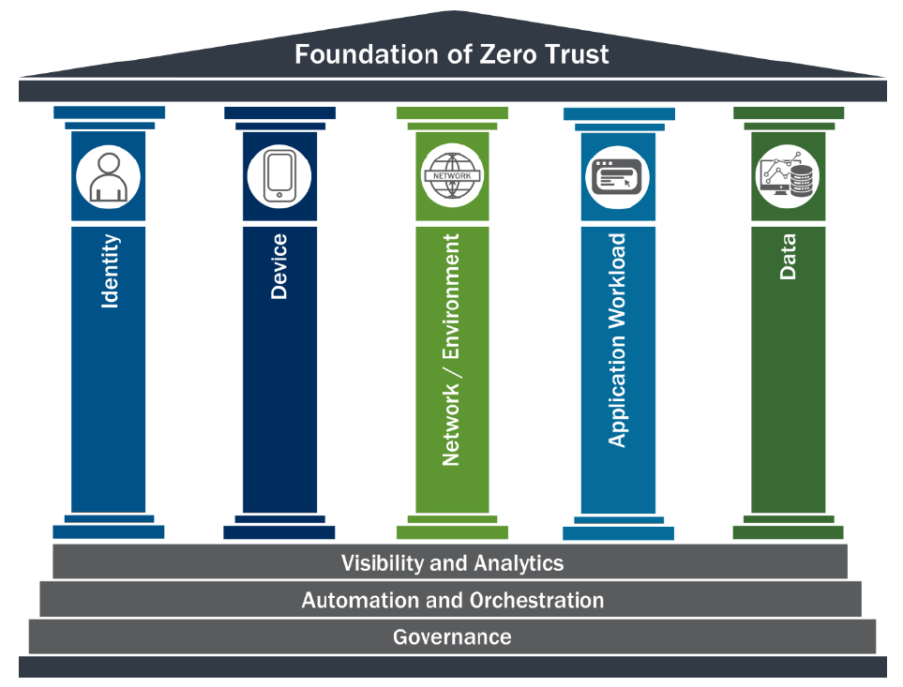
Zero Trust Architecture
Zero Trust Maturity Model
The pillars: Identity, Device, Network, Application Workload, and Data.
Each pillar also includes Visibility and Analytics, Automation and Orchestration, and Governance.
This maturity model is one of many paths to support the transition to zero trust.

Slide 17
Zero Trust Architecture
Important Technologies for Zero Trust
Micro segmentation
Identity and Access Management (IDAM)
Two-Factor Authentication (2FA)
Security Information and Event Management (SIEM)
Security Orchestration, Automation and Response (SOAR)
Cloud Assess Security Brokers (CASB)
Discovery & Shadow IT
Deception Technology (Honeypots)
Network Detection and Response (NDR)
User and Entity Behavior Analytics (UEBA)
Adaptive Access Control (AAC)

Slide 18
Zero Trust Architecture
Identity
Device
Network
Application
Data
Zero Trust Journey
Conditional Access
Analytics & Threat Intel
ZERO TRUST
Policy Engine

Slide 19
Appendix

