Slide 1
C groups 1x1conv kenerl
1x1xC
H
W
H
C
W
C
C groups features

Slide 2
C pcs
C
end
1
...
begin
...
1
...
H
C
H
C
1
C
begin
1
end
W
W
1x1xC
C pcs
C
end
1
...
begin
end
1
...
...
C
H
...
H
C
C
H
C
begin
1
end
begin
1
W
W
W
1x1xC

Slide 3
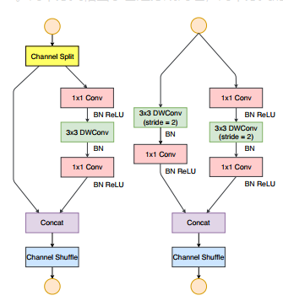
1x1Conv
1x1Conv
1x1Conv
3x3 DWConv
(stride=2)
BN ReLU
3x3 DWConv
(stride=2)
1x1 DWConv
(stride=2)
BN SiLU
3x3 DWConv
(stride=2)
BN SiLU
BN
3x3 DWConv
(stride=2)
BN
BN
3x3 DWConv
(stride=2)
1x1 DWConv
(stride=2)
BN
3x3 DWConv
(stride=2)
1x1Conv
BN
BN
BN
1x1Conv
BN
BN ReLU
1x1Conv
1x1Conv
BN SiLU
1x1Conv
BN SiLU
1x1Conv
BN ReLU
BN SiLU
BN SiLU
Concat
Concat
Concat
Channel Shuffle
Channel Attention
Channel Shuffle Conv
1x1 Conv
training
inference

Slide 4
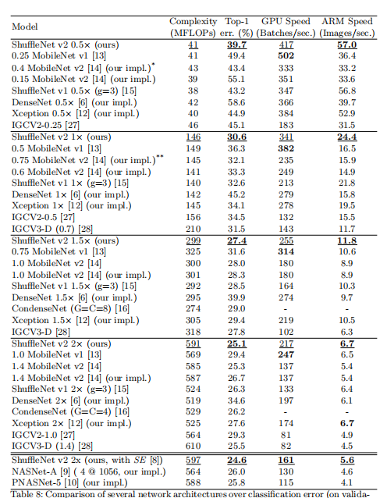
Models | Param.(M) | FLOPs | Top-1 err.(%) | Top-5 err.(%) | GPU Speed (Batches/sec.) | 差异数据
ShuffleNetV2-0.5x-256 |  |  | 42.6 | 19.8
ACFNet-0.5x-256 |  |  | 41.0 | 18.7 |  | 1.6% 1.1%
ShuffleNetV2-1.0x-256 |  |  | 33.4 | 12.9
ACFNet-1.0x-256 |  |  | 31.8 | 11.9 |  | 1.6% 1.0%
ShuffleNetV2-1.5x-256 ShuffleNetV2-1.5x-200 |  |  | 30.1 31.0 | 10.8 11.1
ACFNet-1.5x-200 |  |  | 29.3 | 10.1 |  | 1.7% 1.0%
ShuffleNetV2-2.0x-256 ShuffleNetV2-2.0x-150 |  |  | 27.9 30.0 | 9.5 10.7
ACFNet-2.0x-150 |  |  | 28.3 | 9.6 |  | 1.7% 1.1%

Slide 5
BaseLine | SiLU | 3x3+1x1 | Channel Attention | Top-1 err.(%) | Top-5 err.(%) | GPU Speed (Batches/sec.) | FLOPs
√ |  |  |  | 33.4 | 12.9
 | √ |  |  | 32.3 33.1 | 12.2 12.6
 | √ | √ |  | 32.0 | 12.1
 | √ |  | √
 | √ | √ | √ | 31.8 | 11.9

Slide 6
修改

